Slide 1
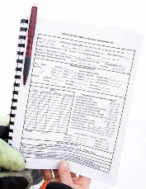









Acquire
QC/Process
Analyze
Report

Slide 2
















R Package
Acquire
QC/Process
Analyze
Report

