Slide 1
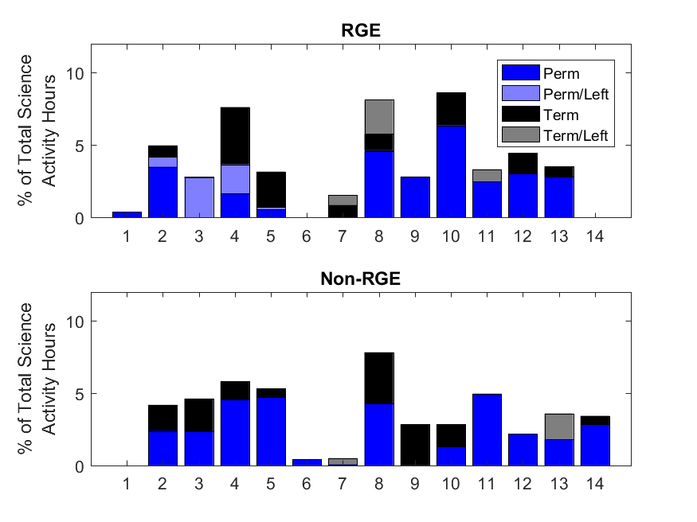
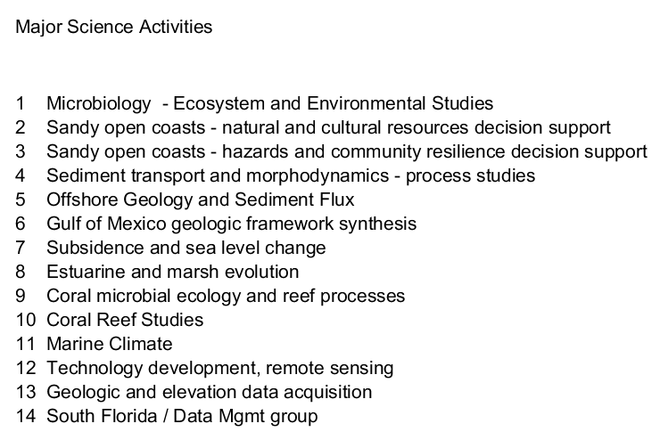
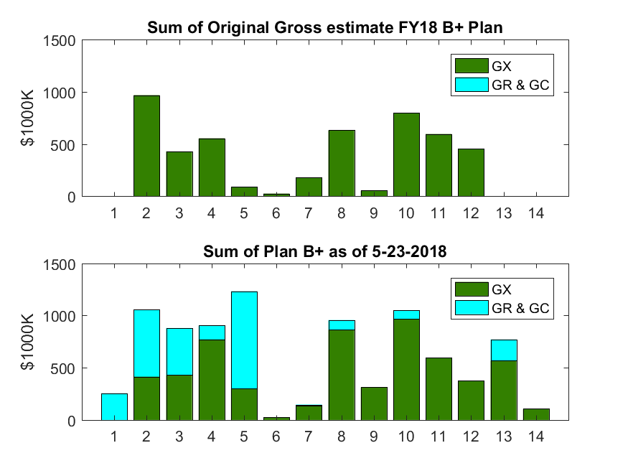
Gap analysis tool
Notes
Draft sorting into science activities based on input from WFP team
Excludes Center operations projects (COM, etc.)
Planned hours from OM300 on 15Aug2017
73,476 total hours on the included projects (2080 hours = 2.8% = 1 FTE)
Coding to identify people who have left SP includes those who have retired, gone to other assignments, or have announced departure
All values are estimates (e.g., some reimbursibles are GX, like Breton)

