Slide 1
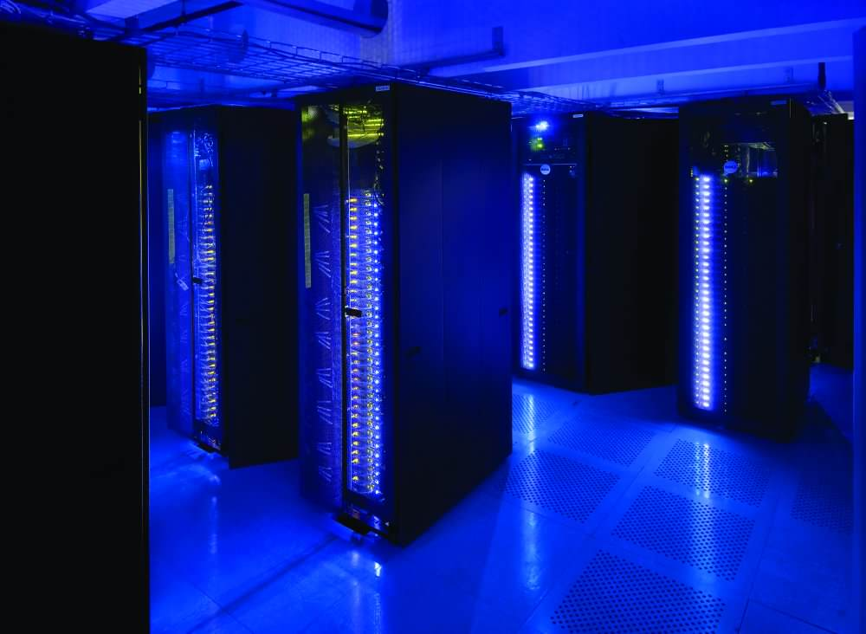
Introduction to High Throughput Computing
Luke Winslow
OWI a-la-carte

Slide 2
Overview
What is Parallel Computing
Example Uses
Intro to Condor
Demo

Slide 3
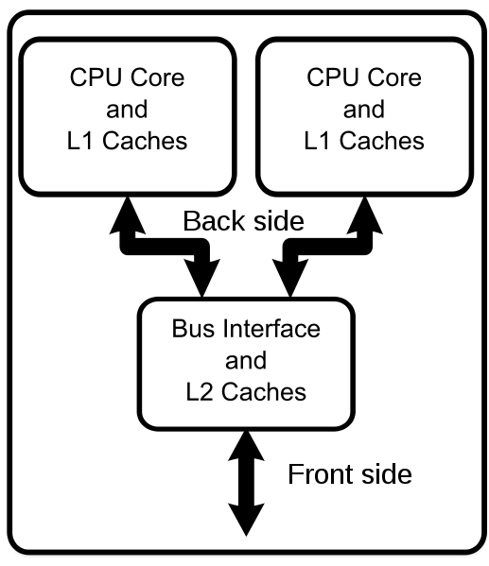

Parallel Computing

Slide 4
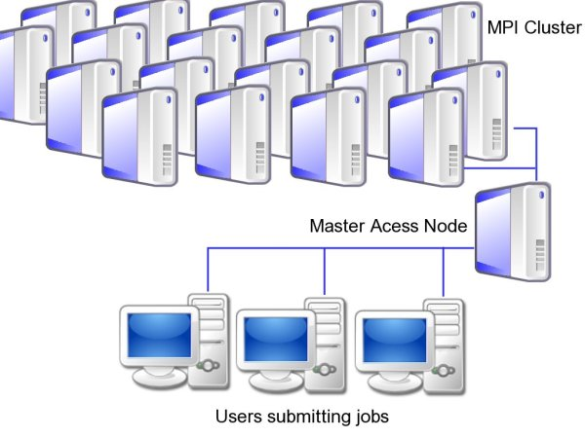
Cluster

Slide 5
Why would I need this?

Slide 6
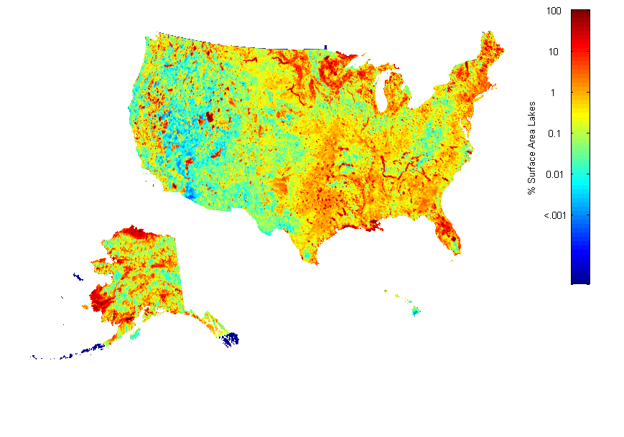
Dealing with Large Datasets

Slide 7
Lake Shape Characteristics

Slide 8
Bootstrapping Analyses

Slide 9
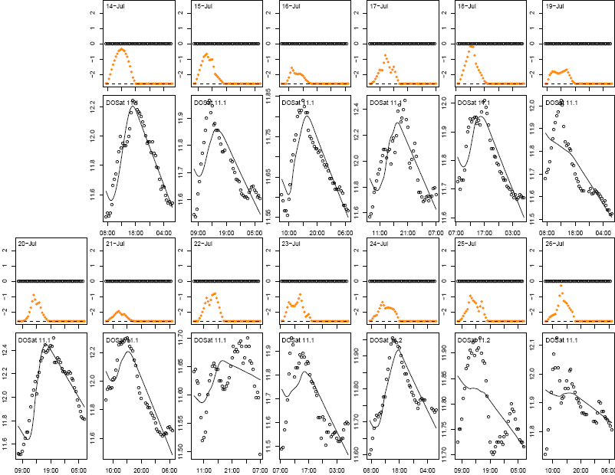

Slide 10
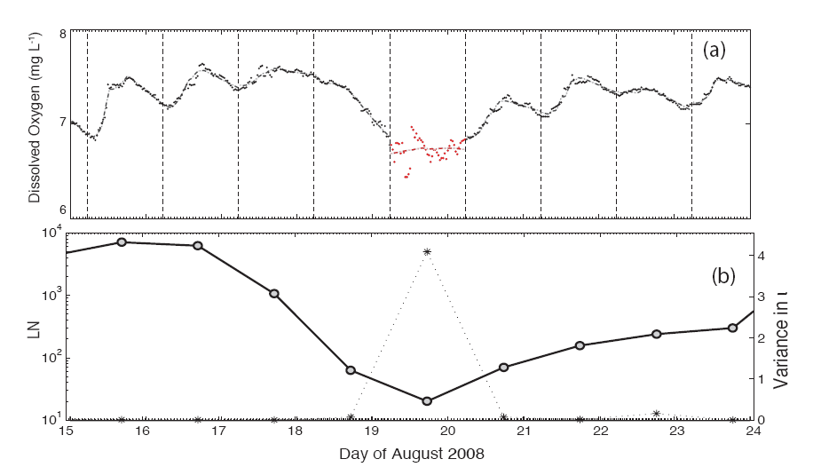
Bootstrapping Analyses

Slide 11
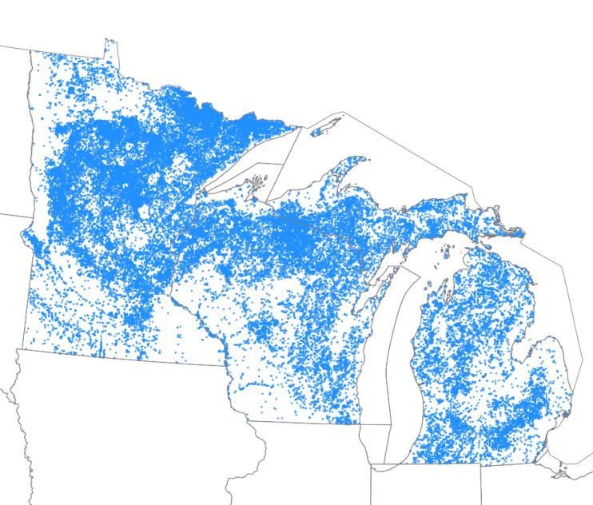
Large-scale simulations

Slide 12
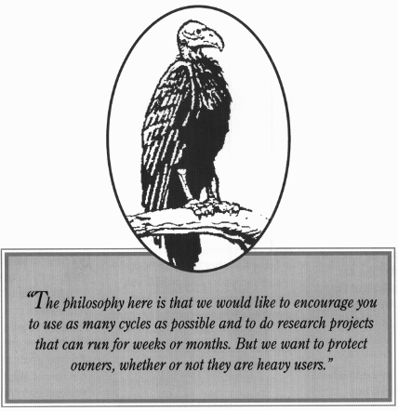
HTCondor
Scavenging wasted compute cycles
Runs on basically any normal computer
Computer Labs are perfect
A lot of dedicated clusters exist

Slide 13

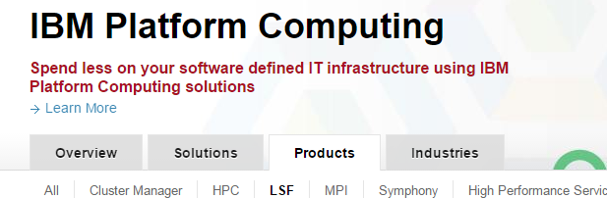

Known by many names
HTCondor
SLURM
LSF
PBS
SGE

Slide 14
Parallelizability
For i=1:1000
var(i) = i;
End
For i=1:1000
var(i) = var(i-1) + i;
End

Slide 15
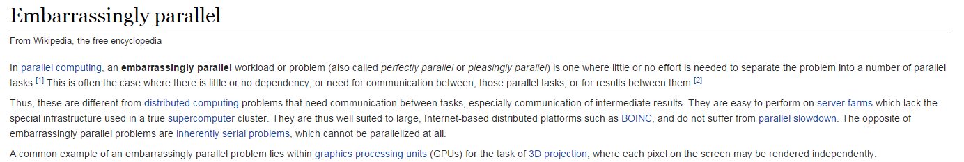
Important Term: Embarrassingly parallel

Slide 16

Example
1D model run on all lakes on a landscape
Models don’t need to “talk”

Slide 17
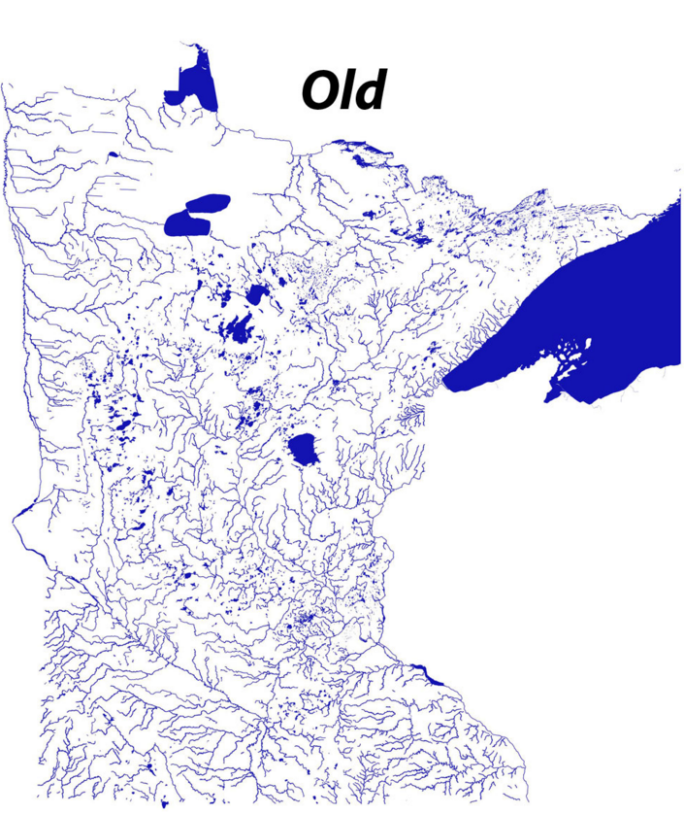
Counter example
Modeling a connected hydrologic network
Stream model must pass info to lake model
Lake model must info to downstream model
Etc, etc

Slide 18
parallel package in R
Interactive demo
Cross your fingers

Slide 19


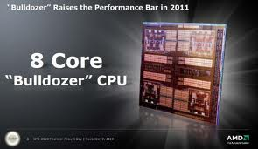


Slide 20

Questions?

Slide 22
