Slide 1
Introduction to Computer Science
Computer model: Von Neumann Model
How programs and data are stored: Binary System
How computers are built: Logic Gates
From higher level languages to machine language

Slide 2
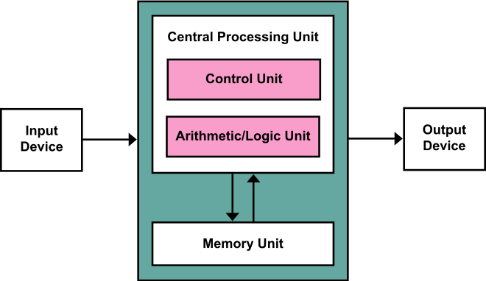
Von Neumann Model
Basic model of a computer architecture
Processing Unit
ALU and processor registers
Control Unit: Program Counter and Instruction Register
Memory: holds data and instructions
Input and output devices
Human Interface
Mouse, keyboard, screen, etc.
Storage
Networking
Graphics
Notes:
A computer architecture based on that described in 1945 by the mathematician and physicist John von Neumann

Slide 3
Von Neumann Model: closer look
Addresses
Memory
1011 | 0
0010 | 1
1111 | 2
1011 | 3
0010 | 4
1011 | 5
0101 | 6
1110 | 7
0110 | 8
1011 | 9
1011 | 10
…
CPU
Data to memory
ALU
+ - * /
Data from memory
Control Unit
Store both
instructions
and data
IR
1010
PC
1000
Address for R/W
Notes:
Main memory is a temporary device that holds both program and data while the processor is executing the program
Physically consists of a collection of DRAM
Logically it is organized as a linear array of bytes, each with its own unique address starting at 0
The CPU executes instructions stored in main memory
PC contains the memory address of the next instruction to be executed

Slide 4
CPU Fetch-and-Execute Cycle
Programs
Written in a high level language
Translated into machine language that can be executed by the CPU
CPU executing a program
Program is in main memory
FETCH[PC++]
DECODE
EXECUTE
Arithmetic: +, -, *, /
Logic: bre, jmp

Slide 5
Von Neumann Model: in practice
Register file
ALU
PC
CPU
System bus
Memory bus
Main
memory
Bus interface
I/O
bridge
I/O bus
Expansion slots for
other devices such
as network adapters
USB
controller
Graphics
adapter
Disk
controller
Mouse
Keyboard
Display
Disk
Input
Output
Notes:
Hardware organization of a computer system
Main memory holds both program and data while the processor is executing the program
The register file is a collection of word-sized registers (local memory for the CPU)
If the CPU is executing a program how can it be aware that there is input on keyboard?
Polling: cpu checks incoming data over and over again (inefficient)
Interrupts are sent from the device to the cpu.
Several things happening at the same time: multitasking
Talk about what they are going to learn in each CS course
CS 211: how data is stored inside a computer system; how a program is executed inside the CPU (from high level language to assembly to binary code); circuitry inside the cpu (adder)
CS 416: concept of processes and threads and how they are executed in the cpu; virtual memory; file access
CS 352: how computers communicate…

Slide 6
How data is stored?
Computers use the binary system to represent data.
All data from numbers, alphabet to images are represented using the binary system
Register file
Disk
Memory
Network

Slide 7
Binary Numbers
Base 2
Symbols = {0,1} often called {false, true} or {off, on}
Numbers are written as d_{n}...d₂d₁d₀
The decimal value of a binary number is
101
1101
Binary representation is used in computers
Bit and byte
1 | 0 | 1
2² | 2¹ | 2⁰ | → 2² + 2⁰ = 5
1 | 1 | 0 | 1
2³ | 2² | 2¹ | 2⁰ | → 2³ + 2² + 2⁰ = 13
Notes:
We’ve learned that computers use the binary system to represent data
Today’s lecture is about how integers are represented inside our computers today
Each position has a power of two value
How many arrangements can we have with 1 bit?
- 2 symbols, 1 bit

Slide 8
How Many Binary Patterns from N Bits
Number of Bits | Number of Patterns | Number of Patterns as Power of Two
1 | 2 | 2¹
2 | 4 | 2²
3 | 8 | 2³
4 | 16 | 2⁴
Number of possible patterns of N bits = 2^{N}
How many patterns can be formed with:
10 bits = 2¹⁰ = 1024 → 1024 bytes (1 Kilobyte)
20 bits = 2²⁰ = 2¹⁰ x 2¹⁰ → 1024 Kbytes (1 Megabyte)
30 bits = 2³⁰ = 2¹⁰ x 2²⁰ → 1024 Mbytes (1 Gigabyte)
40 bits = 2⁴⁰ = 2¹⁰ x 2³⁰ → 1024 Gbytes (1 Terabyte)
50 bits = 2⁵⁰ = 2¹⁰ x 2⁴⁰ → 1024 Tbytes (1 Petabyte)
60 bits = 2⁶⁰ = 2¹⁰ x 2⁵⁰ → 1024 Pbytes (1 Exabyte)
Notes:
NS: how do we add two binary numbers?

Slide 9
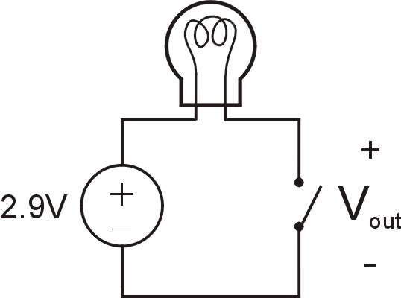
Transistor: Building Block of Computers
Microprocessors contain millions (billions) of transistors
Intel Pentium 4 (2000): 48 million
IBM PowerPC 750FX (2002): 38 million
IBM/Apple PowerPC G5 (2003): 58 million
Logically, each transistor acts as a switch
Combine transistors to implement logic gates
AND, OR, NOT, NAND, NOR, XOR
Combine gates to build higher-level structures
Adder, multiplexer, decoder, register, …
Combine higher-level structures to build processor
Switch open:
Light is off
Switch closed:
Light is on
Notes:
Intel and Pentium are trademarks of Intel Corporation. IBM and PowerPC are trademarks of International Business Machines Corporation. Apple is a trademark of Apple Computer, Inc.

Slide 10
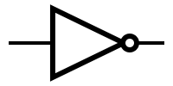
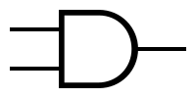
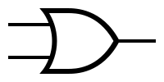
Logic Gates
Symbol
A
A
A
A
A+B
B
AB
B
NOT
AND
OR
A | A
0 | 1
1 | 0
A | B | AB
0 | 0 | 0
0 | 1 | 0
1 | 0 | 0
1 | 1 | 1
A | B | A+B
0 | 0 | 0
0 | 1 | 1
1 | 0 | 1
1 | 1 | 1
Truth Table

Slide 11
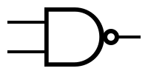
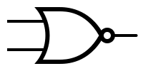
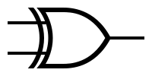
Logic Gates
Symbol
A
A
A
B
AB
B
A+B
B
A B
NAND
NOR
XOR
A | B | AB
0 | 0 | 1
0 | 1 | 1
1 | 0 | 1
1 | 1 | 0
A | B | A+B
0 | 0 | 1
0 | 1 | 0
1 | 0 | 0
1 | 1 | 0
A | B | A B
0 | 0 | 0
0 | 1 | 1
1 | 0 | 1
1 | 1 | 0
Truth Table

Slide 12
Program Meets Hardware
Programs are written in higher level language
Java, C, C++, Perl, Python
The CPU can execute very simple machine language instructions
Add, Sub, Jmp
How to obtain runnable code from a program written in some programming language?
Compiler: translates a higher level language program into machine language program (executable). The executable program can be executed many times.
Interpreter: executes the computation written on a higher level language program.

Slide 13
Program Meets Hardware
C uses compilation
C Compiler for Mac OS
Executable Program for Mac OS
C Program
(.c)
C Compiler for Windows
Executable Program for Windows
C Compiler for Linux
Executable Program for Linux
gcc …
$ gcc Example.c
$ ./Example
Compiles Example.c into Example
Execute Example

Slide 14
Program Meets Hardware
Java combines compilation and interpretation
Java Interpreter for Mac OS
Java Program
(.java)
Java
Bytecode Program
(.class)
Java Interpreter for Windows
Compiler
Java Interpreter for Linux
javac …
java …
$ javac Example.java
$ java Example.class
Compiles Example.java into Example.class
Interprets Example.class (JVM)

Slide 15
Wrapping Up
Von Neumann Model
Some CS courses will dive into a piece of this model while others make use of the model as a whole
We understand that computers use the binary system to represent data
Basic building blocks of a computer
The adder inside the CPU is built from a XOR and a AND gates
How programs written in higher level languages are executed by the CPU

Slide 16
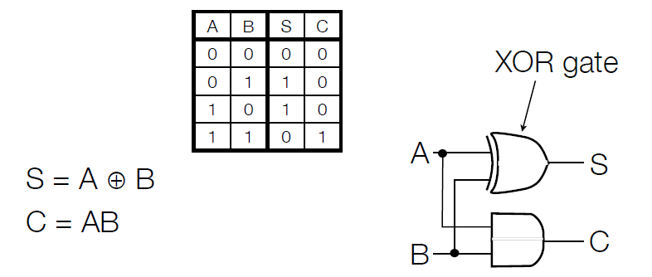
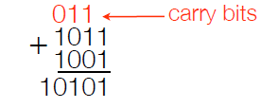
Addition: The Half Adder
Addition of 2 bits: A & B produces summand (S) and carry (C)
But to do addition, we need 3 bits at a time (to account for carries)
Notes:
Prepare for full adder showing the sum and saying we need 3 bits

