Slide 1
Credit: Jae Woo Joo
CS 211 Computer Architecture jaewoo.joo@cs.rutgers.edu
Recitation 4

Slide 2
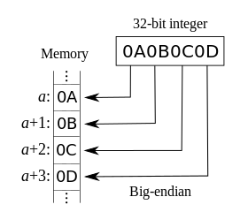
ENDIANNESS
The order of the bytes stored in memory
Big endian
MSB is stored at a particular address and the subsequent bytes are stored in the following higher memory addresses
LSB is stored at the highest memory address
Motorola, IBM

Slide 3
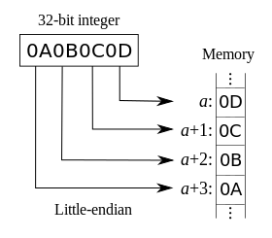
ENDIANNESS
Little endian
LSB is stored at the lower memory address and the subsequent bytes are stored in the following higher memory addresses
MSB is stored at the highest memory address
Intel

Slide 4
TWO’S COMPLEMENT
Flip the bits and add 1
Ex)
40 = 0010 1000
-> Flip 1101 0111
-> Add1 1101 1000 (-40 in two’s complement form)
-40 = 1101 1000
-> Flip
-> Add1
0010 0111
0010 1000 (two’s complement of -40)

Slide 5
ARITHMETIC OF TWO’S COMPLEMENT
Arithmetic addition
+ 6 0000 0110
+13 0000 1101
+19 0001 0011
- 6 1111 1010
+13 0000 1101
+ 7 0000 0111

Slide 6
ARITHMETIC OF TWO’S COMPLEMENT
Arithmetic subtraction
-5 | 1111 1011 | -5 | 1111 1011
- 6 | 0000 0110 | - -6 | 1111 1010
-11 | 1111 0101 | + 1 | 0000 0001

Slide 7
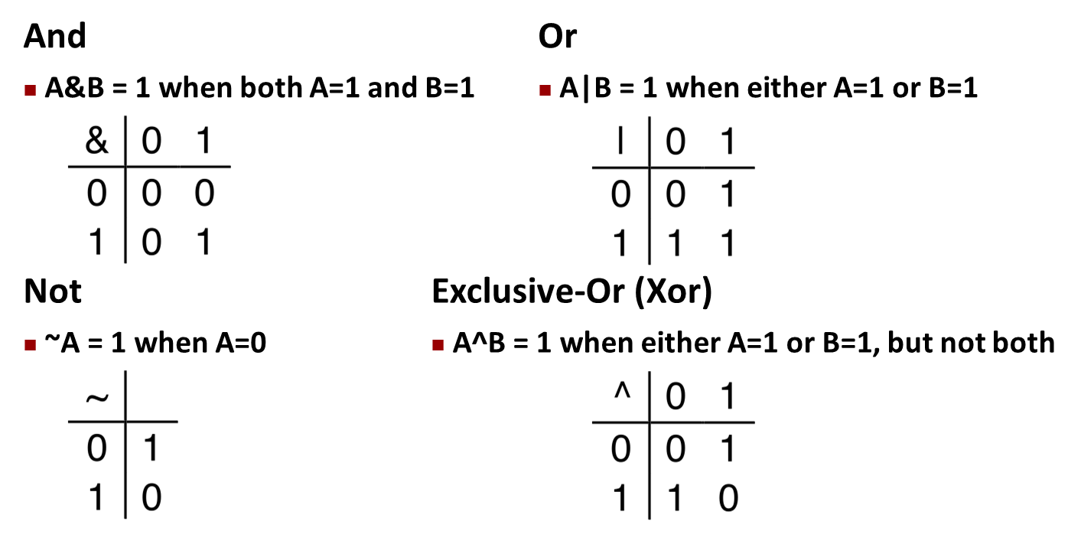
BOOLEAN ALGEBRA
Developed by George Boole in 19th Century
Algebraic representation of logic
Encode 1 as “True” and 0 as “False”

Slide 8
GENERAL BOOLEAN ALGEBRAS
Operate on Bit Vectors
– Operations applied bitwise
01101001
& 01010101
01101001
| 01010101
01101001
^ 01010101
~ 01010101
01000001 01111101 00111100 10101010
All of the properties of Boolean Algebra Apply

Slide 9
EXAMPLE: REPRESENTING & MANIPULATING SETS
Representation
Width w bit vector represents subsets of {0, …, w–1}
a_{j} = 1 if j ∈ A
• 01101001 • 76543210 | { 0, 3, 5, 6 }
• 01010101 • 76543210 | { 0, 2, 4, 6 }
Operations
– & Intersection | 01000001 | { 0, 6 }
– | Union | 01111101 | { 0, 2, 3, 4, 5, 6 }
^ Symmetric difference 00111100
~ Complement 10101010
{ 2, 3, 4, 5 }
{ 1, 3, 5, 7 }

Slide 10
BIT-LEVEL OPERATIONS IN C
Operations %, |, ~, ^ are available in C
Apply to any “integral” data type
View arguments as bit vectors
Arguments applied bit-wise
C expression | Binary expression | Binary result | Hexadecimal result
~0x41 | ~[0100 0001] | [1011 1110] | 0xBE
~0x00 | ~[0000 0000] | [1111 1111] | 0xFF
0x69 & 0x55 | [0110 1001] & [0101 0101] | [0100 0001] | 0x41
0x69 | 0x55 | [0110 1001] | [0101 0101] | [0111 1101] | 0x7D

Slide 11
CONTRAST: LOGIC OPERATIONS IN C
Contrast to Logical Operators
– &&, ||, !
View 0 as “False”
Anything nonzero as “True”
Always return 0 or 1
C expression | Result
!0x41 | 0x00 = “False”
!0x00 | 0x01 = “True”
0x69 && 0x55 | 0x01 = “True”
0x69 || 0x55 | 0x01 = “True”

Slide 12
SHIFT OPERATIONS
Left Shift:
x << y
Shift bit-vector x left y positions
– Throw away extra bits on left
Fill with 0’s on right
Right Shift: x >> y
Shift bit-vector x right y positions
Throw away extra bits on right
Logical shift
Fill with 0’s on left
Arithmetic shift
Replicate most significant bit on left
Undefined Behavior
Shift amount < 0 or ≥ word size
Argument x | 01100010
<< 3 | 00010000
Log. >> 2 | 00011000
Arith. >> 2 | 00011000
00010
011000
011000
Argument x | 10100010
<< 3 | 00010000
Log. >> 2 | 00101000
Arith. >> 2 | 11101000
00010
101000
101000

Slide 13
Any questions?
Q&A

