Slide 1

CACHE MEMORY
CS211 Recitation
Guangyan Hu

Slide 2
LOCALITY
PRINCIPAL OF LOCALITY is the tendency to reference data items that are near other recently referenced data items, or that were recently referenced themselves.
TEMPORAL LOCALITY : memory location that is referenced once is likely to be referenced multiple times in near future.
SPATIAL LOCALITY : memory location that is referenced once, then the program is likely to be reference a nearby memory location in near future.

Slide 3
CACHE MEMORY
Principle of locality helped to speed up main memory access by introducing small fast memories known as CACHE MEMORIES that hold blocks of the most recently referenced instructions and data items.
Cache is a small fast storage device that holds the operands and instructions most likely to be used by the CPU.

Slide 4
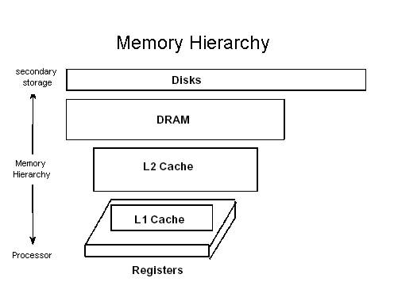
Memory Hierarchy of early computers: 3 levels
CPU registers
DRAM Memory
Disk storage

Slide 5
Due to increasing gap between CPU and main Memory, small SRAM memory called L1 cache inserted.
L1 caches can be accessed almost as fast as the registers, typically in 1 or 2 clock cycle
Due to even more increasing gap between CPU and main memory, Additional cache: L2 cache inserted between L1 cache and main memory : accessed in fewer clock cycles.

Slide 6
L2 cache attached to the memory bus or to its own cache bus
Some high performance systems also include additional L3 cache which sits between L2 and main memory . It has different arrangement but principle same.
The cache is placed both physically closer and logically closer to the CPU than the main memory.

Slide 7
CACHE LINES / BLOCKS
Cache memory is subdivided into cache lines
Cache Lines / Blocks: The smallest unit of memory than can be transferred between the main memory and the cache.

Slide 8
TAG / INDEX
Every address field consists of two primary parts: a tag which contains the higher address bits, and a index which contains the lower address bits

Slide 9
VALID BIT / DIRTY BIT
When a program is first loaded into main memory, the cache is cleared, and so while a program is executing, a valid bit is needed to indicate whether or not the slot holds a line that belongs to the program being executed. There is also a dirty bit that keeps track of whether or not a line has been modified while it is in the cache. A slot that is modified must be written back to the main memory before the slot is reused for another line.

Slide 10
CACHE HITS / MISSES
Cache Hit: a request to read from memory, which can satisfy from the cache without using the main memory.
Cache Miss: A request to read from memory, which cannot be satisfied from the cache, for which the main memory has to be consulted.

Slide 11
CACHE MEMORY : PLACEMENT POLICY
There are three commonly used methods to
translate main memory addresses to cache
memory addresses.
Associative Mapped Cache
Direct-Mapped Cache
Set-Associative Mapped Cache
The choice of cache mapping scheme affects
cost and performance, and there is no single
best method that is appropriate for all situations

Slide 12
Associative Mapping
a block in the Main Memory can be mapped to any block in the Cache Memory available (not already occupied)
Advantage: Flexibility. An Main Memory block can be mapped anywhere in Cache Memory.
Disadvantage: Slow or expensive. A search through all the Cache Memory blocks is needed to check whether the address can be matched to any of the tags.

Slide 13
Direct Mapping
To avoid the search through all CM blocks needed by associative mapping, this method only allows blocks to be mapped to each Cache Memory block.

Slide 14
Advantage: Direct mapping is faster than the associative mapping as it avoids searching through all the CM tags for a match.
Disadvantage: But it lacks mapping flexibility. For example, if two MM blocks mapped to same CM block are needed repeatedly (e.g., in a loop), they will keep replacing each other, even though all other CM blocks may be available.

Slide 15
Set-Associative Mapping
This is a trade-off between associative and direct mappings where each address is mapped to a certain set of cache locations.
The cache is broken into sets where each set contains "N" cache lines, let's say 4. Then, each memory address is assigned a set, and can be cached in any one of those 4 locations within the set that it is assigned to. In other words, within each set the cache is associative, and thus the name.

Slide 16
DIFFERENCE BETWEEN LINES, SETS AND BLOCKS
In direct-mapped caches, sets and lines are equivalent. However in associative caches, sets and lines are very different things and the terms cannot be interchanged.

Slide 17
BLOCK: fixed sized packet of information that moves back and forth between a cache and main memory.
LINE: container in a cache that stores a block as well as other information such as the valid bit and tag bits.
SET: collection of one or more lines. Sets in direct-mapped caches consist of a single line. Set in fully associative and set associative caches consists of multiple lines.

Slide 18
ASSOCIATIVITY
Associativity : N-way set associative cache memory means that information stored at some address in operating memory could be placed (cached) in N locations (lines) of this cache memory.
The basic principle of logical segmentation says that there is only one line within any particular segment to be capable of caching information located at some memory address.

Slide 19
REPLACEMENT ALGORITHM
Optimal Replacement: replace the block which is no longer needed in the future. If all blocks currently in Cache Memory will be used again, replace the one which will not be used in the future for the longest time.
Random selection: replace a randomly selected block among all blocks currently in Cache Memory.

Slide 20
FIFO (first-in first-out): replace the block that has been in Cache Memory for the longest time.
LRU (Least recently used): replace the block in Cache Memory that has not been used for the longest time.
LFU (Least frequently used): replace the block in Cache Memory that has been used for the least number of times.

Slide 21
The optimal replacement : the best but is not realistic because when a block will be needed in the future is usually not known ahead of time.
The LRU is suboptimal based on the temporal locality of reference, i.e., memory items that are recently referenced are more likely to be referenced soon than those which have not been referenced for a longer time.
FIFO is not necessarily consistent with LRU therefore is usually not as good.
The random selection, surprisingly, is not necessarily bad.

Slide 22
WRITE METHODS
Note: Words in a cache have been viewed simply as copies of words from main memory that are read from the cache to provide faster access. However this view point changes.
There are 3 possible write actions:
Write the result into the main memory
Write the result into the cache
Write the result into both main memory and cache memory

Slide 23
Write Through: A cache architecture in which data is written to main memory at the same time as it is cached.
Write Back / Copy Back: CPU performs write only to the cache in case of a write hit. If there is a write miss, CPU performs a write to main memory.

Slide 24
When the cache is missed :
Write Allocate: loads the memory block into cache and updates the cache block
No-Write allocation: this bypasses the cache and writes the word directly into the memory.

Slide 25
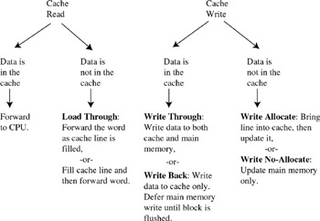

Slide 26
CACHE COHERENCY
The synchronization of data in multiple caches such that reading a memory location via any cache will return the most recent data written to that location via any (other) cache.
Some parallel processors do not cache accesses to shared memory to avoid the issue of cache coherency.

Slide 27
If caches are used with shared memory then some system is required to detect when data in one processor's cache should be discarded or replaced because another processor has updated that memory location. Several such schemes have been devised.

Slide 28
REFERENCES
Computer Architecture and Organization: An Integrated Approach by Miles J. Murdocca and Vincent P. Heuring
Logic and Computer Design Fundamentals by M.Morris Mano and Charles R. Kime
Computer Systems : A Programmers Perspective by Randal E. Bryant and David R. O’Hallaron
Websites :
http://www.alasir.com/articles/cache_principles/index.html
http://burks.bton.ac.uk/burks/foldoc/
http://fourier.eng.hmc.edu/e85/lectures/memory/memory.html
http://en.wikipedia.org/wiki/CPU_cache
http://www.tpub.com/content/fc/14100/css/14100_120.htm
http://laynetworks.com/Cache%20Mapping%20and%20Associativity.htm

