Slide 1
Relational Table design from Extended Entity Relationship (EER) diagrams (Mapping from EER to Relational Model)

Slide 2
A simple way to start:
We will go through the various kinds of entities and relationships, showing an example design
Create a separate table for every entity and
every relationship appearing in the EER diagram.

Slide 3
Minimal needs for declaring tables:
list of columns (and their datatype)
primary key
foreign key references
non-null constraints
other constraints

Slide 4
Mapping an Entity Set:
Relation T_A for every entity A. Attributes of relation are all attributes of the entity.
Constraints
key of ER entity becomes primary key
name
table T_Employee(
ssn integer primary key,
name varchar(30),
age integer)
ssn
age
Employee

Slide 5
Mapping an Entity Set: e.g. 2
in case multiple attributes form the key.
table T_ Person(
fname varchar(30),
lname varchar(30),
age integer,
primary key (fname,lname)
)
lname
fname
age
Person

Slide 6
Mapping a relationship set:
A table with
columns for all the keys of the things being related (remember, relational data model represents relationships between the names of entities)
these form a super-key
plus columns for the relationship attributes
(further constraints to come)

Slide 7
Mapping a Relationship e.g.:
Person
likes
Car
since
fname
lname
vin
age
color
table T_ likes(
vin int references Car,
fname char(25),
lname char(25),
since date,
primary key ( fname, lname, vin) ,
foreign key (vin) references T_Car
foreign key (fname,lname) references Person
)
on delete cascade,
on update cascade
on delete cascade,
on update cascade

Slide 8
Mapping a Binary Relationship:
A
R
B
p
q
ka
kb
e.g., A=Person, B=Car
R=buys
c
d
table T_R
( ka integer references T_A
kb char(5) references T_B
p date,
q char(3),
primary key ( ka , kb ) ,
foreign key (ka) references T_A
foreign key (kb) references T_B)
on delete cascade,
on detete cascade,
same idea for n-ary relationships, which have n foreign keys then

Slide 9
Mapping a “reflexive” relationship (when A = B)
subord
mgr
Employe
manages
from
till
eId
name
T_Employee(eId, name)
T_manages(mgr_eId, subord_eId, from, till)
(Notation: keys are underlined; arrows show foreign keys)

Slide 10
Mapping Relationships with functional constraints (eg):
Car
ownedBy
Driver
since
vin
did
color
age
table T_ownedBy
( vin char(25) references T_Car,
did int references T_Driver,
since date,
primary key ( vin, did ) )

Slide 11
Mapping Weak Entities
c
ka
p
wkInfo
g
R
A
W
table T_W(
wkInfo
g
p
ka references T_A
primary key (wkInfo, ka)
Cannot have wkInfo be a key alone since it does not identify objects in W on its own. (That is the whole point of weak entities)
Throw in attribute p of the relationship, so T_W is really T_WR

Slide 12
Weak entity example:
name
salary
firstName
eId
age
relativeOf
Employee
Dependent
table T_Dependent(
firstName,
eId,
age,
primary key (firstName, eId)
foreign key (eId) references T_Employee,
)
Identifies a Dependent

Slide 13
Mapping Subclasses (simple):
A
kA
table T_A(
kA primary key
p )
is-a
p
table T_B(
kA primary key
q)
B
q
C
s
foreign key(kA) references T_A
These capture the
subclass
inclusion constraints
“every B,C is an A”
table T_C(
kA primary key
s)
foreign key(kA) references T_A
One table per entity, just like before
For B and C, just inherit the key for the root class (A here), since every B and C is also an A
Disjointness or covering by subclasses cannot be expressed using SQL keywords (see constraints later)

Slide 14
Mapping Subclasses (example):
Vehicle
vin
table T_Vehicle(
vin primary key
price)
is-a
price
table T_Car(
vin primary key
#doors)
Car
#doors
Plane
#engines
foreign key(vin) references T_Vehicle
table T_Plane(
vin primary key
#engines)
foreign key(vin) references T_Vehicle

Slide 15
A.Weak entities participating in other relationships
name
salary
firstName
eId
age
relativeOf
Employee
Dependent
Dependent can be related to School by attends
attends is not an “identifying relationship”, so
Dependent is identified by the primary key of
its table
table attends( firstName, eid, sName, since,
primary key ????
foreign key ????
attends
since
School
sName

Slide 16
(Weak entities participating in other relationships)
name
salary
firstName
eId
age
relativeOf
Employee
Dependent
table attends(
firstName,
eid,
sName,
since,
primary key (firstName,eId,sName),
foreign key (sName) references School,
foreign key (firstName,eid) refs
Dependent )
Note that “firstName references Dependent” is illegal, and “eid reference Employee” is too weak.
attends
since
School
sName

Slide 17
B. Table for Aggregation
name
ssn
Employee
Monitors
until
started_on
since
dname
pid
did
Project
Undertakes
Department
Notes:
2

Slide 18
Tables for Aggregation: applying previous ideas
name
ssn
Tables for nested reln’s
table T_proj(
pid primary key ...)
table T_dept(
did primary key ...)
table T_undertakes(
pid references T_proj,
did references T_dept,
primary key(pid,did),
since date )
Employee
Monitors
until
started_on
since
dname
pid
did
Project
Undertakes
Department
Table for “aggregate” relationship treats nested as entity
table T_monitors(
ssn integer references T_emp
did integer
pid integer
foreign key (did,pid) references T_undertakes )
until date
primary key (did,pid,ssn) )
table T_emp(
ssn key
...
Notes:
2

Slide 19
*Mapping Subclasses: 3rd way (collapse down - not a ‘merge’
A
kA
table T_B(
kA primary key
p
q )
is-a
p
table T_C(
kA primary key
p
s )
B
q
C
s
This design is used when subclasses cover totally the superclass (otherwise loose some A's)
and usually are disjoint
otherwise A information, such as kA, p is repeated in both tables for some object <-- against no duplication principle (see later)

Slide 20
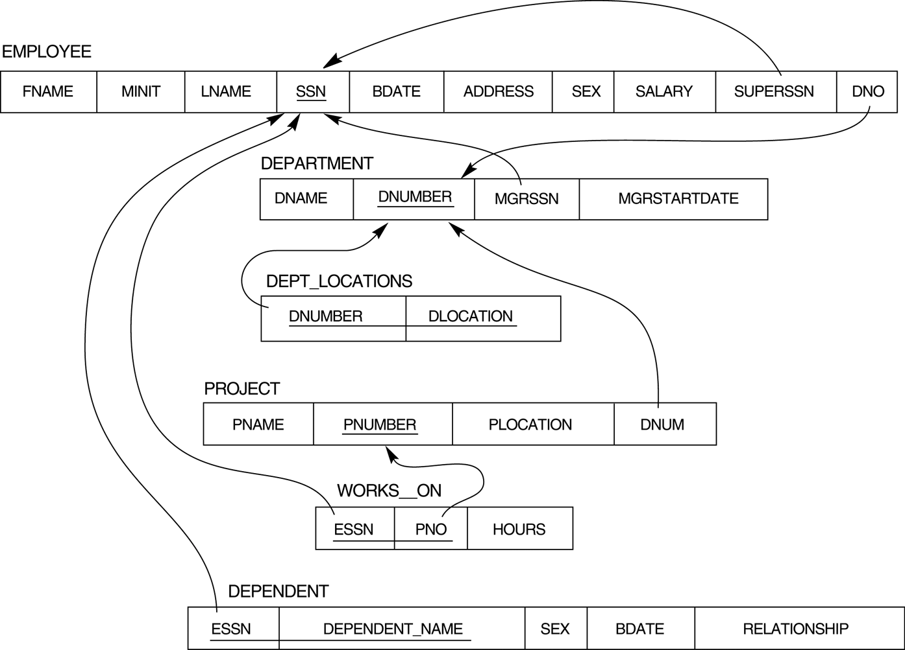
Result of mapping the COMPANY ER schema into a relational schema.

Slide 21
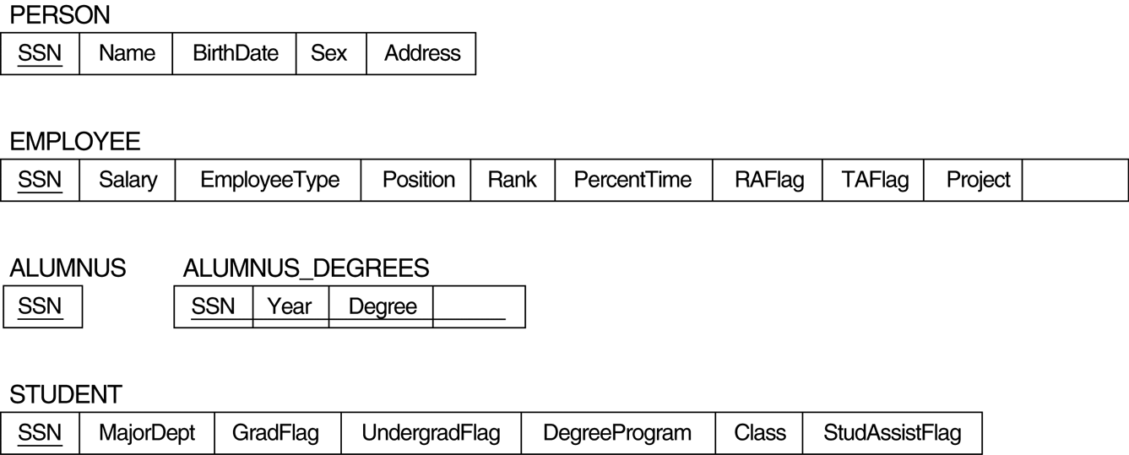
(** Elmasri & Navathe solution to whole picture)

Slide 22
Sample analysis for subclass mapping:
Recall the three techniques taught:
a table per class
merge subclass tables up into superclass
collapse superclass table down into subclasses
representing Person and its subclasses
subclasses overlap, so (3) is not good because person info is duplicated
because many instances only in one subclass, and Students may not have a majorDept (so this would be null), technique (2) not good
so use (1)
representing Student and its subclasses
can use technique (3)
Final solution:
Person(ssn,name,sex,address,birthdate)
Employee(ssn,salary)
Alumnus(ssn,degrees)
GradStd(ssn,majorDept,degreeProgr)
UndGradStd(ssn,majorDept,class)
foreign key
(ssn) referencing
Person

Slide 23
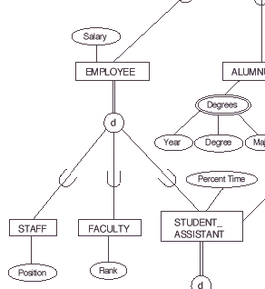
( *Analysis using technique 2 – merge up )
Using it on Employee, would yield
Emp(ssn,salary,position,rank, percentTime)
Would be good if lots of overlap between Staff, Faculty and StudAssist; and position, rank, percentTime are non-null for their respective subclasses. In that case an Employee row would have few nulls.
ssn

