Slide 1
Relational Databases
1 Relational Model of Data
2 Relational Algebra (and connection to Datalog)

Slide 2
Relational Databases
Relational database: a set of relations/tables
Relation schema : specifies
name of relation,
fixed set of named columns (a.k.a. fields, attributes)
additional information/constraints about the columns
For now we continue to use both named columns, and, as in logic, columns identified by position.
E.G.
student(Sid, Name, Age, Gpa).
Relation instance: is a set of tuples (a.k.a. rows, records) of values in the columns. Think of it as a table
(As a set, it is not supposed to have duplicates! )
Must “match” the schema
Notes:
3

Slide 3
e.g. Schema & Example Instance of student Relation
student(Sid,Name,Age,Gpa)
sid | name | age | gpa
5366 | Jones | 18 | 3.4
53688 | Smith | 18 | 3.2
53650 | Smith | 19 | 3.8
cardinality = 3, all rows distinct
Notes:
4

Slide 4
Operators for Relational I.M.
Declare: name of table, number and name of columns, datatype
Constrain: additional constraints
domain/type of columns
key: a minimal set of columns that can be used to identify a row
Tell: insert and remove rows; change fields of existing rows
Ask:
Relational Algebra
Datalog (“Domain Calculus”)
SQL

Slide 5
Relational databases
L_{declare/constrain}: SQL syntax for tables
A set of fields is a key if no
distinct tuples can have same
key values. No subset of
these columns should have
this property.
CREATE TABLE student
(sid INT,
name VARCHAR,
grade CHAR(2),
gpa REAL,
PRIMARY KEY (sid) )
CREATE TABLE enrolledIn
(sid INT,
cid INT,
grade CHAR(2),
PRIMARY KEY (sid,cid) )

Slide 6
Relational databases
L_{tell}: ground atomic formulae as tuples in tables (no rules!)
Datalog: e.g. likes(bob,eve).
SQL: INSERT INTO likes VALUES (‘bob’,’eve’);
L_{question} :
“relational algebra”
“tuple calculus” : SQL
“domain calculus”: arbitrary First Order Logic formulae with free variables (Datalog + universal quantifier)
L_{answer} : set of tuples in a table

Slide 7
Relational Algebra
What is an Algebra?
constants
expressions made of operators applied to operand expressions
laws for manipulating expressions to get equivalent ones
e.g., Algebra of sets:
start from sets defined by enumeration
operators: union, intersection, complement
Algebra of Relational Tables
not really used for querying by end-users
more like instructions to compute answers
but useful terminology (everyone uses it), and used in making queries run more efficiently (optimization)

Slide 8
“Constants”
student(Sid,Name,Age, Gpa)
course(Cid, Title, Dept)
enrolledIn(Sid,Cid,Grade)
Table name
e.g. “Find all students”
Algebra
student
( Datalog
answer(Sid,Name,Age,Gpa) :- student(Sid,Name,Age,Gpa)

Slide 9
“Project” operator
student(Sid,Name,Age, Gpa)
course(Cid, Title, Dept)
enrolledIn(Sid,Cid,Grade)
Eliminates columns
e.g. “Find name and age of students”
Algebra
PROJECT[#2,#3](student) PROJECT[Name,Age](student)
π_{#2,#3}(student) π_{Name,Age}(student)
( Datalog
answer(Name,Age) :- student(_,Name,Age,_)

Slide 10
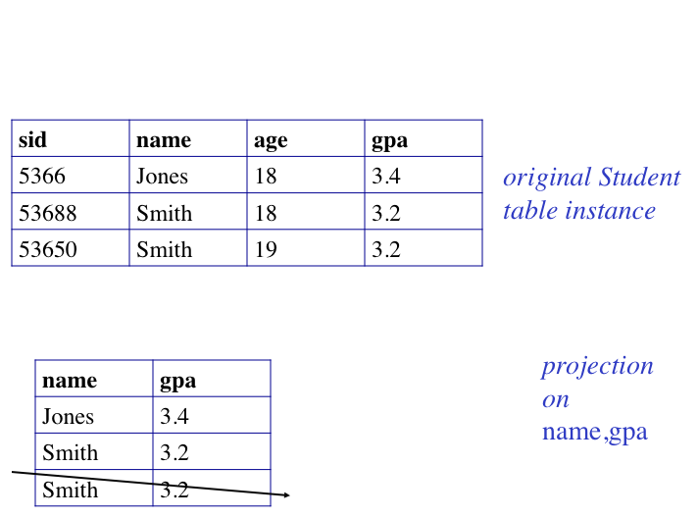
e.g.
Student
PROJECT[name,gpa](Student)
(eliminated because duplicate)

Slide 11
“Select” operator
student(Sid,Name,Age, Gpa)
course(Cid, Title, Dept)
enrolledIn(Sid,Cid,Grade)
Eliminates rows
“Find all information about students whose age = 18”
Algebra
SELECT[Age=18](student) << ascii notation
σ_{Age=18}(student) << math notation
Datalog
answer(Sid,Name,Age,Year) :- student(Sid,Name,Age,Year), Age =18
answer(Sid,Name,18,Year) :- student(Sid,Name,18,Year)
OR

Slide 12
e.g.
sid | name | age | gpa
5366 | Jones | 18 | 3.4
53688 | Smith | 18 | 3.2
53650 | Smith | 19 | 3.8
original Student
table
SELECT[Age=18](student)
sid | name | age | gpa
5366 | Jones | 18 | 3.4
53688 | Smith | 18 | 3.2
answer

Slide 13
Algebra: combine things
student(Sid,Name,Age, Gpa)
course(Cid, Title, Dept)
enrolledIn(Sid,Cid,Grade)
“Find name of 18 year old students”
PROJECT[name] ( SELECT[age=18] (student) )
σ_{Age=18}(student)

Slide 14
“Product” operator
student(Sid,Name,Age, Gpa)
course(Cid, Title, Dept)
enrolledIn(Sid,Cid,Grade)
Combines relations (cartesian product in math)
“Find all possible combinations of enrolledIn and course”
(not very useful on its own)
The Cartesian product, also referred to as a cross-join, returns all the rows in all the tables listed in the query. Each row in the first table is paired with all the rows in the second table. This happens when there is no relationship defined between the two tables.
Algebra
PRODUCT(enrolledIn,course)
enrolledIn × course
Datalog
answer(Sid,EnrolledIn_cid,Grade,Course_cid,Title,Dept) :- enrolledIn(Sid,EnrolledIn_Cid,Grade),
course(Course_cid,Title,Dept).
Name conflict needs to be resolved

Slide 15
e.g.
R
p | q
a1 | b1
a2 | b2
T
q | s | t
c1 | d1 | e1
c2 | d2 | e2
c3 | d3 | e3
R × T
p | R.q | T.q | s | t
a1 | b1 | c1 | d1 | e1
a1 | b1 | c2 | d2 | e2
...
a2 | b2 | c3 | d3 | e3

Slide 16
Union, Intersect
student(Sid,Name,Age, Gpa)
course(Cid, Title, Dept)
enrolledIn(Sid,Cid,Grade)
Combines relations using set-operations; must have “compatible schema” (same column names and datatypes)
“Find Sid of young students or A students”
Algebra
student1 := PROJECT[Sid]( SELECT[Age<18](students) )
student2 := PROJECT[Sid]( SELECT[grade=‘A’](enrolledIn))
s3 := UNION(student1,student2)
(note the use of named intermediate relations to clarify steps)
π_{Sid}( σ_{Age=18}(student)) ∪ π_{Sid}( σ_{Grade=‘A’}(enrolledIn))
Datalog
answer(Sid):- student(Sid,Name,Age,Year), Age < 18.
answer(Sid):- enrolledIn(Sid,_,’A’).

Slide 17
Difference – also set theoretic
student(Sid,Name,Age, Gpa)
course(Cid, Title, Dept)
enrolledIn(Sid,Cid,Grade)
“Students not taking classes”
Algebra
DIFF( PROJECT[Sid](student) , PROJECT[Sid](enrolledIn))
π_{Sid}(student) - π_{Sid}(enrolledIn)
Datalog
answer(Sid):- student(Sid,_,_,_),
NOT enrolledIn(Sid,_,_)
(What if you wanted their name too?)

Slide 18
“Rename table and/or column”
student(Sid,Name,Age, Gpa)
course(Cid, Title, Dept)
enrolledIn(Sid,Cid,Grade)
(Trivial name change. But will be necessary when combination of multiple tables results in conflicting names or doing set ops)
“What are scores gotten by students taking classes.”
Algebra
RENAME[taking(Grade~> Score)] (enrolledIn)
taking := RENAME[Grade~> Score] (enrolledIn)
ρ _{taking(Grade~> Score)} (enrolledIn)
Datalog
taking(Sid,Cid,Score):- enrolledIn(Sid,Cid,Grade),Grade=Score.
OR

Slide 19
“Natural Join” (very useful)
student(Sid,Name,Age, Gpa)
course(Cid, Title, Dept)
enrolledIn(Sid,Cid,Grade)
“Get students with their courses and grades”
Algebra
JOIN(student,enrolledIn)
student ⋈ enrolledIn
Resulting schema: set of attributes in both schemas R and S (no duplics)
Tuples: t such that projection onto R and S yield tuples in R and S
Datalog
answer(Sid,Name,Age,Year,Cid,Grade):-
student(Sid,Name,Age,Year), enrolledIn(Sid,Cid,Grade)

Slide 20
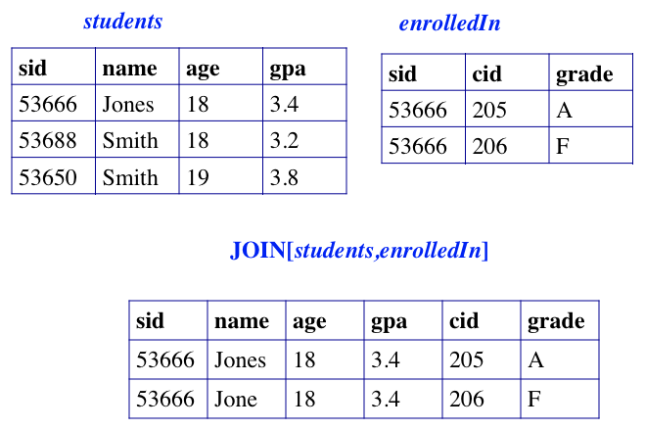
e.g.
Combine rows from S and E where columns with the same name have identical values, and eliminate duplicate columns.

Slide 21
Generalized Join: “Theta Join”
student(Sid,Name,Age, Gpa)
course(Cid, Title, Dept)
enrolledIn(Sid,Cid,Grade)
“Find courses in which a student got less than their GPA”
Algebra
THETA_JOIN[student.sid=enrolled.sid & gpa>grade]
(student,enrolledIn)
student ⋈ _{Condition} enrolledIn
Same as SELECT[Condition] (PRODUCT(student, enrolledIn)

Slide 22
Examples of Division A/B
B1
B2
B3
A
A/B1
A/B2
A/B3
Notes:
14

