Slide 1


A Very Basic Introduction to VHDL – Software installation
Dag A. H. Samuelsen
Associate Professor
Institute for Natural Sciences and Industry Systems

Slide 2
Xilinx Vivado Installation in Windows 10 x64
Go to https://www.xilinx.com/member/forms/download/xef.html?filename=Xilinx_Vivado_SDK_Web_2018.2_0614_1954_Win64.exe and create a account to download the file.
Optional:
Create a folder named C:\Xilinx, right click on the folder and select properties.
Click “Advanced…”, select “Compress contents to save extra disk space” and click “OK” twice.
Start the installation.

Slide 3
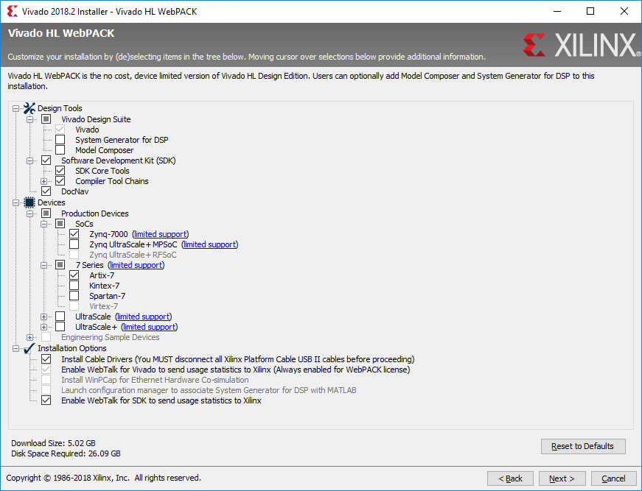
Xilinx Vivado Installation in Windows 10 x64
Choose the defaults in the installation, and choose Vivado HL WebPack when asked.
Make sure to match exactly the choices in the figure to the right, and click next.
Make sure that the installation directory is the same as the one you created, choose to install the drivers and finish the installation.

Slide 4
Digilent Inc. Zybo Zynq board
Go to https://reference.digilentinc.com/reference/programmable-logic/zybo/start
Under “Documentation” click on Master XDC Files, and click on Zybo-Master.xdc.
Click on “RAW” in the window, select all text (CTRL-A) and copy (CTRL-C), and open notepad or other suitable text editor and paste (CTRL-V) the text into that.
Now save the file as any meaningful name in “Documents” or other preferred place of your choice, but make sure the extension is “.xdc” (not “.xdc.txt”), by using “Save as…” and selecting “all files” under File type.
Start Vivado (not Vivado HLS).

Slide 5
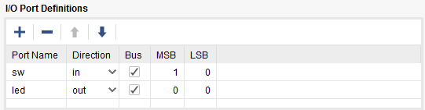
Testing programmability of Vivado and Zynq
After starting, choose “Create project”, click Next, and type in a project name, and choose a desired folder (not the default choice) for your project, and click Next.
Select RTL-project, then Next.
Select VHDL as target and simulator languages, then click Create File, type “top”, and click OK, then Next.
Click Add Files and select the .xdc-file you created earlier and click OK. Make sure to set a mark in the “Copy constraints files into project”, before clicking Next.
Click Next, and choose part by typing “xc7z010clg400-1” into the search field, click on the single component found, and click Next, then Finish.
Wait for the process to complete.
Under “I/O Port Definitions”, add port names as shown, and click OK:

Slide 6
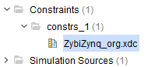
Testing programmability of Vivado and Zynq
In the Project Manager window, click on the small arrow outside Constraints to show the .xdc-file, and double click to open.
Remove the #-character on line 13, 14 and 27. Save the file (CTRL-S).
Double-click “top(Behavioral) (top.vhd)” in the sources frame to open the top file.
On the line after the “begin” key word, type in “led(0) <= sw(0) and sw(1);”, and save the file.
Double-click on “Run Implementation”, click OK in the first and second box, and (after a few minutes…) click in “Generate Bitstream” in the third box, then OK twice (and wait a few minutes…).
Do not select anything in the next dialog box, yet.

Slide 7
Testing programmability of Vivado and Zynq
Connect the USB cable to the Zybo board (PROG/UART) and to your computer, and switch the board on. Wait for the driver installation to finish.
Select “Open Hardware Manager” and click OK. Wait for the process to finish, then click on “Open target” and “Auto connect”. Wait for the process to finish.
Click on “Program device” and click on “Program”. Wait for the process to finish, and when the “DONE”-led on the Zybo board lights up, everything is OK.
Test the functionality by switching switches SW0 and SW1 to see when LED0 lights up.

