Slide 1


A Very Basic Introduction to VHDL – Language Basics
Dag A. H. Samuelsen
Associate Professor
Institute for Natural Sciences and Industry Systems

Slide 2
What VHDL is
VHDL – Very high speed Hardware Description Language
Language for describing hardware functionality
Several versions: VHDL-87, -93, -2006, -2008…
In this case used to configure an FPGA (Field Programmable Gate Array)
A standard VHDL code consists of:
Declarations: Libraries used by the compiler.
Entity description: I/O ports and other configurables
Architecture: “The inside”; or the functional description.

Slide 3
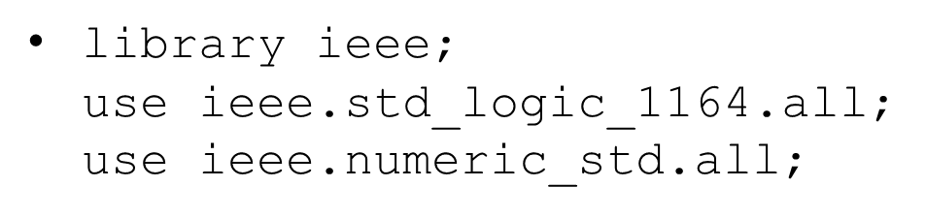
Libraries
Libraries that we want the compiler to use, e.g.
Library “Standard” is always included:
Synthezisable data types: bit, bit_vector, boolean, integer, natural, postive, character, string (++2008)
Data types for simulations (non- synthezisable): time, delay_lenght, file_open_kind, file_open_status, severity level
Operators: Logic, arithmetic, comparison, shift, og combining vectors: NOT, AND, NAND, OR, NOR, XOR, XNOR, +, -, *, /, **, ABS, REM, MOD, =, /=, <, >, <=, >=, SLL, SRL, SLA, SRA, ROL, ROR, &
Other functions: maximum, minimum, rising_edge, falling_edge, to_string, ++

Slide 4
Libraries
Library std_logic_1164:
Industry standard: std_logic and std_logic_vector
Others: std_ulogic and std_ulogic_vector
9 values: 0, 1, z, u, x, -, h, l, w
Operators: only logic, shift(2008) and comparison(2008)
Type converters: to_bit, to_bit_vector, to_stdlogicvector, etc.
Library numeric_std:
Two data types: unsigned and signed (based on std_logic).
Operators: Logic, shift and comparison
Type converters: to_bit, to_bit_vector, to_stdlogicvector, etc.
Defined types, e.g. «type state is (idle, wait, running, finish);»

Slide 5
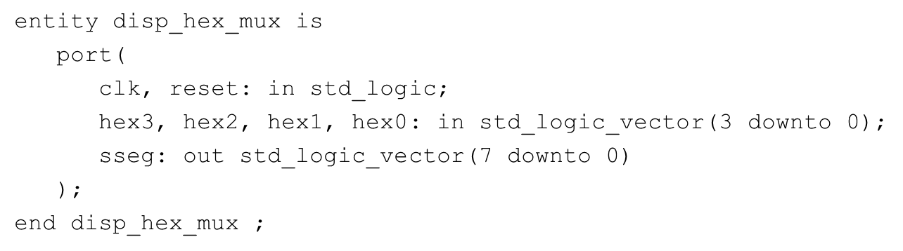
Entity descriptions
Describes ports (signals) in and out of the entity
May use the key word “generic” for configuration of reusable code.
Example:

Slide 6
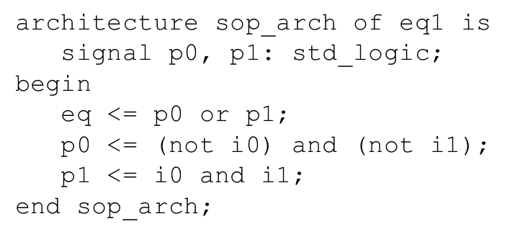
Architecture
Describes the functionality of the entity
The description falls between the “begin” and “end” key words.
Signals for internal use are placed after the “architecture” and before the “begin” key words.
Example:

Slide 7
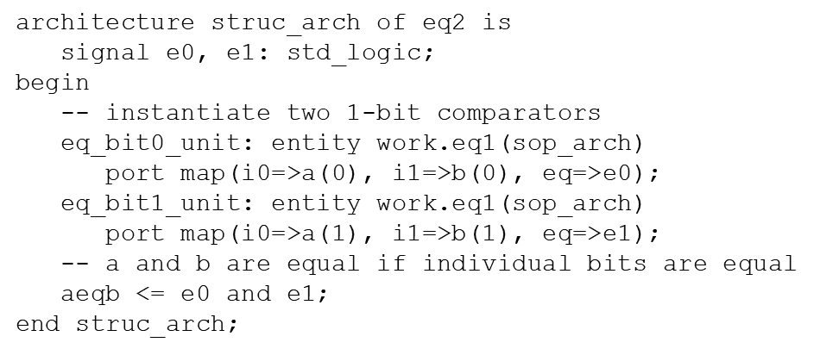
Hierarchical design
Possible to “instantiate” pre-made VHDL modules in another VHDL module
Consists of the name of the entity, where it is collected from, and the port mapping
Example:

Slide 8
Test bench
Used for verifying the functionality of VHDL modules.
The test bench itself is a VHDL module without ports, where the unit under test (UUT) is instantiated inside the test bench and is subject to stimulus as desired
Several variants of tests: functional testing – based on the VHDL code; or implemented testing – based on the implementation as it will be in the FPGA with time delays and everything.

Slide 9
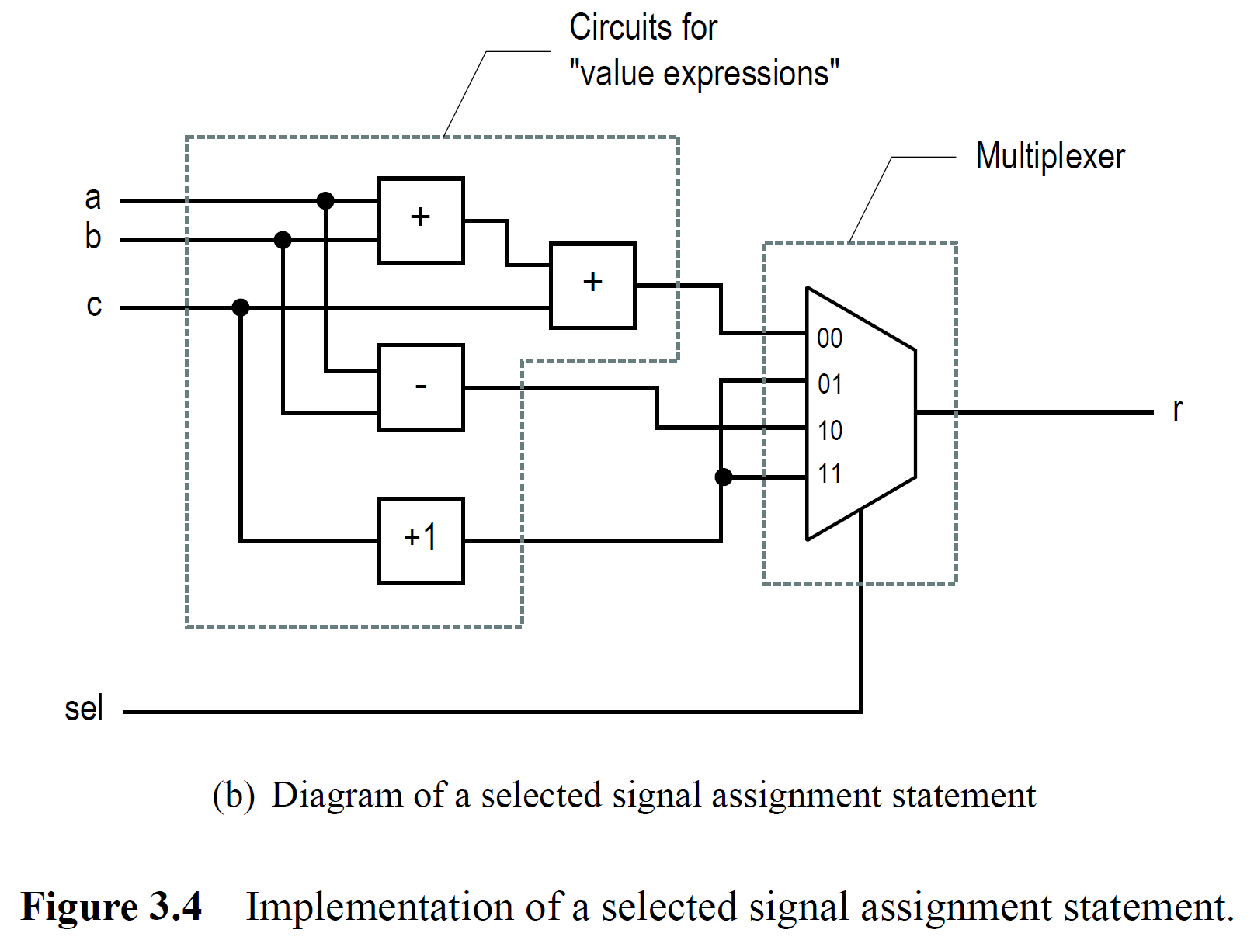
Combinatorial circuits
Circuits without memory
Fixed propagation delay
Any changes on the inputs will immediately affect the output.

Slide 10
Combinatorial circuits
Several ways to implement combinatorial circuits:
Use of “when”:
signal_name <= value_expr_1 when bool_expr_1 else value_expr_2 when bool_expr_2 else . . . value_expr_n
Use of “select”:
with sel select signal_name <= value_expr_1 when bool_expr_1, value_expr_2 when bool_expr_2, . . . value_expr_n when others

Slide 11
Sequential circuits
Key word “process” is used to tell the compiler that the expressions should be evaluated sequentially. The sensitivity list is used to tell the compiler which signals that should trig the process.
IMPORTANT: Sequential evaluation does not mean sequential execution of the expressions!
Syntax:
process (sensitivity_list) begin sequntial_expr_1; sequntial_expr_2; . . . sequntial_expr_n; end process;

Slide 12
IF-statements
architecture if_arch of prio_encoder is
begin
process(r)
begin
if (r(4)='1') then
pcode <= "100";
elsif (r(3)='1')then
pcode <= "011";
elsif (r(2)='1')then
pcode <= "010";
elsif (r(1)='1')then
pcode <= "001";
else
pcode <= "000";
end if;
end process;
end if_arch;

Slide 13
CASE-statements
architecture case_arch of prio_encoder is
begin
process(r)
begin
case r is
when "1000"|"1001"|"1010"|"1011"|
"1100"|"1101"|"1110"|"1111" =>
pcode <= "100";
when "0100"|"0101"|"0110"|"0111" =>
pcode <= "011";
when "0010"|"0011" =>
pcode <= "010";
when "0001" =>
pcode <= "001";
when others =>
pcode <= "000"; -- ‘others’ covers non-listed combinations of r
end case;
end process;
end case_arch;

Slide 14
Limitations
“when” and “select” can only be used outside a process
«if» and «case» can only be used inside a process

Slide 15
Implementation of memory
Memory can only be implemented inside a process – using “if” or “case” statements.
Incomplete “if” or “case” statements will cause the compiler to implement memory!
Example: process(r)
begin
if (r(4)='1') then
pcode <= "100";
end if; end process;
In this example, it is not specified what should happen if bit 4 of r not has the value ‘1’. The compiler will interpret this as “keep the value of pcode when bit 4 of r is not equal to ‘1’.

Slide 16
Constants
Syntax: constant constant_name: data_type := value_expr;
Example: constant my_constant: integer := 8;
constant s0: std_logic_vector(3 downto 0) := "1011";

Slide 17
Generics
Makes it possible to re-use code
Specifies properties for a circuit, such as number of bits in a vector and the value of constants.
Is placed right before the port declaration.
Example:
entity gen_add_w_carry is
generic(N: integer:=4);
port(
a, b: in std_logic_vector(N-1 downto 0);
cout: out std_logic;
sum: out std_logic_vector(N-1 downto 0)
);
end gen_add_w_carry;

Slide 18
Excercises
Make a three-bit adder, which gets inputs from switches SW2-0 on one side, and buttons BTN2-0 on the other side. The result should be displayed using the LED’s.
Make a three bit subtractor, which displays using the LED’s, the result of the operation [SW2-0] – [BTN2-0].
Set up a combination of the two functions, where SW3 is used to select whether to add or subtract.
Add memory to the combination so that the result of the operation is updated on the LED’s when button BTN3 is pressed, and that the result is kept on the LED’s until BTN3 is pressed next time.
Make a 4-bit counter that counts one step for each time BTN0 is pressed. BTN3 is used to select between up- and down counter. If BTN2 is pressed, the counter should immediately take the value present on SW2-0. If BTN1 is pressed, the value of SW2-0 is stored, and transferred to the counter on next cycle of BTN0. The state of the counter should be displayed using the LED’s.

