Slide 1


A Very Basic Introduction to VHDL – Language Constructs
Dag A. H. Samuelsen
Associate Professor
Institute for Natural Sciences and Industry Systems

Slide 2
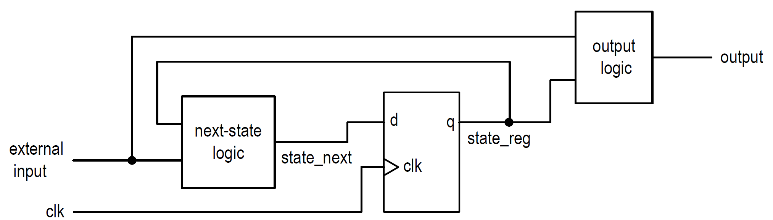
Finite State Machines - Concept
Standardised way of organising sequential circuits: State Machines
Separation of the circuit into two parts: sequential part and combinatorial part
Next-state logic will do one of two things:
If we are going to keep the state: Route the q-signal back to the d-input
If we are going to change state: Set up the next state signal on the d-input

Slide 3
Finite State Machines - States
The memory element is used for storing the current state
The combinatorial “next state” logic is used for calculating next state.
In the pattern presented here, the current state is named “state_reg”, and the next state is named “state_next”

Slide 4
Finite State Machines – Design elements: Flip-flop
library ieee;
use ieee.std_logic_1164.all;
entity d_ff is
port(
clk: in std_logic;
d: in std_logic;
q: out std_logic
);
end d_ff;
architecture arch of d_ff is
begin
process(clk)
begin
if rising _edge(clk) then
q <= d;
end if;
end process;
end arch;
Using library std_logic_1164.all
d is the input; q is the output
A process is added to implement memory
rising_edge(clk) evaluates to true on a positive going transition of the clk signal
The value on the d input is then copied to the q output
This is an incomplete if-structure and will implement memory

Slide 5
Finite State Machines – Design elements: Flip-flop
entity d_ff_en is
port( clk, reset, en, d: in std_logic;
q: out std_logic);
end d_ff_en;
architecture arch of d_ff_en is
begin
process(clk,reset)
begin
if (reset='1') then
q <='0';
elsif rising_edge(clk) then
if (en='1') then
q <= d;
end if;
end if;
end process;
end arch;
Adding synchronous enable and asynchronous reset:
Because of the elsif, the (reset=‘1’) has precedence over all the other criterias
Only when reset =‘0’, we are checking for rising_edge(clk)
The test (en=‘1’) is only perfomed when rising_edge(clk) is true.
Pay attention to how this code describes two parts where one is synchronous (en) while the other is asynchronous (reset)

Slide 6
Finite State Machines – A simple example: data FF
architecture two_seg_arch of d_ff_en is
signal state_reg, state_next: std_logic;
begin
-- D FF
process(clk,reset)
begin
if (reset='1') then
state_reg <='0';
elsif (clk'event and clk='1')
then state_reg <= state_next;
end if;
end process;
-- next-state logic
state_next <= d when en ='1' else
state_reg;
-- output logic
q <= state_reg;
end two_seg_arch;
The first part is a standard memory element with asynchronous reset
state_reg is the memory output; state_next is the memory input
On every rising edge of the clk signal, the value of state_next is copied to state_reg
The next state logic is responsible for setting the correct value for the state_next signal
The output logic is not always used/necessary
Buffering of the output is often a good idea…

Slide 7
Finite State Machines – Test bench
See example file test_i2c.vhd:
First, the component is instantiated
Internal signals is created for all ports of the UUT, and an initial value is assigned for in-ports
For every signal (stimulus) that should be injected into the UUT, there is a process, e.g clk_process, stim_proc, etc.
“wait for” statement allows for timing
“wait until” statement allows for synchronisation with other signals

Slide 8
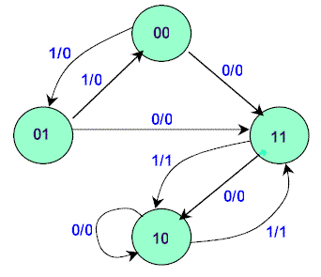
Finite State Machines – The big example: i2c-bus-controller
Tasks:
Identify where the states are defined: how many, signal names, values, etc.
In “SYNC_PROC”: four types of memory elements: state register, counters, data register and output buffers. Identify how these are implemented
Implementation of Boolean signals before next process to increase readability of if-statements
Separate process for output decode; special arrangement for implementation in hierarchical design.
Task: Draw a state diagram for the states implemented in this code

Slide 9
Finite State Machines – Assignment 1 – Delivery: Sept. 8th
Tasks:
Create a state machine that debounces a button in the following ways:
When the button is pressed, the output goes high immediately, and goes low only when the button is released.
When the button is pressed, the output goes high immediately for one clock cycle, then goes low and stay low until the button is released and pressed again.
When the button is pressed, the output goes high immediately for one clock cycle, then low again. If the button is held down for more than 2 sec., the output is pulsed high for one clock cycle every 0.5 sec.
The output can be connected to a LED to show the result of 1 and 3. To show 2 and 3, the output can be used as the enable input of a counter.

Slide 10
Finite State Machines – Assignment 2 – Delivery: Nov. 24th
Tasks:
Create a state machine that implements an UART, using the TX/RX lines. See #6 on page https://reference.digilentinc.com/reference/programmable-logic/zybo/reference-manual
The UART should receive and store up to 16 characters. When an LF (ASCII 10) appears, the stored string should be echoed back to the terminal.
Use Termite (https://www.compuphase.com/software_termite.htm) to communicate with the Zybo Board.

