Slide 1
S.A.V.E

Slide 2
The need is to find a safe, reliable, user-friendly oxygen information/warning system which provides for the general scuba diver a more secured and independent diving experience.

Slide 3
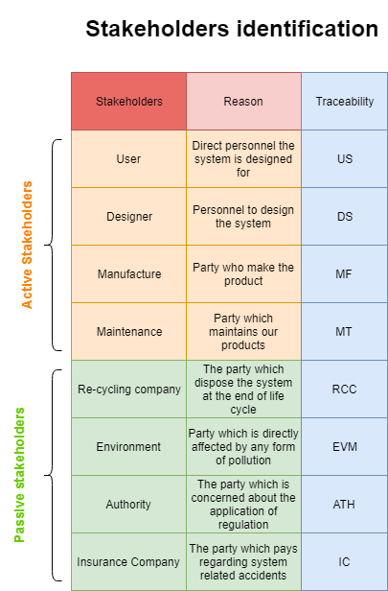
Stakeholders

Slide 4
CONOPS
Our goal and objective is to ensure a reliable and safe warning system for novel divers. To enhance their diving experience by reducing stress.
The deep sea level might cause bounderies for our

Slide 5
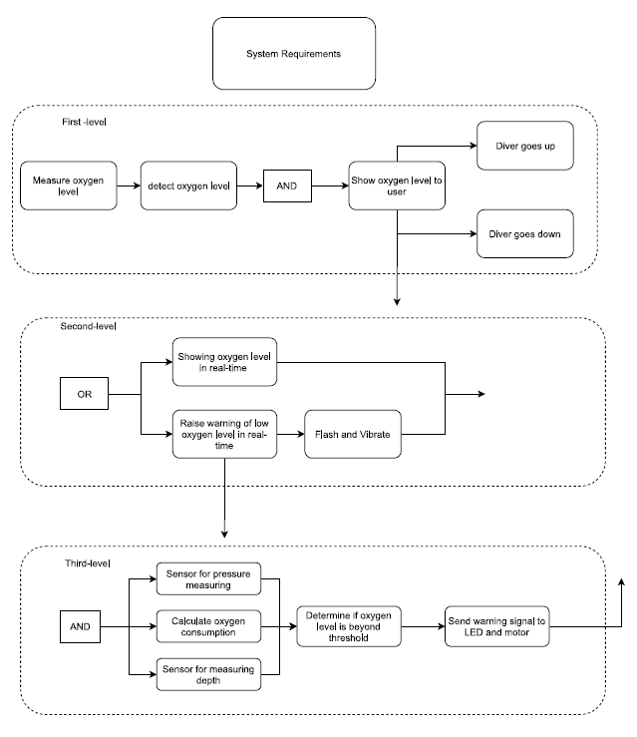
Functional Analysis Block Diagram

Slide 6
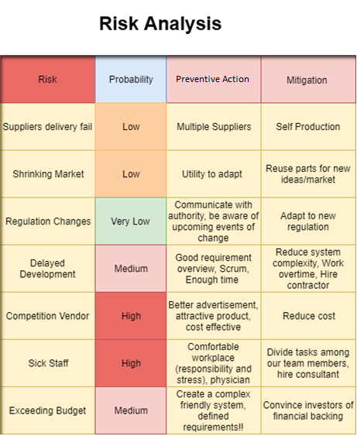
RISK

Slide 7
Verification and validation
Analysis
Critical Design Review
Bottoms up

