Slide 1
Group No 07 Group Members : 1. Umma Sadia Nasrin Sathi (1812187642) 2. Nushrat Kamrul Zahan (1812387642) 3. Jannatul Ferdous Eusha (1821801042)
Smart MediCare

Slide 2
Project Details
Smart MediCare system is a computerized web application system designed and programmed to deal with everyday operations taking place.
The program can show the hospital list, staff list, doctor list, vacant beds, records and billings.
It also maintains information such as ward id, cabin id, CCU id, ICU id, staff in charge and all types of special wards and cabins.

Slide 3
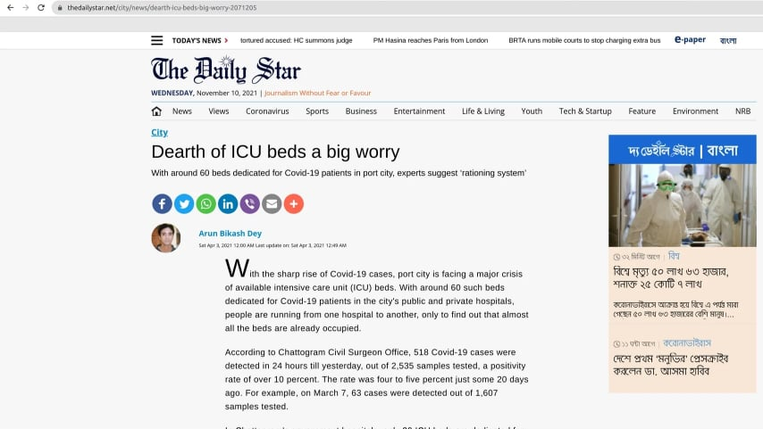
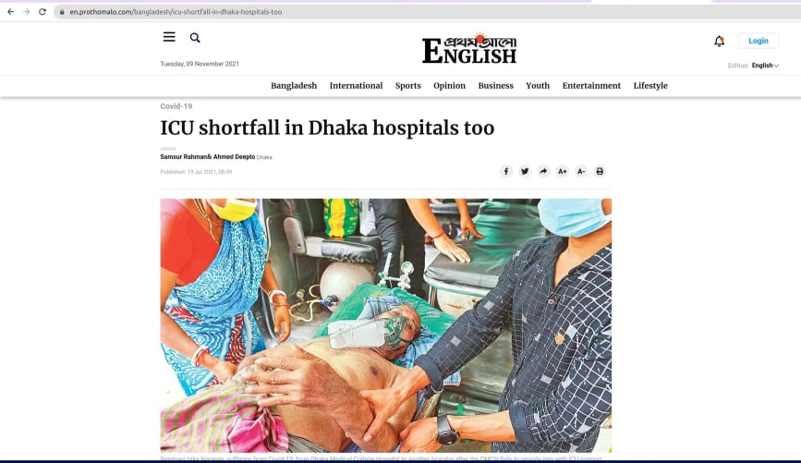
Problems or Opportunity
With the sharp rise of Covid-19 cases, port city is facing a major crisis of available intensive care unit (ICU) beds. With around 60 such beds dedicated for Covid-19 patients in the city's public and private hospitals, people are running from one hospital to another, only to find out that almost all the beds are already occupied.
Evidence of research
https://en.prothomalo.com/bangladesh/icu-shortfall-in-dhaka-hospitals-too
https://www.thedailystar.net/city/news/dearth-icu-beds-big-worry-2071205

Slide 4
Solving the Problems
To overcome such problem, the booking system can be made from home via online the internet. With an internet-based booking system, beds booking can be done from anywhere and at any time without having to go to the hospital, therefore is time and cost-effective.
Smart MediCare is encouraging the hospitals by helping them in developing a Hospital Bed Management System for smooth flow of Patient inflow and Outflow.

Slide 5
Objectives
This Study provides the benefits as listed below:
Provides the support to see the vacancy of the hospitals.
Provide safe and secure online reservations.
Reduce effort and time.
Minimize the waiting time for patients during an emergency.
Increased coordination resulting in better patient transfer and better pre-planning.

Slide 6
Clear target market or Audience
People with smart phone and with a stable internet will be able to access our service.
2. Our target audience is city people.
3. Most cities have hospital so we are also considering them as our audience.

Slide 7


Similar Solution
There are several software available in the market for hospital bed management which helps manage the bed allocation and serve patients in a better way.
https://www.softwaresuggest.com/acgil-hospital-sys
https://www.adsc.com/medics-bed-management-system

Slide 8
Project Environment
In this study, we will develop an online reservation system of hospitals in Bangladesh by the vacancy data provided by the hospitals. This system can be remotely accessed by users from anywhere, anytime, using internet applications from mobile devices for booking seats. The development made use of SQL server database and visual studio code 2020. Mobile devices include laptops, computers, and mobile phones. A web application is a computer program that utilizes web browsers and web technology to perform tasks over the internet.
The web application uses a combination of server-side scripts to handle the storage and retrieval of the information, and client-side scripts demonstrate those data to the user. Visual Studio Code is an Integrated Development Environment (IDE) that can be used to develop graphical user interface applications along with Windows Forms Applications and web applications for all platforms supported by Microsoft Windows, Windows mobile, Windows.NET, is used here to build the React-Framework, Next.js web application.

Slide 9
User Type
The application is for the booking system for the hospital beds and consulting with doctors during an emergency. It maintains two levels of user: -
Administration Level
User Level
Supported Operating Systems
Windows
MAC
Linux
Use Languages
HTML: page layout
CSS: design
JS: frontend & backend functionality
MySQL: database schema
Prisma: backend (database accessing tool)

Slide 10
Use Frameworks
Next.js v11 — React-Framework: backend
Bootstrap v4.6: frontend – design & outlook
SASS: CSS compiler
Typescript: frontend & backend for type-safe code
Project Plan:
 | Task Name | Duration | Start | Finish
1 | Planning | 11 | 2/11/2021 | 12/11/2021
2 | Design | 15 | 13/11/2021 | 27/11/2021
3 | Codding | 37 | 27/11/2021 | 02/01/2022
4 | Delivery | 4 | 03/01/2022 | 06/01/2022

Slide 11
Roles and Responsibilities
Front-end : Jannatul Ferdous Eusha
Back-end : Umma Sadia Nasrin Sathi and
Nushrat Kamrul Zahan
Database : Nushrat Kamrul Zahan

Slide 12
Conclusion
Recently, increasing number of hospitals has been an obvious trend in many countries. This is mainly because the needs to provide medical services to increasing patients due to various forms of disease. One have to run from one place to another for booking, as because they don’t know where there are available seats. And during this time many of them loose their lives. Such scenario needs careful attentions from the hospital management system to provide appropriate service to patients. This application will change the way hospitals function. This will brought technology to handle all the movements of the hospital, and the result will be positive and useful for both Hospitals and patients.
The project Smart Medicare is for computerizing the working in a hospital. The application takes care of all the requirements for booking the beds of a hospital and is capable to provide easy and effective storage of information related to the list of hospitals. It generates a booking system, hospital information including staff, beds, etc.

Slide 13
Thank You

