Slide 1
Indoor Passive Bistatic Radar using WiFi
Alexander Tooke and Ernest Carozza

Slide 2
Introduction and Motivation
Indoor localization has many applications
Supplement to GPS in absence of line of sight to satellites
Tracking equipment in factory
Search and rescue
Law enforcement
WiFi is widely used in homes and offices, transmissions reflect off walls, furniture, people all the time
Analyzing fading can lead to information about objects’ position and movement
Notes:
Aim for 1 minute

Slide 3
Problem Statement
Is it feasible to detect the position and speed of a uncooperative target inside a building using signals from an existing WiFi network?
Assumptions:
Transmitter (WiFi router) position known
Transmitter using 802.11g based on OFDM at 2.4GHz
Main idea: apply radar techniques and understanding of wireless communication protocols
Notes:
Aim for 2 minutes
Precise definitions
Formulas/mathematical models
Specific goal

Slide 4
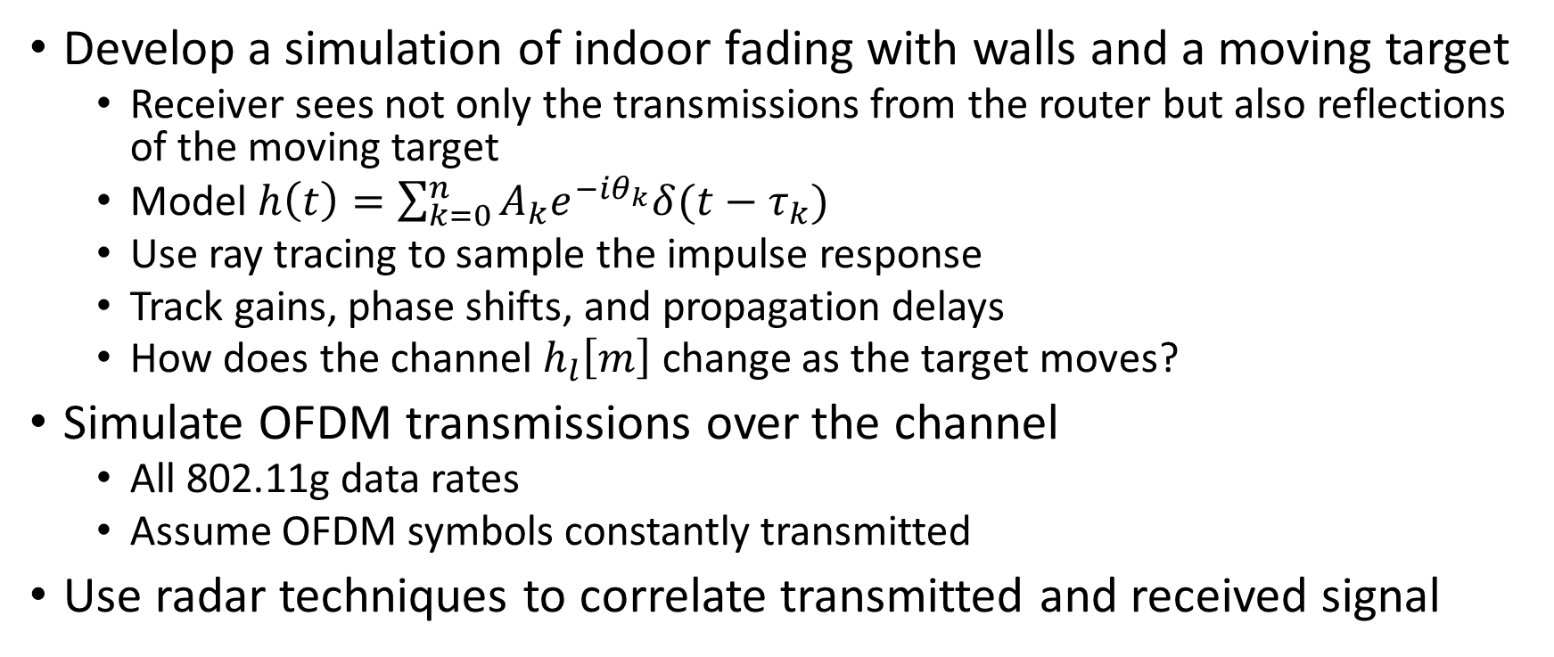
Approach
Develop a simulation of indoor fading with walls and a moving target
Receiver sees not only the transmissions from the router but also reflections of the moving target
Model $h\left(t\right)=\sum_{k=0}^{n}{A_{k}e^{−iθ_{k}}δ(t−τ_{k})}$
Use ray tracing to sample the impulse response
Track gains, phase shifts, and propagation delays
How does the channel $h_{l}\left[m\right]$ change as the target moves?
Simulate OFDM transmissions over the channel
All 802.11g data rates
Assume OFDM symbols constantly transmitted
Use radar techniques to correlate transmitted and received signal
Notes:
Aim for 3 minutes
Main ideas used to tackle the problem
Key equations

Slide 5
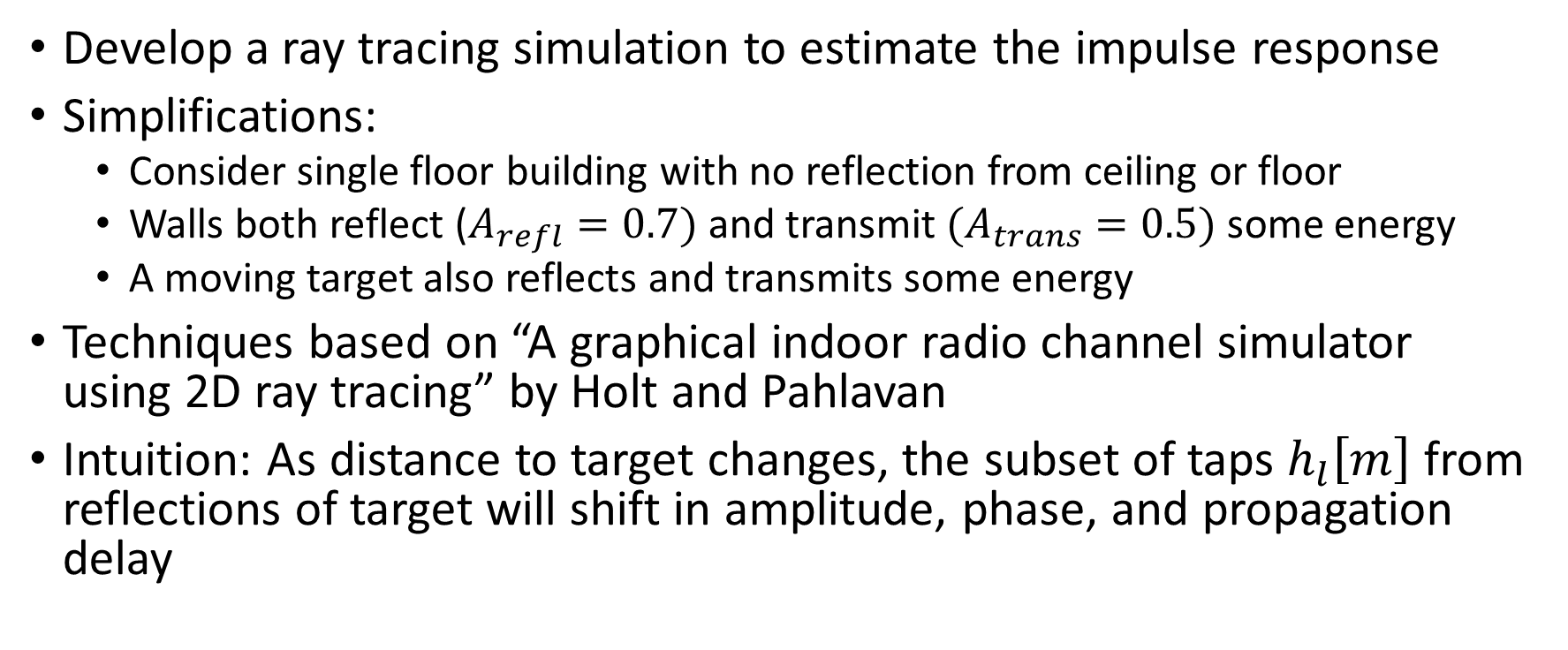
Simulating the Indoor Channel
Develop a ray tracing simulation to estimate the impulse response
Simplifications:
Consider single floor building with no reflection from ceiling or floor
Walls both reflect ($A_{refl}=0.7)$ and transmit $(A_{trans}=0.5)$ some energy
A moving target also reflects and transmits some energy
Techniques based on “A graphical indoor radio channel simulator using 2D ray tracing” by Holt and Pahlavan
Intuition: As distance to target changes, the subset of taps $h_{l}\left[m\right]$ from reflections of target will shift in amplitude, phase, and propagation delay
Notes:
Aim for 1-2 minutes
Why were these simulations chosen?
Clear descriptions of parameter choices
Discuss what the plots mean
Do the plots match the papers? If not, why?

Slide 6
Simulating the Indoor Channel

Slide 7
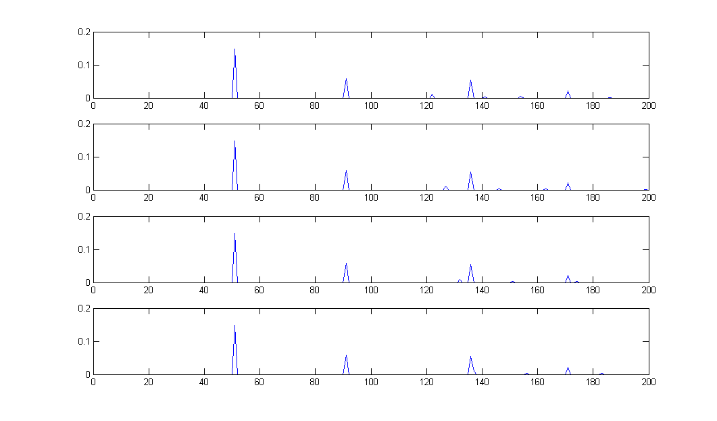
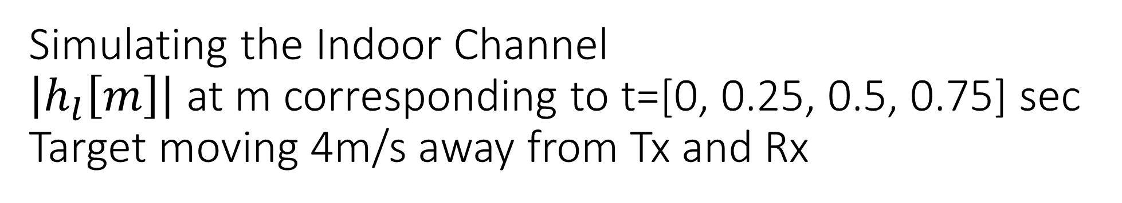
Simulating the Indoor Channel $\left|h_{l}\left[m\right]\right|$ at m corresponding to t=[0, 0.25, 0.5, 0.75] sec Target moving 4m/s away from Tx and Rx

Slide 8
Simulating WiFi OFDM Transmissions
Used and verified against IEEE 802.11g standard document a Simulink model available on MATLAB File Exchange:
http://www.mathworks.com/matlabcentral/fileexchange/38073-802-11g-wlan-phy-model
Each pulse contains a preamble with training data for channel estimation, data rate selection, diversity selection, etc.
Data frames follow, each of which is 4us long, including 0.8us guard interval
Assumption: data is constantly transmitted
A more detailed simulation could partially decode the incoming reference data to determine pulse start times, since typically there will be time gaps between sent packets

Slide 9
Forming Range-Doppler Maps
RDMs are a 2D power map with dimensions of time delay and freq. shift
Moving objects in field of view of the receiver show up as high-power spots at their range and velocity
Maps are formed constantly over time and a target’s movement can be tracked
WiFi signals are difficult to use for radar due to low power, multipath, and poor autocorrelation properties
Main reference: “WiFi-Based Passive Bistatic Radar: Data Processing Schemes and Experimental Results” by Colone, et. al
Notes:
Aim for 1-2 minutes
Why were these simulations chosen?
Clear descriptions of parameter choices
Discuss what the plots mean
Do the plots match the papers? If not, why?

Slide 10
Forming Range-Doppler Maps
Autocorrelation function of simulated WiFi data used in project

Slide 11
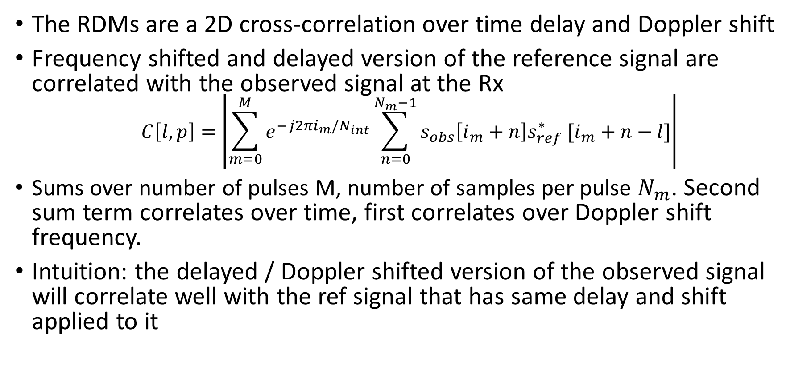
Forming Range-Doppler Maps
The RDMs are a 2D cross-correlation over time delay and Doppler shift
Frequency shifted and delayed version of the reference signal are correlated with the observed signal at the Rx
$$C\left[l, p\right]=\left|\sum_{m=0}^{M}{e^{−j2πi_{m}/N_{int}}}\sum_{n=0}^{N_{m}−1}{s_{obs}\left[i_{m}+n\right]s_{ref}^{∗} [i_{m}+n−l]}\right|$$
Sums over number of pulses M, number of samples per pulse $N_{m}$. Second sum term correlates over time, first correlates over Doppler shift frequency.
Intuition: the delayed / Doppler shifted version of the observed signal will correlate well with the ref signal that has same delay and shift applied to it

Slide 12
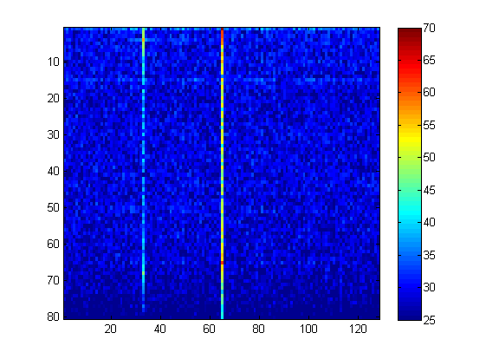
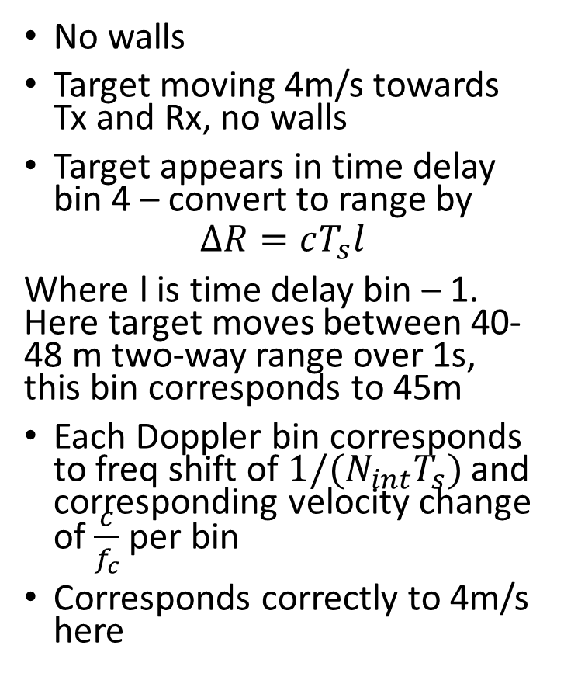
Full Simulation Results
No walls
Target moving 4m/s towards Tx and Rx, no walls
Target appears in time delay bin 4 – convert to range by
$$∆R=cT_{s}l$$
Where l is time delay bin – 1. Here target moves between 40-48 m two-way range over 1s, this bin corresponds to 45m
Each Doppler bin corresponds to freq shift of $1/(N_{int}T_{s})$ and corresponding velocity change of $\frac{c}{f_{c}}$per bin
Corresponds correctly to 4m/s here

Slide 13

Full Simulation Results
44m from Tx to target to Rx
Target moving 4m/s away from Tx and Rx
1 wall in between Tx and target

Slide 14
Full Simulation Results
Target and Tx inside 30x40 m room
Target moving 1 m/s toward Tx
Rx placed outside of walls
Target is seen first in time bin 3 – 30m. Reflections from back wall seen in range bin 5, at weaker power and an additional 30m of propagation

Slide 15
Conclusion
In situations with low noise and limited multipath fading from walls/furniture, detecting position of motion of object is feasible
In a scheme with multiple receivers, trilateration (like in GPS) is a possible solution to indoor localization
While other studies into bistatic radar using WiFi have focused on using actual data with real antennas, simulation has value as well
Simulations in this study allow studying which properties of environment are required for the procedure to work
Including for studying defense against such a scheme
Notes:
Aim for 1 minute

