Slide 1
SBA: U.S. Small Business Administration

Slide 2
Women-Owned Small Business Federal Contracting Program (WOSB Federal Contracting Program)

Slide 3
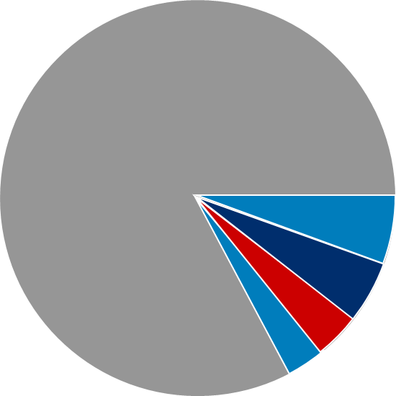
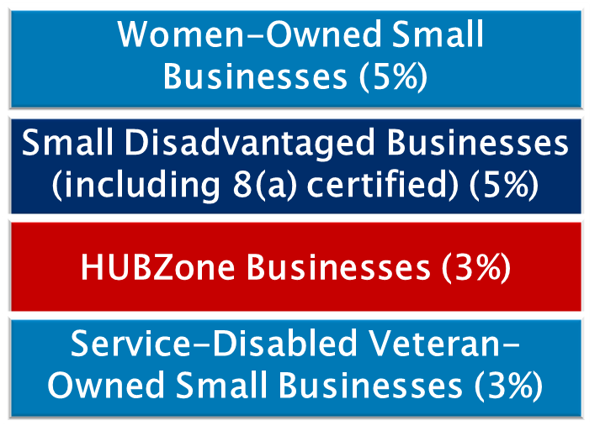

Set-Asides for Certification Programs and Socioeconomic Categories
Targeted set-asides and acquisition goals:
Set-asides are reserved for small businesses between $3,500 (Micro-purchase Threshold) to $250,000 (Simplified Acquisition Threshold).
Notes:
The federal government has specified annual prime contracting goals for designated small businesses.
Targeted Set-asides and Acquisition Goals
Women-owned small businesses–(5%)
Small disadvantaged businesses including 8(a) certified–(5%)
HUBZones (historically underutilized business zones)–(3%)
Service-disabled veteran-owned small businesses–(3%)
Overall small business goal of 23%
Set-asides are reserved for small business between the Micro-purchase Threshold and the Simplified Acquisition Threshold.

Slide 4
Women-Owned Small Business (WOSB) Certification

Slide 5

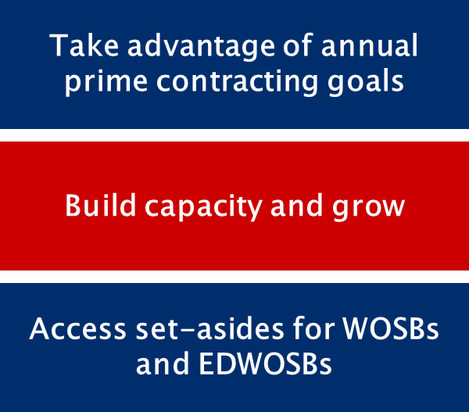
WOSB Federal Contracting Program
Notes:
To help provide a level playing field for women business owners, the WOSB Federal Contracting Program allows contracting officers (COs) to set aside contracts for certified WOSBs and economically disadvantaged women-owned small businesses (EDWOSBs) in eligible industries.
The federal government’s annual prime contracting goal for WOSBs and EDWOSBs is 5%. Agencies can meet the 5% goal through contract awards made under the WOSB Federal Contracting Program.
A certified WOSB or EDWOSB is eligible for contract awards under other socioeconomic programs for small businesses. The awards made under other programs will also be counted toward the 5% goal established for WOSBs.
The WOSB Federal Contracting Program allows COs to make sole-source awards to WOSBs (including EDWOSBs) under specific circumstances. Sole-source contracts are subject to thresholds—$6.5 million for manufacturing and $4 million for services.
SBA implements and administers the WOSB Federal Contracting Program. SBA regulations provide the framework, with SBA procedures incorporated into the Federal Acquisition Regulation (FAR).
Starting on July 15, 2020, SBA will implement Congress’ changes to the WOSB Federal Contracting Program, as put forth in the 2015 National Defense Authorization Act (NDAA), with new WOSB Federal Contracting Program regulations intended to enhance program oversight and effectiveness.

Slide 6
Upcoming Certification Changes
As of October 15, 2020, businesses competing for WOSB Federal Contracting Program set-aside contracts will have to be certified either through:
SBA’s new, free online certification process; or
An approved Third-Party Certifier (TPC), at a cost.
The current self-certification process will remain available for firms until October 15, 2020, in certify.sba.gov.
Small businesses will still be able to utilize an approved TPC, at a cost, to obtain WOSB or EDWOSB certification.
Notes:
The SBA is making it easier for qualified small businesses to participate in the WOSB Federal Contracting Program by improving the customer experience. At the same time, the SBA is strengthening oversight and maintaining the integrity of the certification process.
The changes will make it easier and more efficient for COs to set aside contracts for, and make awards to, firms certified as WOSBs and EDWOSBs.
These regulations state that as of October 15, 2020, businesses competing for WOSB Federal Contracting Program set-aside contracts will have to be certified either through:
SBA’s new, free online certification process; or
An approved Third-Party Certifier (TPC), at a cost.
Please note that the current self-certification process will remain available for firms until October 15, 2020, in certify.sba.gov.

Slide 7
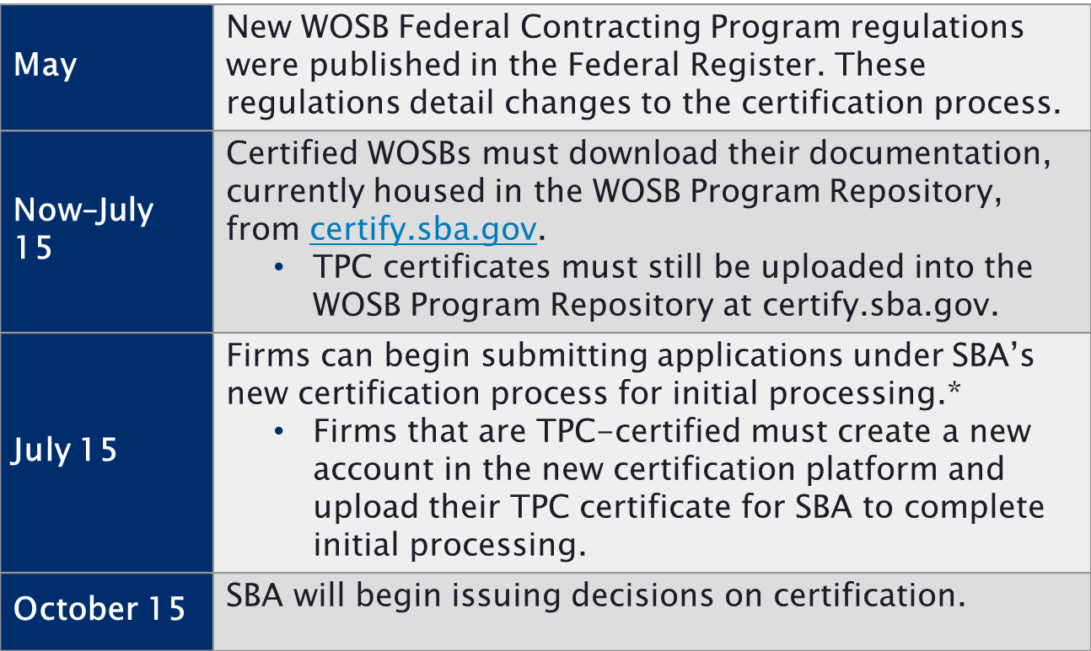
Certification Changes 2020 Timeline
* Further instructions for the new certification process will be detailed prior to July 15.

Slide 8
Certification Changes Resources
To stay up to date with changes to the WOSB Federal Contracting Program, please visit sba.gov/wosbready.
You also can contact your local SBA regional and district office, SBA resource partner, or Procurement Technical Assistance Center (PTAC) with questions.
Please review SBA’s latest FAQs and certification options table for more information about the certification changes.

Slide 9
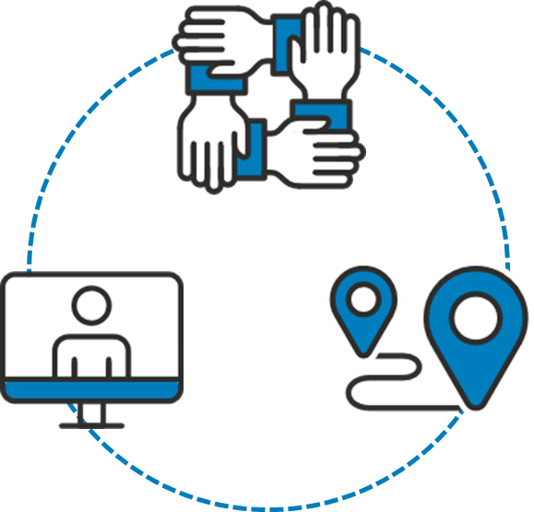
What is WOSB Ready ?
Partners on initiatives like ChallengeHER
Hosts country-wide events
Expands partnerships with stakeholders
Shares updates on social media
Conducts informational webinars
Notes:
WOSB Ready is SBA’s campaign to raise awareness of the upcoming changes to the WOSB Federal Contracting Program.
SBA wants small business owners to consider if they are eligible and ready to compete in the federal marketplace.
Outreach efforts:
We’ve partnered with Women Impacting Public Policy (WIPP) and American Express on initiatives like ChallengeHER, which boost contracting opportunities for WOSBs. This program is entering its 7th year and has educated more than 22,000 women entrepreneurs.
We’ve hosted 70 events across the country for WOSBs and government officials.
We’ve worked on expanding partnerships with other stakeholders and SBA Resource Partners for FY20.
We’re sharing updates on SBA’s LinkedIn, Facebook, and Twitter pages.
We are conducting informational webinars.

Slide 10
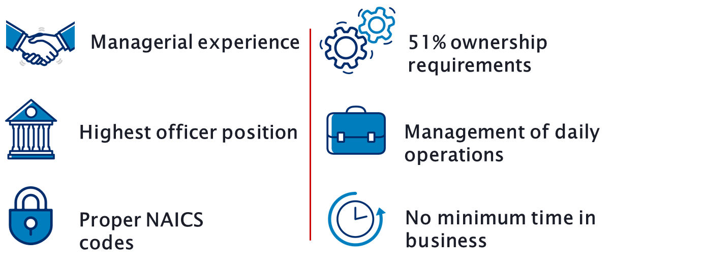
Is the WOSB Certification Appropriate for You?
Notes:
Presenter tip: Depending on the audience, provide some information on when this may be an appropriate certification.
Must be a small business concern for the primary NAICS code or contract (not all NAICS codes are authorized for use under the WOSB Federal Contracting Program).
Must be at least 51% owned and controlled by one or more women who are U.S. citizens. The 51% ownership must be direct and unconditional.
There is no minimum amount of time for the business to have been operational.
A woman must manage daily business operations. This means:
A woman must hold the highest officer position within the business;
The woman must work at the business full-time during normal working hours;
The woman must have managerial experience required to run the business; and
Women must make long-term decisions for the business.

Slide 11
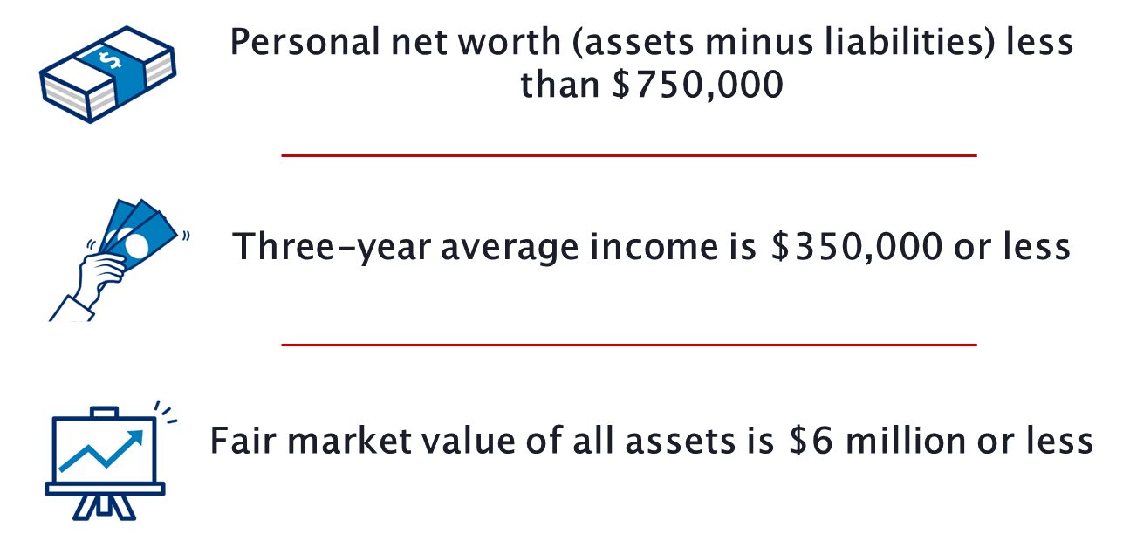
Economically Disadvantaged Requirements to Qualify
Notes:
Presenter tip: Discuss the requirements and information required to qualify as economically disadvantaged.
Small businesses seeking EDWOSB certification will have to submit additional information demonstrating economic disadvantage.
Effective July 15, 2020, SBA has adjusted the standards for determining economic disadvantage for participants in the 8(a) Business Development and WOSB Federal Contracting Programs. They include:
The net worth of an individual claiming economic disadvantage must be less than $750,000.
The adjusted gross income of the individual, averaged over the three preceding years, must be less than $350,000.
The fair market value of all the individual’s assets (including primary residence and the value of the individual’s firm) must be less than $6 million.
Funds invested in an Individual Retirement Account (IRA) or other official retirement account will not be considered in determining the individual’s net worth.
Note: SBA will look at a spouse’s finances if the spouse has a role in the WOSB/EDWOSB, has lent money to, or provided financial support (including credit or guarantee of loan) to the business. SBA may also look at a spouse’s finances if both spouses are in the same or similar line of business and their businesses share names, websites, equipment, and employees.

Slide 12

WOSB Eligibility Process
Register in SAM
Submit application
Represent status in SAM
Notes:
Note: This is for the current process. On July 15, 2020, firms can begin submitting applications under the new certification process for initial processing.
Further instructions for the new certification process will be detailed prior to July 15.
Step 1: Register in SAM.
The System for Award Management (SAM) is a registration system owned by GSA and located at www.SAM.gov.
SAM is where companies represent their eligibility for federal contracts (representations and certifications).
In order to begin the process of certifying as a WOSB or EDWOSB, you must first establish a user account on the SAM site, and then register your entity in SAM.
Note: DO NOT represent as a WOSB or EDWOSB at this stage.
Step 2: Submit Application.
Step 3: Represent Status in SAM.
Represent your status as a WOSB/EDWOSB on the SAM site.
Check the boxes as appropriate to indicate your status as a WOSB and/or EDWOSB (please note that all EDWOSBs are also WOSBs).
Note: All required documents must be uploaded before representing as a WOSB or EDWOSB. Penalties for false representation are steep.

Slide 13
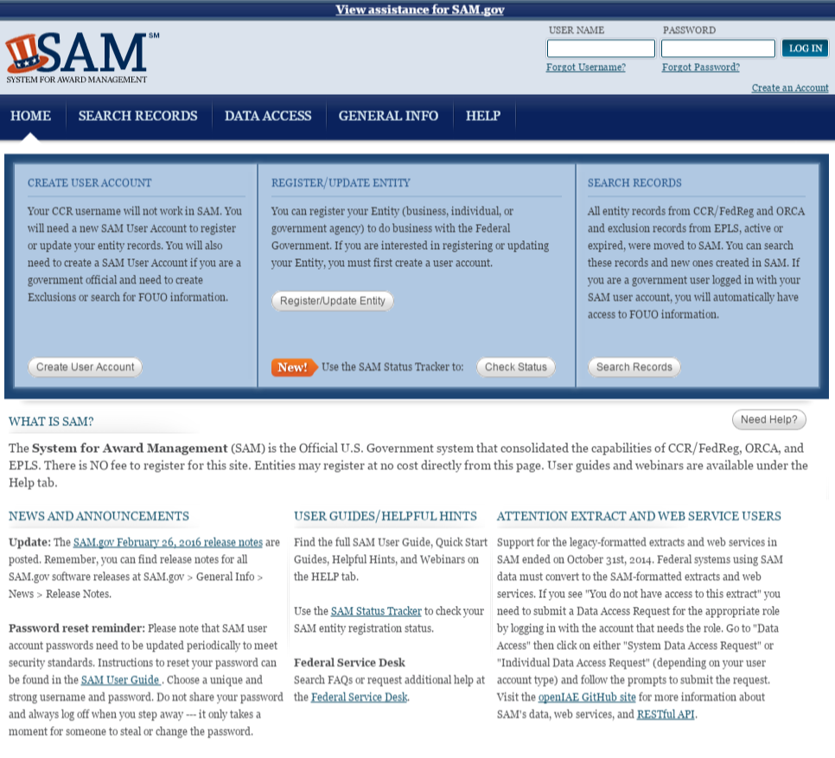
Register in SAM.gov
Notes:
The System for Award Management (SAM) is a registration system owned by GSA and located at www.SAM.gov.
SAM is where companies represent their eligibility for federal contracts (representations and certifications).
To begin the process of certifying as a WOSB or EDWOSB, you must first establish a user account on the SAM site, and then register your entity in SAM.
Note: DO NOT represent as a WOSB or EDWOSB at this stage.
Note: the beta.sam.gov link and screenshot will be provided once the GSA timeline is confirmed, etc.

Slide 14
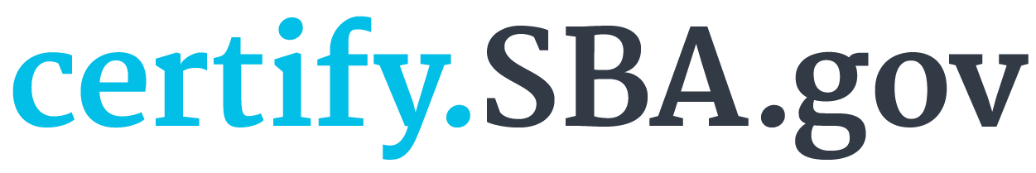
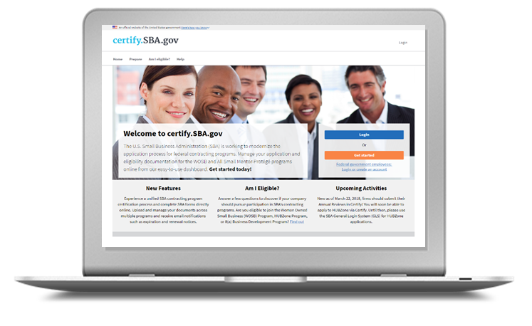
Certification
SBA Certification Portal
SBA’s certification portal where businesses can submit documents to seek SBA certifications
Automatic Migration
Pulls business information from SAM.gov
Online Forms
Forms completed online (no longer required to upload certain SBA forms)
Notes:
Presenter tip: Provide the level of detail needed based on the audience in discussing the Certify system. It may be appropriate to schedule a demonstration of the site with a Q&A session.
SBA’s certification portal where businesses can submit documents to seek SBA certifications.
Pulls business information from SAM.gov.
SBA plans to add other certification programs to certify.sba.gov in the future.
Forms are completed online—no longer required to upload WOSB Federal Contracting Program Certifications (SBA Forms 2413 and 2414) and Personal Financial Statement (SBA Form 413).
Certification questions are filtered by business organization.
Must complete WOSB or EDWOSB certification questionnaire (or application) and add documents to the question when prompted—to be reviewed by CO when in line for award.
Only owner/officer authorized to certify on behalf of company should create account.

Slide 15
WOSB Prime Contracting–FY18
Historic high: $22B
Number of awardees: 16.8K WOSB prime contractors
Industries:
Professional, scientific, and technical services (NAICS sector 54)
Construction (NAICS sector 23)
Top 5 agencies:
AGENCY | ACHIEVEMENT
SBA | 28.52%
Office of Personnel Management | 21.94%
Department of Housing and Urban Development | 15.84%
Nuclear Regulatory Commission | 13.84%
Department of the Interior | 13.11%

Slide 16
WOSB and EDWOSB Set-Aside Contracts
Industry
WOSB
NAICS code assigned to contract is in an industry where WOSBs are substantially underrepresented.
EDWOSB
NAICS code assigned to contract is in an industry where WOSBs are underrepresented.
Rule of Two
Contracting officer has reasonable expectation that 2 or more WOSBs will submit an offer.
Award Price
Contract must be awarded at fair market price.
Notes:
Presenter tip: Provide any relevant information on how set-aside contracts work within the WOSB certification.

Slide 17




WOSB and EDWOSB Sole-Source Contracts
1
2
Eligible NAICS Code
Fair and Reasonable Price
WOSB/EDWOSB-eligible NAICS code
Awarded at a fair and reasonable price
3
4
Contract Value
Sole-Source
$6.5M for manufacturing or $4M for all others
Only 1 WOSB/EDWOSB that can perform
Notes:
To make a sole-source award to a WOSB or EDWOSB, the following conditions must be met:
Is the contract in a WOSB/EDWOSB-eligible NAICS code?
Can the contract be awarded to the WOSB/EDWOSB at a fair and reasonable price?
Is the contract (including options) valued at $6.5 million or less for manufacturing contracts or $4 million or less for all other contracts?
In the determination of the contracting officer (CO), is there a reasonable expectation that there is only 1 WOSB/EDWOSB that can perform?
The WOSB Federal Contracting Program is a business development program without authority to make a direct award. Agencies are required to prepare and approve justification and approval.

Slide 18




Proactive Self-Marketing
Identify federal buyers and get to know them.
Identify the agency contracting procedures and those who make buying decisions.
Focus on areas in your niche and prioritize.
Make contacts through small business events and network your business.
Notes:
Presenter tip: Discuss the requirements for the business to have a marketing plan and/or strategy to proactively self-market their programs or services in order to succeed in the WOSB Federal Contracting Program.
Determine which federal agencies buy your product or service and get to know them.
Identify the contracting procedures of those agencies and the personnel who make buying decisions. Find out if your target agencies require you to register in their database in order to do business with them.
Focus on opportunities in your niche and prioritize.
Make contacts. Attend small business events and network your business to gain exposure to key agencies.
Remember, registering your business is not enough to obtain a federal contract. Ultimately, you are responsible for your own success and you will need to market your business to attract attention from federal agencies.

Slide 19
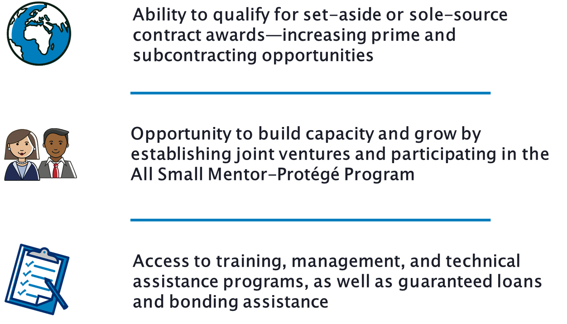
Getting the Most Out of the WOSB Federal Contracting Program
Notes:
There are 444 NAICS codes eligible for set-aside or sole-source awards under WOSB(364)/EDWOSB(80). To check which NAICS codes are authorized under the WOSB Federal Contracting Program, visit sba.gov/wosb.
A WOSB or an EDWOSB may establish a joint venture with another small business to pursue a WOSB Federal Contracting Program contract. SBA does not approve WOSB or EDWOSB joint venture agreements, but will process protests challenging the eligibility of joint ventures as a WOSB or an EDWOSB.
You are eligible for the 7(j) management and technical assistance program.
Perform market research to identify federal agencies that purchase your products and services.
Review agency procurement forecasts and expiring procurements.
Market your firm’s capabilities to agencies.
Consider the All Small Mentor-Protégé Program and joint ventures to allow your firm to pursue larger contract opportunities.

Slide 20
Contact Us
For more information and to keep informed of events, go to: www.sba.gov/wosbready.
For questions on the WOSB Federal Contracting Program, email wosb@sba.gov.
For technical questions on the WOSB Program Repository, please email help@certify.sba.gov.

Slide 21
Resources
There are several resources available to help answer questions about the WOSB Federal Contracting Program.
Visit a local resource:
Procurement Center Representative (PCR) Directory
Find your local PCR at: sba.gov/contracting/resources-small-businesses/pcr-directory.
Small Business Administration District Offices
Find your local office at: sba.gov/tools/local-assistance/districtoffices.
Women’s Business Centers
Find your local center at: sba.gov/tools/local-assistance/wbc.
Procurement Technical Assistance Centers
Find your local center at: aptac-us.org.
Small Business Development Centers
Find your local center at: americassbdc.org/home/find-your-sbdc.
SCORE (Service Corps of Retired Executives)
Find your SCORE office at: score.org.
Call the SBA Answer Desk: 1-800-U-ASK-SBA (1-800-827-5722)

Slide 22
Questions and Answers
THANK YOU!

