Slide 1
Women-Owned Small Business Federal Contracting Program (WOSB Federal Contracting Program)

Slide 2
Women-Owned Small Business (WOSB) Certification
General Overview and Changes

Slide 3
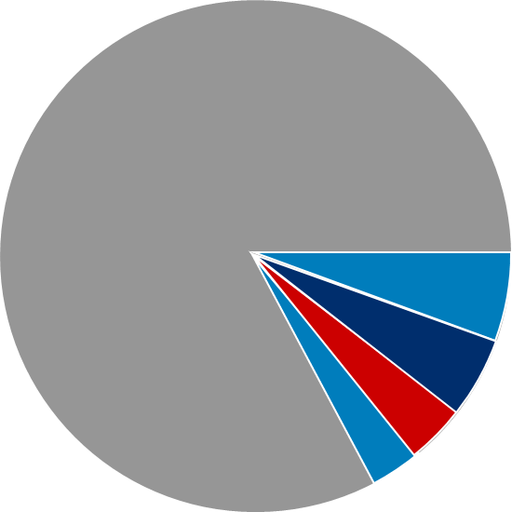
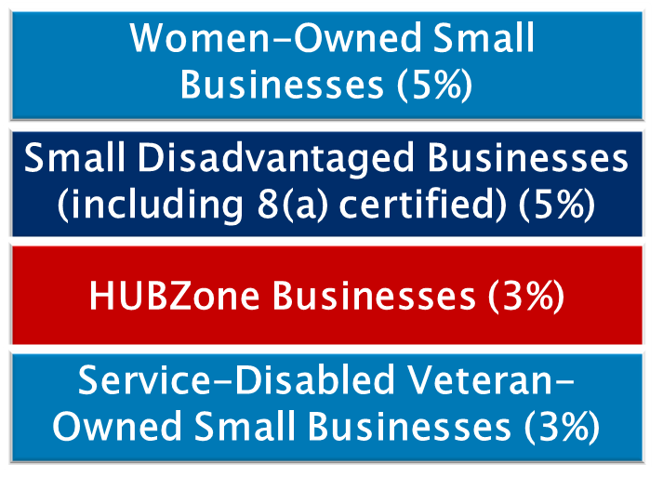

Set-Asides for Certification Programs and Socioeconomic Categories
Targeted set-asides and acquisition goals:
Set-asides are reserved for small businesses between $3,500 (Micro-purchase Threshold) to $250,000 (Simplified Acquisition Threshold).
Notes:
The federal government has specified annual prime contracting goals for designated small businesses.
Targeted Set-asides and Acquisition Goals
Women-owned small businesses–(5%)
Small disadvantaged businesses including 8(a) certified–(5%)
HUBZones (historically underutilized business zones)–(3%)
Service-disabled veteran-owned small businesses–(3%)
Overall small business goal of 23%
Set-asides are reserved for small business between the Micro-purchase Threshold and the Simplified Acquisition Threshold.
FY2019 highlights:
Federal Government exceeded the small business contracting goal for the seventh consecutive year
Awarded a record breaking $132.9 billion in prime contracts to small business
26.5% of all federal small business eligible dollars were awarded to small firms
Over 72,000 small business prime contractors received average awards of $1.8 million

Slide 4
WOSB Prime Contracting–FY19
Historic high: $26B
Number of awardees: Over 15K WOSB prime contractors
Exceeded goal: 5.19% of eligible contracting dollars to WOSBs
Top five agencies (prime contracting to WOSBs and EDWOSBs):
AGENCY | ACHIEVEMENT
SBA | 24.2%
Nuclear Regulatory Commission | 15%
Office of Personnel Management | 15%
Department of the Interior | 13.6%
Department of Housing and Urban Development | 12.7%
Notes:
Federal government exceeded the small business contracting goal for the seventh consecutive year.
Exceeded goal: achieved 5.19% ($26 billion) of eligible contracting dollars: highest amount ever.
Could equate to over 134,000 jobs.
Surpassed goal for second time in past seven years.
Prime contracts awarded to 15,000 WOSB prime contractors–21% total small business vendors.
Average award of $1.85 million per prime contractor.

Slide 5

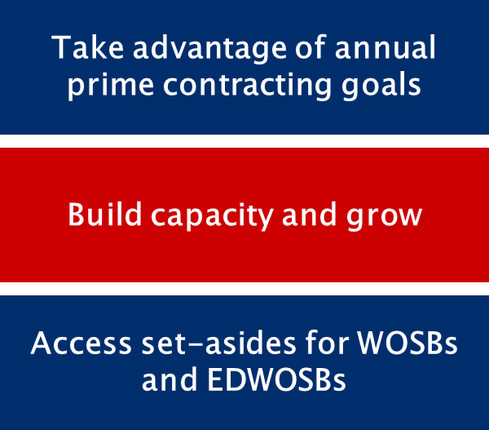
WOSB Federal Contracting Program
Notes:
To help provide a level playing field for women business owners, the WOSB Federal Contracting Program allows contracting officers (COs) to set aside contracts for certified WOSBs and economically disadvantaged women-owned small businesses (EDWOSBs) in eligible industries.
The federal government’s annual prime contracting goal for WOSBs and EDWOSBs is 5%. Agencies can meet the 5% goal through contract awards made under the WOSB Federal Contracting Program.
A certified WOSB or EDWOSB is eligible for contract awards under other socioeconomic programs for small businesses. The awards made under other programs will also be counted toward the 5% goal established for WOSBs.
The WOSB Federal Contracting Program allows COs to make sole-source awards to WOSBs (including EDWOSBs) under specific circumstances. Sole-source contracts are subject to thresholds—$6.5 million for manufacturing and $4 million for services.
SBA implements and administers the WOSB Federal Contracting Program. SBA regulations provide the framework, with SBA procedures incorporated into the Federal Acquisition Regulation (FAR).
Starting on July 15, 2020, SBA will implement Congress’ changes to the WOSB Federal Contracting Program, as put forth in the 2015 National Defense Authorization Act (NDAA), with new WOSB Federal Contracting Program regulations intended to enhance program oversight and effectiveness.

Slide 6
WOSB and EDWOSB
WOSB: Women-Owned Small Business
EDWOSB: Economically Disadvantaged Women-Owned Small Business; WOSBs whose owner and/or manager claims economic disadvantage
EDWOSB is a subset of WOSB. As such, if you qualify as an EDWOSB, you automatically qualify as a WOSB.
The industry specific NAICS codes for WOSB and EDWOSB are listed here: https://www.sba.gov/document/support--qualifying-naics-women-owned-small-business-federal-contracting-program
WOSB
EDWOSB

Slide 7
Certification Improvements
SBA has implemented Congress’ changes to the WOSB Federal Contracting Program, as put forth in the 2015 National Defense Authorization Act (NDAA).
These updated regulations make it easier for qualified small businesses to participate in the WOSB Federal Contracting Program by improving the customer experience.
At the same time, SBA is strengthening oversight and maintaining the integrity of the certification process.
The updated WOSB Federal Contracting Program regulations were published in the Federal Register in May 2020. These regulations detail changes to the certification process.
Notes:
Full link to regulations changes posted in the federal register: https://www.federalregister.gov/documents/2020/05/11/2020-09022/women-owned-small-business-and-economically-disadvantaged-women-owned-small-business-certification

Slide 8
Certification Improvements, 2
SBA’s new, free online certification process for WOSBs and EDWOSBs is live on SBA’s new online portal: beta.certify.sba.gov.
All WOSB firms need to take action in the new beta.certify.sba.gov in order to compete for WOSB Federal Contracting Program set-aside contracts.
Notes:
Presenter note: The new beta.certify.sba.gov website is covered later in this presentation. Highlight here that “all firms need to take action” including formerly self-certified, TPC, CVE, and 8(a)
Specifically any firm that wants to compete on set-asides or sole-source contracts within the WOSB Federal Contracting Program will have to become certified through beta.certify.sba.gov.

Slide 9
Self-Certified Firms
As of October 15, 2020, the previous self-certification option on the old certify.sba.gov platform is no longer available.
For previously self-certified WOSBs and EDWOSBs, all documents previously uploaded in certify.sba.gov will be available through March 31, 2021, for retrieval.
For any currently active contracts through the WOSB Federal Contracting Program:
You will remain certified for the duration of existing contracts.
To bid on any new contracts:
You need to submit documents to become certified through the new, free online process at beta.certify.sba.gov.
Notes:
Presenters Note: please emphasize the following:
As a reminder, previous or current WOSB and EDWOSB self-certification does not qualify you for certification in beta.certify.sba.gov.
If you are currently or previously self-certified, you will have to complete a new application in beta.certify.sba.gov that SBA will review and approve.
If your firm would like to compete for WOSB Federal Contracting Program set-asides, you must submit an application in beta.certify.sba.gov for approval.

Slide 10
Third-Party Certification
SBA allows continued participation from businesses that utilize approved Third-Party Certifiers (TPCs) to obtain WOSB or EDWOSB certification.
Approved TPCs:
El Paso Hispanic Chamber of Commerce
National Women Business Owners Corporation
U.S. Women’s Chamber of Commerce
Women’s Business Enterprise National Council
If you are currently a TPC-certified firm with active contracts through the WOSB Federal Contracting Program:
You will remain certified for the duration of existing contracts.
To bid on any new contracts:
You need to complete an application and upload your unexpired WOSB or EDWOSB TPC-certified documentation through the new, free online process at beta.certify.sba.gov.

Slide 11
Other Certifications
SBA allows participation from firms certified by the following entities, provided they meet all eligibility requirements:
The U.S. Department of Veterans Affairs Center for Verification and Evaluations (CVE)
8(a) Business Development Certification Program

Slide 12
Certification Changes Resources
To stay up to date with changes to the WOSB Federal Contracting Program, please visit sba.gov/wosbready.
You also can contact your local SBA regional and district office, SBA resource partner, or Procurement Technical Assistance Center (PTAC) with questions.
Please review SBA’s latest FAQs, certification options table, infographic, and beta.certify.sba.gov fact sheet for more information about the certification changes.

Slide 13
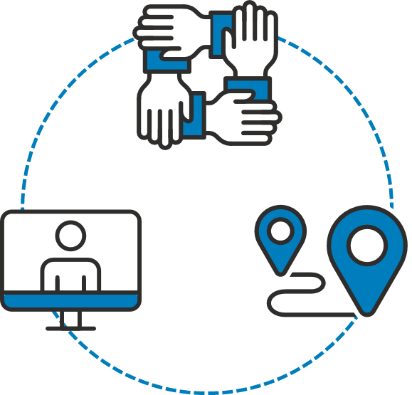
What is WOSB Ready ?
Partners on initiatives like ChallengeHER
Hosts country-wide events
Expands partnerships with stakeholders
Shares updates on social media
Conducts informational webinars
Notes:
WOSB Ready is SBA’s campaign to raise awareness about the changes to the WOSB Federal Contracting Program.
SBA wants small business owners to consider if they are eligible and ready to compete in the federal marketplace.
Outreach efforts:
We’ve partnered with Women Impacting Public Policy (WIPP) and American Express on initiatives like ChallengeHER, which boost contracting opportunities for WOSBs. This program is entering its 7th year and has educated more than 22,000 women entrepreneurs.
We’ve hosted 70 events across the country for WOSBs and government officials.
We’ve worked on expanding partnerships with other stakeholders and SBA Resource Partners for FY21.
We’re sharing updates on SBA’s LinkedIn, Facebook, and Twitter pages.
We are conducting informational webinars.

Slide 14
Women-Owned Small Business (WOSB) Certification, 2
Program Eligibility

Slide 15
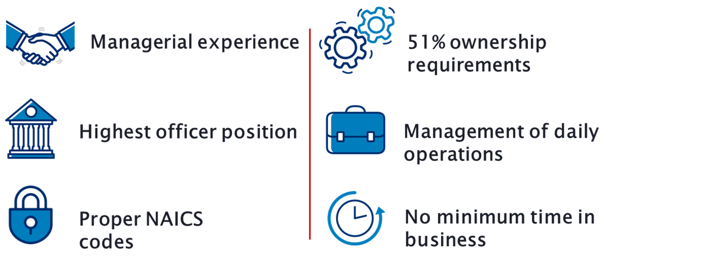
Is the WOSB Certification Appropriate for You?
Notes:
Presenter tip: Depending on the audience, provide some information on when this may be an appropriate certification.
Must be a small business concern for the primary NAICS code or contract (not all NAICS codes are authorized for use under the WOSB Federal Contracting Program).
Must be at least 51% owned and controlled by one or more women who are U.S. citizens. The 51% ownership must be direct and unconditional.
There is no minimum amount of time for the business to have been operational.
A woman must manage daily business operations. This means:
A woman must hold the highest officer position within the business;
The woman must work at the business full-time during normal working hours;
The woman must have managerial experience required to run the business; and
Women must make long-term decisions for the business.
Full link to program NAICS codes for WOSB and EDWOSB: https://www.sba.gov/document/support--qualifying-naics-women-owned-small-business-federal-contracting-program

Slide 16
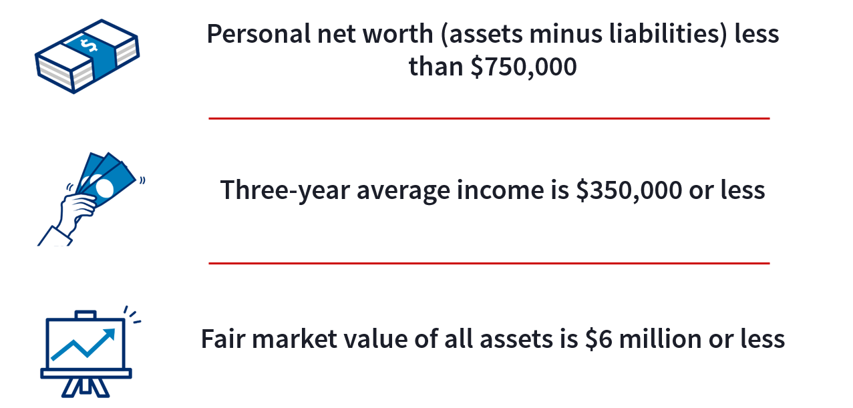
Economically Disadvantaged Requirements to Qualify
Notes:
Presenter tip: Discuss the requirements and information required to qualify as economically disadvantaged.
Small businesses seeking EDWOSB certification will have to submit additional information demonstrating economic disadvantage.
Effective July 15, 2020, SBA has adjusted the standards for determining economic disadvantage for participants in the 8(a) Business Development and WOSB Federal Contracting Programs. They include:
The net worth of an individual claiming economic disadvantage must be less than $750,000.
The adjusted gross income of the individual, averaged over the three preceding years, must be less than $350,000.
The fair market value of all the individual’s assets (including primary residence and the value of the individual’s firm) must be less than $6 million.
Funds invested in an Individual Retirement Account (IRA) or other official retirement account will not be considered in determining the individual’s net worth.
Note: SBA will look at a spouse’s finances if the spouse has a role in the WOSB/EDWOSB, has lent money to, or provided financial support (including credit or guarantee of loan) to the business. SBA may also look at a spouse’s finances if both spouses are in the same or similar line of business and their businesses share names, websites, equipment, and employees.

Slide 17
Women-Owned Small Business (WOSB) Certification
Application and Certification Process

Slide 18

WOSB Eligibility Process
Register in SAM.gov
Visit beta.certify.SBA.gov
New site makes it easy for you to understand the changes in the certification process and remain eligible

Slide 19
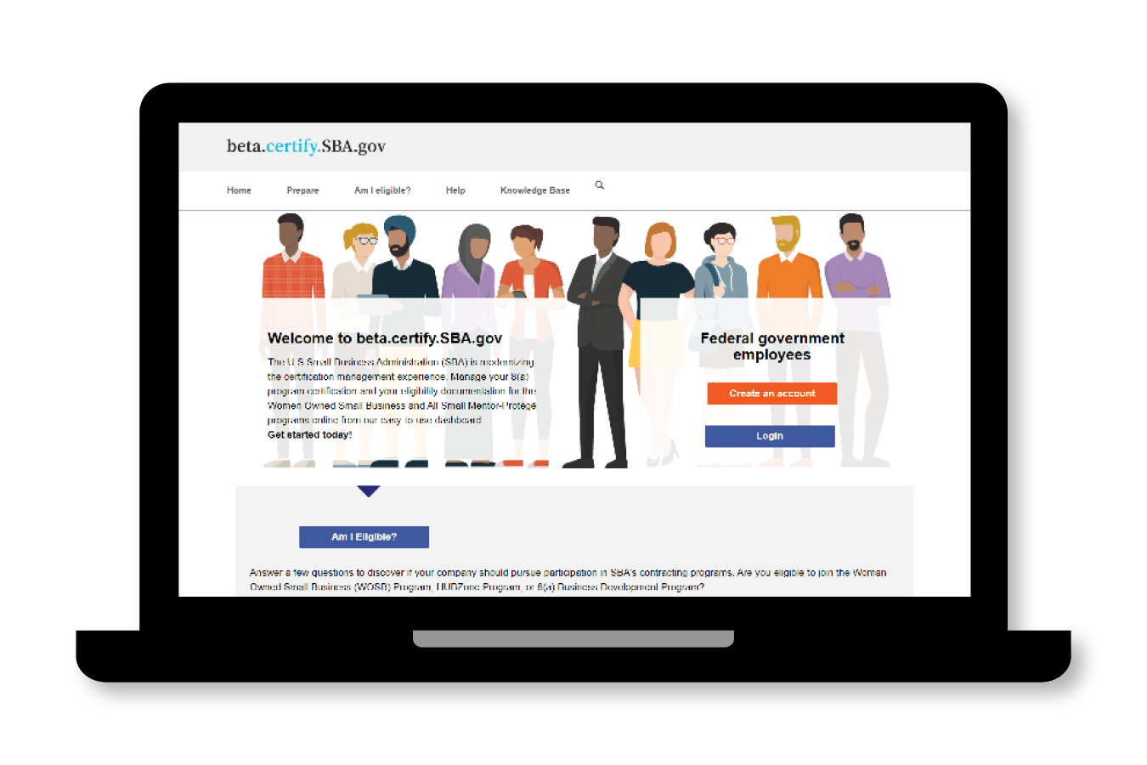
beta.certify.SBA.gov
On the homepage, you can:
Access checklists that provide guidance prior to applying
Verify eligibility
Find answers to questions regarding your firm’s ability to participate in a program
Request information from SBA by submitting the Help form
Create an account and proceed with your application
Access the beta.certify.sba.gov knowledge base including training videos, user guides, and more

Slide 20
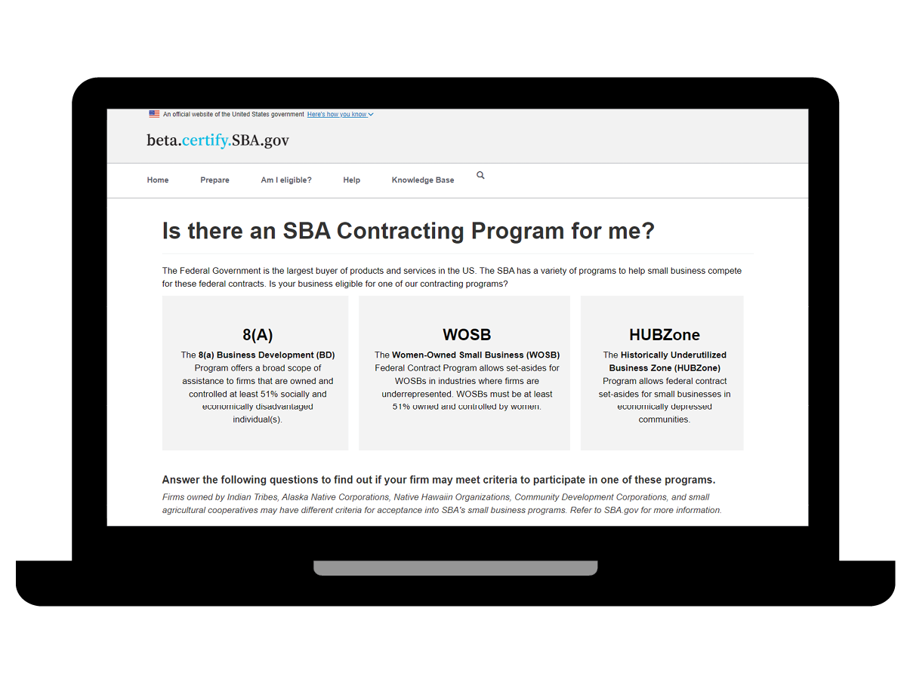
beta.certify.SBA.gov, 2
Are you eligible?
Here you will find:
Criteria needed to qualify for the program
Interactive links to questionnaires that will help evaluate your firm’s preliminary eligibility

Slide 21
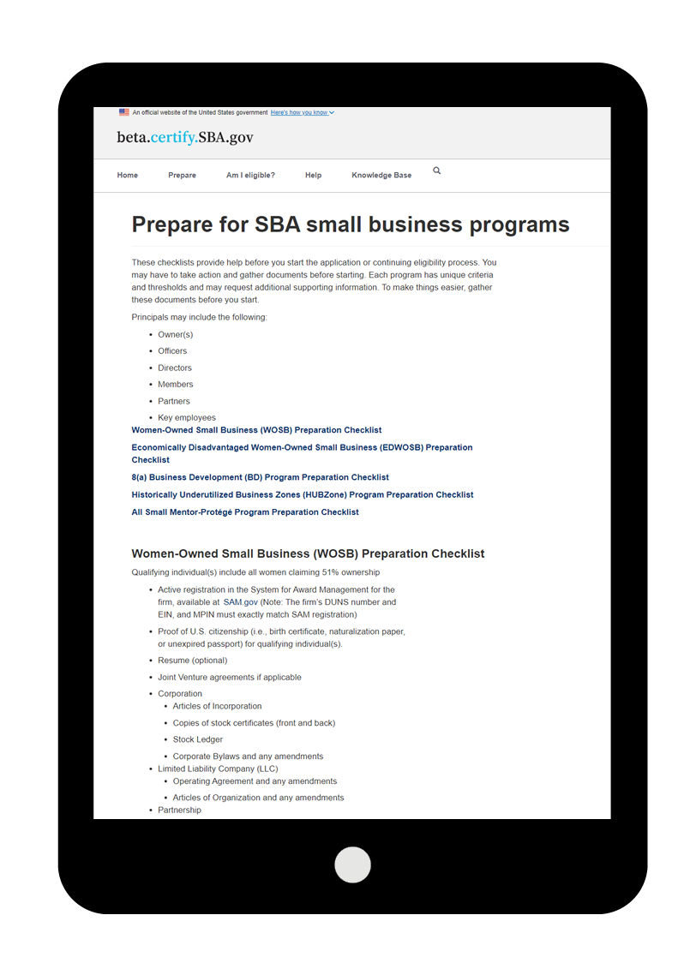
beta.certify.SBA.gov, 3
Prepare to apply
Here you will find:
Checklists to guide you through the process
Information on the documents you will need as you begin

Slide 22
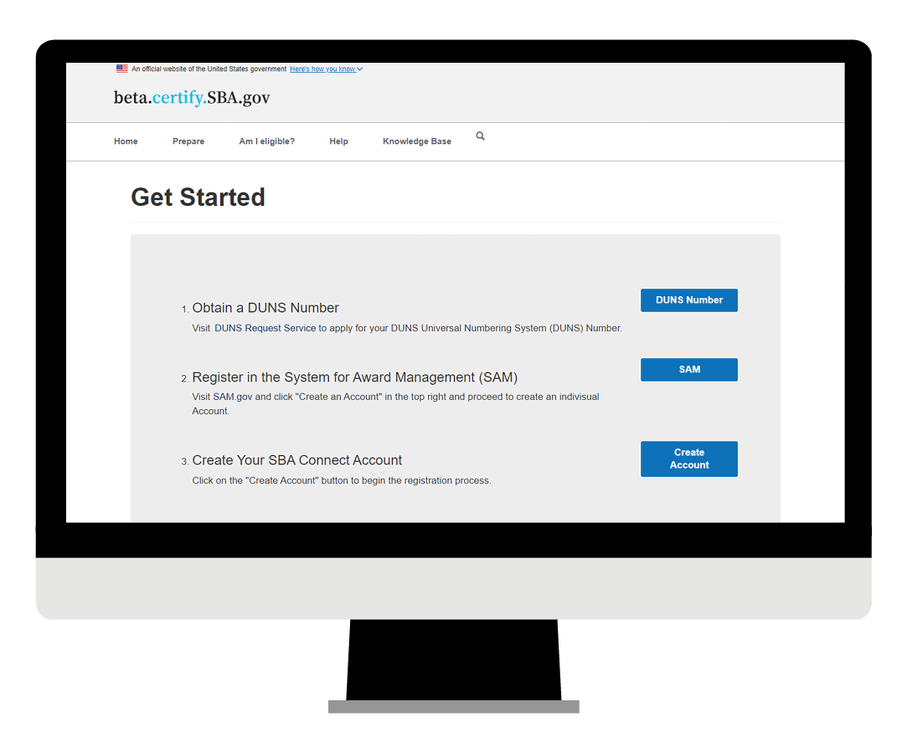
beta.certify.SBA.gov, 4
Getting started
Once you have determined your eligibility and gathered the required documents, this page allows you to:
Obtain a DUNS number
Register in the System for Award Management
Create your SBA account

Slide 23
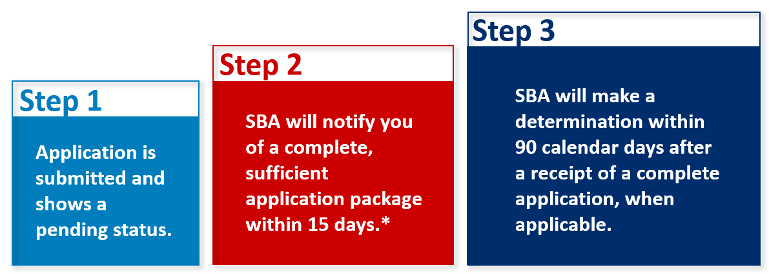
Issuing Decisions on Certification
*An SBA representative may reach out if additional information or documentation is required.
Notes:
In order to ensure all necessary documents are uploaded to the portal, carefully review the documentation checklists on beta.certify.sba.gov prior to applying and collect the necessary documents in advance.
These steps detail the typical process for a complete and sufficient application package. If there are issues with an application package the timeline may take longer due to requests for additional information in order to fully process the application.

Slide 24
Tips to Complete a Successful Application
Claiming your business:
To apply for WOSB or EDWOSB certification on beta.certify.sba.gov, you need to first obtain a Data Universal Numbering System (DUNS) number and have an active account on SAM.gov.
Make sure you maintain and update your SAM.gov data to ensure your information is accurate, as it will be used to determine your eligibility for the program when you claim your business in beta.certify.sba.gov.
See User Guide Sections 2.2 for details.
Notes:
Applicant user guide: https://beta.certify.sba.gov/knowledgebase/portal-article/KAB-01014/en-US

Slide 25
Tips to Complete a Successful Application, 2
Determining who needs to complete what portion of the application:
The business owner should be the one to create the account and claim the business.
Once the account is created and you begin the application, you will be asked if you wish to assign a delegate to work on the application. This ensures individuals other than the business owner are not listed as the highest owner.
However, note that the business owner will be the one required to attest and submit the application.
See User Guide Sections 2.4 for details.
Notes:
Applicant user guide: https://beta.certify.sba.gov/knowledgebase/portal-article/KAB-01014/en-US

Slide 26
Tips to Complete a Successful Application, 3
Attesting and submitting a completed application:
Once all the required information and the documents are submitted, the user must submit the application to SBA by attesting the Program Self-Certification Summary. This can only be done by the applicant.
Follow the instructions below to complete the attestation:
Navigate to the Application Overview page
Click the “Individual Contributors” link
Then navigate to Invitee section
Click the “Next” button
Read and complete the declaration form by selecting each checkbox
Click the “Attest and Submit” button
See User Guide Section 2.19 for details.
Notes:
Applicant user guide: https://beta.certify.sba.gov/knowledgebase/portal-article/KAB-01014/en-US

Slide 27
Women-Owned Small Business (WOSB) Certification, 3
Contracting Opportunities

Slide 28
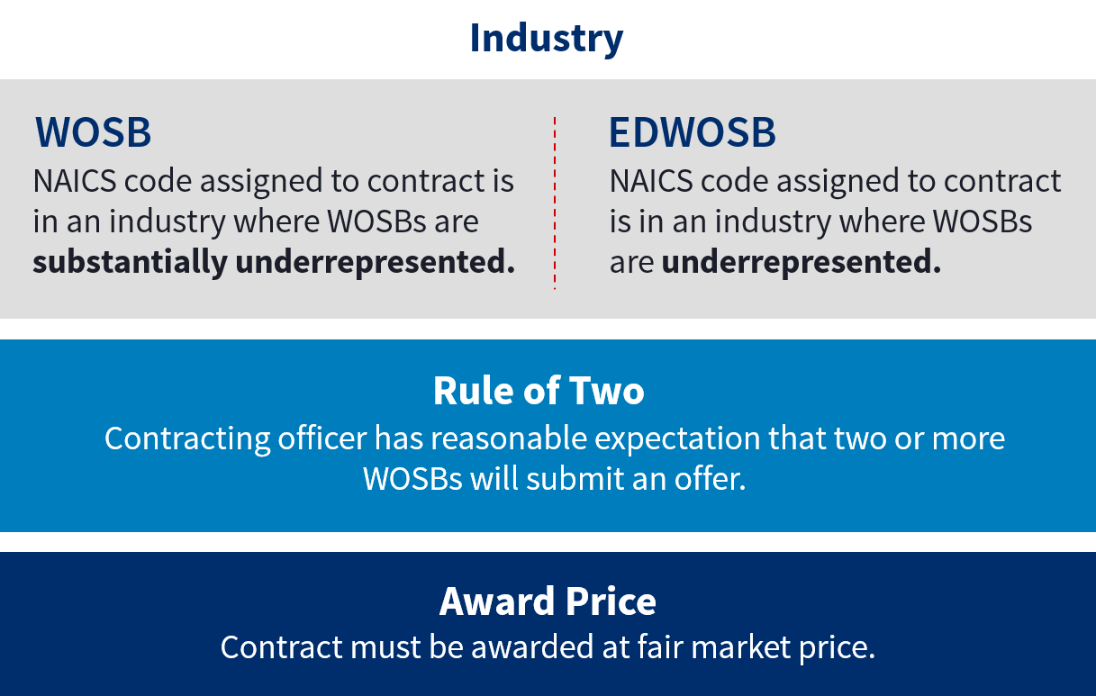
WOSB and EDWOSB Set-Aside Contracts
Notes:
Presenter tip: Provide any relevant information on how set-aside contracts work within the WOSB certification.

Slide 29
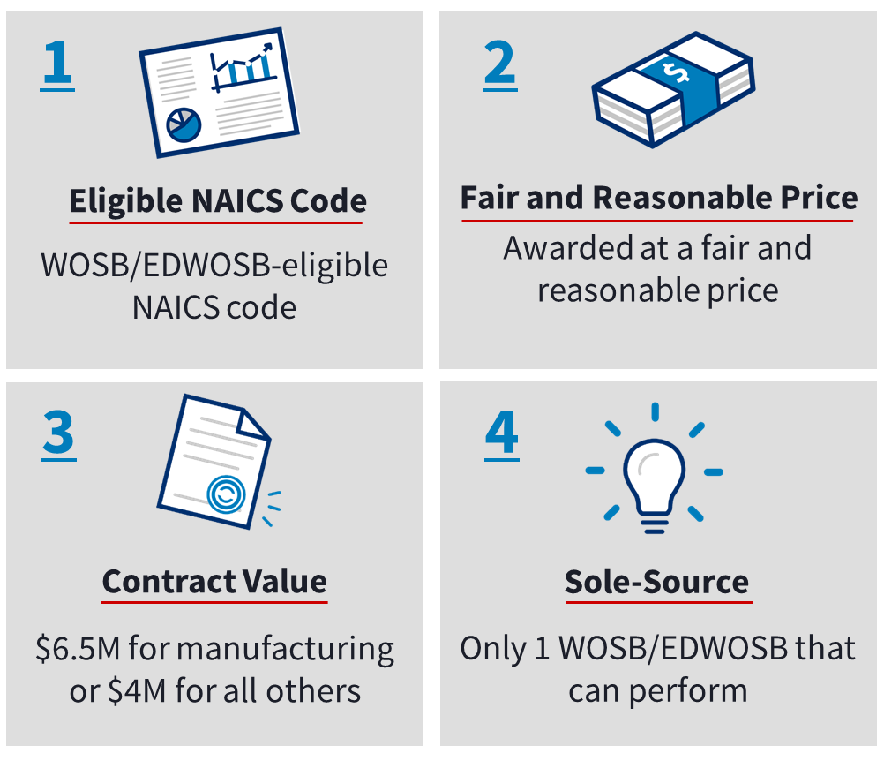
WOSB and EDWOSB Sole-Source Contracts
Notes:
To make a sole-source award to a WOSB or EDWOSB, the following conditions must be met:
Is the contract in a WOSB/EDWOSB-eligible NAICS code?
Can the contract be awarded to the WOSB/EDWOSB at a fair and reasonable price?
Is the contract (including options) valued at $6.5 million or less for manufacturing contracts or $4 million or less for all other contracts?
In the determination of the contracting officer (CO), is there a reasonable expectation that there is only 1 WOSB/EDWOSB that can perform?
The WOSB Federal Contracting Program is a business development program without authority to make a direct award. Agencies are required to prepare and approve justification and approval.

Slide 30
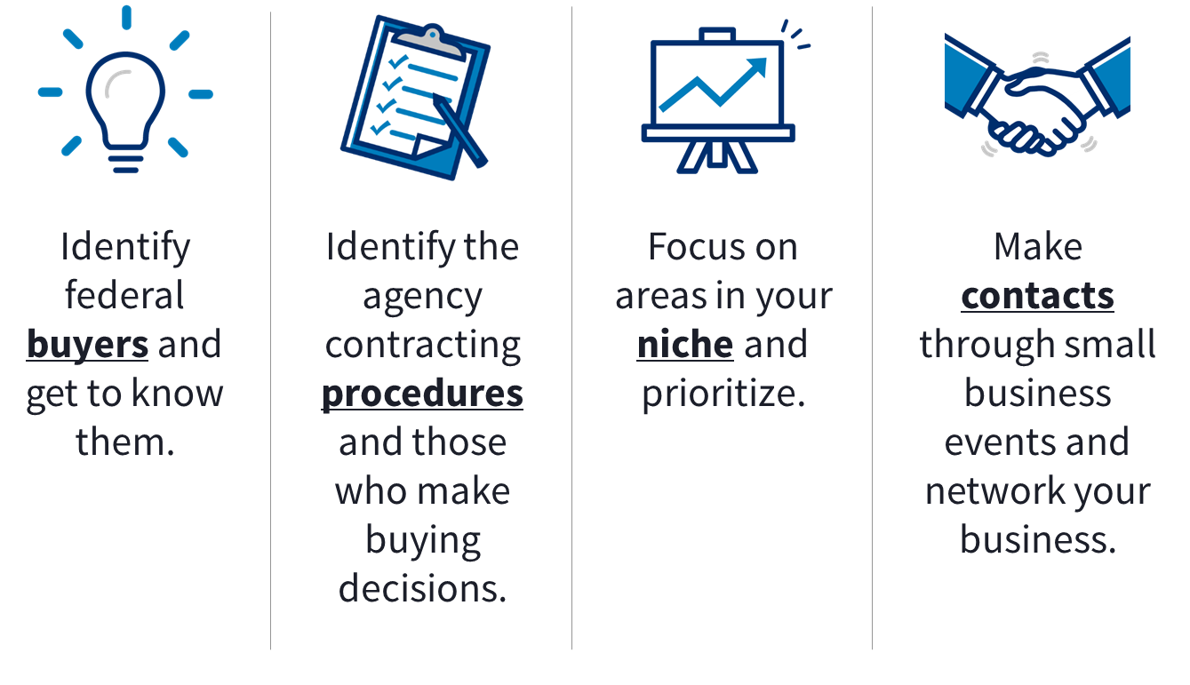
Proactive Self-Marketing
Notes:
Presenter tip: Discuss the requirements for the business to have a marketing plan and/or strategy to proactively self-market their programs or services in order to succeed in the WOSB Federal Contracting Program.
Determine which federal agencies buy your product or service and get to know them.
Identify the contracting procedures of those agencies and the personnel who make buying decisions. Find out if your target agencies require you to register in their database in order to do business with them.
Focus on opportunities in your niche and prioritize.
Make contacts. Attend small business events and network your business to gain exposure to key agencies.
Remember, registering your business is not enough to obtain a federal contract. Ultimately, you are responsible for your own success and you will need to market your business to attract attention from federal agencies.

Slide 31



Getting the Most Out of the WOSB Federal Contracting Program
Ability to qualify for set-aside or sole-source contract awards—increasing prime and subcontracting opportunities
Opportunity to build capacity and grow by establishing joint ventures and participating in the Mentor-Protégé Program
Access to training, management, and technical assistance programs, as well as guaranteed loans and bonding assistance
Notes:
There are 444 NAICS codes eligible for set-aside or sole-source awards under WOSB(364)/EDWOSB(80). To check which NAICS codes are authorized under the WOSB Federal Contracting Program, visit sba.gov/wosbready.
A WOSB or an EDWOSB may establish a joint venture with another small business to pursue a WOSB Federal Contracting Program contract. SBA does not approve WOSB or EDWOSB joint venture agreements but will process protests challenging the eligibility of joint ventures as a WOSB or an EDWOSB.
You are eligible for the 7(j) management and technical assistance program.
Perform market research to identify federal agencies that purchase your products and services.
Review agency procurement forecasts and expiring procurements.
Market your firm’s capabilities to agencies.
Consider the Mentor-Protégé Program and joint ventures to allow your firm to pursue larger contract opportunities.

Slide 32
Women-Owned Small Business (WOSB) Certification, 4
Resources and Contacts

Slide 33
beta.certify.sba.gov Resources
Applicant User Guide
The beta.certify.sba.gov knowledge base is a valuable resource for firms to get started learning about this new platform with how-to videos, user guides, and more!
Notes:
Applicant user guide: https://beta.certify.sba.gov/knowledgebase/portal-article/KAB-01014/en-US

Slide 34
Resources
There are several resources available to help answer questions about the WOSB Federal Contracting Program.
Visit a local resource:
Procurement Center Representative (PCR) Directory
Find your local PCR at: sba.gov/contracting/resources-small-businesses/pcr-directory.
Small Business Administration District Offices
Find your local office at: sba.gov/tools/local-assistance/districtoffices.
Women’s Business Centers
Find your local center at: sba.gov/tools/local-assistance/wbc.
Procurement Technical Assistance Centers
Find your local center at: aptac-us.org.
Small Business Development Centers
Find your local center at: americassbdc.org/home/find-your-sbdc.
SCORE (Service Corps of Retired Executives)
Find your SCORE office at: score.org.
Call the SBA Answer Desk: 1-800-U-ASK-SBA (1-800-827-5722)

Slide 35
Contact Us
For more information and to keep informed of events, go to: sba.gov/wosbready.
For questions on the WOSB Federal Contracting Program, email wosb@sba.gov.
For training requests regarding the WOSB Federal Contracting Program, email WOSBTraining@sba.gov.
Technical help requests for beta.certify.sba.gov can be submitted here, via the “help” tab: beta.certify.sba.gov/help/.

Slide 36
Questions and Answers
THANK YOU!

