Slide 1
SBA: U.S. Small Business Administration
Notes:
[The following slides are intended to be used in presentations to your local HUBZone businesses, business leaders, Procurement Technical Assistance Centers, and other stakeholders. The slides are divided into sections to make it easier to decide which information would be most relevant to your audience. There is not an expectation that you would deliver this entire slide deck, but that you would choose the most pertinent information for your presentation. We have included bulleted notes to guide your delivery of each slide.
For this opening slide, start out by explaining to participants what the webinar will cover, e.g.:
Changes to the HUBZone program related to recent rule change that was effective December 26, 2019
Flexibility that SBA is extending to small businesses related to COVID-19 pandemic]

Slide 2
Primary POCs
Lori Gillen, Director, Office of the HUBZone Program, SBA lori.gillen@sba.gov; 202-205-6349
Bruce Purdy, Deputy Director, Office of the HUBZone Program, SBA bruce.purdy@sba.gov; 202-205-7554
Takeisha Hodge, Supervisory Business Opportunity Specialist, Office of the HUBZone Program, SBA, takeisha.hodge@sba.gov; 202-205-7118
Alison Mueller Amann, Attorney-Advisor, Office of General Counsel, SBA Alison.amann@sba.gov; 202-205-6841
Notes:
[Introduce the points of contact (POCs) who are giving the webinar, and/or who are available for further information. For each POC, include name, title, email, and phone number. A sample POC slide is provided above.]

Slide 3
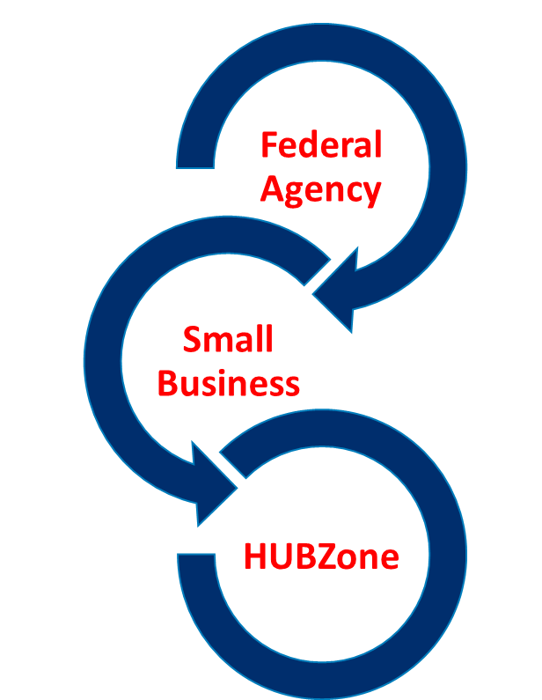
HUBZone Program Purpose
Established in 1997, launched in 1999
Fuels growth of small businesses in Historically Underutilized Business Zones (HUBZone) by providing certification for preferential access to federal government contracts.
Federal agencies set aside contracts for HUBZone-certified small businesses
Small businesses invest in and hire from qualified HUBZones
Undercapitalized Communities benefit from job opportunities and investment
Notes:
The goal of this program is to fuel the growth of small businesses in Historically Underutilized Business Zones (HUBZones).

Slide 4

Contracting Incentive
The HUBZone Program plays an important role in driving 3% of all federal procurement opportunities to small businesses in undercapitalized communities.
5% Small Disadvantaged Business (SDB)
3% Service-Disabled Veteran-Owned Business (SDVOSB)
5% Women-Owned Small Business (WOSB)
3% Historically Underutilized Business Zone (HUBZone)
Notes:
The HUBZone Program play an important role in the government’s effort to award 23% of federal procurement to small businesses. To ensure that a fair share flows to disadvantaged communities, the federal government has a goal of awarding at least 3% of all federal contracting dollars to HUBZone-certified small businesses each year.

Slide 5
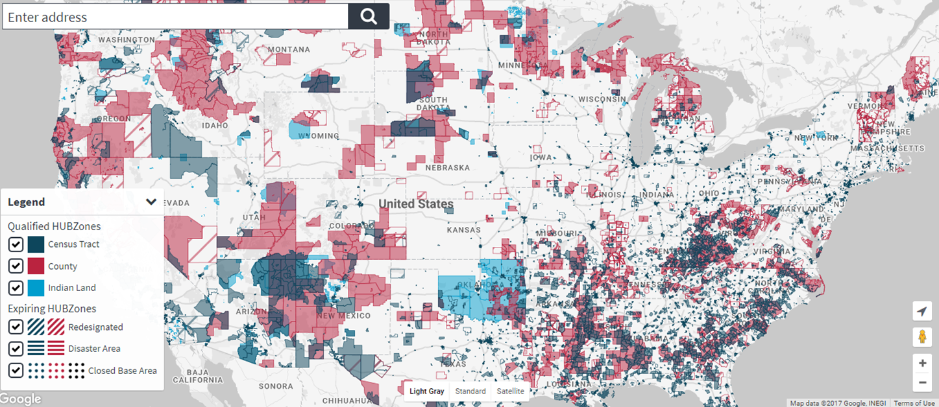
HUBZone Designations
More than 22,000 communities across the country are designated HUBZones.
This photo by Unknown Author is licensed under CC BY.
Notes:
Communities are designated as HUBZones if they have a higher than average rate of unemployment and low-income, or if they meet other statutory definitions for Indian Land, Base Realignment (BRAC), Qualified Disaster Areas, or more recently, if they are rural communities designated by Governors. HUBZones that are set to expire receive an additional three year grace period as a Redesignated Zone to help the firms and employees transition.

Slide 6
Background Information
Eligibility Requirements and Program Support
Notes:
In order to be able to bid on and receive federal contracts that are set-aside for small businesses in designated HUBZones, firms must apply for certification and maintain compliance with the rules of the program.

Slide 7
HUBZone Small Business Certification Eligibility
Firm must:
Be small, by reference to small business size standards;
Be at least 51% owned by U.S. citizens, an Indian Tribal Government, an Alaska Native Corporation (ANC), a Native Hawaiian Organization (NHO), a Community Development Corporation, or an agricultural cooperative;
Have its principal office—the single location at which the greatest number of its employees perform most of their work—located in a HUBZone; and
Have at least 35% of its employees HUBZone residents.
Notes:
There are specific requirements to become a certified HUBZone. But once you are certified you may stay in the program as long as you maintain compliance with the program and for as long as your principal office is located in a designated HUBZone.

Slide 8

HUBZone Certification Application Process
*Submissions are not considered an application until ALL required documents have been received.*
Notes:
If a firm considers itself eligible, it must apply to SBA for evaluation as indicated in this chart.
Approximately 1,500 firms apply each year.
We have close to 6,000 HUBZone firms in the portfolio.

Slide 9
HUBZone Early Applicant Engagement Initiative
How it works
HUBZone will train Resource Partner.
Resource Partner consults with firm and assists with application, verifying they have all required documentation.
Firm applies and Resource Partner notifies HUBZone they have screened application.
HUBZone provides expedited review.
Project Outcomes
Reduced application processing times
Reduced rates of declines
Stronger long-term program compliance due to greater understanding of requirements
Greater procurement readiness and potential for more federal awards
Large and expanding network of Resource Partners improves overall outcomes
Notes:
A network of organizations across the country has been trained to help procurement-ready firms apply and succeed in the HUBZone Program.

Slide 10
Procurement Tips for HUBZone Firms
Get up to speed: Start with a visit to the SBA website for tutorials, referrals and information.
Get Help: Reach out to a Resource Partner for help (PTAC, SBDC, WBC, SCORE, VBOC, District Office).
Do Your Homework: Learn about the opportunities and consider starting with Government purchase card orders, Subcontracting, and Joint Ventures to gain experience.
Secure a Mentor: All Small Mentor Protégé Program offers HUBZone firms an opportunity to develop their government contracting capabilities by entering a formal Mentor Protégé Partnership with an experienced government contractor.
Leverage your small business status: If you are SDB or DSVOSB or WOSB—consider gaining HZ status; already in a HZ—get certified!
Notes:
There is more to the HUBZone Program than certification.
To be effective in bidding on and winning contracts, you need to be ready to do business with the federal government.
Here are some tips for maximizing your participation.

Slide 11
HUBZone Help
For support with government contracting and growing your business visit one of SBA’s resource partners (SCORE, SBDCs, WBC, VBOC, and PTAC): https://www.sba.gov/local-assistance
For support with your HUBZone application:
Visit the HUBZone website: sba.gov/hubzone
View location eligibility: maps.certify.sba.gov/hubzone/maps
Email our Help Desk with specific questions: hubzone@sba.gov
Call our staff via our weekly conference call—every Thursday at 2pm ET: 202-765-1264; Access code: 63068189#
Notes:
There are many SBA resources available to HUBZone businesses looking to apply for certification and grow in government contracting..

Slide 12
Impact and Results
Notes:
Let’s take a look at the impact the HUBZone Program has had on small businesses and disadvantaged communities.

Slide 13






HUBZone Program Impact
+/- 22,000 HUBZones across US and territories
+/- 6,000 certified HUBZone enterprises
Construction, Manufacturing, Professional and Technical Services
$9.9 billion in federal procurement in FY2018 supporting an estimated 52,000 jobs
179+ HUBZone Mentor Protégé Agreements via ASMPP
70% of Opportunity Zones are in HUBZones
Notes:
Here are a few facts about the program to understand its scale and context:
There are 6,000 certified HUBZone enterprises.
Every day, some are added and some are decertified.
About 1/3 of certified HUBZone enterprises have government contracts or have had a government contract within the last several years.
HUBZones represent a wide range of NAICS codes — the most active are construction and manufacturing.
Mentor Protégé Agreements, via the All Small Mentor-Protégé Program (ASMPP), represent an opportunity for HUBZone firms to grow; a recent report revealed that HUBZone Joint Ventures formed under the All Small Mentor Protégé Agreement have received nearly $20 million in contracts since 2016..
How are Opportunity Zones related to HUBZones? The Opportunity Zone program is run out of U.S. Department of the Treasury, in collaboration with the U.S. Department of Housing and Urban Development (HUD) and provides tax incentive for investments in select disadvantaged communities. Not all HUBZones are in Opportunity Zones but more than 70% of Opportunity Zones are located in HUBZones.

Slide 14

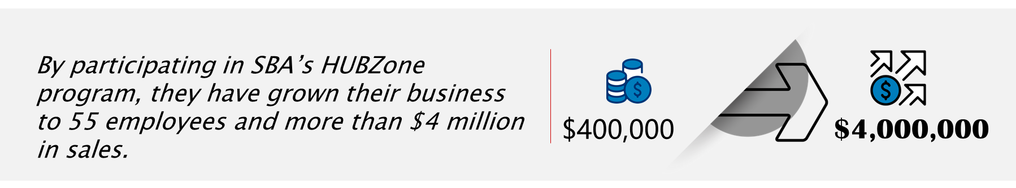
HUBZone Results
When brothers Samuel and Saul Maldonado in Lower Rio Grande Valley, Texas, first founded SAM Engineering & Surveying (SAMES) Inc. in 2008, they employed three people in their community and generated $400,000 in annual sales.
Notes:
Here are just some of the success stories from HUBZone-certified businesses.
As you can see, the program helps businesses expand, growing revenue and employees.

Slide 15



HUBZone Results, example 2
Sridhara Gutti started Essnova Solutions as a home-based business in Huntsville, Alabama. After receiving counseling from SBA and a Procurement Technical Assistance Center (PTAC), he moved his IT software, staffing, and project management business to Birmingham and applied for SBA’s HUBZone certification.
After winning a federal contract from Department of Defense in 2017, Sridhara has grown the business to 25 employees with more than $3 million in revenue and was named the Alabama Small Business Person of the Year for SBA in 2020.
$3,000,000
Notes:
Here are just some of the success stories from HUBZone-certified businesses.
As you can see, the program helps businesses expand, growing revenue and employees.

Slide 16



HUBZone Results, example 3
Pontchartrain Partners helped rebuild the New Orleans flood protection system in the aftermath of Hurricane Katrina. In 2015, the company expanded to a 25,000-square-foot building in a HUBZone.
Company revenue has grown from $160,000 in its first year to $35 million in 2019 and from only seven full-time, local employees to 115 across the South.
7 employees
115 employees
Notes:
Here are just some of the success stories from HUBZone-certified businesses.
As you can see, the program helps businesses expand, growing revenue and employees.

Slide 17
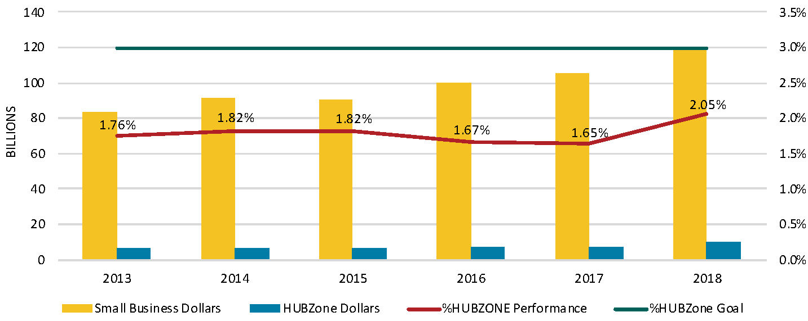
Federal Procurement to HUBZone Certified Firms
Notes:
In fiscal year 2018, 2.05% of federal dollars were dedicated to HUBZone-certified enterprises.
While this comes short of the 3% goal, we should receive 2019 numbers soon, which we hope will show continuation of the upward trajectory.

Slide 18
Program Changes
Related to Rule Change
Notes:
SBA has implemented comprehensive changes to the HUBZone program, effective December 26, 2019.

Slide 19
HUBZone Program Challenges
Small businesses found the program difficult
Instability regarding geographic eligibility (i.e. maps changed too often which served as a disincentive to investment in HZ communities)
Confusing and burdensome requirements for maintaining certification
Lengthy and cumbersome application and recertification processes
Federal Agencies failed to meet 3% goal
Difficulty finding qualified HUBZone firms who could maintain eligibility
A unique and arduous requirement to verify eligibility twice (which lengthened the procurement process for HZ firms and served as a disincentive)
Communities experienced mixed results
The fluidity of the program made it difficult for communities to leverage
Eligibility requirements that failed to recognize the unique characteristics of rural distress may have neglected some deserving communities from participation
Notes:
The reason for the recent changes was to address longstanding challenges facing entrepreneurs, government contractors and communities….as described here.

Slide 20



HUBZone Program Changes
Improve the customer experience
Expand and stabilize the HUBZone footprint
Increase program utilization
Notes:
These are the 3 main changes that offer solutions to those challenges….organized around three important areas designed to improve customer service, stabilize the maps and footprint, and expand utilization by small businesses.

Slide 21



Improve the Customer Experience
Faster Certification: within 60 days of a complete submission
Streamlined Platform: Transitioning to a user-friendly interface.
Early Support: Expansion of Early Engagement Initiative
Notes:
The first set of changes are designed to make the program easier to use.
SBA now is processing applications within 60 days. (This was the result of a statutory change implemented by SBA from the 2018 National Defense Authorization Act (NDAA) from Congress beginning January 1, 2020
The current and very outdated HUBZone Certification Tracking System (HCTS) will be retired later in 2020 and the program will transition to a new platform.
The program will expand its Early Engagement Initiative so that more procurement ready firms can work with the staff in District Offices and resource partners such as Procurement Technical Assistance Centers (PTACs) to expedite their certification and maximize their success in the program.

Slide 22



Expand and Stabilize HUBZone Footprint
STABILIZE THE MAPS
EXPAND INTO RURAL AREAS
RECOGNIZE LONG-TERM INVESTMENT IN COMMUNITIES
Notes:
The second category of changes is related to our maps and the communities that are designated as HUBZones.
We put changes in place to expand and stabilize the HUBZone footprint…so that businesses were not worried that their HUBZone might lose its designation, and we are now able to reward firms for making long-term investments in HUBZone areas.

Slide 23
Expand and Stabilize HUBZone Footprint, Part 2
HUBZone maps are frozen through 2021
Maps will be updated every five years
Redesignated Areas:
Concept Remains—three-year transition period for expiring HUBZone Qualified Census Tracts and Qualified Non-metropolitan Counties
No extension beyond 2021 for current Redesignated Areas
STABILIZE THE MAPS
Notes:
In 2017, the program froze the HUBZone from December 2017 to the end of 2021.
Specifically, qualified census tracks, qualified non-metropolitan counties, and re-designated areas are frozen to provide more stability.
Indian lands are unaffected. They will be added as new Indian lands are designated by the Bureau of Indian Affairs.
Qualified disaster areas will be added as appropriate.
Moving forward, the maps will be updated every 5 years instead of annually, starting early 2022, after the 2020 census.
Areas used to have a lot of fluctuation in HUBZone designation.
Now, they’ll have at least 8 years once designated which will provide stability and help a lot of businesses get into the program and stay in the program.

Slide 24
Expand and Stabilize HUBZone Footprint, Part 3
New category added for Governor-Designated Areas
Rural communities of 50,000 or less
Unemployment of 120% the state or US average
Opportunity Zones encouraged
Governors must petition SBA
EXPAND INTO RURAL AREAS
Notes:
There have been six different categories of HUBZone—and in 2020 one more category was added—Governor’s Designated Areas.
It’s the result of a statutory provision from the 2018 National Defense Authorization Act that went into effect January 1, 2020 and we published a rule outlining the process.
With this new provision, governors can send a petition to SBA asking that certain areas be added to HUBZone maps.
Governor-Designated Areas must meet the requirements described here.
This new category is just getting started.—none have yet been added.
SBA is encouraging governors to include Opportunity Zones that aren’t otherwise HUBZones so we can help those, too.
We encourage Governor’s offices to reach out to us if they have questions regarding their submission.

Slide 25
Expand and Stabilize HUBZone Footprint, Part 4
Small businesses that invest in HUBZones by purchasing a building or entering a long-term lease (of 10 years or more), may maintain HUBZone eligibility for up to 10 years, even if the office location no longer qualifies as a HUBZone.
Does not apply to buildings in areas currently categorized as “Redesignated Areas”
RECOGNIZE LONG-TERM INVESTMENT IN COMMUNITIES
Notes:
Under the new regulation, there’s a new provision specific to the principal office requirement.
We hope this helps firms and rewards them for their investment in these areas.
It’s important to note that this doesn’t apply to Redesignated Areas.

Slide 26



Increase Program Utilization
ANNUAL RECERTIFICATION
CONTRACT VERIFICATION AND ELIGIBILITY
RESIDENCY REQUIREMENT LEGACY EMPLOYEE
Notes:
To increase program utilization, we’ve:
Moved to annual recertification;
Adjusted how firms are verified for contracts; and
Added a provision related to the 35% residency HUBZone requirement that allows firms to be awarded for keeping on “legacy” employees even if those employees have moved out of a HUBZone.

Slide 27
Increase Program Utilization, part 2
Firms must annually recertify.
Once certified, a firm will be eligible for all HUBZone contracts for which it qualifies as small, for a period of one year from the date of its initial certification or recertification (unless it acquires, is acquired by, or merges with another firm).
Full documentation reviews will be required every three years.
ANNUAL RECERTIFICATION
Notes:
Before, firms had to recertify every 3 years. Now, it’s annually, which some people worry about. This is a good change, though!
The change decreases burdens associated with maintaining paperwork related to compliance throughout the year.
Once you certify, or annually recertify, you maintain that certification for an entire year, even if you dip below the 35% requirement (for employment of HUBZone residents) — OR, if your office moves temporarily out of a HUBZone--you won’t be kicked out of the program under this new rule.
Firms can go after as many HUBZone contracts as they want without necessarily worrying about their HUBZone certification until the anniversary of their certification.
Annual recertification will generally not involve document review as it is a self-certification (although the firm should maintain records to demonstrate its compliance on the date of its recertification, in the event that a contract award is protested.)
Every 3 years, firms will need to submit their documentation for a review in connection with their certification.

Slide 28
Increase Program Utilization, part 3
A firm must be appear in DSBS as HUBZone-certified at the time of offer.
SBA will determine the eligibility of a concern subject to a HUBZone protest as of the date of its initial certification or its most recent recertification, if applicable.
A firm that receives a HUBZone contract must attempt to maintain 35% employment of HUBZone residents.
“Attempt to maintain” is defined as employing at least 20% HUBZone residents.
CONTRACT VERIFICATION
Notes:
Under the new annual recertification process, a contracting officer will simply verify that a HUBZone firm was certified or recertified in SBA’s Dynamic Small Business Search (DSBS) at the time of offer. Once certified at the time of initial offer it will be generally considered a HUBZone small business concern throughout the life of that contract
If protested by another firm, the HUBZone certified firm will need to demonstrate it met all eligibility requirements at time of recertification.
Once a firm is awarded a HUBZone contract, it may continue to perform on that contract, even if the firm falls out of compliance.
Firms no longer need to inform the HUBZone Program if they temporarily fall out of compliance between their annual recertification dates.
With one exception: If a firm is performing on a HUBZone set aside contract, and it falls below 20% (for employment of HUBZone residents), it will be at risk of decertification, and must notify the HUBZone program.
Firms must also notify the program if they have a change in ownership.

Slide 29
Increase Program Utilization, part 4
For HUBZone set-aside MACs, a firm that is HUBZone certified at the time of offer for the MAC will be considered HUBZone-certified for each order issued against the MAC.
For non-FSS* MACs issued under full and open competition, where the CO sets aside an order for HUBZone firms, an offeror must be HUBZone certified (and so appear in DSBS) at the time it submits its offer for the order.
For all FSS* MACs, a firm that is HUBZone certified at the time of initial offer for the FSS contract will be considered HUBZone certified for each order issued against the FSS contract.
*FSS = Federal Supply Schedule
CONTRACT ELIGIBILITY (MULTIPLE AWARD CONTRACTS—MACS)
Notes:
The government is making more multiple award contracts—here is how HUBZone designation will be considered.

Slide 30
Increase Program Utilization, part 5
An employee who resided in a HUBZone for at least six months at the time of certification or recertification, and continues to reside in a HUBZone for at least six months after, may continue to be considered a HUBZone resident so long as continuously employed by the firm, even if he/she moves to a non-HUBZone area, or if the area of his/her residence loses HUBZone geographical eligibility.
RESIDENCY REQUIREMENT LEGACY EMPLOYEE
Notes:
Finally—we are really excited to see the benefits of this brand-new provision.
This addresses the problem of what happens when firms start to grow and they are getting more contracts, paying employees more, and as a result, employees may choose to move out of HUBZones.
Firms had a difficult choice of whether to keep the employee and fall out of compliance with the 35% residency requirement, fire the employee, or hire an additional employee to do unnecessary busy work just to maintain compliance with the 35% residency requirement.
This new provision allows the company to keep the employee as a permanent HUBZone employee resident, even if the employee moves out of the HUBZone.

Slide 31
Program Flexibilities
Related to COVID-19
Notes:
We want to make sure you have the most recent updates regarding the COVID-19 pandemic.
These slides address the most common questions SBA has received.
We have resources at the end of the presentation.

Slide 32
Suspension of Annual Recertification Requirement
In response to the COVID-19 pandemic, SBA is temporarily suspending the requirement for annual recertification.
All firms, including those that were due to recertify in 2020 under the triennial recertification schedule (e.g., firms which last recertified in 2017), will not be decertified for failure to recertify.
Firms that voluntarily choose to recertify on their anniversary date will be provided with instruction about how to do this.
Please note: A firm that submits an offer for a HUBZone contract for a solicitation issued after December 26, 2019, must be prepared to demonstrate its eligibility as of the date of its initial certification, or if applicable, its most recent recertification.
Notes:
You can recertify, but won’t be penalized if you don’t certify on time….through September 30.

Slide 33
Student residence hall closures
SBA will temporarily recognize the HUBZone resident status of any student employee required to move from student housing in a HUBZone to a non-HUBZone location. (This applies only to students who were already on payroll and had residency established prior to the university closing.)
HUBZone firms may continue to count student employees as HUBZone residents by providing documentation showing:
The university/college closed the student residence; and
The employee has been maintained on the payroll.
Notes:
We’ve been getting a lot of questions about how to treat student employees who have been required to vacate student housing.
We will allow firms to continue to count these employees as HUBZone residents.
We will review documentation showing where the employee resided prior to COVID-19 measures being put in place. We want to see that the student lived in the HUBZone prior to COVID-19, that they’ve been required to vacate, and that they are still on the payroll.
It’s not for new employees.

Slide 34
Compliance under mandatory telework
SBA will allow firms who place employees on mandatory telework to maintain compliance with the principal office requirement, for certification and recertification purposes, if the firm met the principal office requirement prior to the telework measure being put into place.
Firms will be required to provide a signed statement that: 1) they put their employees on telework in response to social distancing restrictions related to the COIVD-19 pandemic; 2) the teleworking measure is temporary in nature and the employees will return to their normal work location once the teleworking measures have been lifted and 3) the firm will make its best effort to provide meaningful work to employees on telework.
Notes:
There is a similar situation for employees teleworking as it relates to the principal office requirement.

Slide 35
Sick leave and non-paid status for “Legacy “HUBZone Employees
SBA recognizes that many firms have had to place employees on extended (unpaid) sick leave status or are contemplating layoffs.
The revised HUBZone regulations, which became effective December 26, 2019, allow firms to count “legacy” HUBZone resident employees as permanent HUBZone resident employees if they can demonstrate that the employee was a HUBZone resident for 180 days prior to and for 180 days following the firm’s HUBZone certification or recertification.
SBA will allow HUBZone companies to place an employee in a temporary non-paid status during the COVID-19 pandemic and still meet the “continued and uninterrupted employment” requirement, if the firm certifies that it intends to rehire those individuals or put those individuals back on their payroll after the pandemic.
Notes:
This flexibility addresses questions around legacy employees, particularly around absence or interruption of work for Legacy employees.

Slide 36
Expedited Certification
SBA may expedite the application of any firm that submits a complete package for certification and indicates that they intend to respond to a specified solicitation that relates to COVID-19.
Post Event Reviews
After COVID-19 restrictions are removed or diminished, the HUBZone program may conduct program reviews to ensure that firms have returned to following standard compliance practices.
Notes:
With expedited certification, SBA will ask about the specific solicitation. We want to ensure people aren’t simply trying to get their certification expedited, but that they are legitimate firms that can help with COVID-19.
As a reminder, SBAS may conduct post COVID 19 reviews to ensure that firms have returned to following standard compliance practices.

Slide 37
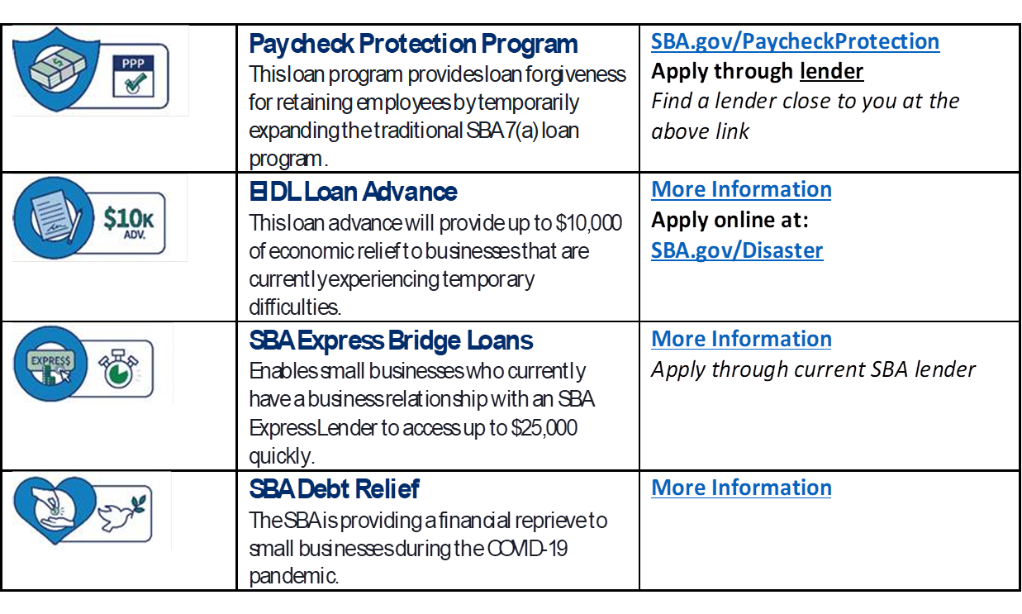
Coronavirus Related Assistance
sba.gov/coronavirus
Notes:
SBA’s website has detailed information regarding other contracting provisions and financing options related to COVID 19.

Slide 38
Additional Information
Contracting Details
Notes:
The following slides provide details regarding specific contracting provisions related to the HUBZone Program that may be of interest to some firms or audiences. They are self-explanatory.

Slide 39
HUBZone Program References
Statutory authority: Small Business Act, 15 U.S.C. 632(p), 657a
HUBZone Program Regulations: 13 CFR Part 126
Size Regulations: 13 CFR Part 121
Recent rulemakings:
Governor-Designated Covered Areas
Direct Final Rule: 84 FR 62449 (Nov. 15, 2019)
Effective Jan. 1, 2020
HUBZone Program Improvements
Final Rule: 84 FR 65239 (Nov. 26, 2019)
Effective Dec. 26, 2019

Slide 40
Relationship Among Small Business Programs (FAR 19.203)
SBA’s small business socioeconomic programs include:
8(a) Program
HUBZone Program
Service-Disabled Veteran-Owned (SDVO) Small Business Program
Women-Owned Small Business (WOSB) Program
There is no order of precedence among these programs
In determining which socioeconomic program to use, the contracting officer should consider, at a minimum—
Results of market research
Agency progress in fulfilling small business goals

Slide 41
HUBZone Contracts (13 CFR 126.600)
HUBZone contracts are contracts awarded to certified HUBZone small business concerns, regardless of the place of performance, through any of the following procurement methods:
Sole source awards
100% HUBZone set-aside awards and partial set-asides
Full and open competition, where the HUBZone price evaluation preference is applied (application of a 10% price evaluation preference applied in full and open competition only applies if initial low offer is from a large business, not if low bidder is a small business)
Reserves for HUBZone SBCs under Multiple Award Contracts (MAC)
Orders set-aside for HUBZone SBCs against a MAC, where the MAC was awarded in full and open competition

Slide 42
HUBZone and Simplified Acquisition (13 CFR 126.607, FAR 19.1305)
AT OR BELOW SAT | CO MAY award via HUBZone set-aside or sole source award
ABOVE SAT | CO shall first consider a set-aside before a HUBZone sole source award or setting aside the requirement as a small business set-aside
SAT=$150,000—proposed to increase to $250,000;
Micro-purchase threshold=$3,500—proposed to increase to $10,000

Slide 43
HUBZone Sole Source Awards (13 CFR 126.612, FAR 19.1306)
CO may award a sole source contract to a HUBZone SBC (before considering a small business set-aside) if—
CO does not expect to receive offers from at least 2 HUBZone SBCs
Anticipated price of the contract (including options) will not exceed—
$7 M for a requirement assigned a manufacturing NAICS code; or
$4 M for all other requirements
The requirement is not currently being performed by an 8(a) participant and has not been accepted as an 8(a) requirement by SBA
The HUBZone SBC has been determined to be a responsible contractor with respect to performance
Award can be made at a fair and reasonable price
SBA has the right to appeal CO’s decision not to make a HUBZone sole source award
Note: This exclusion of FAR 19.1306 was removed: The acquisition is greater than the SAT

Slide 44
HUBZone Set-Aside (FAR 19.1305(c))
To award via HUBZone set-aside, CO must have a reasonable expectation that—
Offers will be received from at least 2 HUBZone SBCs; and
Award will be made at a fair market price
If the CO receives—
only one acceptable offer from a certified HUBZone SBC
the CO should make an award to that concern
no acceptable offers from HUBZone SBCs
the CO should withdraw the HUBZone set-aside and set the procurement aside for small business concerns, as appropriate (see FAR 19.203)

Slide 45
Set-Aside of Orders
A CO may—
Set-aside an order placed against a multiple-award contract for HUBZone SBCs (FAR 19.5) and no justification for this exception to fair opportunity is required (FAR 16.5)
Set-aside part(s) of a multiple-award contract for HUBZone SBCs (FAR 19.5)
Reserve one or more contract awards for HUBZone SBCs under full and open multiple-award procurements (FAR 19.5)
Set-aside orders & BPAs under the GSA Schedule (FAR 8.4)

Slide 46
Set-Aside of Orders – FAR Part 19 Applies
FAR 16.505(b)(2)(i)(F): When setting aside orders for small business concerns:
The specific small business program eligibility requirements identified in part 19 apply.
FAR 8.405-5(a)(2): When setting aside orders and BPAs against the GSA Schedule:
The specific small business program eligibility requirements identified in part 19 apply.
What does this mean? Examples:
HUBZone joint venture requirements apply
HUBZone limitations on subcontracting apply

Slide 47
Price Evaluation Preference (PEP) For HUBZone SBCs (13 CFR 126.613, FAR 19.1307)
The HUBZone price evaluation preference (PEP) shall be used in acquisitions conducted using full and open competition
The preference shall NOT be used—
Where price is not a selection factor (e.g., Architect/Engineer acquisitions)
Where all fair and reasonable offers are accepted (e.g., the award of multiple award schedule contracts)

Slide 48
Applying the HUBZone PEP
The CO shall apply the HUBZone PEP in F&O competition, when the lowest, responsive, responsible offeror is a large business
The PEP is applied by adding a factor of 10% to—
The otherwise lowest, responsive, responsible offer from a large business (AKA the large business that is the apparent successful offeror)
Offers from HUBZone SBCs that have waived the PEP
Offers from small business concerns that are not the apparent successful offeror
NOTE: Apply PEP first, then do best value analysis

Slide 49
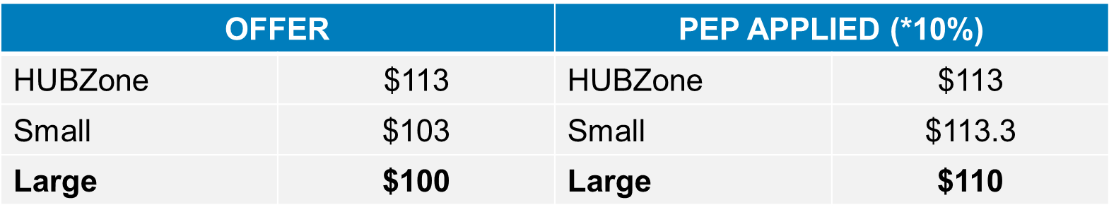
Price Evaluation Preference – Examples
Before PEP applied, the large business is the lowest, responsive and responsible offeror.
After applying the 10% PEP, the large business is still the lowest, responsive and responsible offeror.
In this example, the application of the PEP does not benefit the HUBZone SBC.
NOTE: If price equal → Award to the HZ SBC

Slide 50
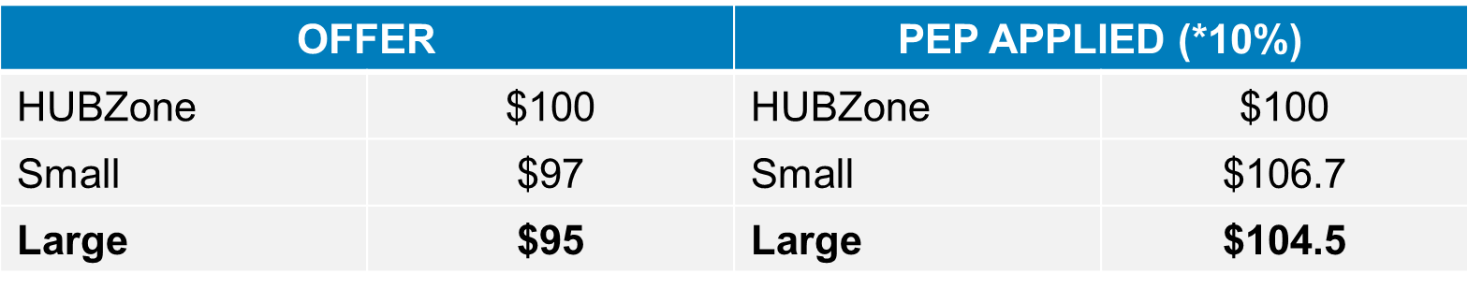
Price Evaluation Preference – Examples, part 2
Before PEP applied, the large business is the lowest, responsive and responsible offeror.
After applying the 10% PEP, the large business is no longer the lowest, responsive and responsible offeror.
In this example, the application of the PEP does benefit the HUBZone SBC.

Slide 51
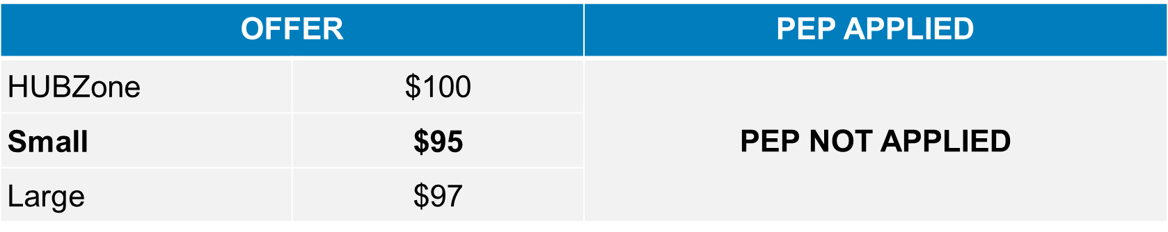
Price Evaluation Preference – Examples, part 3
Before PEP applied, the small business is the lowest, responsive and responsible offeror.
Since lowest offeror is not a large business, the HUBZone PEP is not applied.

Slide 52
Requirements to Bid on HUBZone Contract (13 CFR 126.601)
At the time a certified HUBZone SBC submits its initial offer (including price) on a specific HUBZone contract, it must certify to the CO that:
It is a certified HUBZone SBC that appears on SBA’s List (DSBS)—dsbs.sba.gov;
It is a small business under the NAICS code assigned to the procurement; and
It will “attempt to maintain” having at least 35% of its employees residing in a HUBZone during the performance of a HUBZone contract. (13 CFR 126.200(e))
It will comply with the applicable limitations on subcontracting during performance of the contract, as set forth in 13 CFR 125.6, 126.200(f) and 126.700.
Note: The requirement to notify SBA of a material change was removed with the Regulations published on 12/26/2019.

Slide 53
Eligibility Improvements: Attempt to Maintain
A firm will be eligible to compete for HUBZone set-aside awards while attempting to maintain compliance with the 35% HZ residency requirement, so long as at least 20% of its employees reside in a HUBZone.
HUBZone firms that are performing on a HUBZone contract at the time of their recertification must have at least 20% of their employees residing in a HUBZone to recertify.
HUBZone firms that are not performing on a HUBZone contract at the time of recertification must have at least 35% of their employees residing in a HUBZone to recertify.
* When firms receive a federal contract they often need to ramp up hiring quickly—which in the case of HUBZone threatened to temporarily place them out of compliance with the requirements of the program if fewer than 35% of the workforce did not live in a HUBZone. This change provides clarity regarding the definition of attempting to maintain compliance while performing on a federal contract.

Slide 54
Joint Venture
A HUBZone SBC may joint venture with one or more other small business concerns or its SBA-approved mentor for the purpose of submitting an offer for a HUBZone contract. (13 CFR 126.616)
*Note: The joint venture itself need not be certified as a qualified HUBZone SBC.

Slide 55
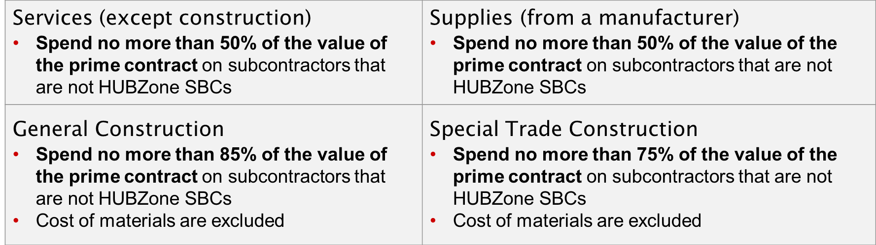
Limitations on Subcontracting (LOS)
Final Rule published at 81 FR 34243 – Effective June 30, 2016
A HUBZone SBC prime contractor may subcontract part of a HUBZone contract, provided the HUBZone SBC meets the following requirements:
*NOTE: Subcontractors that are also HUBZone SBCs are referred to as “similarly situated entities”

Slide 56
Nonmanufacturer Rule (NMR)(13 CFR 126.601, FAR 19.1303)
A HUBZone SBC may submit an offer for supplies as a nonmanufacturer if it meets the requirements of the NMR set forth at 13 CFR 121.406(b)(1)
In 2016, SBA eliminated the requirement that the manufacturer also be a HUBZone SBC (81 FR 34243)
Under SBA regulations, a CO may now request a waiver of the NMR for a HUBZone contract
Class waivers also apply to HUBZone contracts
As a result, the HUBZone program’s treatment of the NMR is now consistent with SBA’s other socioeconomic programs

Slide 57
Compliance With LOS & NMR
When do the HZ LOS and NMR apply?
HUBZone set-asides
Partial HUBZone set-asides
HUBZone reserves
Orders set-aside for HUBZone SBCs
Awards to HUBZone SBCs under F&O after HZ PEP applied
What is the compliance period?
Set aside (full or partial): Base term and each subsequent option period
HOWEVER, CO may require concern to meet the LOS or NMR for each order
Order set-aside under F&O: Term of order

Slide 58
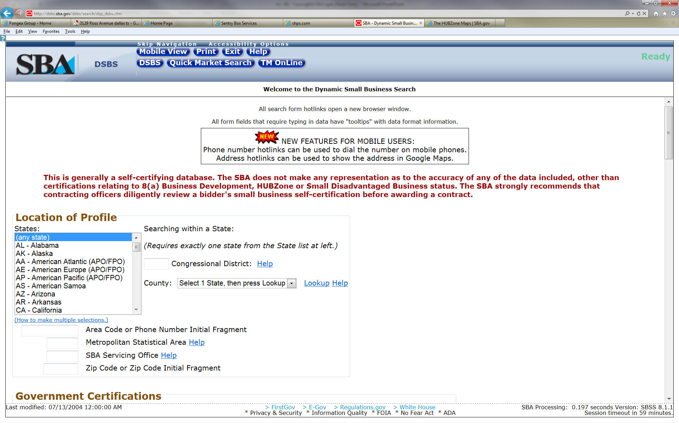
How to Locate HUBZone Contractors Using the Dynamic Small Business Search (DSBS) (dsbs.sba.gov)

Slide 59
DSBS – How HUBZone Certification is Displayed
Each firm’s DSBS profile has two fields relevant to HUBZone certification:
“HUBZone Certified? [ ] Yes [ ] No”
“HUBZone Certification Date”
"HUBZone Certified? [X] Yes [ ] No” - indicates the firm is currently HUBZone certified. The date in the HUBZone Certification Date field is the date the firm was certified and became eligible for HUBZone awards.
"HUBZone Certified? [ ] Yes [X] No” - indicates the firm is NOT currently HUBZone certified. The dates in the HUBZone Certification Date field is the date the firm was originally certified and the date the certification ended. This firm is not currently eligible for HUBZone Awards.
"HUBZone Certified? [ ] Yes [X] No” with N/A next to “HUBZone Certification Date” means that the firm was never HUBZone certified
NOTE:
“HUBZone Certification Date” indicates the initial date of certification and does not reflect the dates of any recertification process, which are internal to SBA
An approval or recertification letter is NOT valid evidence that a firm is currently HUBZone certified, because the firm may have been decertified since the notice was issued.

Slide 60
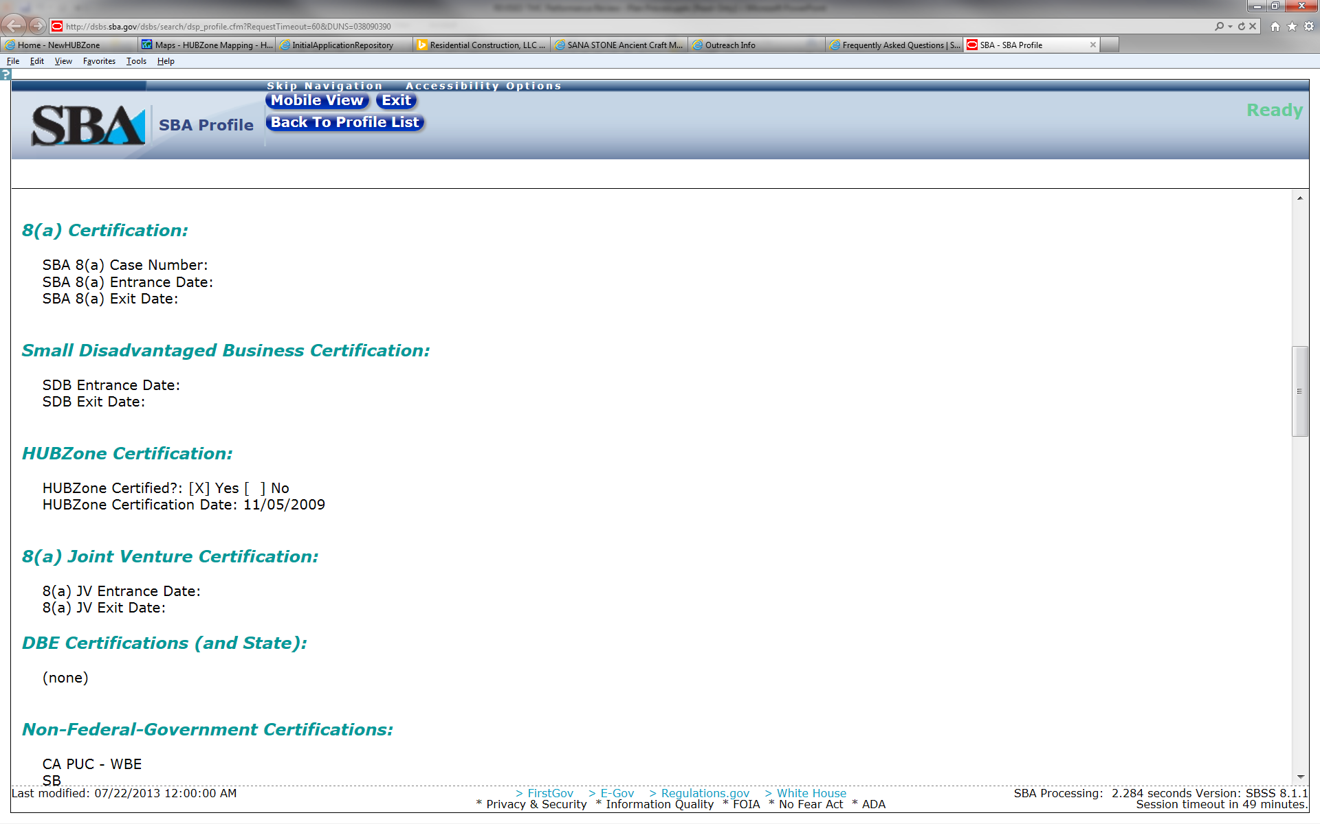
DSBS example: Currently Certified HUBZone Small Business

Slide 61
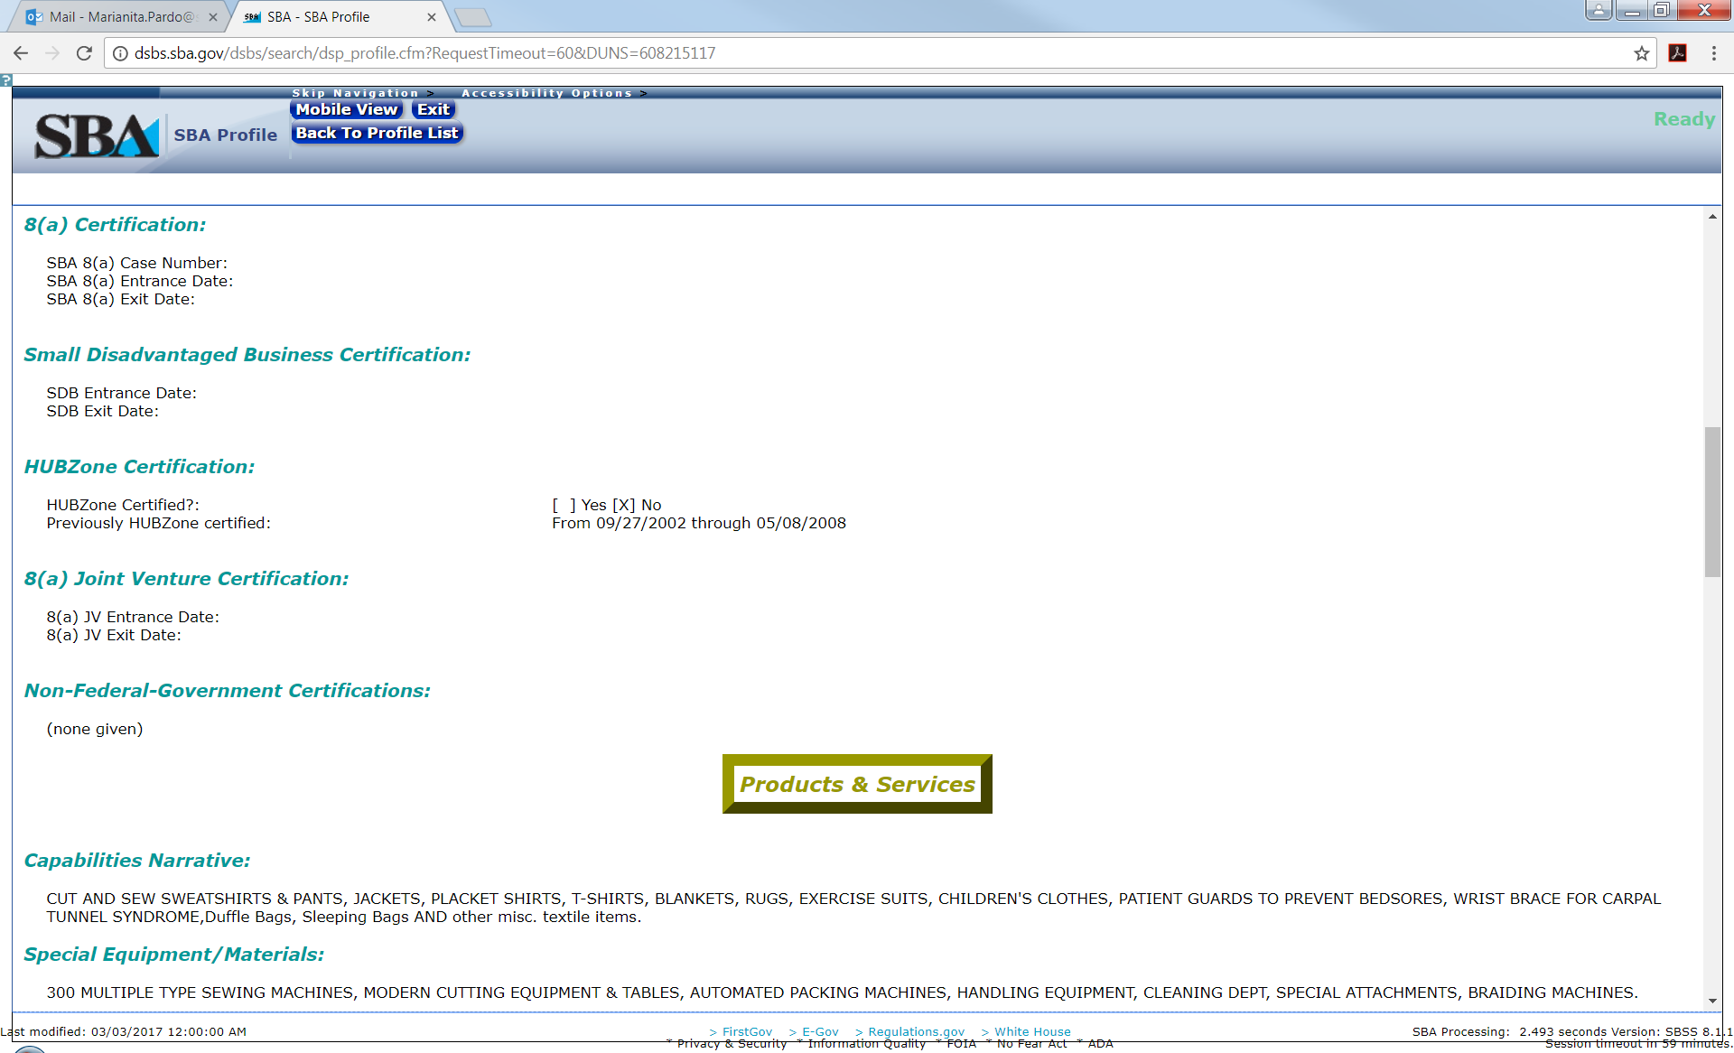
DSBS example: Decertified HUBZone Small Business

Slide 62
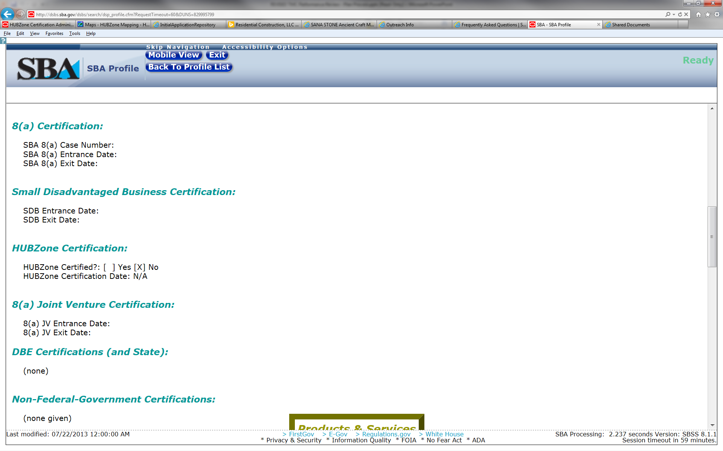
DSBS example: Non-HUBZone Small Business

Slide 63
SBA: U.S. Small Business Administration, closing slide

