Slide 1

BookEz
Team Members
harsh mehta
Divya r nair
K nagaprudhvi

Slide 2
CONTENTS
PROBLEM STATEMENT
PROJECT OVERVIEW
APPLICATION FEATURES
TECH STACK
EUREKA SERVICE DASHBOARD
PROJECT DEMO
FUTURE ENHANCEMENTS
CONCLUSION

Slide 3
PROBLEM STATEMENT
A large company with thousands of employees is facing logistical issues in efficiently managing workspaces and parking slots.
The existing process is manual, leading to miscommunication and resource wastage.
Organizing internal events for employee engagement, such as competitions or team-building activities, becomes overwhelming without a proper system in place.

Slide 4
PROJECT OVERVIEW
Creating a system which can automate the process of managing the workspaces, parking slots and venues more efficiently.

Slide 5
Application features
ADMIN FEATURES :
Check all Employee details
Check all workspace slot and booking details
Check all parking slots and booking details.
Check all venue and booking details
Create new employees, workspace, venues, and parking slots
EMPLOYEE FEATURES :
Book a Parking slot
Book a Workspace
Book a Venue
View the booking details

Slide 6





Tech stack
FRONTEND
BACKEND
BACKEND

Slide 7
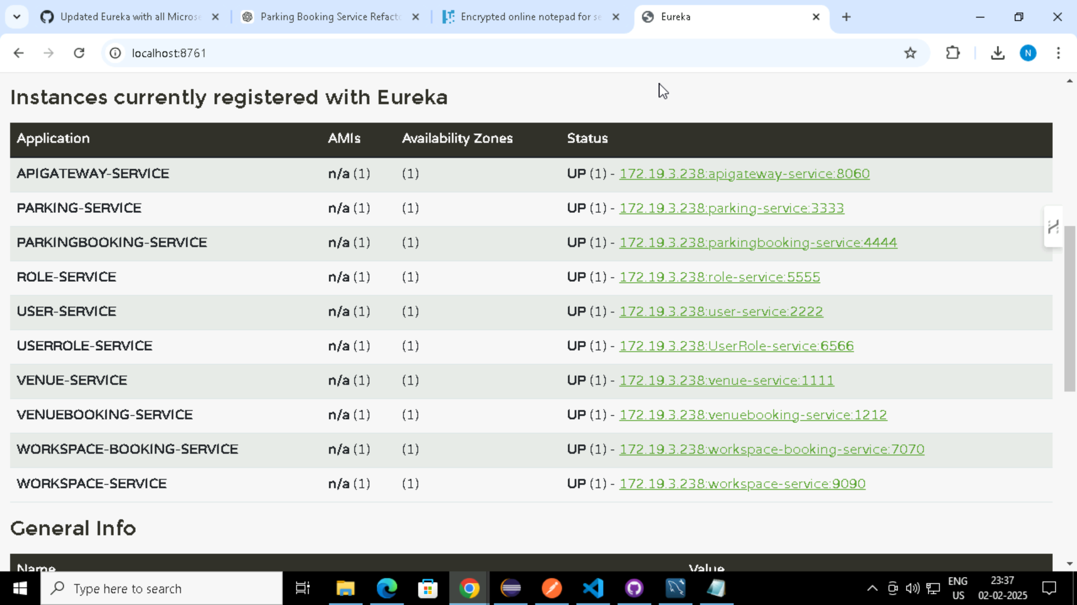
EUREKA SERVICE DASHBOARD

Slide 8
PROJECT DEMO

Slide 9
FUTURE ENHANCEMENTS
Implementing Notification System
Making UI/UX more interactive
Providing dashboard report and analysis on bookings

Slide 10
CONCLUSION
Reduced confusion and improved resource utilization.
A seamless experience for employees and event organizers.
Enhanced employee engagement through smoother venue management.

Slide 11
THANK YOU

