Slide 1
编译器指令调度简介
华为 王颉丰
Security Level:

Slide 3
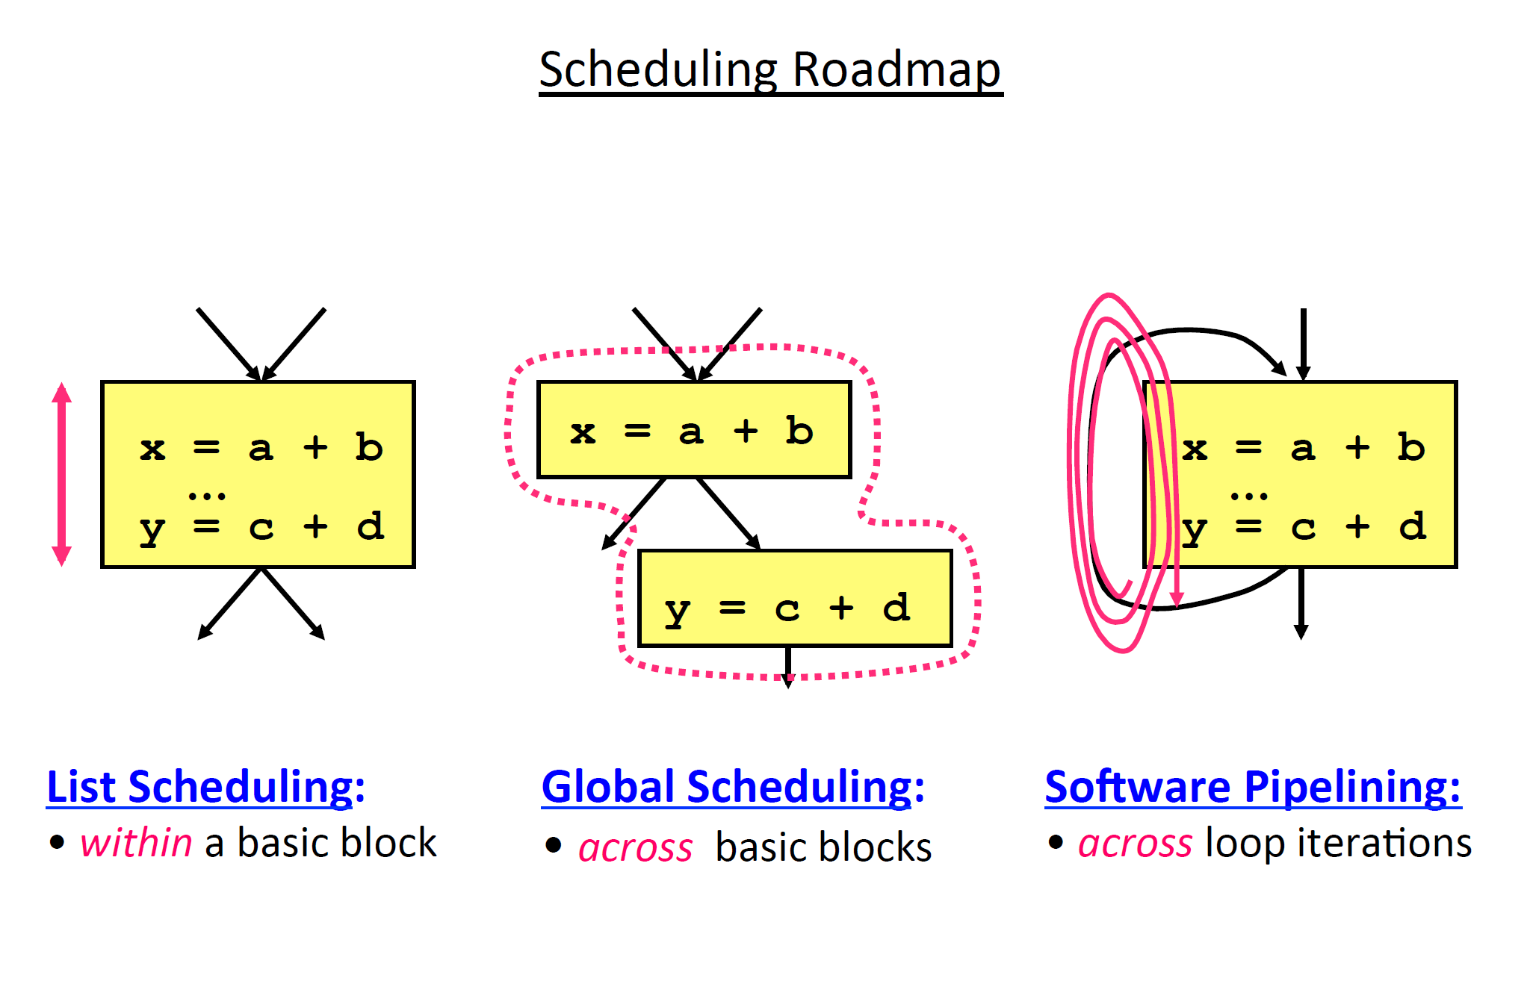

Slide 4
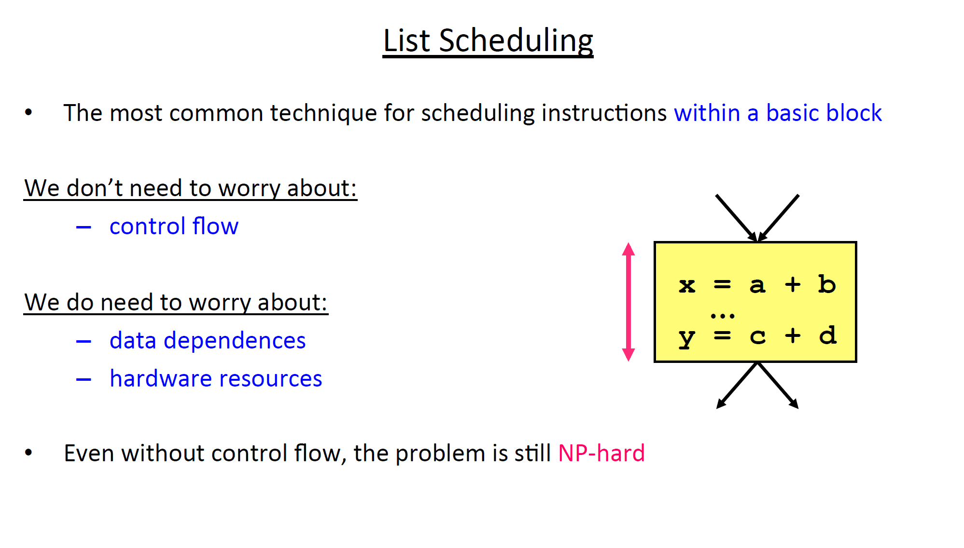

Slide 5
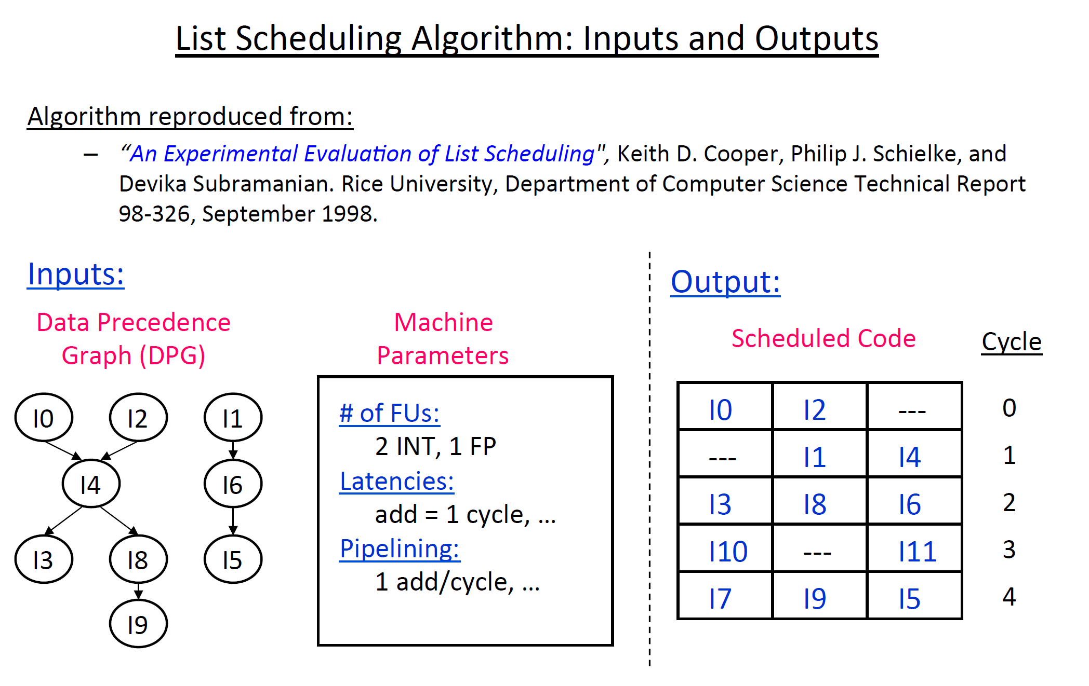

Slide 6
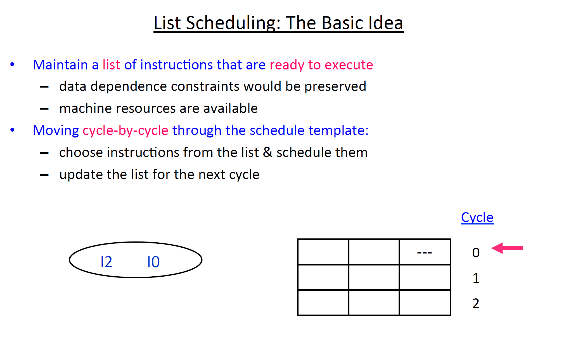

Slide 7
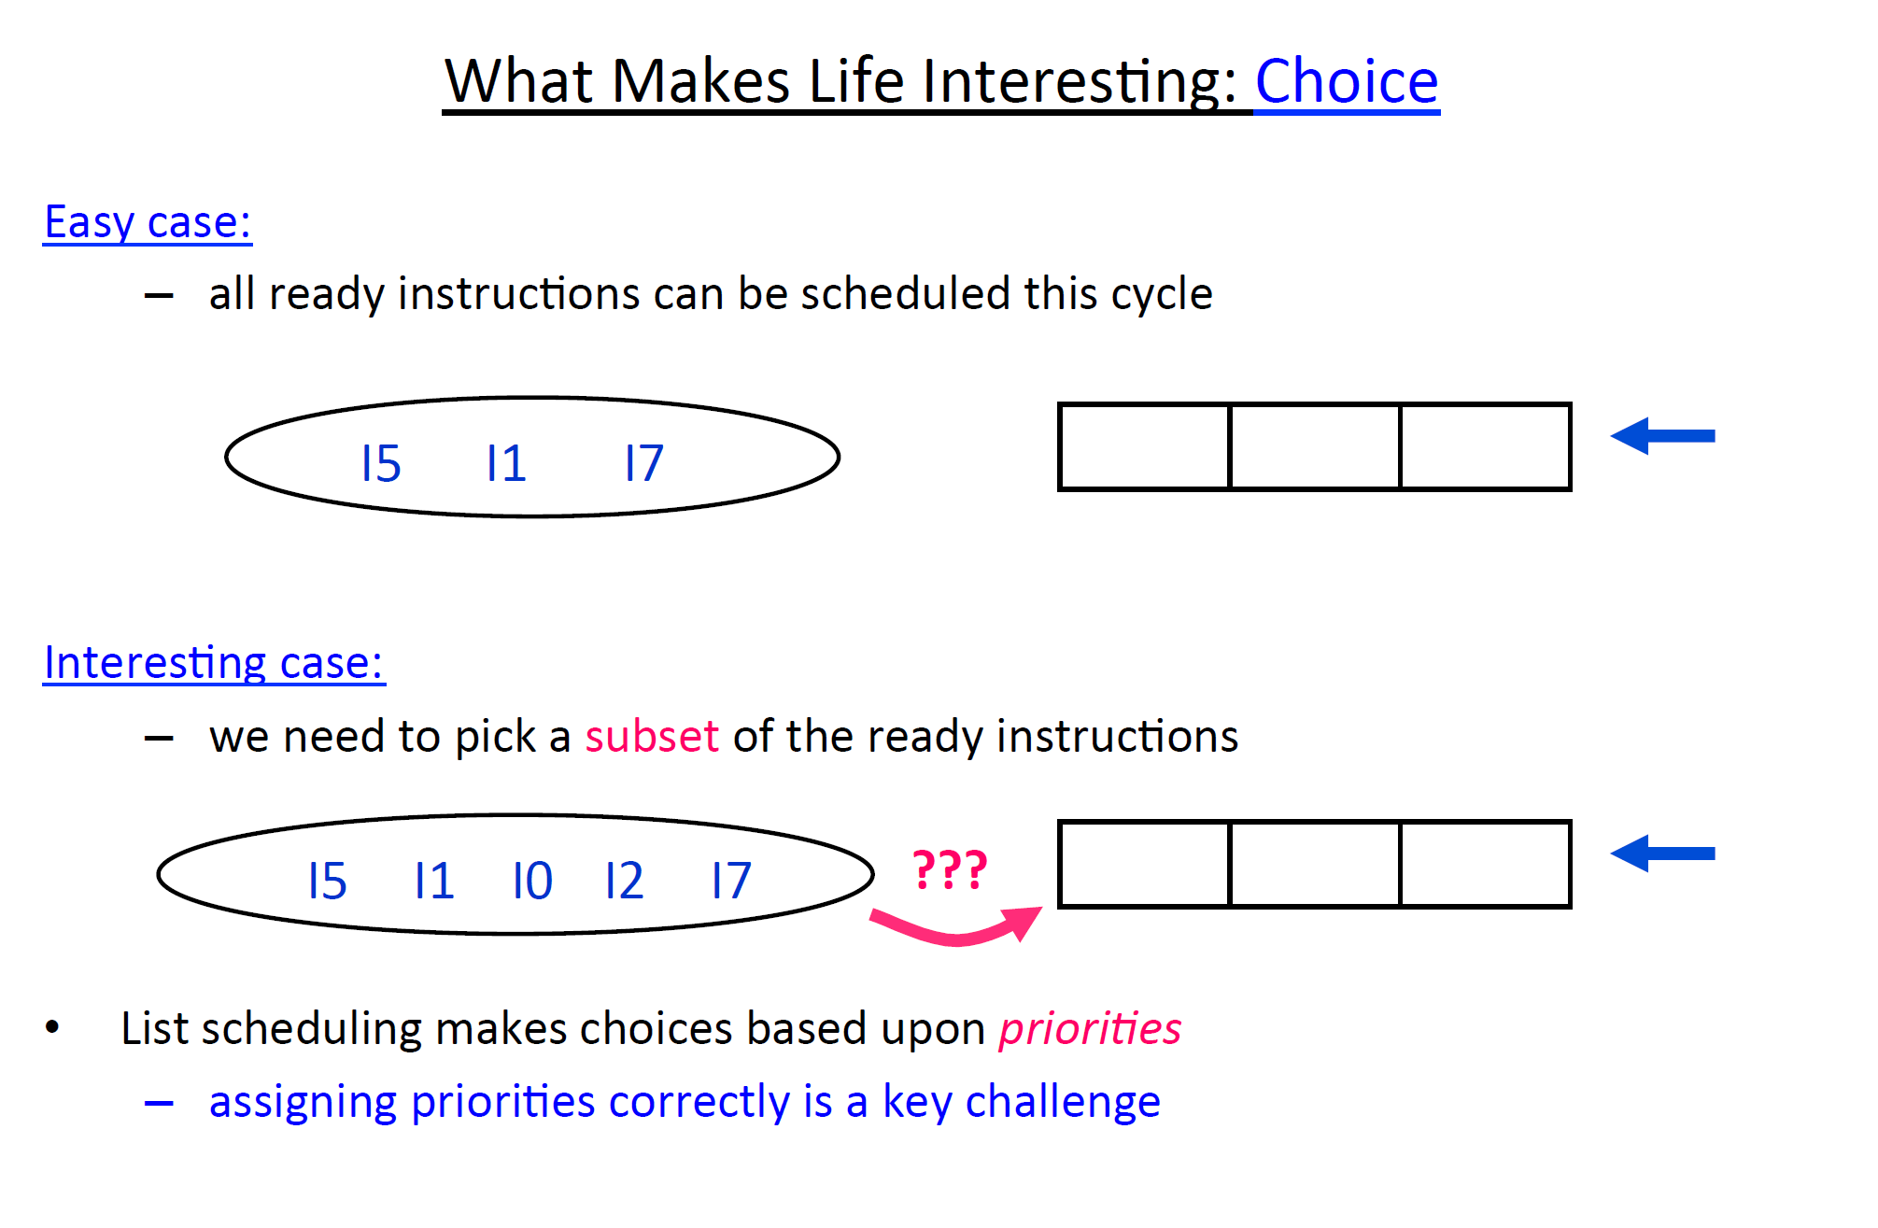
Heuristics: Register Pressure, Latency, Clustering, Critical Resource

Slide 8
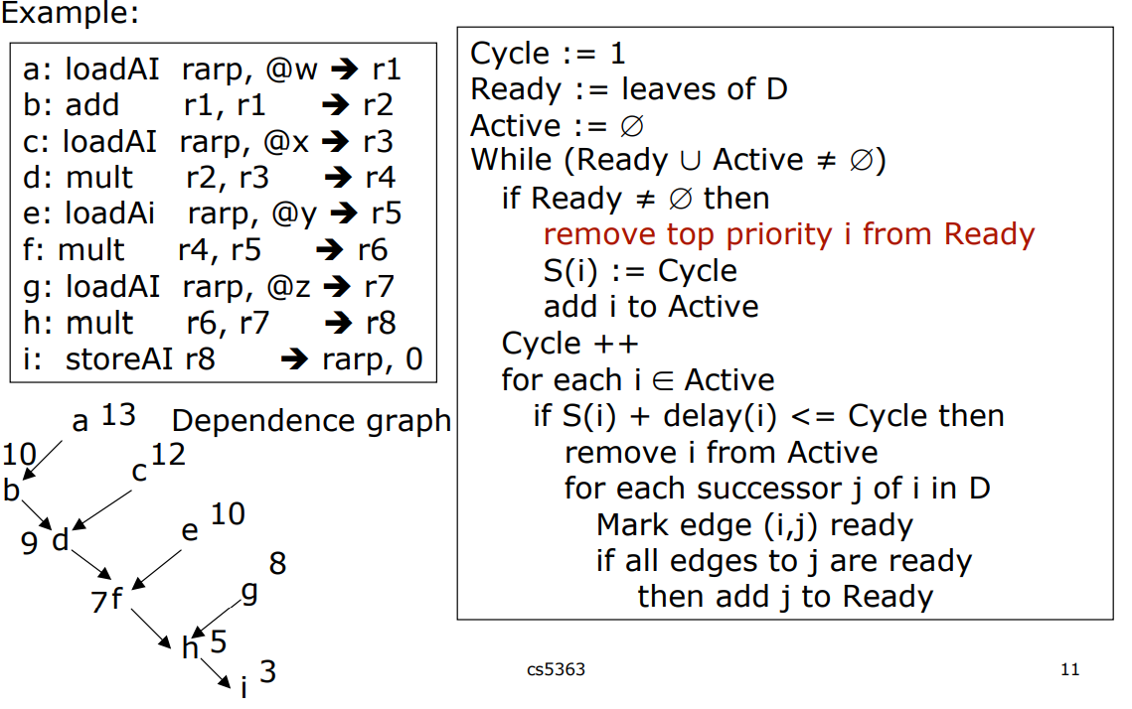
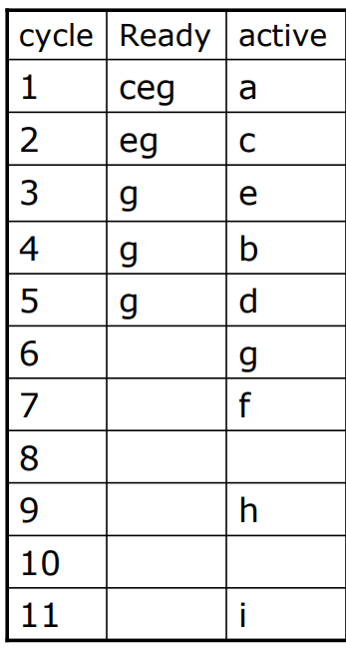
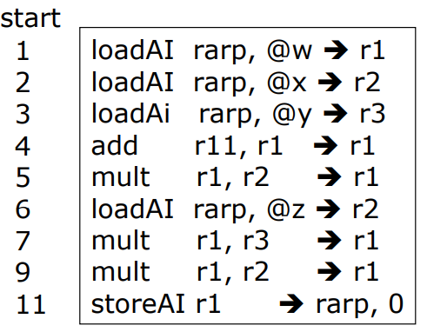
List Scheduling Algorithm

Slide 9
SchedMachineModel
// The following definitions describe the simpler per-operand machine model.
// This works with MachineScheduler. See MCSchedule.h for details.
// Cortex-A53 machine model for scheduling and other instruction cost heuristics.
def CortexA53Model : SchedMachineModel {
let MicroOpBufferSize = 0; // Explicitly set to zero since A53 is in-order.
let IssueWidth = 2; // 2 micro-ops are dispatched per cycle.
let LoadLatency = 3; // Optimistic load latency assuming bypass.
// This is overriden by OperandCycles if the
// Itineraries are queried instead.
let MispredictPenalty = 9; // Based on "Cortex-A53 Software Optimisation
// Specification - Instruction Timings"
// v 1.0 Spreadsheet
let CompleteModel = 1;
list<Predicate> UnsupportedFeatures = !listconcat(SVEUnsupported.F,
PAUnsupported.F,
SMEUnsupported.F,
[HasMTE]);
}

Slide 10
SchedReadWrite
// ALU - Despite having a full latency of 4, most of the ALU instructions can
// forward a cycle earlier and then two cycles earlier in the case of a
// shift-only instruction. These latencies will be incorrect when the
// result cannot be forwarded, but modeling isn't rocket surgery.
def : WriteRes<WriteImm, [A53UnitALU]> { let Latency = 3; }
def : WriteRes<WriteI, [A53UnitALU]> { let Latency = 3; }
def : WriteRes<WriteISReg, [A53UnitALU]> { let Latency = 3; }
def : WriteRes<WriteIEReg, [A53UnitALU]> { let Latency = 3; }
def : WriteRes<WriteIS, [A53UnitALU]> { let Latency = 2; }
def : WriteRes<WriteExtr, [A53UnitALU]> { let Latency = 3; }
// ALU - Most operands in the ALU pipes are not needed for two cycles. Shiftable
// operands are needed one cycle later if and only if they are to be
// shifted. Otherwise, they too are needed two cycles later. This same
// ReadAdvance applies to Extended registers as well, even though there is
// a separate SchedPredicate for them.
def : ReadAdvance<ReadI, 2, [WriteImm,WriteI,
WriteISReg, WriteIEReg,WriteIS,
WriteID32,WriteID64,
WriteIM32,WriteIM64]>;

Slide 11
InstRW
// Miscellaneous
def : InstRW<[WriteI], (instrs COPY)>;
// Defining new, named SchedWrites for re-use within the subtarget
def A53WriteVLD1 : SchedWriteRes<[A53UnitLdSt]> { let Latency = 4; }
def A53WriteVLD2 : SchedWriteRes<[A53UnitLdSt]> { let Latency = 5;
let ResourceCycles = [2]; }
// Using the new SchedWrites to instructions matched by regex
def : InstRW<[A53WriteVLD1], (instregex "LD1i(8|16|32|64)$")>;
def : InstRW<[A53WriteVLD2], (instregex "LD1Twov(8b|4h|2s|1d|16b|8h|4s|2d)$")>;
def : InstRW<[A53WriteVLD1], (instregex "LD2i(8|16|32|64)$")>;
def : InstRW<[A53WriteVLD2], (instregex "LD2Twov(8b|4h|2s)$")>;
// SCVT/UCVT S/D, Rd = VLD5+V4: 9 cycles.
def CyWriteCvtToFPR : WriteSequence<[WriteVLD, CyWriteV4]>;
def : InstRW<[CyWriteCopyToFPR], (instregex "FCVT[AMNPZ][SU][SU][WX][SD]r")>;
// FCVT Rd, S/D = V6+LD4: 10 cycles
def CyWriteCvtToGPR : WriteSequence<[CyWriteV6, WriteLD]>;
def : InstRW<[CyWriteCvtToGPR], (instregex "[SU]CVTF[SU][WX][SD]r")>;

