Slide 1
挑战赛题背景
【题目】代码规模（CodeSize）优化
随着物联网产业的兴起，传统的MCU（Microcontroller Unit）芯片迎来了更多的应用，例如智能穿戴设备（手表、手环）、智能车机、智能家具等。由于MCU芯片可使用内存容量较小，针对运行其中的程序的代码规模（CodeSize）的优化，一直是个重要课题。更小的代码规模，意味着更小的芯片面积、更低的成本、更高的市场竞争力。本题要求参赛队在确保程序功能正确且性能损失合理的前提下，使用汇编/链接/后链接时代码规模优化技术，尽可能减小面向特定目标平台的二进制可执行文件代码规模。

Slide 2
RISC-V Linker Relaxation
The goal of RISC-V linker relaxtion
To reduce the number of instructions to access symbol, for example
Fuction call be generated by either jal or auipc + jalr
Use GP register to access a global value
And more ……
Current status of LLVM linker
Support most RISC-V dependent linker relaxation, for example
Can relax call to short version
Can relax lui + load to load gp
May not be optimal, like choose GP base wisely
Reference:
https://riscv.org/wp-content/uploads/2019/03/11.15-Shiva-Chen-Compiler-Support-For-Linker-Relaxation-in-RISC-V-2019-03-13.pdf
https://github.com/llvm/llvm-project/tree/main/lld

Slide 3
Global Pointer(GP)介绍
The global pointer is defined by the ABI. （以下以riscv架构为例介绍GP）
In the standard ABI and embedded ABI it is register x3 AKA gp.
The global pointer is a software convention, it has no implementation in hardware or specific instructions.
It is implemented in the linker, enabled (default) or disabled by the --relax and --no-relax options.
Global variables are ‘relaxed’ and accessed via a relative immediate offset from the global pointer.
The global variables need to be within imm12 reach of the global pointer to be relaxed. (That is +-2048 bytes.)
引用自：https://five-embeddev.com/quickref/global_pointer.html
Linker relax请参考：https://www.sifive.com/blog/all-aboard-part-3-linker-relaxation-in-riscv-toolchain

Slide 4
基于GP的优化示例
RISC-V可以基于Global Pointer（GP）寄存器偏移（Offset）对data段数据进行快速存取，但允许的Offset范围有限（在32位指令系统中，Offset一般为12位整型）。
mov x0, global_example_address
load x1, x0, 0
global pointer register = current address value
.data
offset
load x1, gp, offset
global_example_address

Slide 5
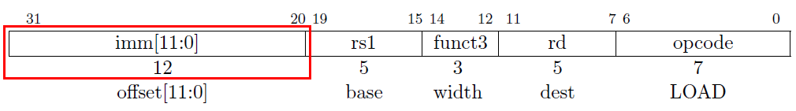
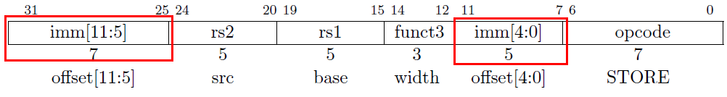
基于GP的优化示例
RISC-V访存指令示意：
note：1）load&store with gp register are 32bit instructions
2）both have 16bit and 32bit load&store instructions

Slide 6
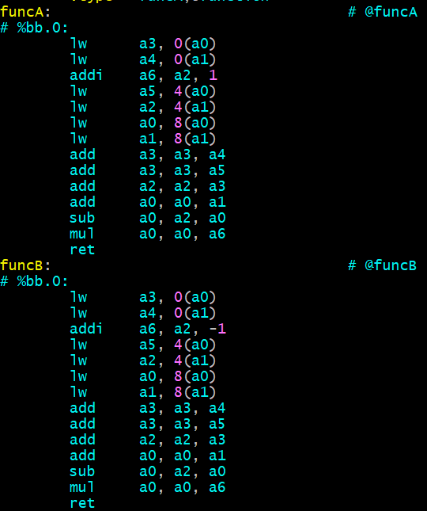
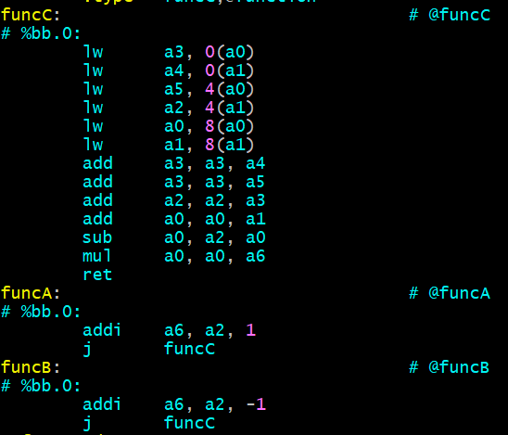
相似代码合并优化的示例
函数内或函数间的相似代码片段抽取成一个函数，来减少重复指令序列

Slide 7
Post-Link Optimizer
Post-link optimization is a technique to improve the performance of a program after it is compiled and linked
Design purpose of post-link optimizer
Archive better performance on a highly optimized binary
Work on binary side, give us a better chance to optimize code
Some common post-link optimizer
BOLT, a binary optimization and code layout tool
Propeller, a frame work for post link optimizations
thin-layout-optimizer, a project used to get better layout from profiling
Current status of LLVM post-link optimizer
BOLT has been part of LLVM since 2022
Support various backend: AArch64, X86, RISC-V
RISC-V backend has been active in upstream
Reference:
https://research.facebook.com/publications/bolt-a-practical-binary-optimizer-for-data-centers-and-beyond/
https://github.com/llvm/llvm-project/tree/main/bolt

Slide 8
BOLT工作原理介绍
BOLT基于二进制反汇编代码，重构控制流图并提升为低级IR，在其基础上优化指令流，再对程序做链接并改写二进制，具体流程图如下：
为达到最优的效果，BOLT依赖：
为尽可能精确解析二进制并还原程序的控制流图，BOLT依赖Dwarf信息与relocation entry
为尽可能提升性能，BOLT利用导入的profile来优化程序，这对code size优化并不是必须的
经过重链接后的二进制程序可以删除不必要的调试信息来进一步减少code size
BOLT对RISC-V的支持
RISC-V是当前LLVM社区支持的第三个BOLT后端，也是当前最活跃的部分
尽管如此当前RISC-V后端主要聚焦于性能优化，对code size优化较少（除去架构无关的code size优化）
针对RISC-V的架构优化仅有一个修复JALR编码的功能性支持

Slide 9
答疑
交付件内容
优化后的编译器工具链（包含汇编器链接器与后链接器）以及其源码
验证环境
使用开源的QEMU仿真器做验证，架构为32bit RISC-V架构，指令集仅支持imcfd（与去年相同）

