Slide 1
OpenCV
——第二讲
杨子江

Slide 2
INDEX
1. 图像几何变换
2. 图像阈值化

Slide 3
1. Geometric Transformations of Images
缩放：
dst=cv2.resize(src, dsize[, dst[, fx[, fy[, interpolation]]]])
import cv2
import numpy as np
img = cv2.imread('messi5.jpg')
res = cv2.resize(img,None,fx=2, fy=2, interpolation = cv2.INTER_CUBIC)
#OR
height, width = img.shape[:2]
res = cv2.resize(img,(2*width, 2*height), interpolation = cv2.INTER_CUBIC)

Slide 4

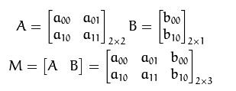

1. Geometric Transformations of Images
cv2.warpAffine:二维仿射变换

Slide 5

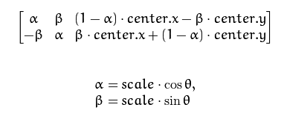

平移：
旋转：

Slide 6
1. Geometric Transformations of Images
平移：
dst = cv2.warpAffine(src, M, dsize[, dst[, flags[, borderMode[, borderValue]]]])
import cv2
import numpy as np
img = cv2.imread('messi5.jpg',0)
rows,cols = img.shape
M = np.float32([[1,0,100],[0,1,50]])
dst = cv2.warpAffine(img,M,(cols,rows))
cv2.imshow('img',dst)
cv2.waitKey(0)
cv2.destroyAllWindows()

Slide 7
1. Geometric Transformations of Images
旋转：
import cv2
import numpy as np
img = cv2.imread('messi5.jpg',0)
rows,cols = img.shape
M = cv2.getRotationMatrix2D((cols/2,rows/2),90,1)
dst = cv2.warpAffine(img,M,(cols,rows))
cv2.imshow('img',dst)
cv2.waitKey(0)
cv2.destroyAllWindows()

Slide 8
1. Geometric Transformations of Images
一般仿射：
import cv2
import numpy as np
img = cv2.imread('drawing.png')
rows,cols,ch = img.shape
pts1 = np.float32([[50,50],[200,50],[50,200]])
pts2 = np.float32([[10,100],[200,50],[100,250]])
M = cv2.getAffineTransform(pts1,pts2) // 根据传入的点自动生成仿射变换矩阵
dst = cv2.warpAffine(img,M,(cols,rows))
cv2.imshow('img',dst)
cv2.waitKey(0)
cv2.destroyAllWindows()

Slide 9
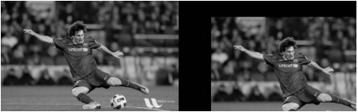
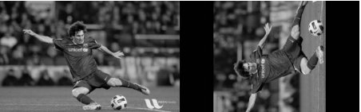
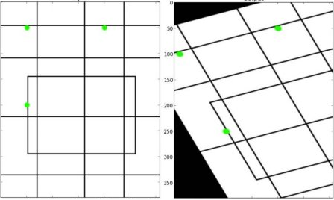

Slide 10
2. Image Thresholding
import cv2
import numpy as np
from matplotlib import pyplot as plt
img = cv2.imread('gradient.png',0)
ret,thresh1 = cv2.threshold(img,127,255,cv2.THRESH_BINARY)
ret,thresh2 = cv2.threshold(img,127,255,cv2.THRESH_BINARY_INV)
ret,thresh3 = cv2.threshold(img,127,255,cv2.THRESH_TRUNC)
ret,thresh4 = cv2.threshold(img,127,255,cv2.THRESH_TOZERO)
ret,thresh5 = cv2.threshold(img,127,255,cv2.THRESH_TOZERO_INV)
titles = ['Original Image','BINARY','BINARY_INV','TRUNC','TOZERO','TOZERO_INV']
images = [img, thresh1, thresh2, thresh3, thresh4, thresh5]
for i in xrange(6):
plt.subplot(2,3,i+1),plt.imshow(images[i],'gray')
plt.title(titles[i])
plt.xticks([]),plt.yticks([])
plt.show()

Slide 11
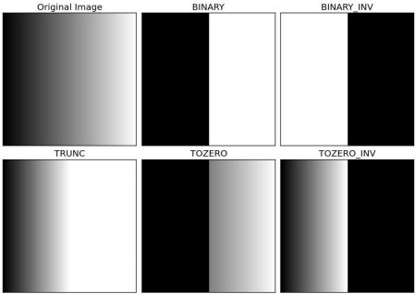

Slide 12
2. Image Thresholding
import cv2
import numpy as np
from matplotlib import pyplot as plt
img = cv2.imread('dave.jpg',0)
img = cv2.medianBlur(img,5)
ret,th1 = cv2.threshold(img,127,255,cv2.THRESH_BINARY)
th2 = cv2.adaptiveThreshold(img,255,cv2.ADAPTIVE_THRESH_MEAN_C, cv2.THRESH_BINARY,11,2)
th3 = cv2.adaptiveThreshold(img,255,cv2.ADAPTIVE_THRESH_GAUSSIAN_C, cv2.THRESH_BINARY,11,2)
titles = ['Original Image', 'Global Thresholding (v = 127)',
'Adaptive Mean Thresholding', 'Adaptive Gaussian Thresholding']
images = [img, th1, th2, th3]
for i in xrange(4):
plt.subplot(2,2,i+1),plt.imshow(images[i],'gray')
plt.title(titles[i])
plt.xticks([]),plt.yticks([])
plt.show()

Slide 13
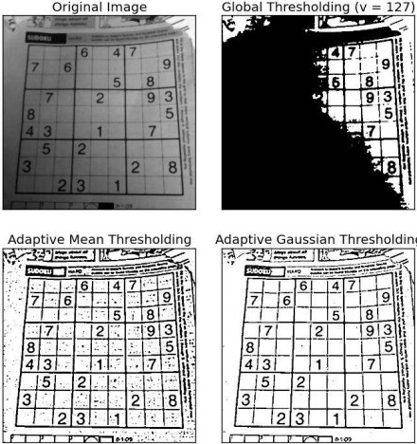

Slide 14
感谢观看

