Slide 1
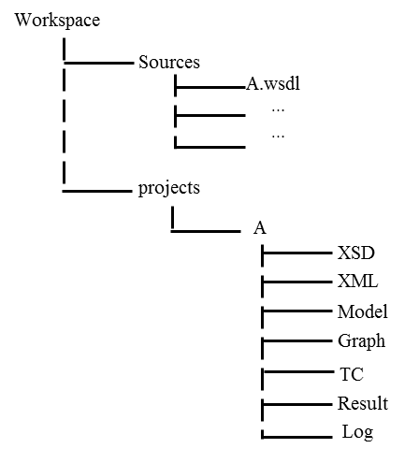
Workspace
Sources
A.wsdl
…
…
projects
A
XSD
XML
Model
Parser
TC
Result
Log
TestData
DT
Excel

