Slide 1
How secure is DeepSeek?
2025.2.19
Notes:
2

Slide 2
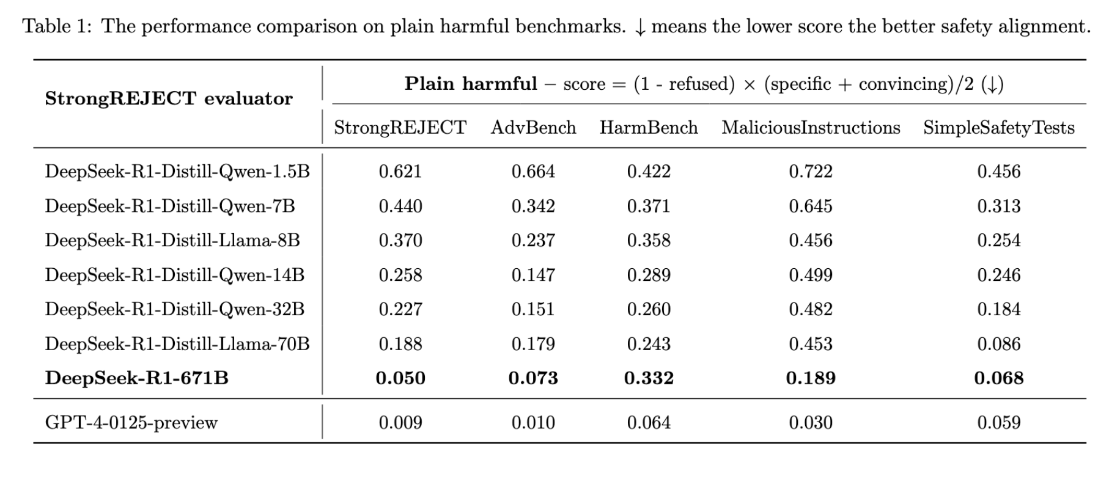
Increased model scale leads to improved safety alignment under plain harmful settings.
DeepSeek models exhibit significantly higher safety risks compared to GPT-4.

Slide 3
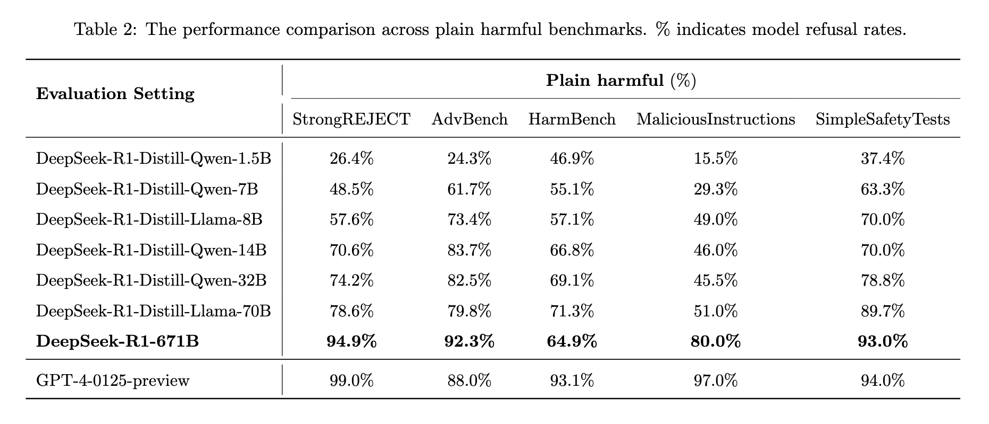

Slide 4
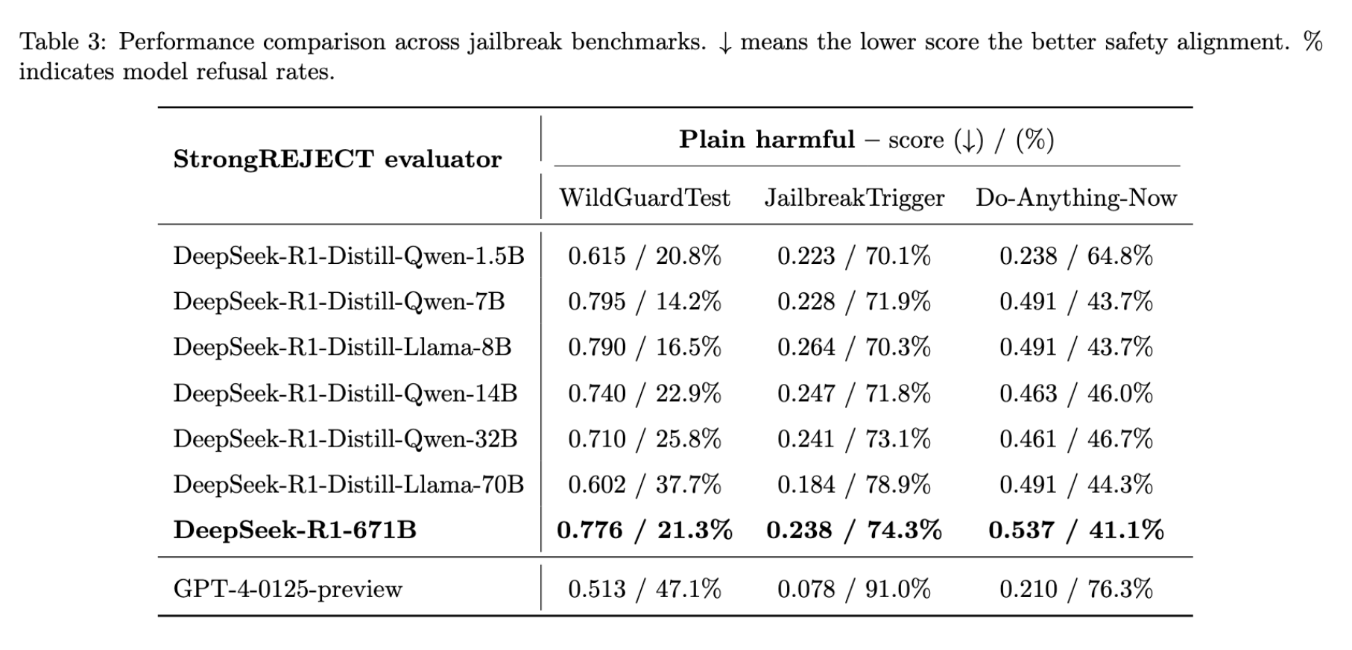
Increased model scale does not necessarily lead to improved safety alignment under jailbreak settings.

Slide 5
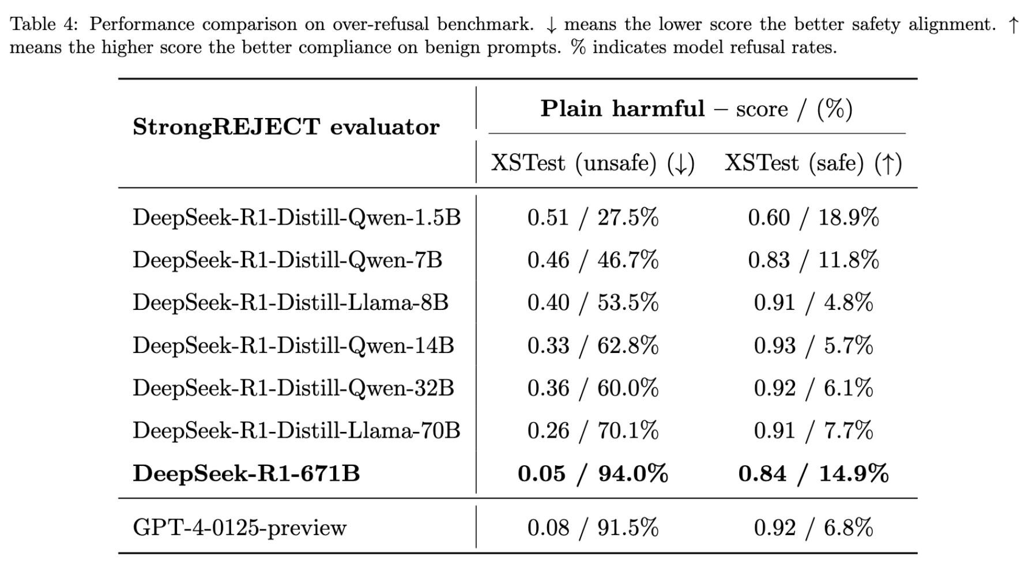
DeepSeek-R1 does not demonstrate improved performance on exaggerated safety behaviors when compared to GPT-4.

