Slide 1
Brief Introduction to Operator Dev
Presenter: Jingwen Sun
2026.1.22 Thu
USTC, Hefei, China

Slide 2

Outline
Our contest
GPU & NPU
Operator
Languages
Parallel programming algorithms
Learning resources

Slide 3



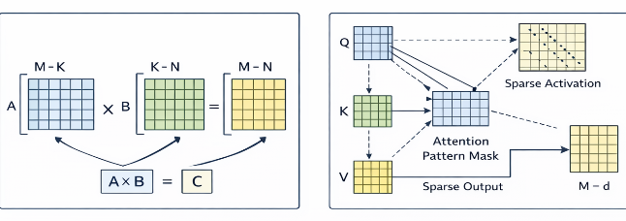
Our contest
日期 | 赛事安排
1月12日-1月18日 | 选手报名
1月21日-2月1日 | 基础知识培训
2月2日-2月28日 | 基础算子开发
3月1日-3月15日 | 综合算子开发
3月16日-3月31日 | 综合实验
Docker + Required Environment
Operator dev language
TileLang Triton
🔗
培训内容（暂定） | 主讲人
1.22 并行计算 | 孙婧雯
1.23 NPU编程与达芬奇架构 | 周华漫（华为）
1.24 NPU-Ascend | 程琛（华为）
1.25 开发环境搭建 | 王宇航、艾琮焜
1.26? Triton入门 | 蒋斌（中科院计算所）
1.28? TileLang入门 | 解文浩（北大杨智教授团队）
Specific Operator
GEMM SparseAttn
Profilling, Test, Debugging…

Slide 4
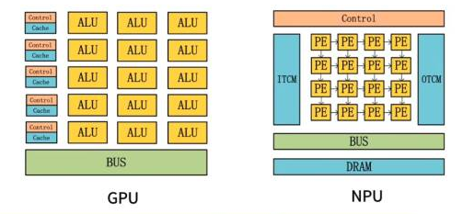
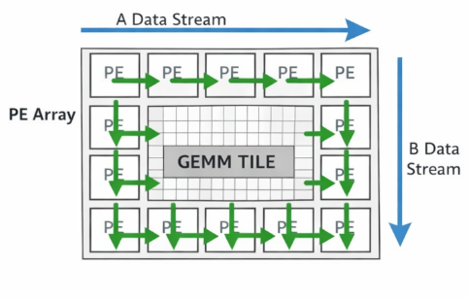
GPU&NPU
Graphics Processing Unit
Neural network Processing Unit

Slide 5
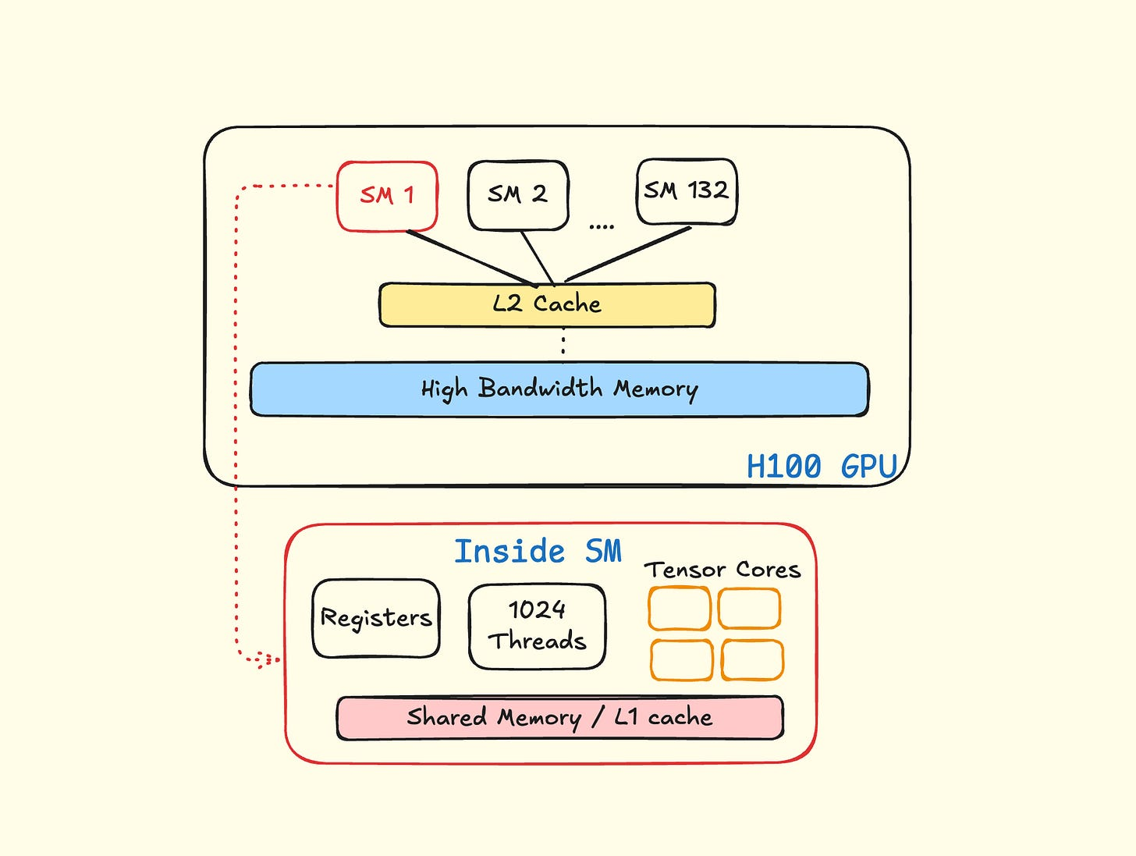
GPU
NVIDIA Hopper Architecture In-Depth | NVIDIA Technical Blog
Global Memory
Off-chip
PyTorch lives here
On-chip
Triton lives here
Finer block control

Slide 6
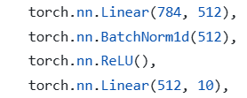
Operator
What is an “operator”?
Neither a function, nor a line of code

Slide 7
Operator
What is an “operator”?
Neither a function, nor a line of code
What is “Computation Architecture”?
从英伟达CUDA到昇腾CANN，计算架构为何这么重要？_哔哩哔哩_bilibili

Slide 8
Operator
What is an “operator”?
Neither a function, nor a line of code
What is “Computation Architecture”?
从英伟达CUDA到昇腾CANN，计算架构为何这么重要？_哔哩哔哩_bilibili
compile
launch
translate
mapping
parallel
code
computation graph
operator
kernel
GPU/NPU inst
y = torch.relu(x)
x -> ReLU -> y
An op Instance
dtype?shape?device?...
__global__ void xxx(fl* x, fl* y, int n) {
int idx = blockIdx.x * blockDim.x + threadIdx.x;
if (idx < n) {
y[idx] = x[idx] > 0 ? x[idx] : 0;
}
}
LOAD x[i]
MAX x[i], 0
STORE y[i]

Slide 9
Operator
AI acceleration
Reduced Memory Access
Better Hardware Utilization
Enable New Model Designs
Operator Fusion

Slide 10




Languages
Different dev languages:
cuTile

Slide 11


Languages
Operator development for deep learning
  Pytorch: low performance
  Cuda C: difficult coding
  Python-like program language: Triton & TileLang
    High performance
    Easy coding

Slide 12
Parallel programming algorithms
Tile(Tiling)
Naïve GEMM:
Time-consuming
Too large to cache
🤔
for i in range …
for j in range …
for k in range …
c[i,k]=a[i,j]*b[j,k] …

Slide 13
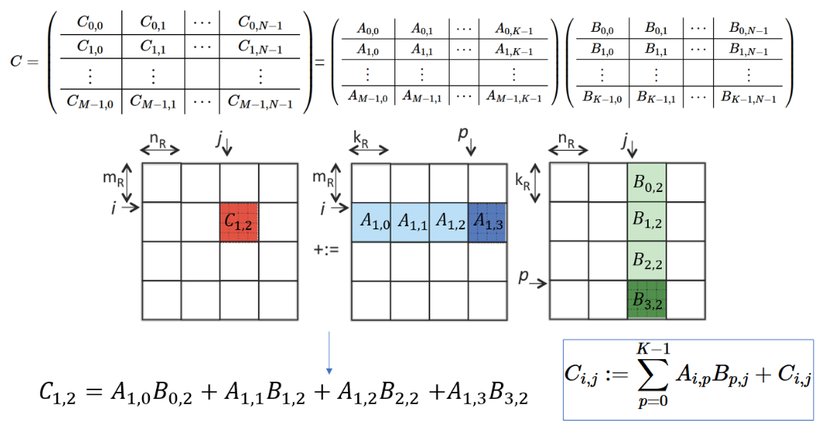
Parallel programming algorithms
Tile(Tiling)
Degrade
Decrease cost
😋

Slide 14
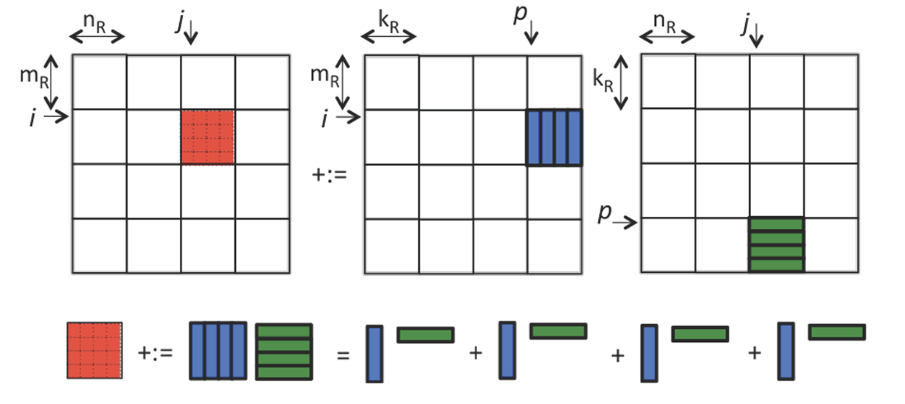
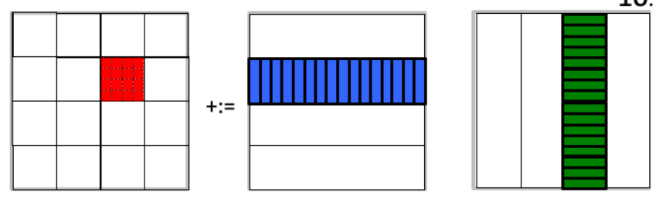
Parallel programming algorithms
Tile(Tiling)+Vector
Degrade
Decrease cost
Finer control(thread level)
😋

Slide 15
Learning resources
GEMM:
deepseek-ai/DeepGEMM: DeepGEMM: clean and efficient FP8 GEMM kernels with fine-grained scaling
NVIDIA/cutlass: CUDA Templates and Python DSLs for High-Performance Linear Algebra
Advanced Matrix Multiplication Optimization on Modern Multi-Core Processors
Parallel Programming:
iTechX | CS121 Parallel Computing
Intro to Triton: A Parallel Programming Compiler and Language (esp for AI acceleration)

Slide 16
Thanks!
Presenter: Jingwen Sun
2026.1.22 Thu
USTC, Hefei, China

