Slide 1



FPGA BASED IMAGE PROCESSING WITH SOBEL FILTER
Team 1 : Sl24225001 - Sl24225007 - Sl24225008

Slide 2
OVERVIEW
Introduction
Background and Motivation
Methodology and implementation
Result
Conclusion

Slide 3
INTRODUCTION
Image preprocessing is a crucial first step in computer vision workflows.
Enhances input image quality by reducing noise and highlighting features.
This project focuses on implementing the Sobel edge detection algorithm on an FPGA to accelerate preprocessing.
Target hardware: Xilinx ZedBoard using the MNIST dataset

Slide 4
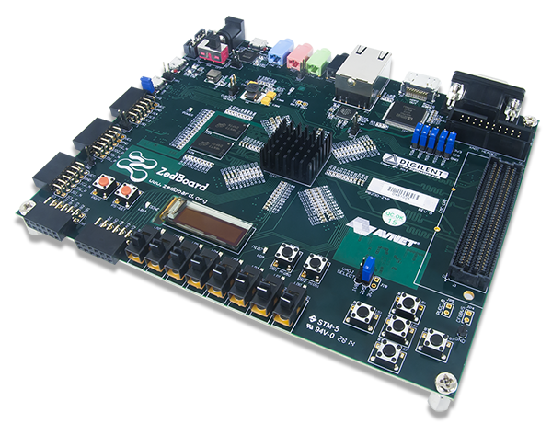
BACKGROUND AND MOTIVATION
FPGA is a reconfigurable hardware device. Unlike CPUs or GPUs, where the architecture is fixed, an FPGA can be custom-wired to perform specific tasks.

Slide 5
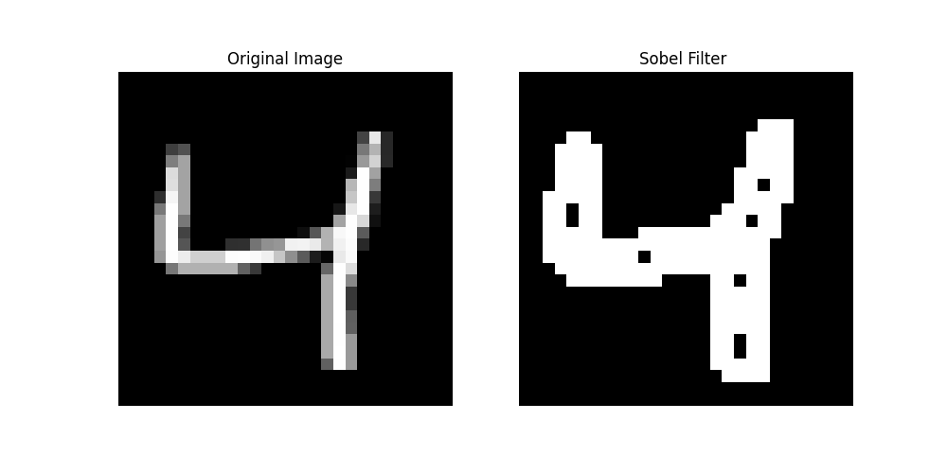
BACKGROUND AND MOTIVATION
Edge detection is a technique used in image processing to identify the boundaries of objects in an image. It works by detecting sharp changes in pixel intensity, which usually correspond to edges.
The Sobel filter is a widely used edge detection operator. It uses two 3×3 kernels (one for detecting horizontal edges and one for vertical edges)

Slide 6
BACKGROUND AND MOTIVATION
Advantages of Using FPGA:
Parallelism FPGAs can compute many pixels simultaneously.
Low Latency :fast hardware logic response.
Real-Time Processing :Great for video streams (e.g., cameras, drones).
Custom Hardware Logic : You can optimize performance & area.
Lower Power (vs GPU) : Ideal for embedded & battery-powered systems.

Slide 7
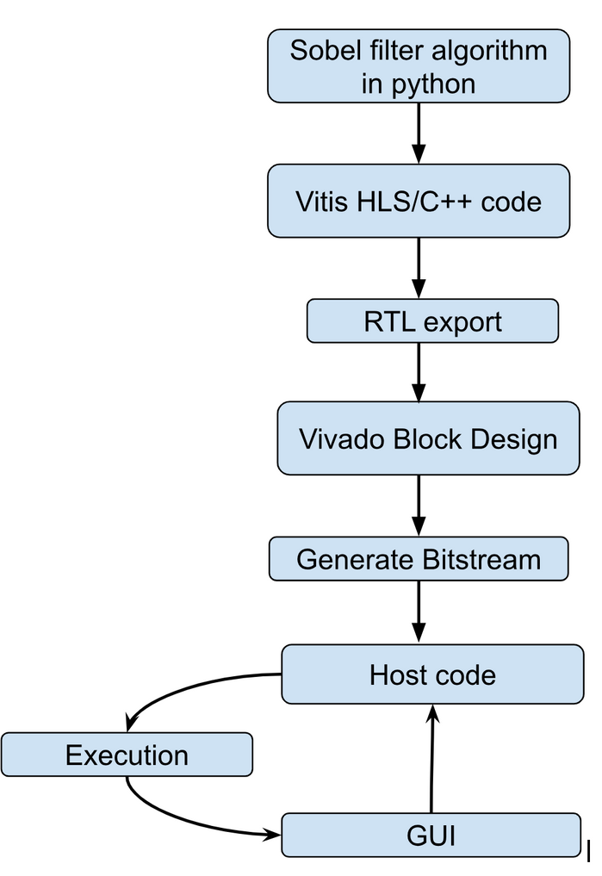
METHODOLOGY AND IMPLEMENTATION

Slide 8
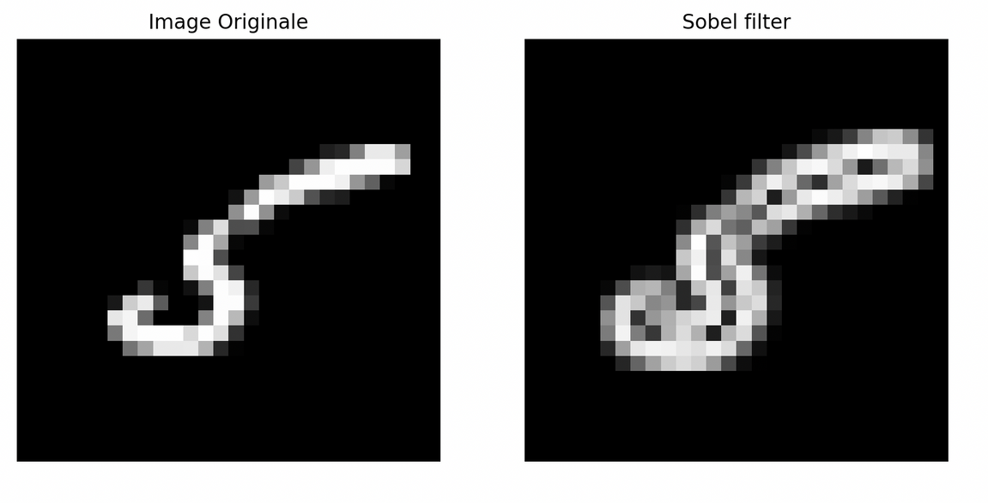
METHODOLOGY AND IMPLEMENTATION
used python to apply sobel filter
understant how sobel filter works
have a vision of the result more easily

Slide 9
METHODOLOGY AND IMPLEMENTATION
Rewrote the Python logic in C++ using Vitis HLS.
Optimization techniques:
Loop pipelining
Loop unrolling
Bit-width reduction to fixed-point
Array partitioning
RTL exportation

Slide 10
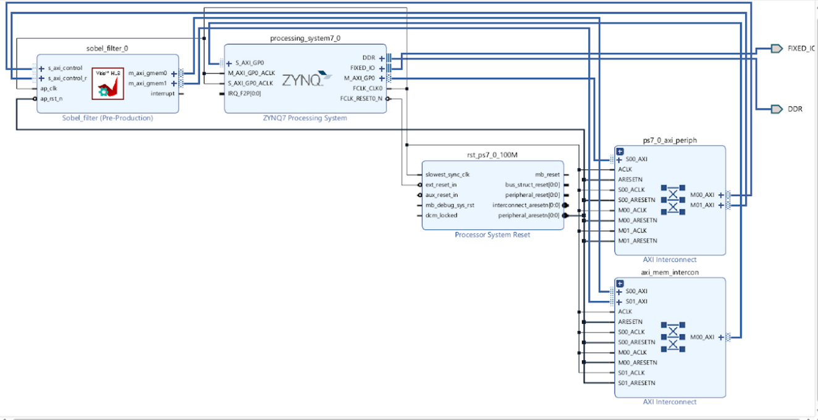
METHODOLOGY AND IMPLEMENTATION
Vivado project targeted the ZedBoard
Sobel IP core integrated with AXI interfaces. - PS7 (Processing System) configured for DDR, UART
Interconnects established
Bitstream generated after validation and synthesis

Slide 11
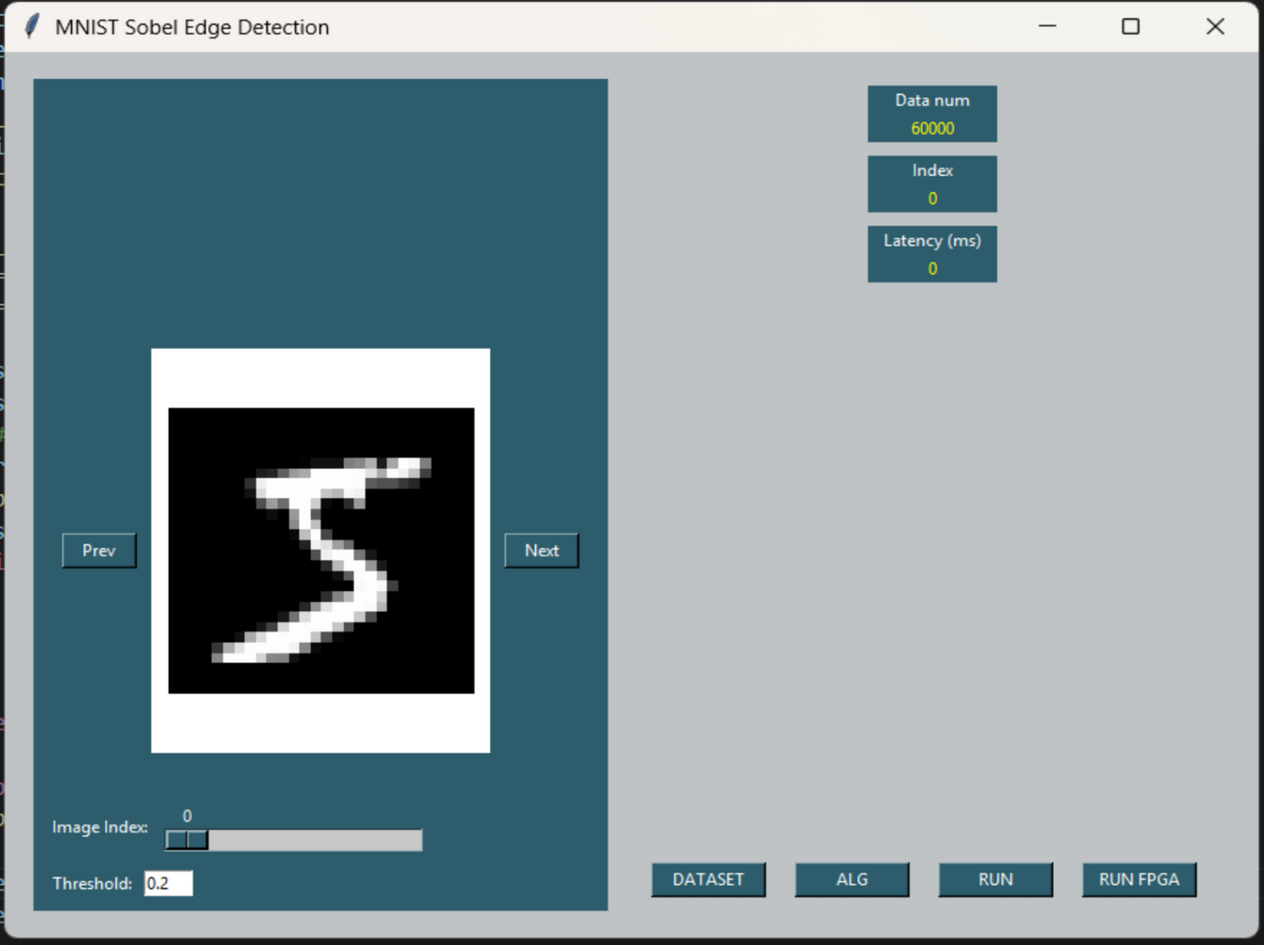
METHODOLOGY AND IMPLEMENTATION

Slide 12
Thank You
For your attention

