Slide 1
f-GAN: Training Generative Neural Samplers using Variational Divergence Minimization
16 NIPS
Microsoft Research

Slide 2
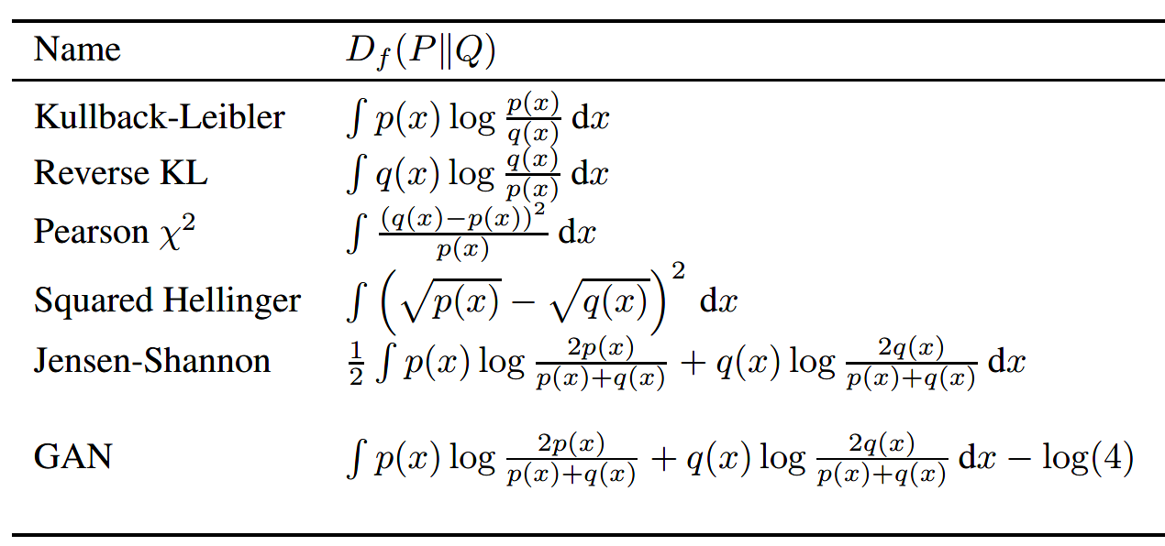
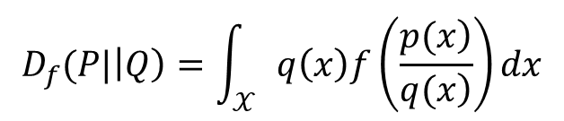
Goal: Estimate the f-divergence, which can be considered as a generalized form of divergence.
$$D_{f}(P|\left|Q\right)=\int_{𝒳}{q\left(x\right)f\left(\frac{\left.p(x\right)}{\left.q(x\right)}\right)dx}$$
$f:ℝ_{+}→ℝ$ is a convex, lower-semicontinuous function satisfying $f\left(1\right)=0$, $𝔼[f\left(x\right)]≥f\left(𝔼(x)\right)$

Slide 3
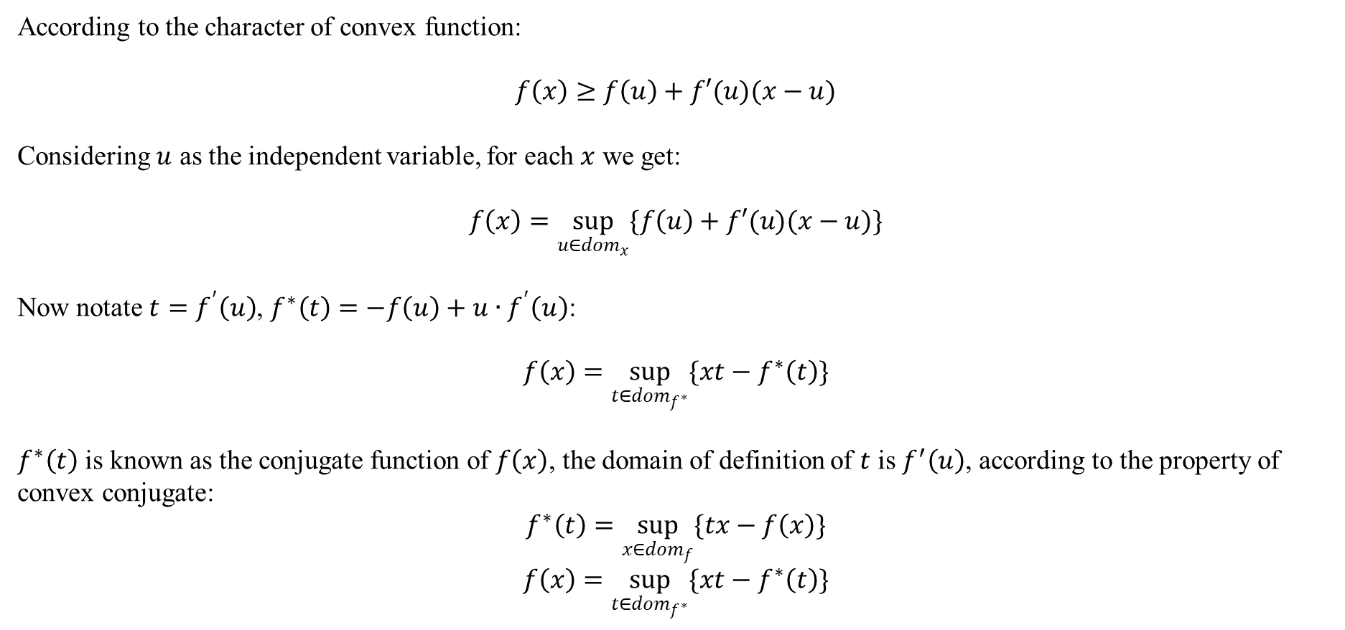
According to the character of convex function:
$$f\left(x\right)≥f\left(u\right)+f′(u)(x−u)$$
Considering $u$ as the independent variable, for each $x$ we get:
$$f\left(x\right)=\sup_{u∈{dom}_{x}}{\{f\left(u\right)+f′(u)(x−u)\}}$$
Now notate $t=f^{′}\left(u\right)$, $f^{∗}\left(t\right)=−f\left(u\right)+u∙f^{′}\left(u\right)$:
$$f\left(x\right)=\sup_{t∈{dom}_{f^{∗}}}{\{xt−f^{∗}\left(t\right)\}}$$
$f^{∗}\left(t\right)$ is known as the conjugate function of $f\left(x\right)$, the domain of definition of $t$ is $f^{′}\left(u\right)$, according to the property of convex conjugate:
$$f^{∗}\left(t\right)=\sup_{x∈{dom}_{f}}{\{tx−f\left(x\right)\}}$$
$$f\left(x\right)=\sup_{t∈{dom}_{f^{∗}}}{\{xt−f^{∗}\left(t\right)\}}$$

Slide 4
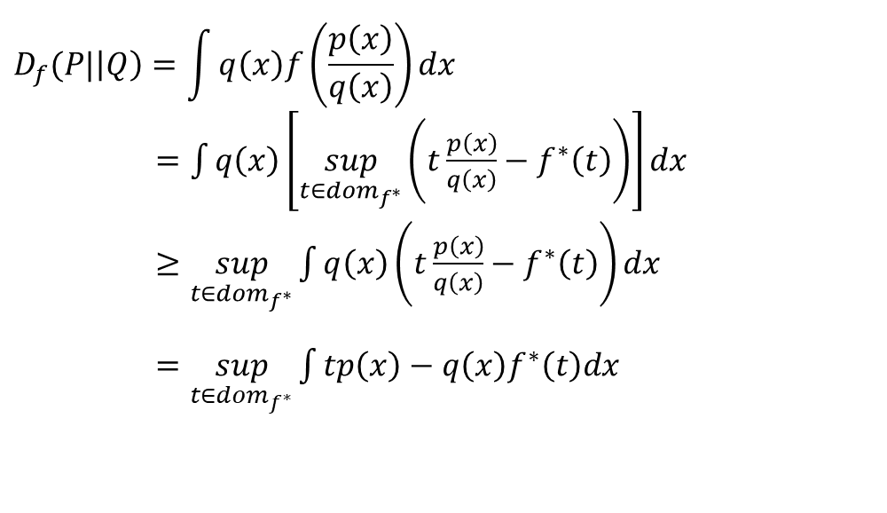
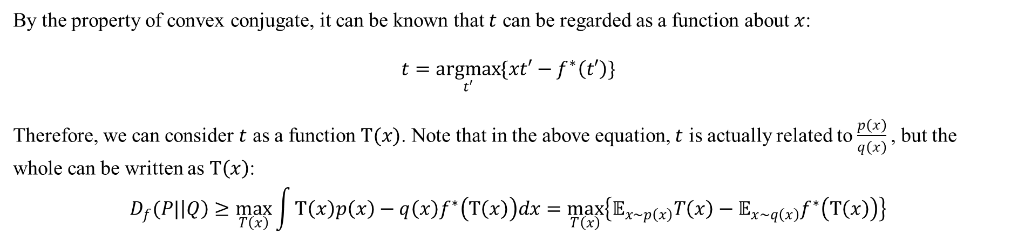
Taking $f\left(x\right)=\sup_{t∈{dom}_{f^{∗}}}{\{xt−f^{∗}\left(t\right)\}}$ into the f-divergence:
$$D_{f}(P|\left|Q\right)=\int{q\left(x\right)f\left(\frac{p\left(x\right)}{q\left(x\right)}\right)dx}$$
$=\int{q\left(x\right)\left[\sup_{t∈{dom}_{f^{∗}}}\left(t\frac{p\left(x\right)}{q\left(x\right)}−f^{∗}\left(t\right)\right)\right]dx}$
$≥\sup_{t∈{dom}_{f^{∗}}}{\int{q\left(x\right)\left(t\frac{p\left(x\right)}{q\left(x\right)}−f^{∗}\left(t\right)\right)dx}}$
$=\sup_{t∈{dom}_{f^{∗}}}{\int{tp\left(x\right)−q\left(x\right)f^{∗}\left(t\right)dx}}$
By the property of convex conjugate, it can be known that $t$ can be regarded as a function about $x$:
$$t=\underset{t′}{argmax}{\{xt′−f^{∗}\left(t′\right)\}}$$
Therefore, we can consider $t$ as a function $T(x)$. Note that in the above equation, $t$ is actually related to $\frac{p\left(x\right)}{q\left(x\right)}$, but the whole can be written as $T\left(x\right)$:
$$D_{f}(P|\left|Q\right)≥\max_{T\left(x\right)}{\int{T\left(x\right)p\left(x\right)−q\left(x\right)f^{∗}\left(T\left(x\right)\right)dx}}=\max_{T\left(x\right)}\left\{𝔼_{x\sim p\left(x\right)}T\left(x\right)−𝔼_{x\sim q\left(x\right)}f^{∗}\left(T\left(x\right)\right)\right\}$$

Slide 5
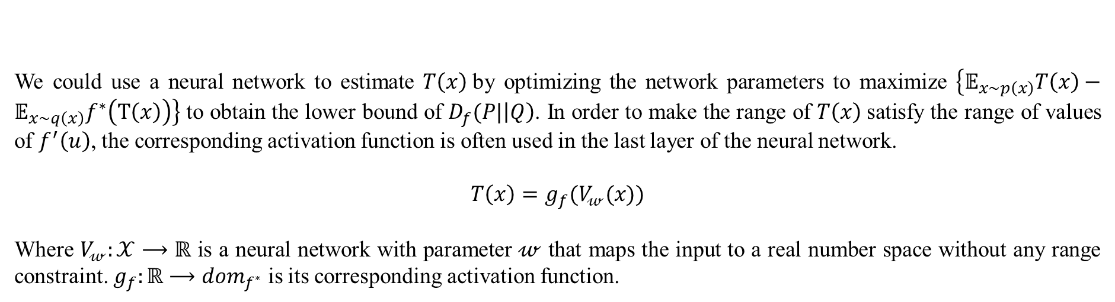
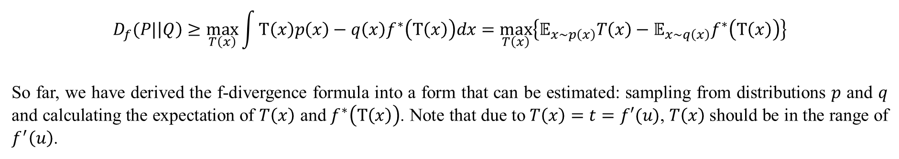
$$D_{f}(P|\left|Q\right)≥\max_{T\left(x\right)}{\int{T\left(x\right)p\left(x\right)−q\left(x\right)f^{∗}\left(T\left(x\right)\right)dx}}=\max_{T\left(x\right)}\left\{𝔼_{x\sim p\left(x\right)}T\left(x\right)−𝔼_{x\sim q\left(x\right)}f^{∗}\left(T\left(x\right)\right)\right\}$$
So far, we have derived the f-divergence formula into a form that can be estimated: sampling from distributions $p$ and $q$ and calculating the expectation of $T\left(x\right)$ and $f^{∗}\left(T\left(x\right)\right)$. Note that due to $T\left(x\right)=t=f′(u)$, $T\left(x\right)$should be in the range of $f^{′}\left(u\right)$.
We could use a neural network to estimate $T\left(x\right)$by optimizing the network parameters to maximize $\left\{𝔼_{x\sim p\left(x\right)}T\left(x\right)−𝔼_{x\sim q\left(x\right)}f^{∗}\left(T\left(x\right)\right)\right\}$ to obtain the lower bound of $D_{f}(P|\left|Q\right)$. In order to make the range of $T\left(x\right)$satisfy the range of values of $f^{′}\left(u\right)$, the corresponding activation function is often used in the last layer of the neural network.
$$T\left(x\right)=g_{f}(V_{𝓌}(x))$$
Where $V_{𝓌}:𝒳⟶ℝ$ is a neural network with parameter $𝓌$ that maps the input to a real number space without any range constraint. $g_{f}:ℝ⟶{dom}_{f^{∗}}$ is its corresponding activation function.

Slide 6
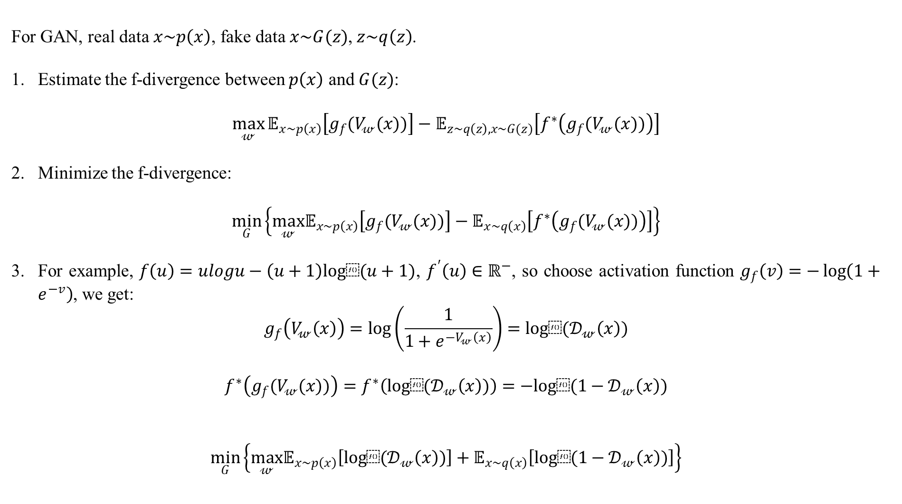
For GAN, real data $x\sim p\left(x\right)$, fake data $x\sim G(z)$, $z\sim q\left(z\right)$.
Estimate the f-divergence between $p\left(x\right)$ and $G(z)$:
$$\max_{𝓌}{𝔼_{x\sim p\left(x\right)}\left[g_{f}(V_{𝓌}(x))\right]−𝔼_{z\sim q\left(z\right), x\sim G(z)}\left[f^{∗}\left(g_{f}(V_{𝓌}(x))\right)\right]}$$
Minimize the f-divergence:
$$\min_{G}\left\{\max_{𝓌}𝔼_{x\sim p\left(x\right)}\left[g_{f}(V_{𝓌}(x))\right]−𝔼_{x\sim q\left(x\right)}\left[f^{∗}\left(g_{f}(V_{𝓌}(x))\right)\right]\right\}$$
For example, $f\left(u\right)=ulogu−\left(u+1\right)log⁡(u+1)$, $f^{′}\left(u\right)∈ℝ^{−}$, so choose activation function $g_{f}\left(v\right)=−\log\left(1+e^{−v}\right)$, we get:
$$g_{f}\left(V_{𝓌}\left(x\right)\right)=\log\left(\frac{1}{1+e^{−V_{𝓌}\left(x\right)}}\right)=log⁡(𝒟_{𝓌}\left(x\right))$$
$$f^{∗}\left(g_{f}(V_{𝓌}(x))\right)=f^{∗}\left(log⁡(𝒟_{𝓌}\left(x\right))\right)=−log⁡(1−𝒟_{𝓌}\left(x\right))$$
$$\min_{G}\left\{\max_{𝓌}𝔼_{x\sim p\left(x\right)}\left[log⁡(𝒟_{𝓌}\left(x\right))\right]+𝔼_{x\sim q\left(x\right)}\left[log⁡(1−𝒟_{𝓌}\left(x\right))\right]\right\}$$

Slide 7
Learning Deep Representations by Mutual Information Estimation And Maximization
19 ICLR
Microsoft Research

Slide 8
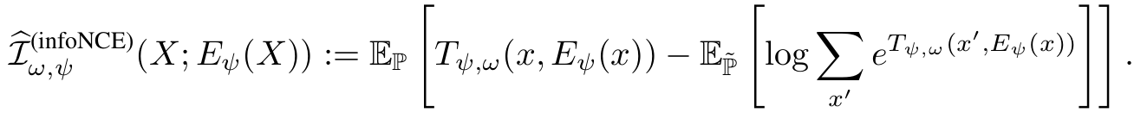
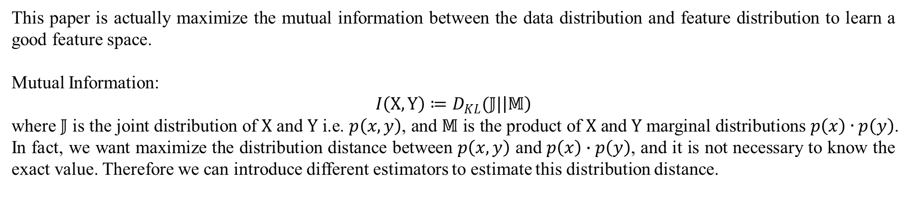
This paper is actually maximize the mutual information between the data distribution and feature distribution to learn a good feature space.
Mutual Information:
$$I\left(X,Y\right)≔D_{KL}(𝕁|\left|𝕄\right)$$
where $𝕁$ is the joint distribution of $X$ and $Y$ i.e. $p\left(x,y\right)$, and $𝕄$ is the product of $X$ and $Y$ marginal distributions $p\left(x\right)∙p\left(y\right)$.
In fact, we want maximize the distribution distance between $p\left(x,y\right)$ and $p\left(x\right)∙p\left(y\right)$, and it is not necessary to know the exact value. Therefore we can introduce different estimators to estimate this distribution distance.
DV representation:
f-GAN with JSD:
InfoNCE:

Slide 9
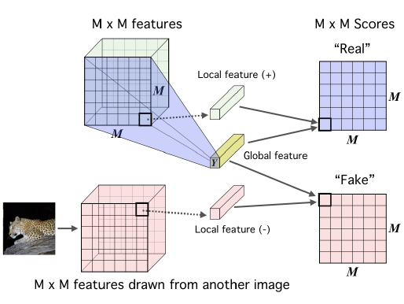
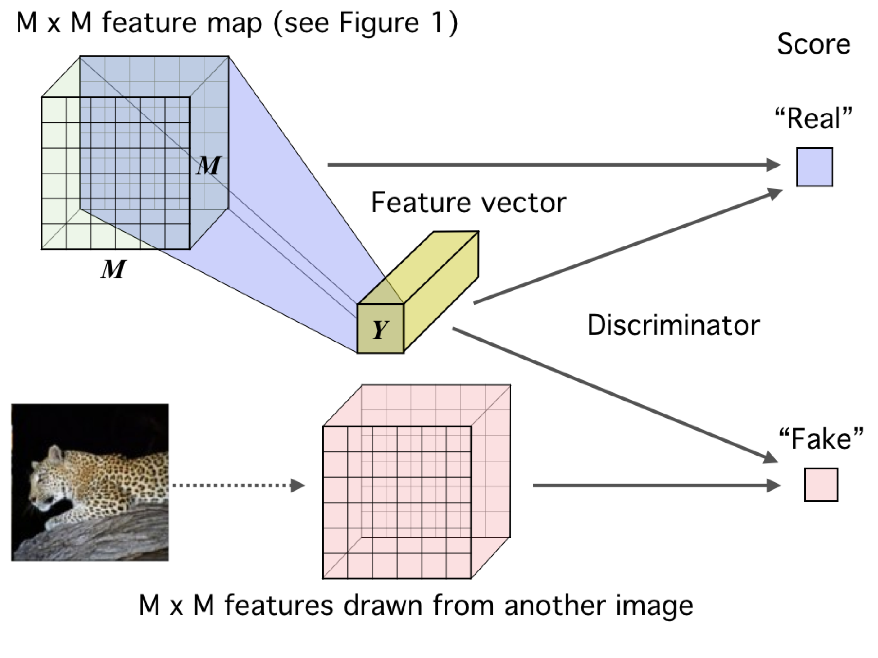



$$I\left(X,Y\right)≔D_{KL}(𝕁|\left|𝕄\right)$$
$$p\left(x,y\right)$$
$$p\left(x\right)∙p\left(y\right)$$
Global
Local

Slide 10
InfoSeg: Unsupervised Semantic Image Segmentation with Mutual Information Maximization
21 Arxiv
Graz University of Technology

Slide 11
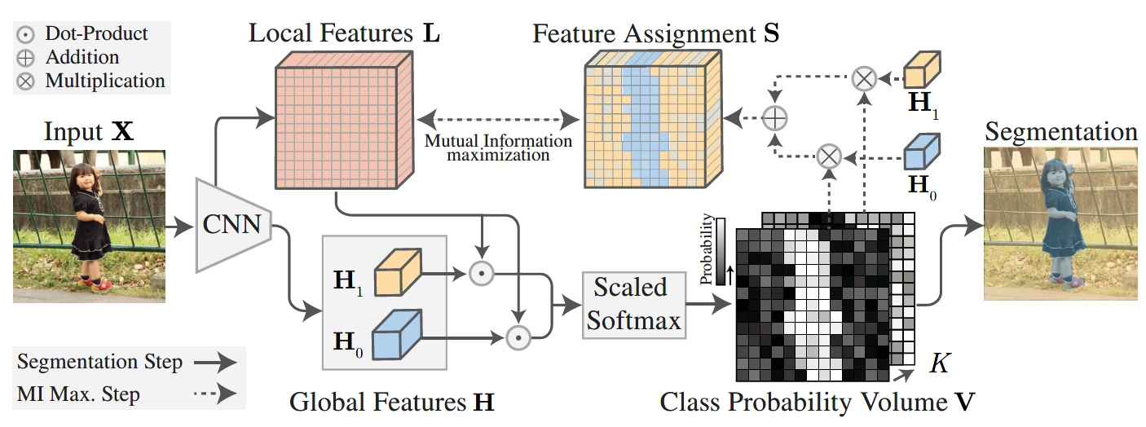
Image level
Pixel level

