Slide 1
TASK2VEC: Task Embedding for Meta-Learning
Multi-task Learning & Meta-Learning

Slide 2
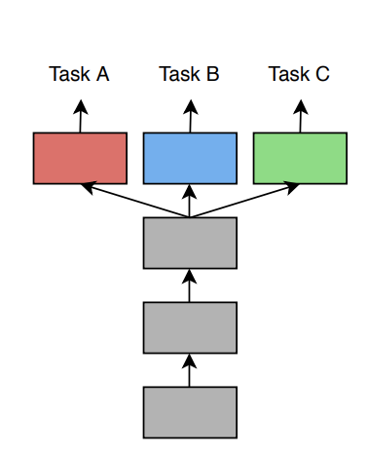
Multi-task Learning
improve the generalization of several related tasks by learning them jointly.
Meta-Learning
fast adaptation with limited labels during the test phase (few shot)
shared structure between existing training tasks could lead to better generalization and adaptation.

Slide 3
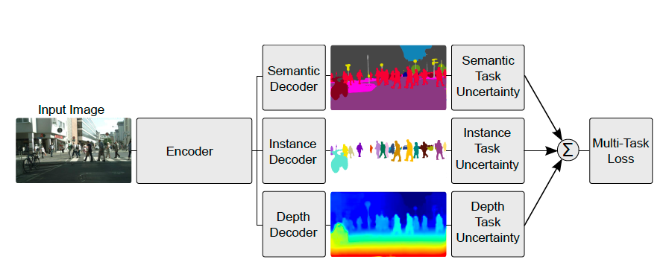
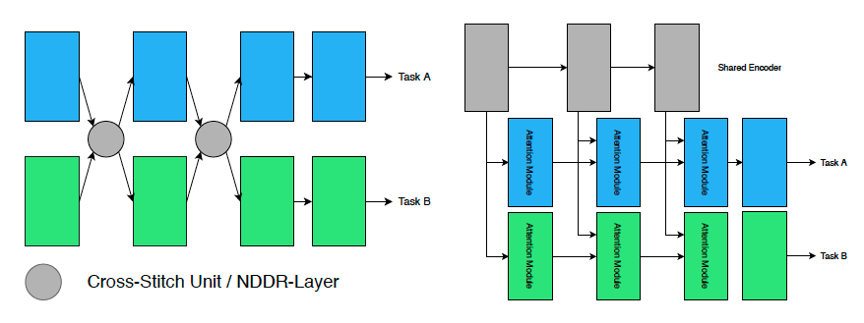
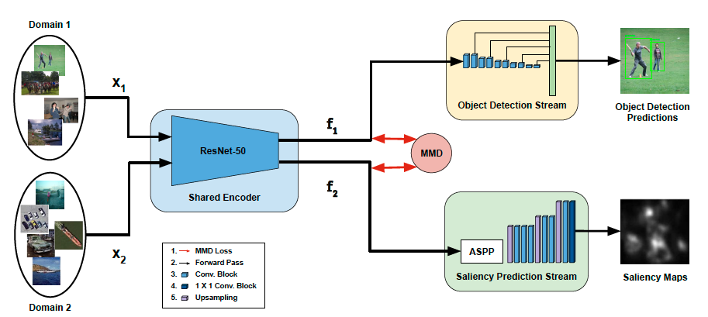
Multi-task learning
How to weight different tasks
Which parameters to share
Align domains
cvpr2020
cvpr2021

Slide 4
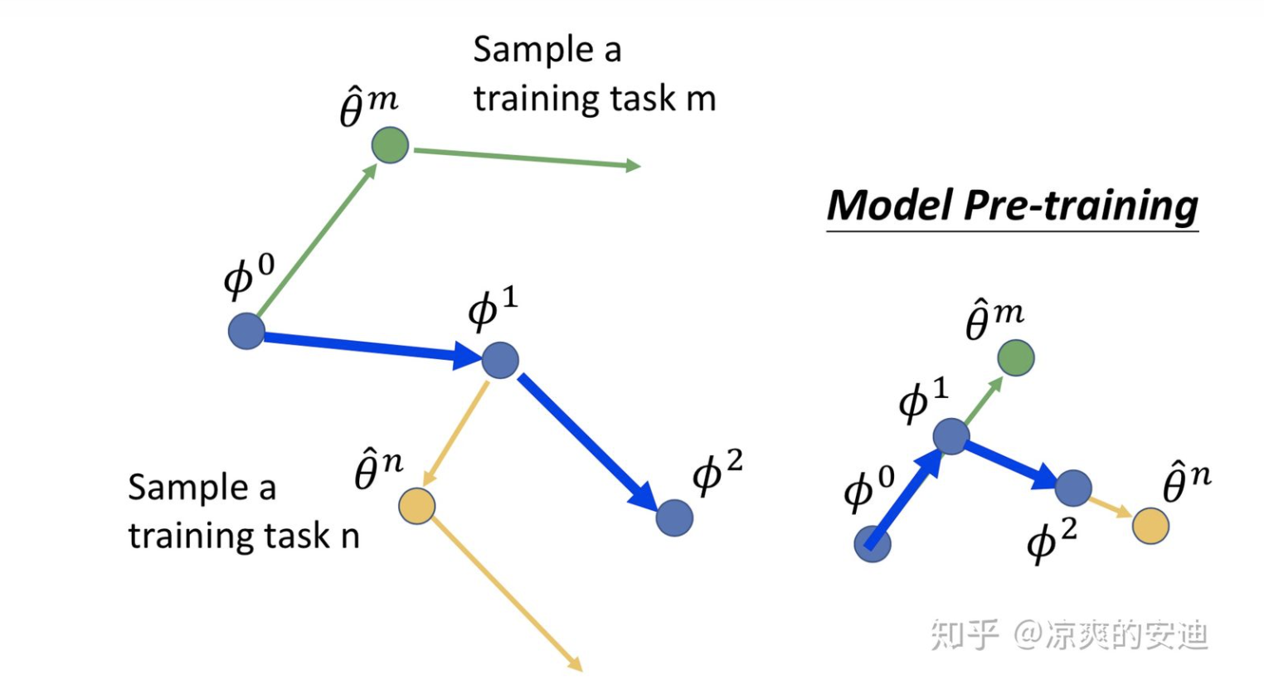
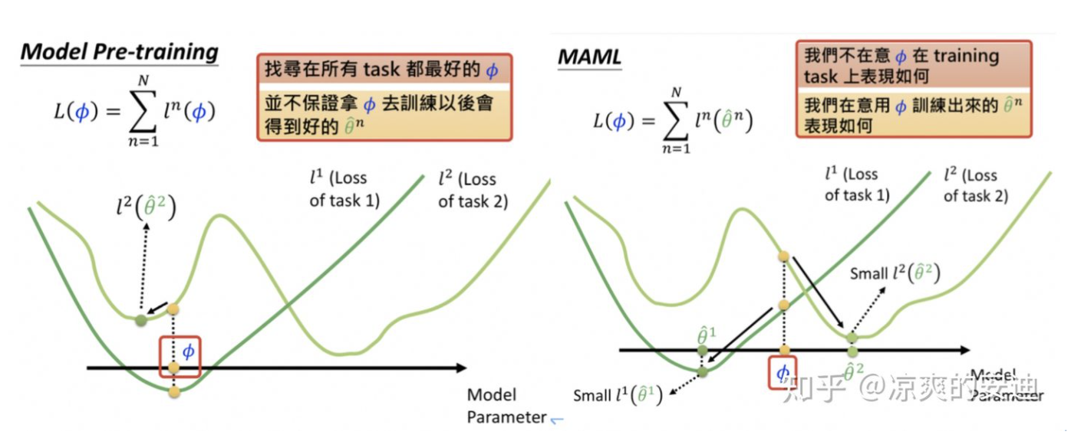
Meta learning
(learning to learn)
MAML

Slide 5
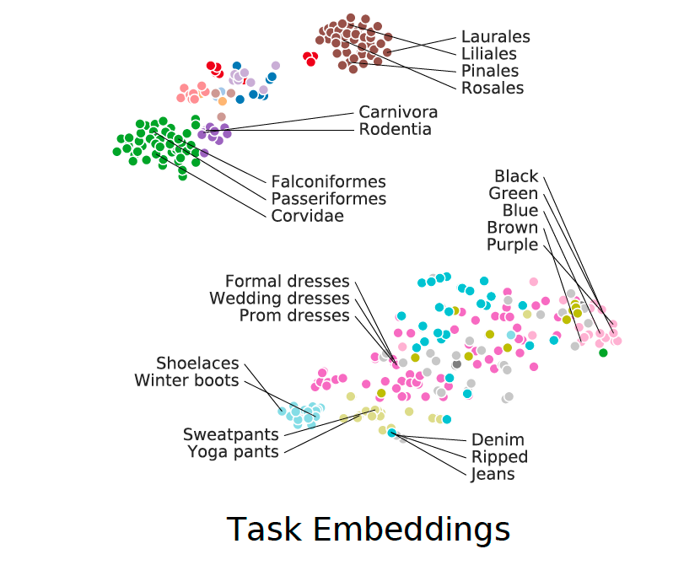
TASK2VEC: Task Embedding for Meta-Learning
Not all network weights are equally useful in predicting the task variable
importance of weights —> vector of task

Slide 6
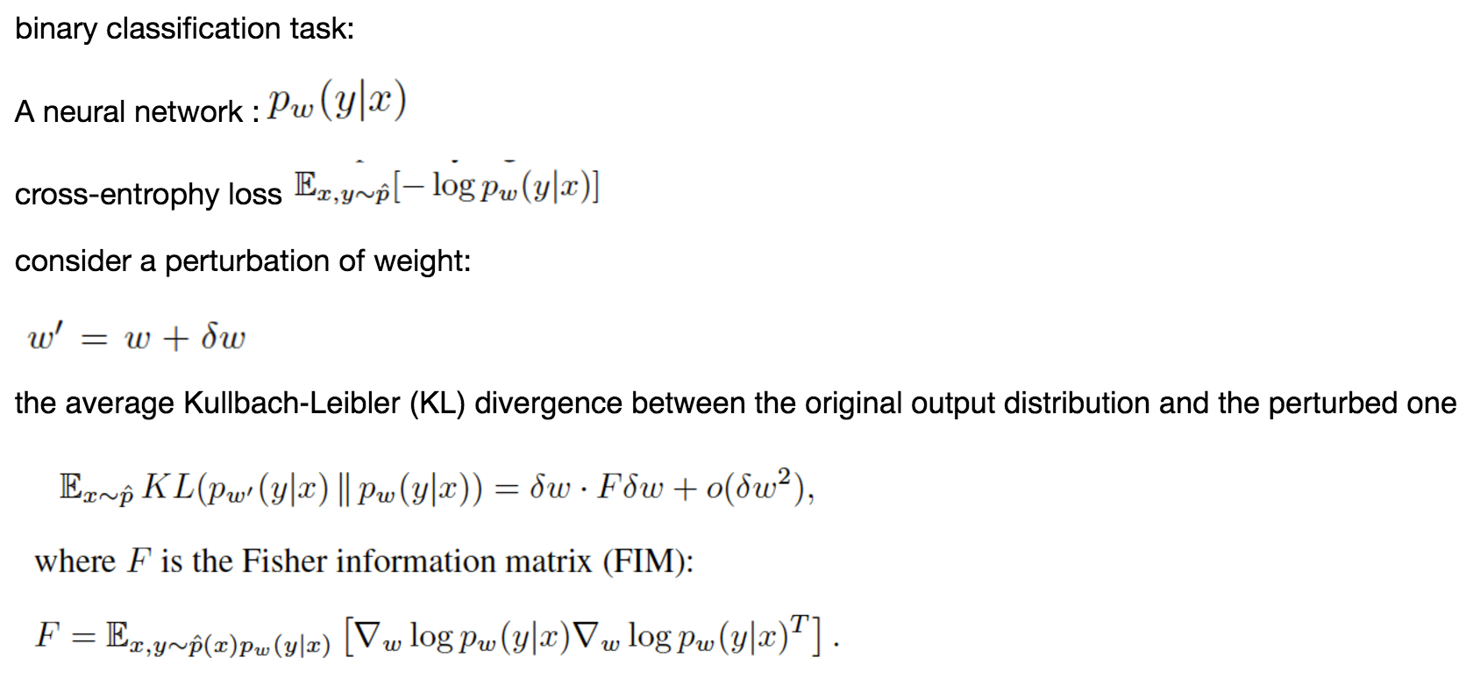
TASK2VEC: Task Embedding for Meta-Learning

Slide 7
TASK2VEC: Task Embedding for Meta-Learning
the expected covariance of the scores (gradients of the log-likelihood) with respect to the model parameters

Slide 8
TASK2VEC: Task Embedding for Meta-Learning
F is a function of w
For CNN, we compute F for every filter and get TASK2VEC
we use network pre-trained on ImageNet as the “probe”

Slide 9
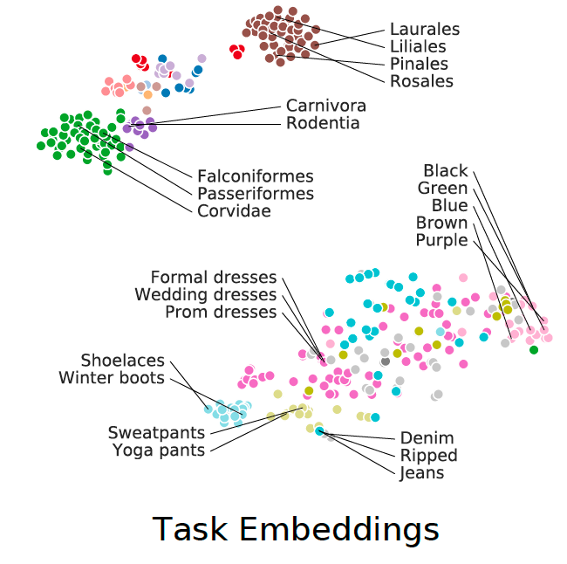
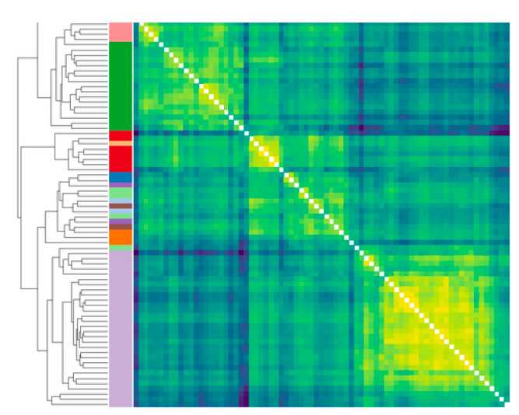
TASK2VEC: Task Embedding for Meta-Learning
Experiment: Relation of tasks

Slide 10
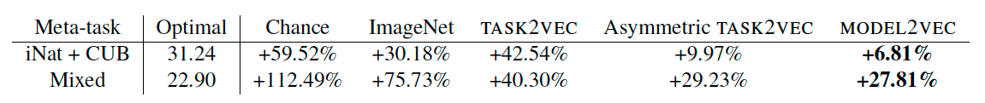
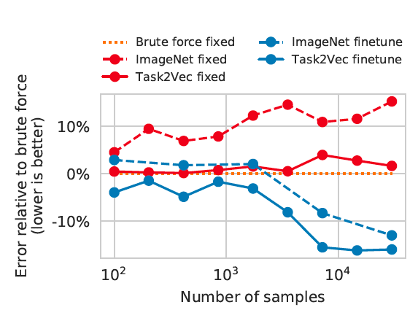

TASK2VEC: Task Embedding for Meta-Learning
Experiment: Best model selection
task/model co-embedding
MODEL2VEC

