Slide 1
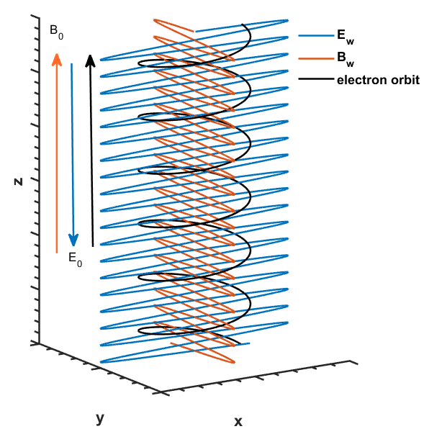
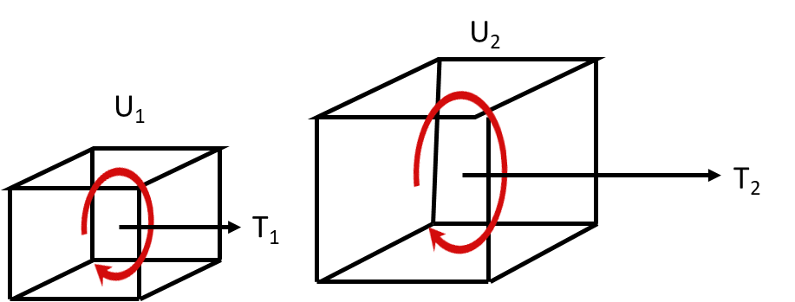




U₂
B_{Z}
$$\vec{k}$$
$$φ$$
U₁
$$ℏω$$
T₂
+
T₁
B_{Z}

Slide 2
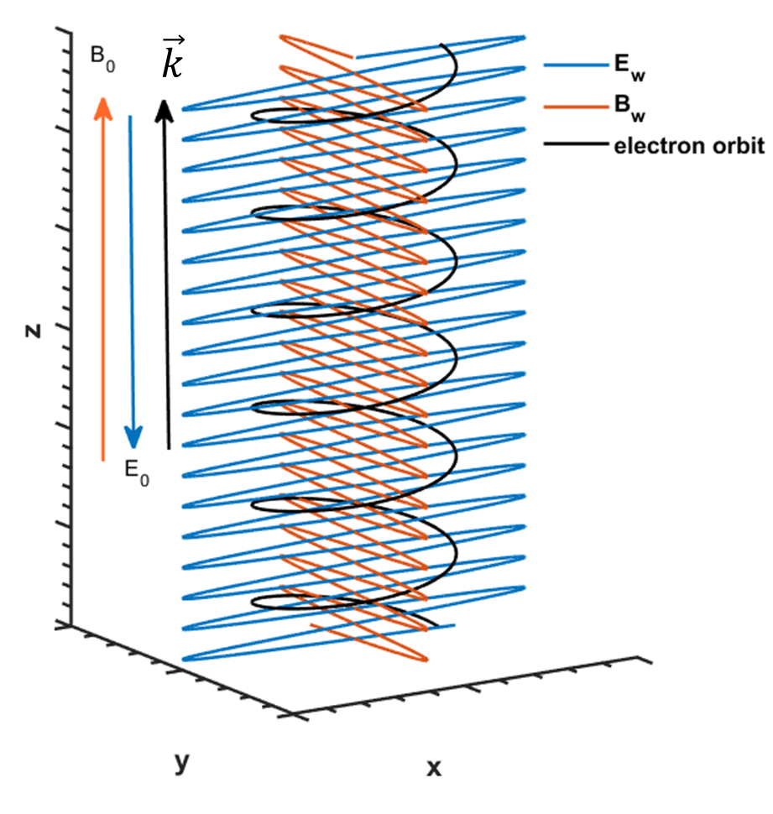


Slide 3
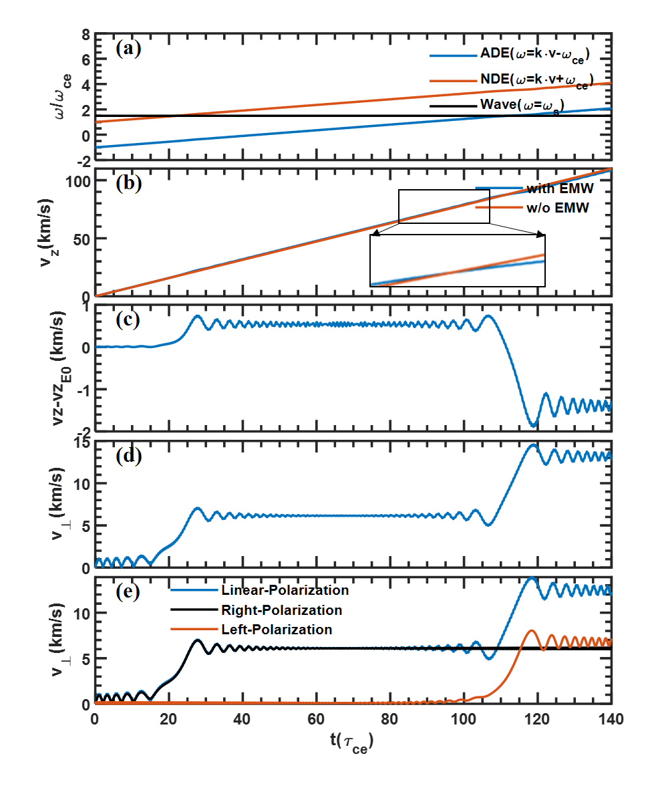

Slide 4
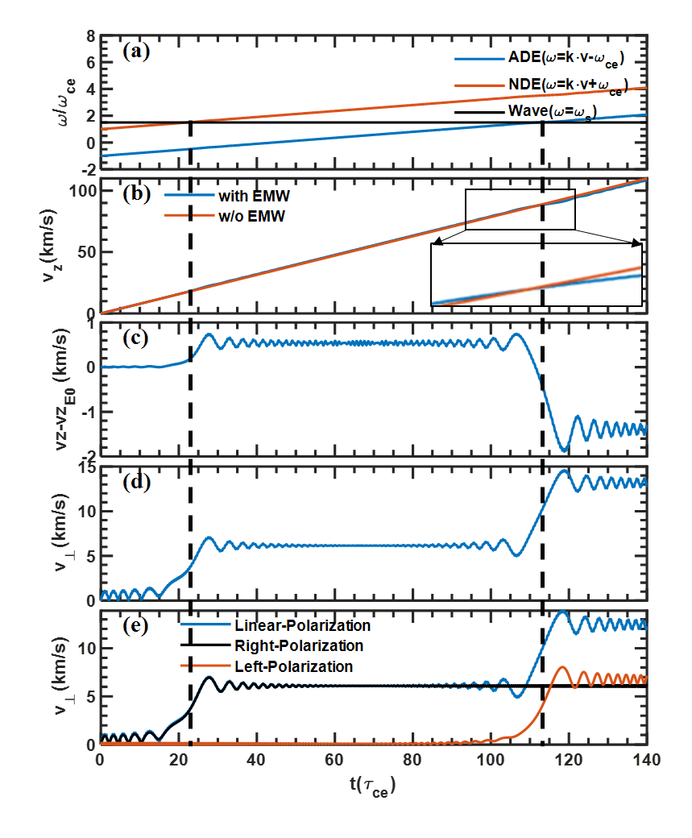
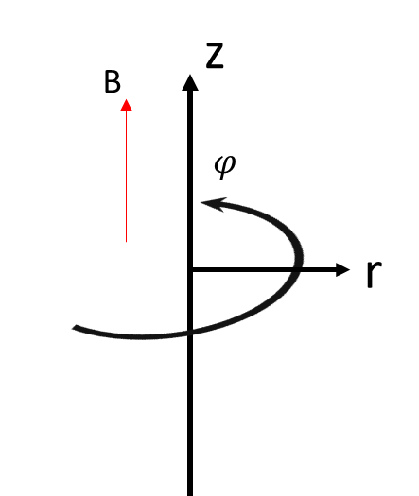

z
B
$$φ$$
r

Slide 5
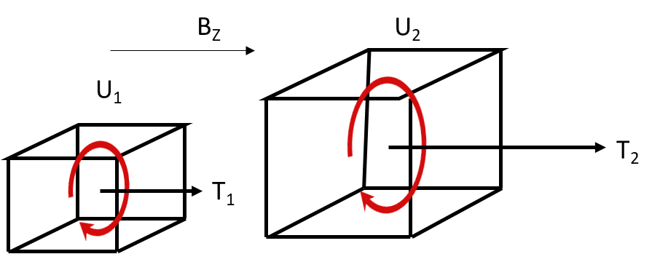
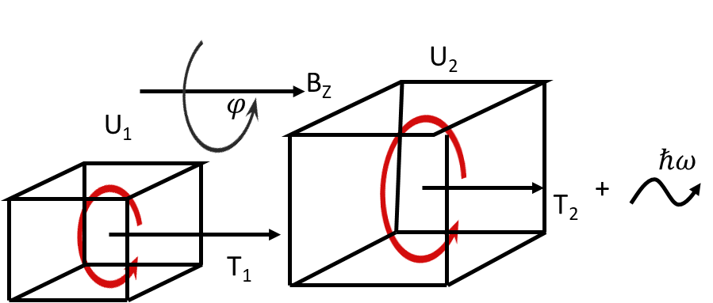
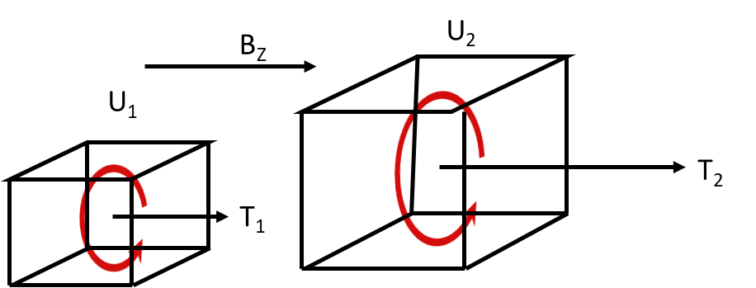

Slide 6

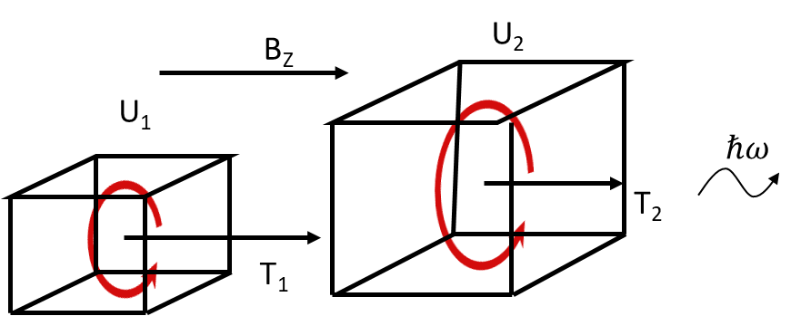


Slide 7
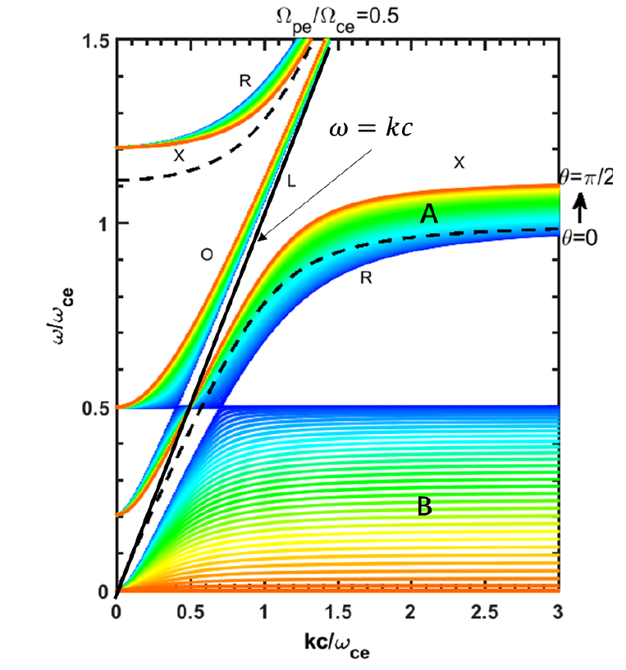

Slide 8
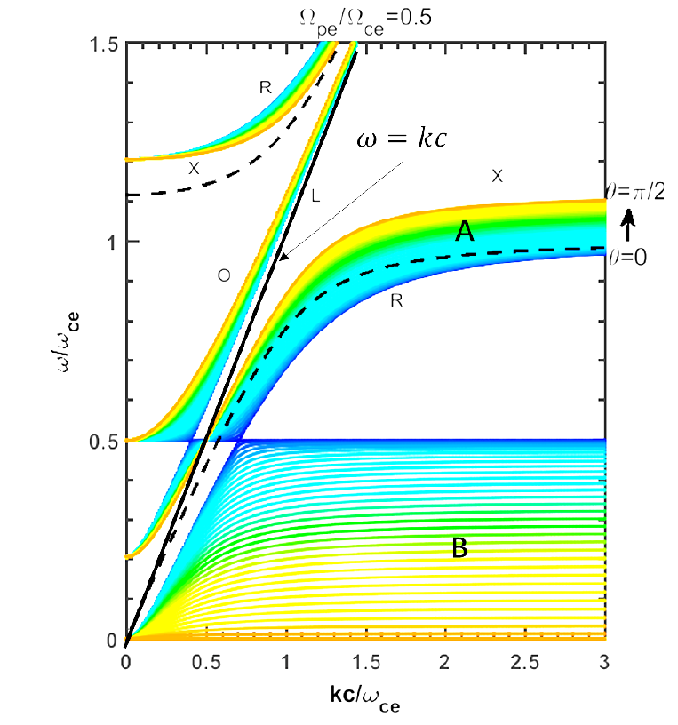

Slide 10
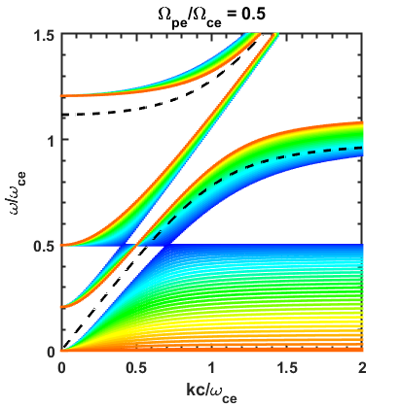
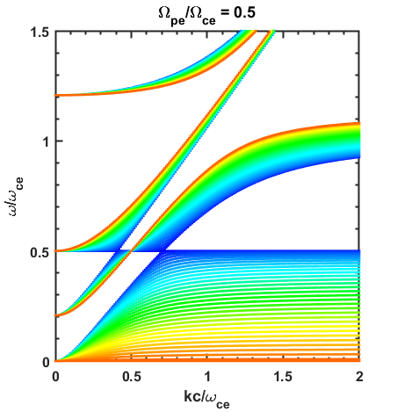








$ω_{pe}/ω_{ce}$ $=$ $0.5$
$ω_{pe}/ω_{ce}$ $=$ $0.5$
$ω_{pe}/ω_{ce}$ $=$ $0.5$
$ω_{pe}/ω_{ce}$ $=$ $0.5$
$ω_{pe}/ω_{ce}$ $=$ $0.5$
$$ω=kc$$
High Frequency Region
Low Frequency Region

Slide 11
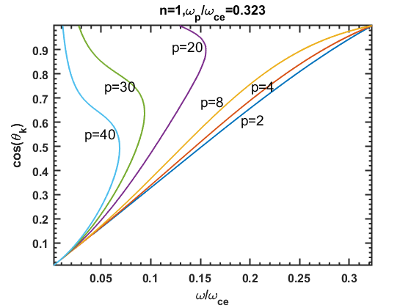

Slide 12
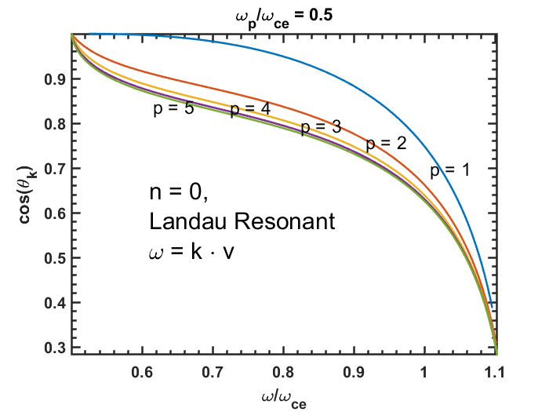
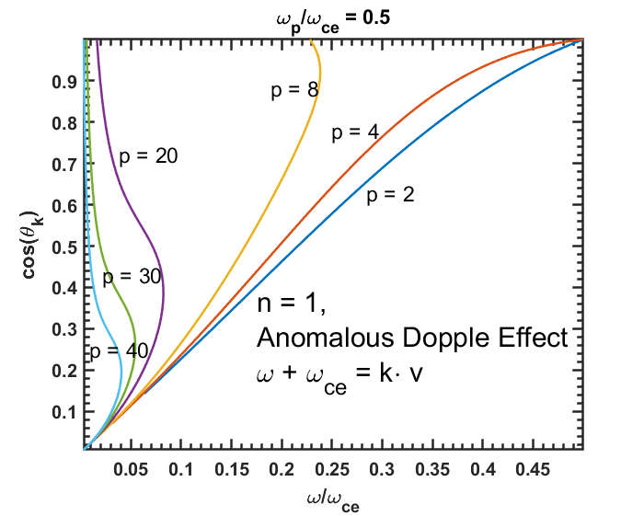
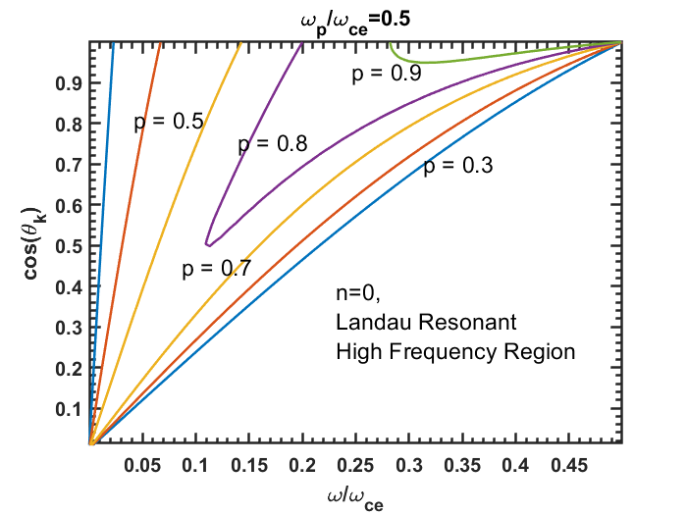
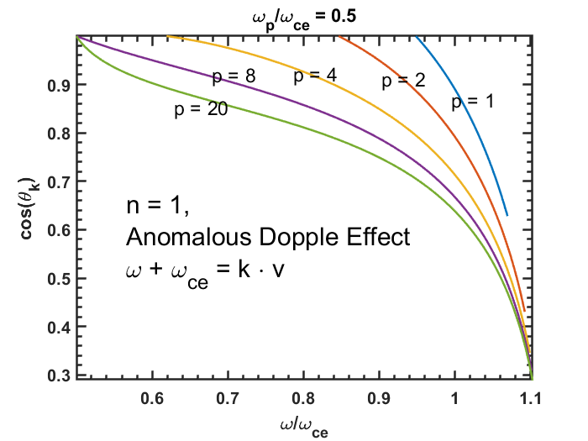

Slide 13
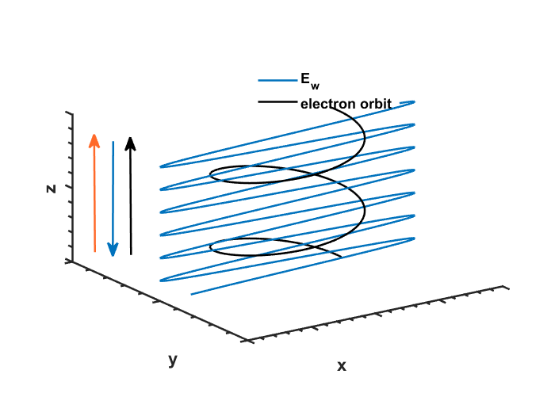
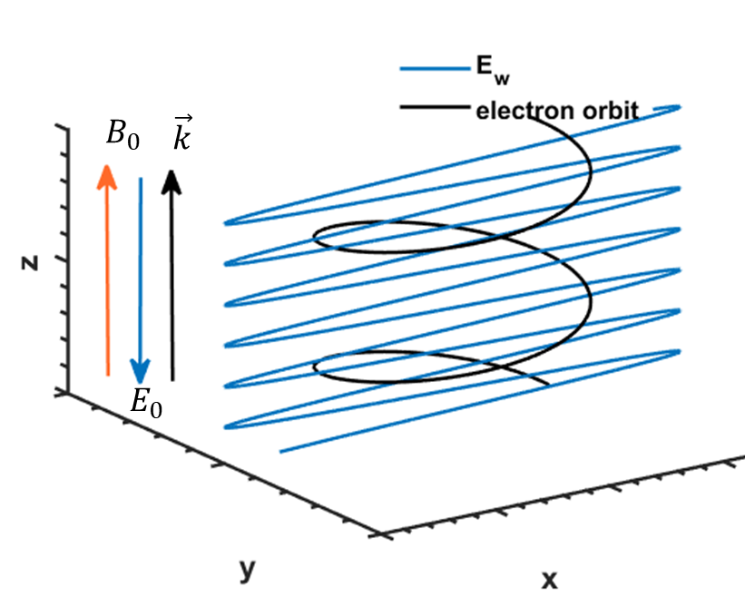



$$B_{0}$$
$$\vec{k}$$
$$E_{0}$$

