Slide 1
Back-end
Created by :
Riyamol Sara Jayan
Minnu Augustine

Slide 2
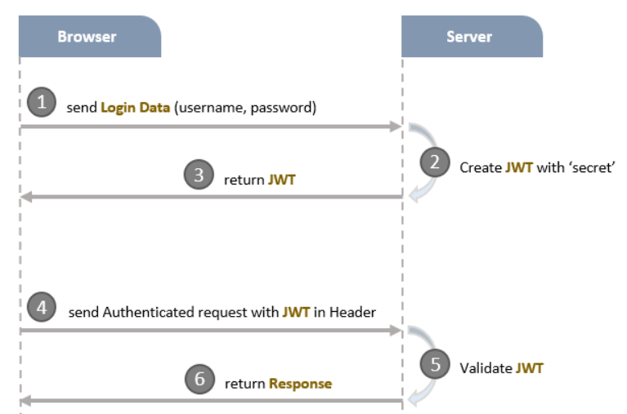
Token Based Authentication

Slide 3
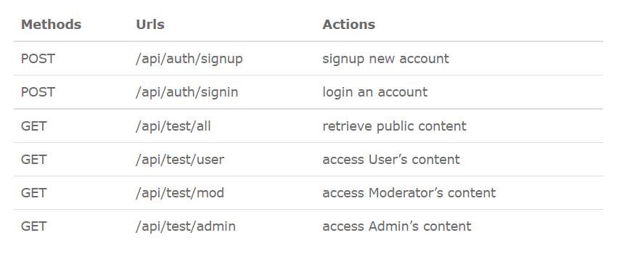
Node.js & MongoDB User Authentication
We will build a Node.js Express application in that:
User can signup new account, or login with username & password.
By role (admin, moderator, user), the User has access to protected resources or not
These are APIs that we need to provide:

Slide 4
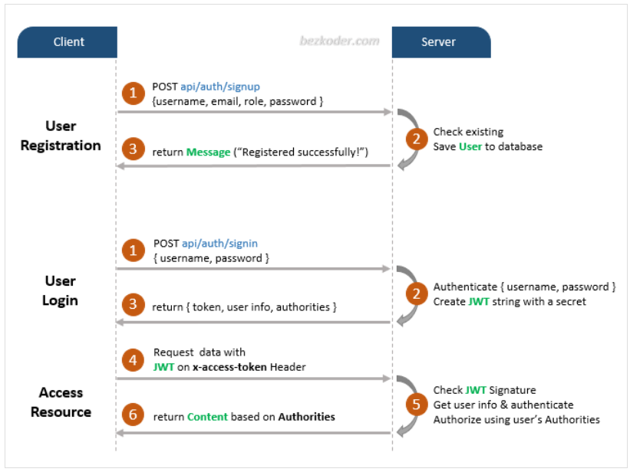
Flow for Signup & Login with JWT Authentication

Slide 5
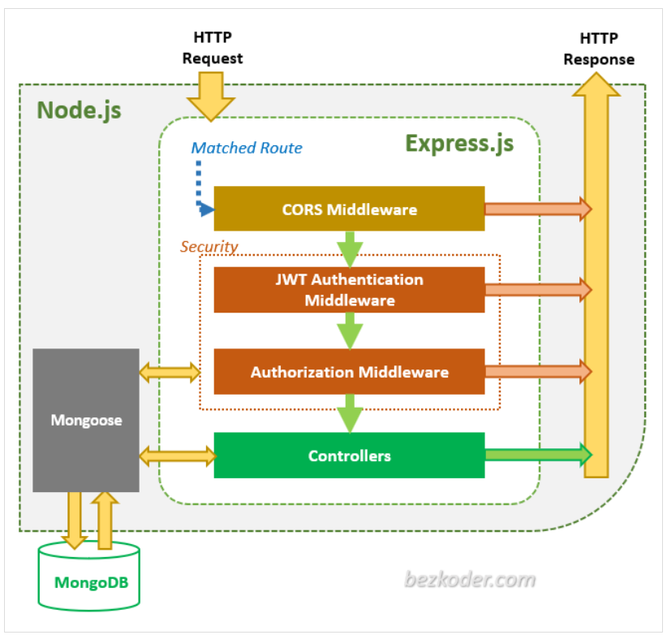
Node.js Express Architecture with Authentication & Authorization
Here is an overview of our Node.js Express App:

Slide 6
An overview of Express app
Via Express routes, HTTP request that matches a route will be checked by CORS Middleware before coming to Security layer.
Security layer includes:
JWT Authentication Middleware: verify SignUp, verify token
Authorization Middleware: check User’s roles with record in database
An error message will be sent as HTTP response to Client when the middlewares throw any error, .
Controllers interact with MongoDB Database via Mongoose library and send HTTP response (token, user information, data based on roles…) to Client.

Slide 7
Technology
Express 4.17.1
bcryptjs 2.4.3
jsonwebtoken 8.5.1
mongoose 5.9.1
MongoDB

Slide 8
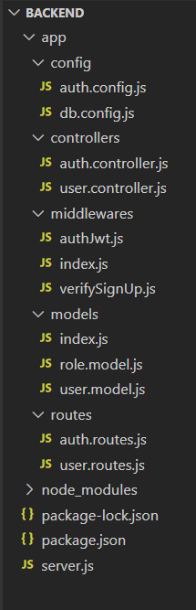
Project Structure
This is directory structure for our Node.js Express & MongoDB application:

Slide 9
Controller for Authentication
There are 2 main functions for Authentication:
- signup: create new User in database (role is user if not specifying role)
- signin:
find username of the request in database, if it exists
compare password with password in database using bcrypt, if it is correct
generate a token using jsonwebtoken
return user information & access Token

Slide 10
Defining Routes
When a client sends request for an endpoint using HTTP request (GET, POST, PUT, DELETE), we need to determine how the server will response by setting up the routes.
We can separate our routes into 2 part: for Authentication and for Authorization (accessing protected resources).
Authentication:
POST /api/auth/signup
POST /api/auth/signin

Slide 11
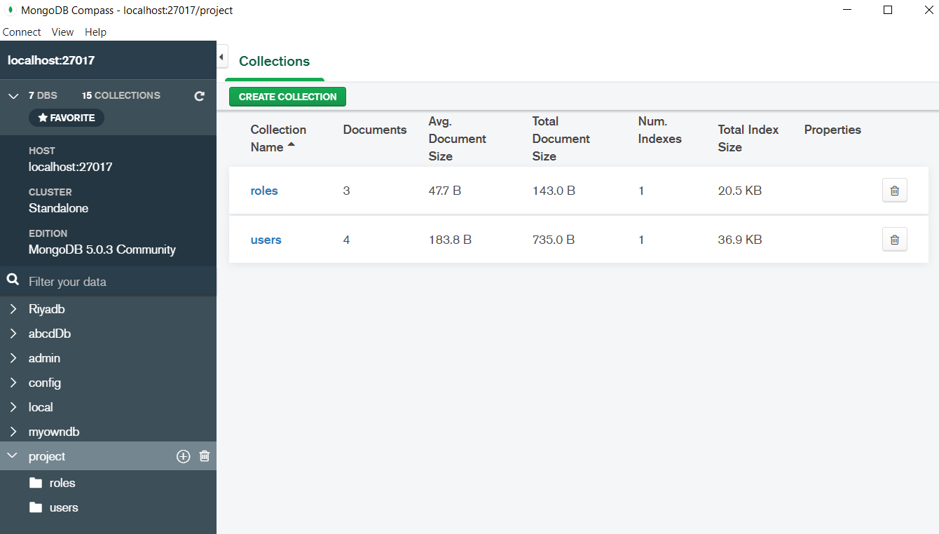
Mongo Db

Slide 12
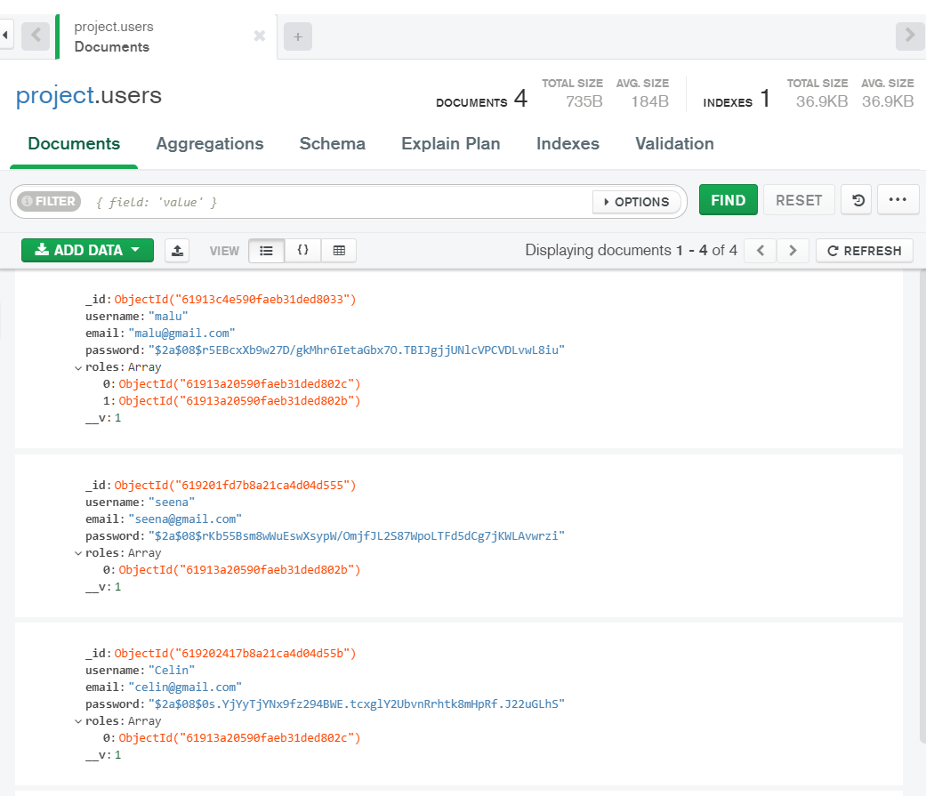
Users collection

Slide 13
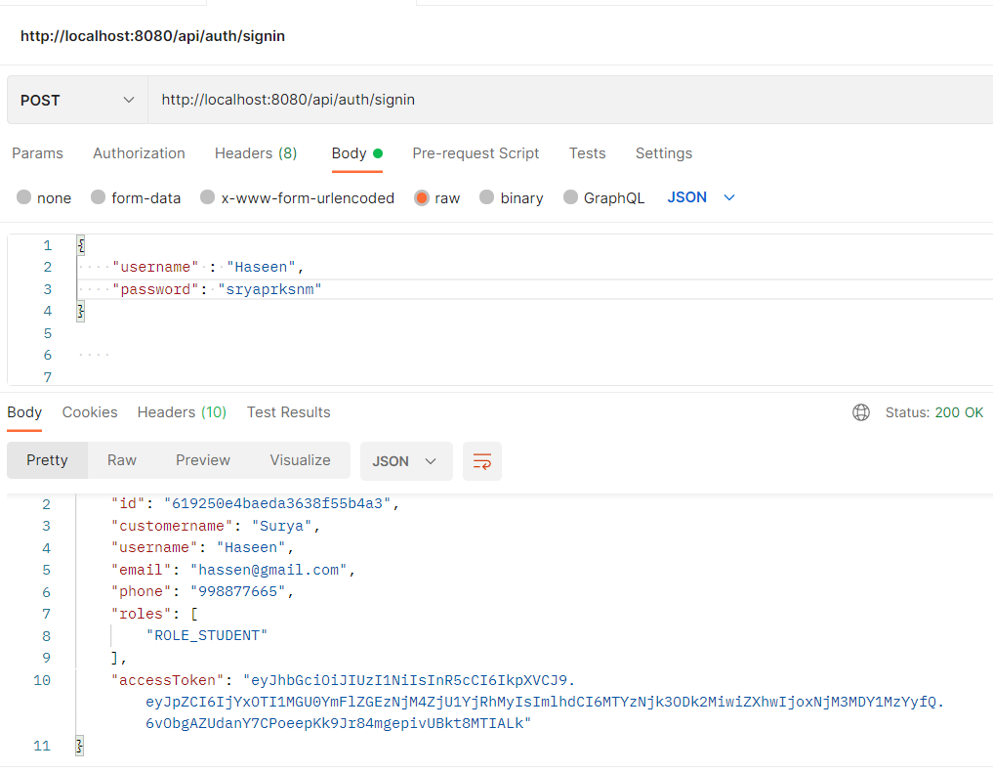

Slide 14
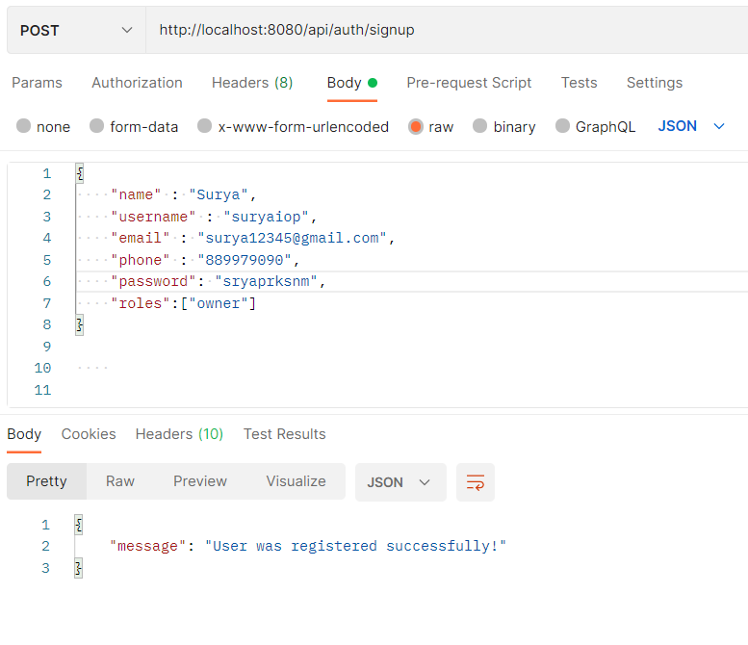

Slide 15
