Slide 1
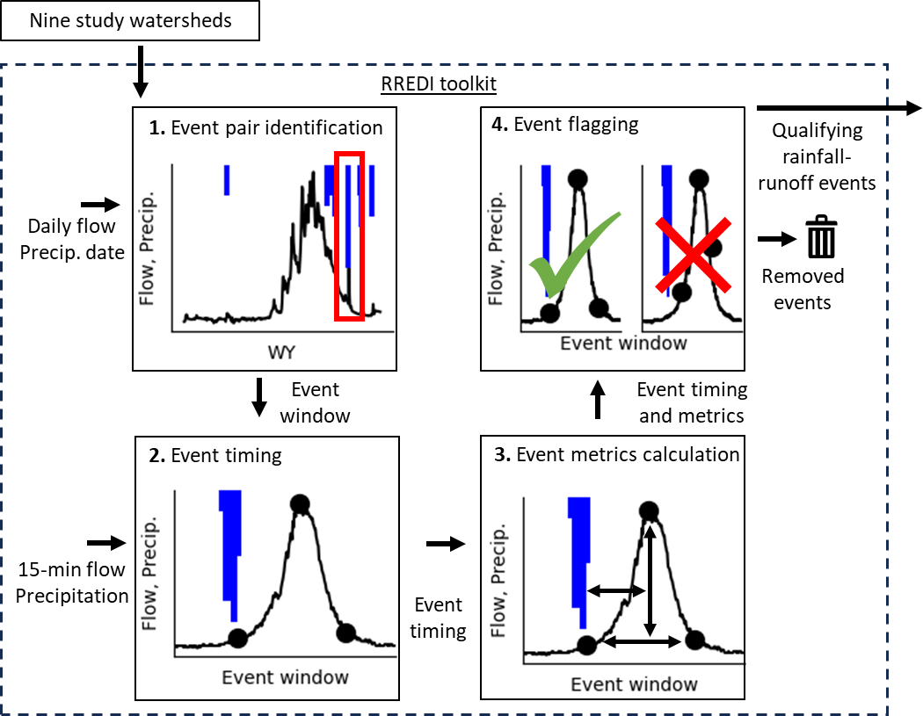
Study watershed
Adapted from Canham et al. (2025 ) Figure 2

Slide 2
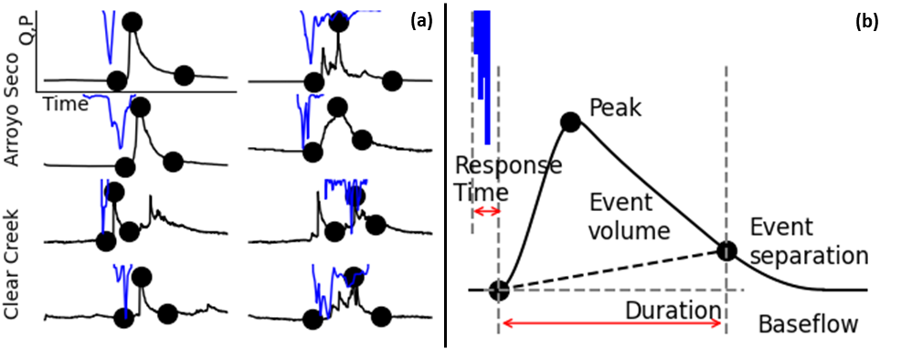
Adapted from Canham et al. (2025 ) Figure 3
Adapted from Canham et al. (2025 ) Figure 3

