Slide 1
McKesson NIST Tax Form Classification Competition June 29, 2018
Francis Gallego

Slide 2
Problem Statement

Slide 3

Problem Statement
Purpose: Given any of 5 possible tax form types from NIST, maximize performance in predicting which form the image is. The initial dataset contained 1,915 total forms:
1) ‘1040_1’: 540 forms (28.2%)
2) ‘1040_2’: 540 forms (28.2%)
3) ‘sch_a’: 288 forms (15.0%)
4) ‘sch_b:’ 333 forms (17.4%)
5) ‘sch_e’: 214 forms (11.2%)

Slide 4
Training Sample (70%)
1,345 Total Tax Forms in PNG format
1) ‘1040_1’: 426 total forms (31.7%) – 45 upside down
2) ‘1040_2’: 426 total forms (31.7%) – 45 upside down
3) ‘sch_a’: 174 total forms (12.9%) – 30 upside down
4) ‘sch_b’: 219 total forms (16.3%) – 24 upside down
5) ‘sch_e’: 100 total forms (7.4%) – 15 upside down
Original Image Size: 3330 x 2560 pixels

Slide 5
Testing Sample (30%)
570 Total Tax Forms in PNG format
1) ‘1040_1’: 114 total (20.0%) – 11 upside down
2) ‘1040_2’: 114 total (20.0%) – 11 upside down
3) ‘sch_a’: 114 total (20.0%) – 11 upside down
4) ‘sch_b’: 114 total (20.0%) – 11 upside down
5) ‘sch_e’: 114 total (20.0%) – 11 upside down
Original Image Size: 3330 x 2560 pixels

Slide 6
Classification Approach

Slide 7
Pre-Processing Images
Resizing and Flattening
Why Resize?
Each image was originally 3330 x 2560 (= 8,524,800 total pixels) to begin with
Processing Capacity – computer crashing
Each image reduced to 165 x 128 pixels (=21,120 total pixels)
Eliminates the need for Principal Component Analysis when we flatten
Why flatten?
Each image becomes a 1 x 21120 row that is put into a matrix
For further analysis, we can think of each of the 21120 columns as pixel color values that would be put into a machine learning algorithm

Slide 8
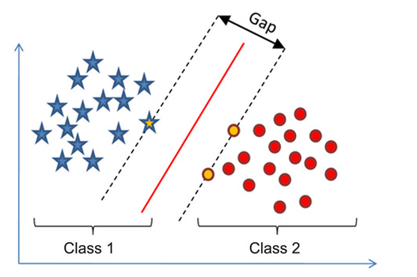
SVM – Support Vector Machines – Binary Classifier
SVM Models aim to divide 2 categories by a clear gap that is wide as possible
Gap is known as a hyperplane in SVM
Applicable to any n number of dimensions
Optimal Parameters found using GridSearch
Main Tuning Parameters –
Cost: extent to which misclassifications are penalized in the cost function
Low C : wider ‘cushion’ : may not handle data nuances
High C : narrower ‘cushion’ : may overfit
Gamma: controls shape of peaks
Note: Gamma only for nonlinear SVM
Larger Gamma means support vector has larger influence on classification of the positive class
Smaller Gamma may not capture complexity

Slide 9
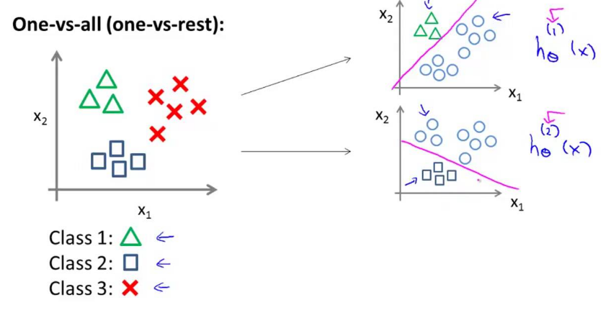
Linear Multiclass SVM – One vs All (for 3+ Classes)
Used for Classifying NIST Tax forms – 5 different types
C = 1.0, no Gamma term since linear
N = 5 different classes
One vs. All trains one classifier per class in N total classifier
i.e. in the first round we train for 1040_1 vs the rest, then 1040_2 vs the rest and so on
One against all SVMs requires unanimity across all SVMs
A point is classified under a certain class (tax form) if the class’s SVM accepted it and all other classes’ SVMs rejected it. Otherwise classified to best fit
Ex: One vs All with 3 Classes

Slide 10
Results

Slide 11
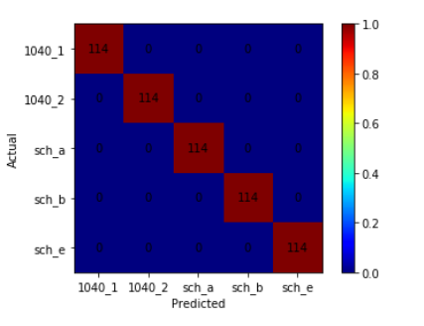
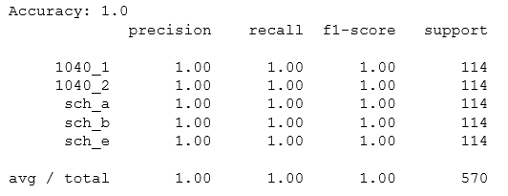
Classification Results
Overall and By Form
We got perfect results!
Was there something wrong?
Same Results with C = 0.1 and C = 10
Time to crash the problem
Each of the testing points were classified correctly to their 5 respective classes

Slide 12
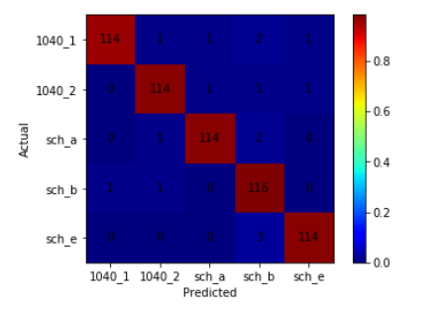
Try to Crash Perfection
Add 18 obvious black and white non-tax forms with labels same as my original test set
5 different fake ‘1040_1’
3 different fake ‘1040_2’
3 different fake ‘sch_a’
4 different fake ‘sch_b’
3 different fake ‘sch_e’
Other than 2 out of 5 fake ‘sch_b’, the rest were misclassified as desired
Notice non-zero numbers outside red diagonal
Real Deal!?!?!

Slide 13
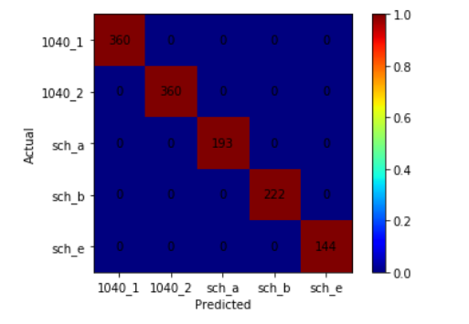
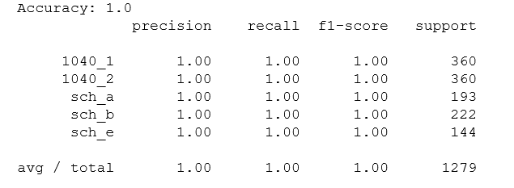
Results on Anandhi’s Test Set
New Test Sample -- 1,279 total forms
‘1040_1’ : 360 copies (28.1%)
‘1040_2’ : 360 copies (28.1%)
‘sch_a’ : 193 copies (15.1%)
‘sch_b’ : 222 copies (17.4%)
‘sch_e’ : 144 copies (11.3%)
Yes, this is the real deal!!!

Slide 14
Post-Classification Analysis and Lessons Learned
Possible Explanations for Great Results –
Each of the 5 form types may be completely distinct form one another when flattened
Further mDNA applications –
SRF Forms?
Lessons Learned:
Pytesseract and Word Matching: Poor performance due to blurriness throughout different words on the forms – couldn’t read words
Be more memory efficient!

