Slide 1
React
Promise & Routing

Slide 2
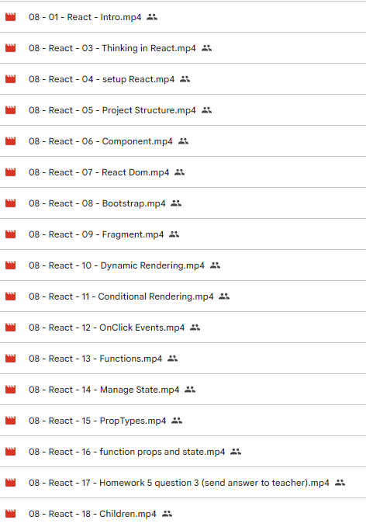
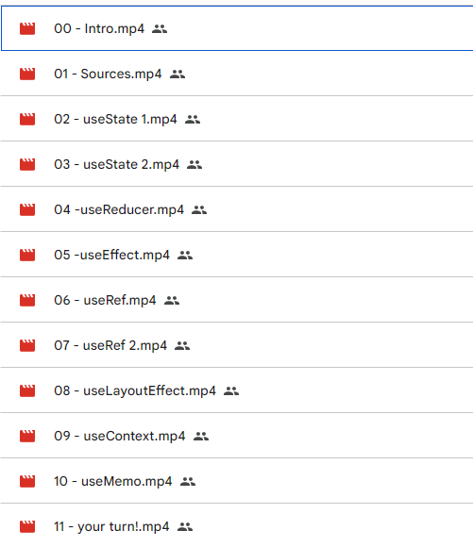
Questions

Slide 3
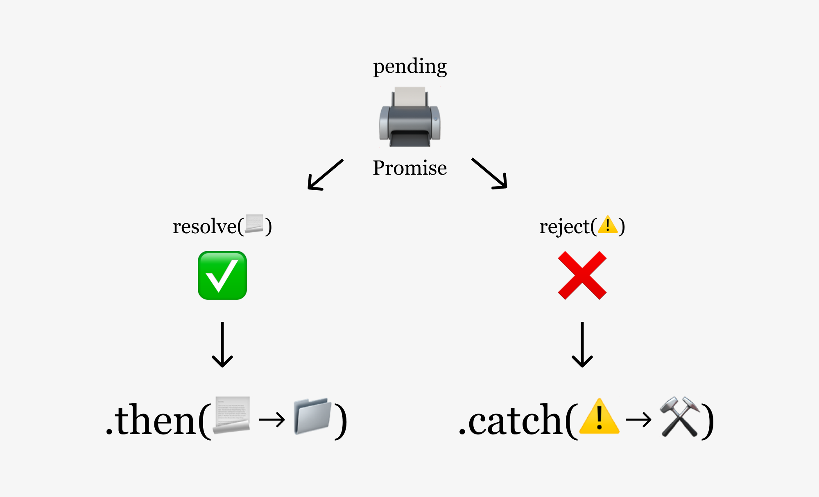
Promises

Slide 4
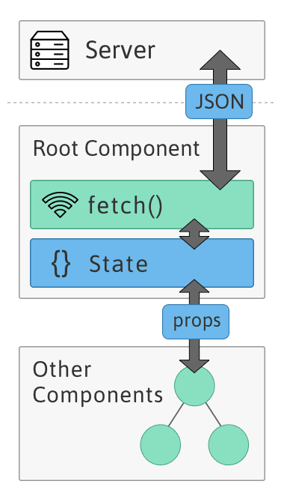
Ajax

Slide 5
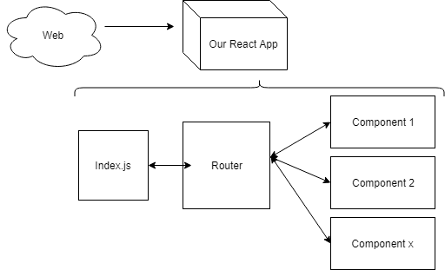
React Routing
Home v6.15.0 | React Router

Slide 6
