Slide 1

React
introduction

Slide 2
What you should know
HTML
CSS
JavaScript

Slide 3

What is React?

Slide 4
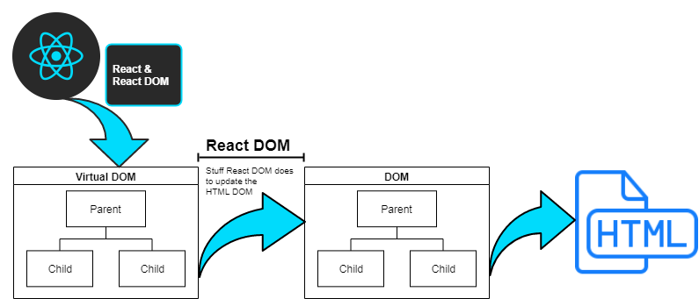
React

Slide 5

Thinking in React

Slide 6
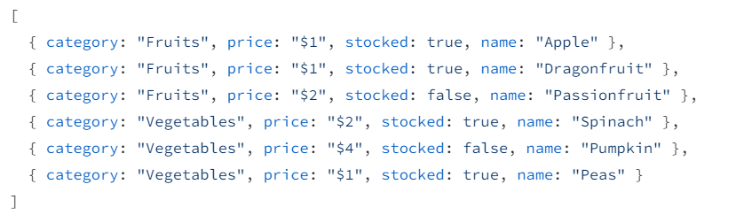
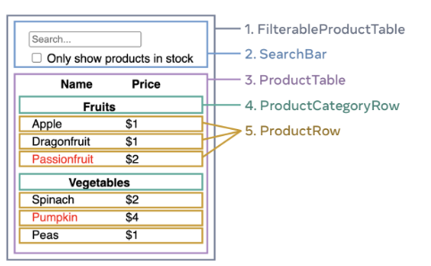
Example
Start with the mockup
5 gold steps in React

Slide 7
Setup React
Official: Create React App (CRA)
Faster: Vite

Slide 8
What happened
Virtual DOM
DOM
App
div
div
MessageHi
h1
h1

Slide 9
Good luck!

