Slide 1

Hypertextmarkuplanguage
HTML!

Slide 2

Danger!

Slide 3
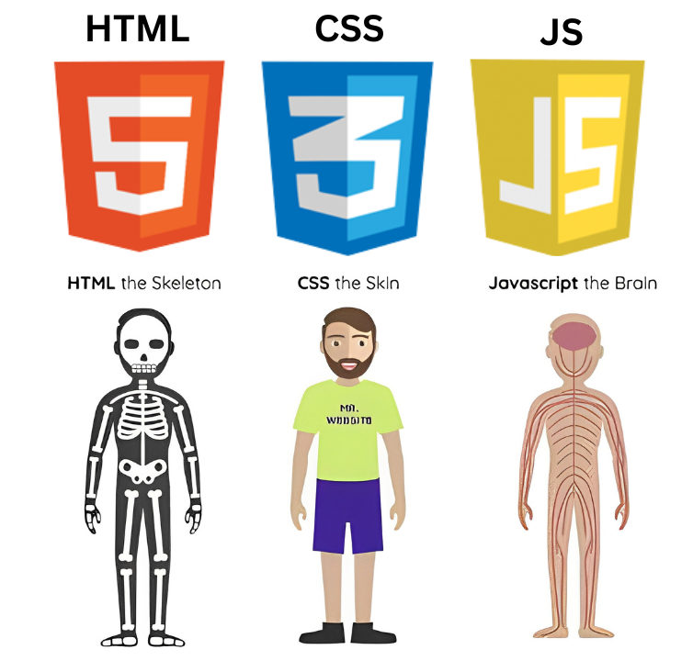
Html, css, js

Slide 4

Js frameworks

Slide 5
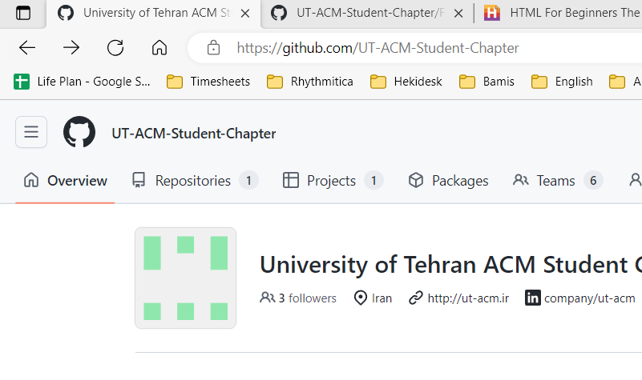
URL
Uniform Resource Locator

Slide 6
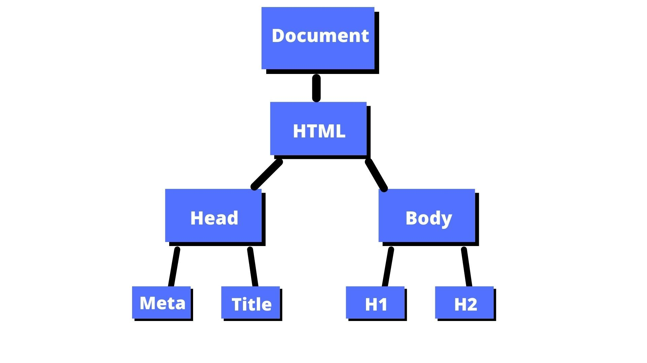
DOM

Slide 7
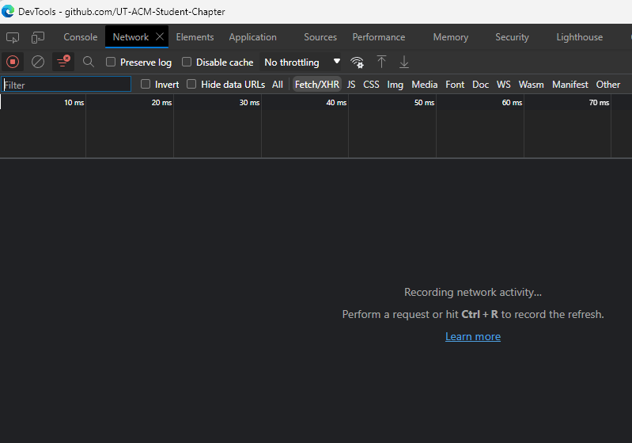
Dev tool in the browser

Slide 8


Before we start…

Slide 9
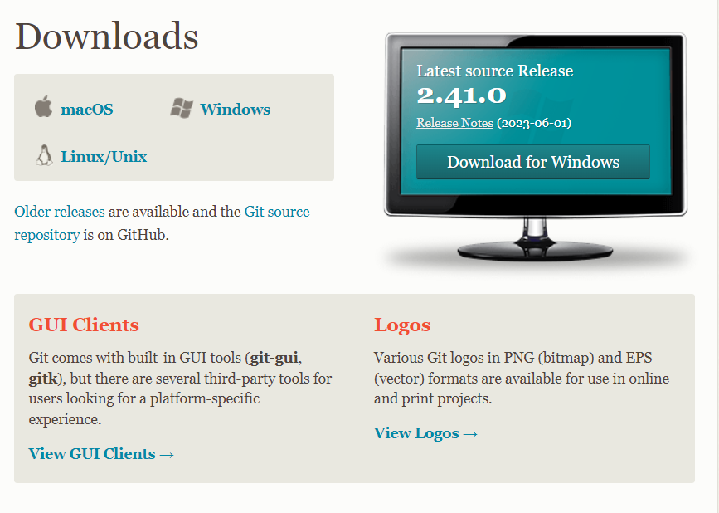
Install git
Git - Downloads (git-scm.com)

Slide 10
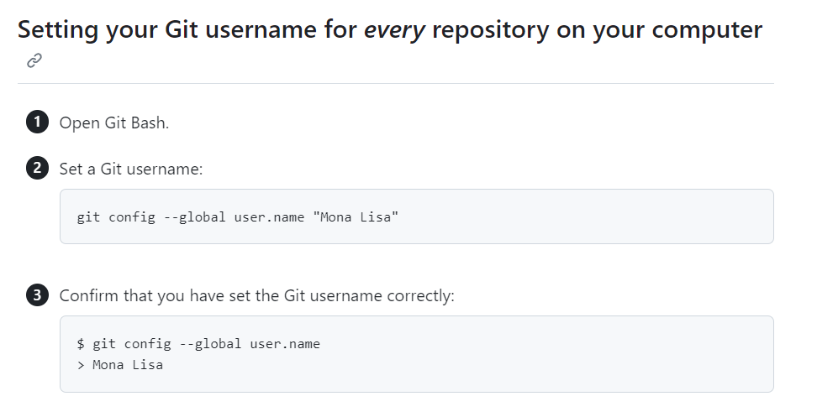
SETUP git
Setting your username in Git - GitHub Docs

Slide 11
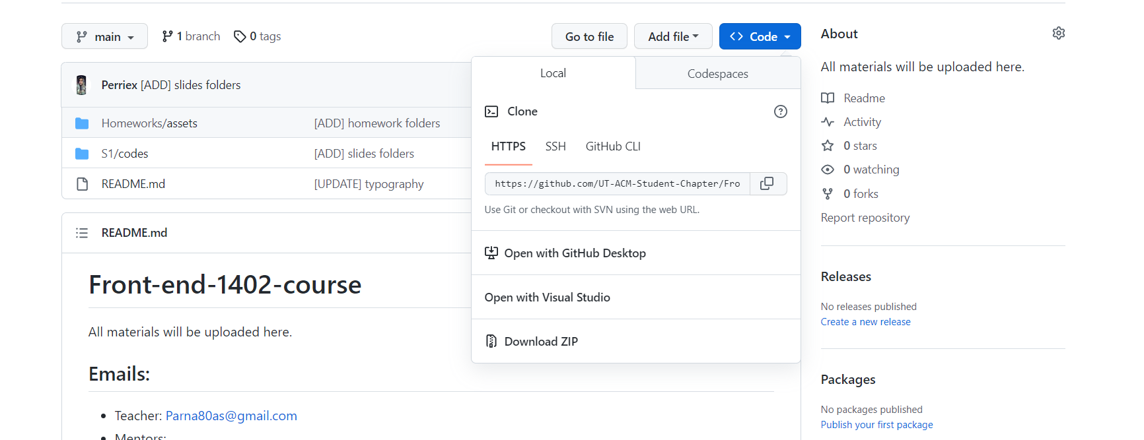
Clone your first repository!

Slide 12
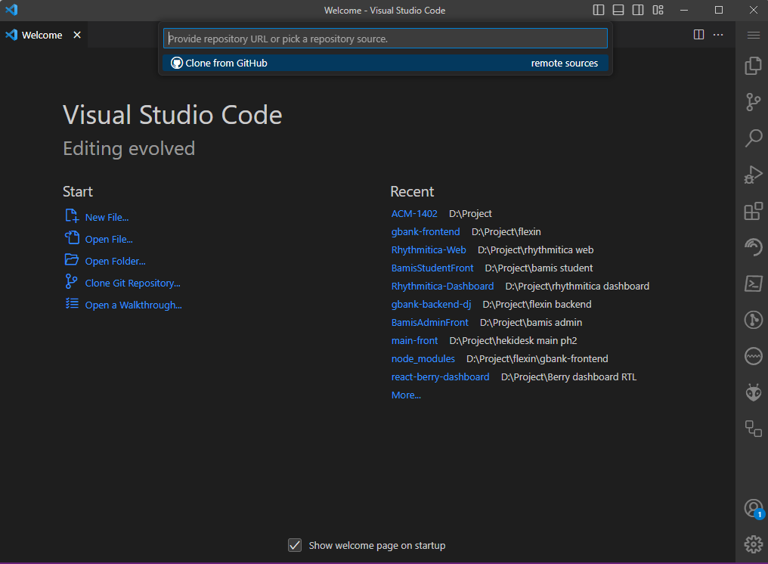
Open your vs code

Slide 13
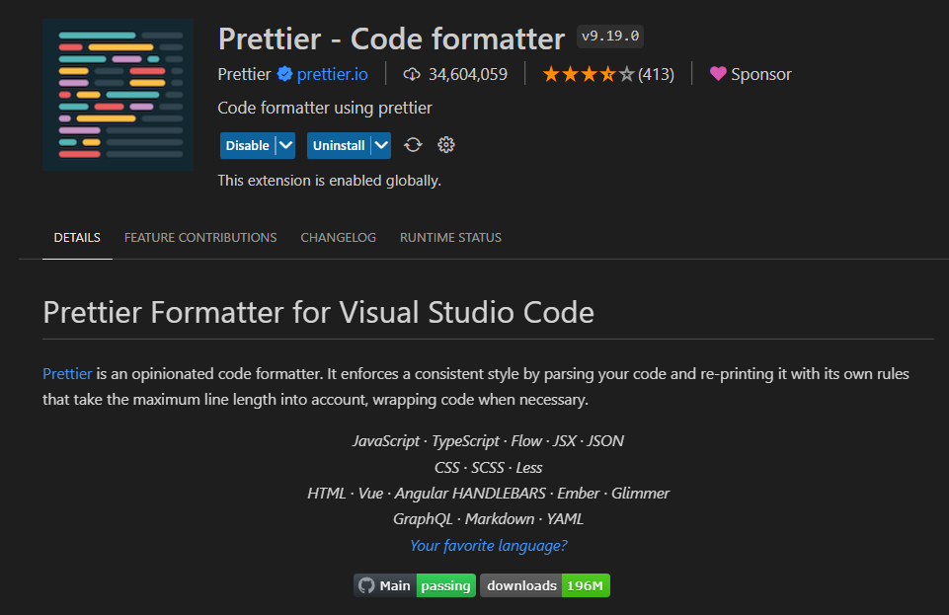
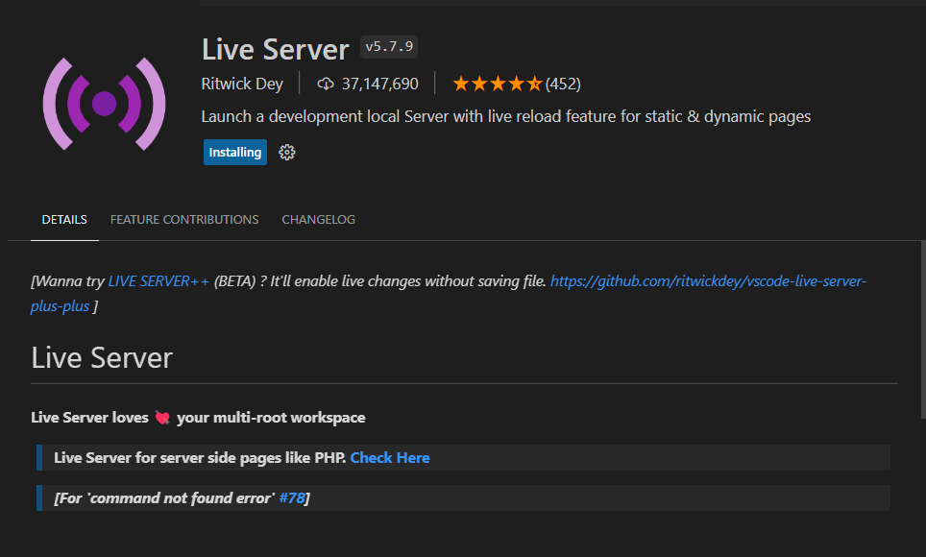
Prettier and live server

Slide 14
HTML
introduction

Slide 15

Let’s start!
HTML For Beginners The Easy Way: Start Learning HTML & CSS Today »

Slide 16
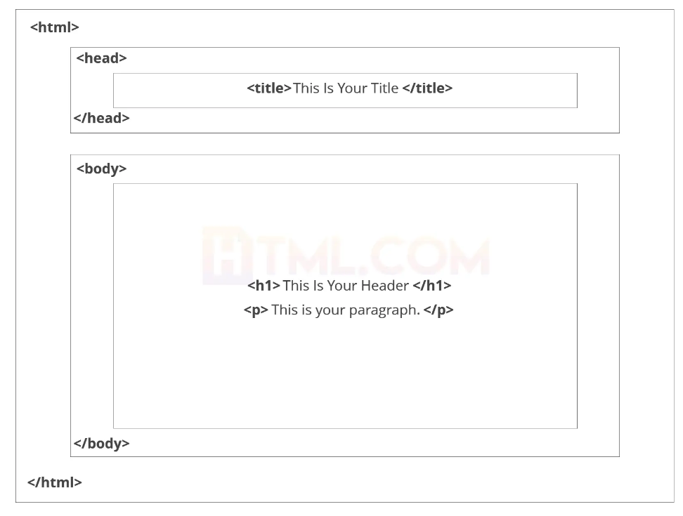
HTML

Slide 17
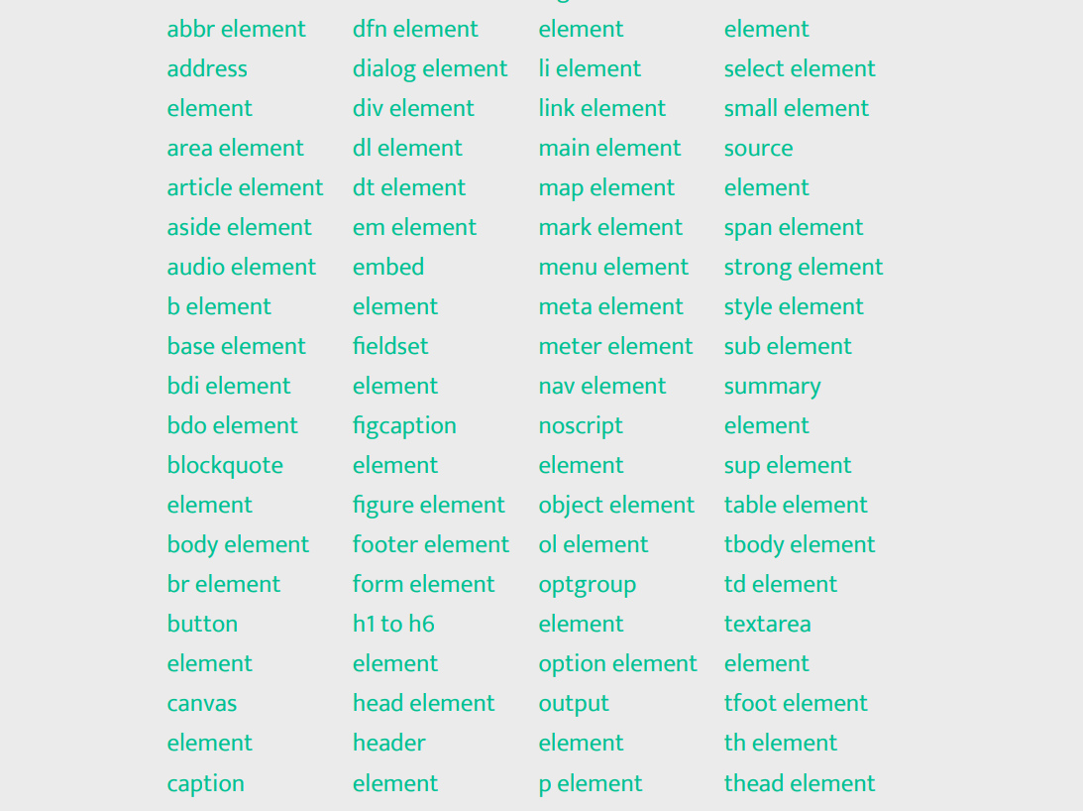
Tags

Slide 18
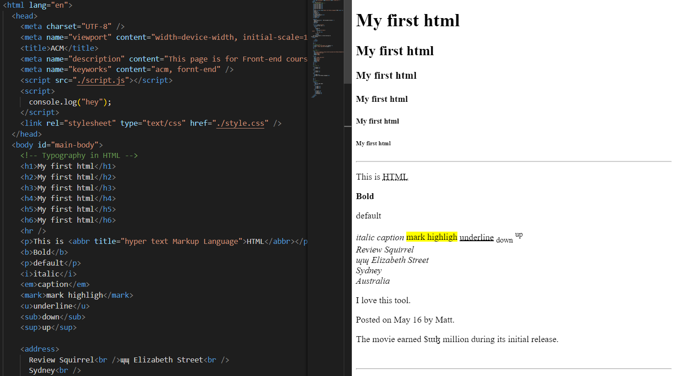
Example and explain

Slide 19
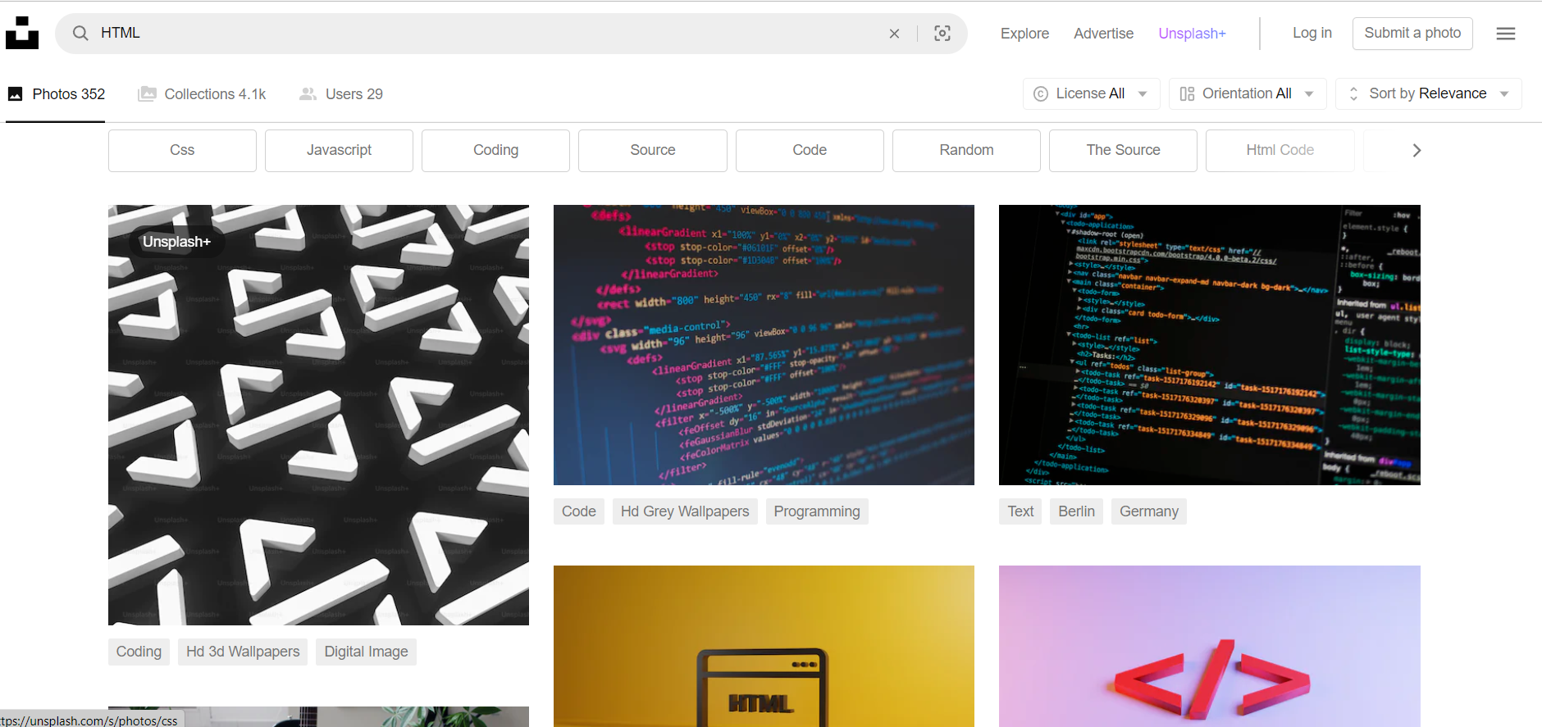
Images!
Beautiful Free Images & Pictures | Unsplash

Slide 20
<DIV>How do you annoy a web developer?</SPAN>

