Slide 1

HTML
Useful example!

Slide 2

Notes!

Slide 3

QA

Slide 4
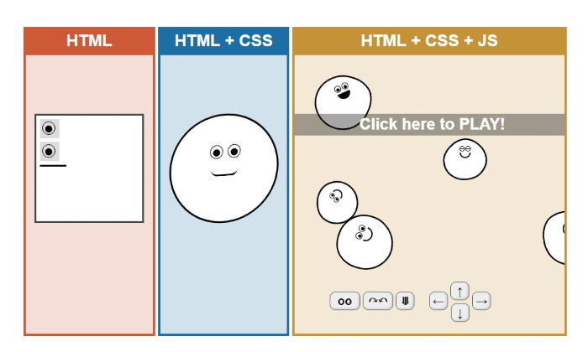
Where we are.
Square Head!

Slide 5
What is semantic markup?
Let’s discuss it!

Slide 6
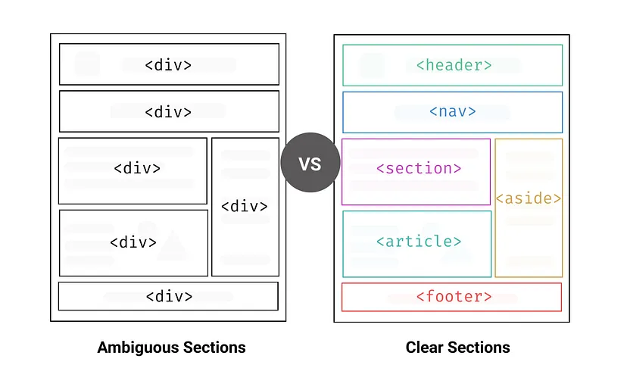
Clear Sections
Semantic tags
What Is Semantic Markup and Why You Should Use It | by Sumudu Siriwardana | CodeX | Medium

Slide 7
Instead of Div!
<header>
<nav>
<main>
<article>
<section>
<aside>
<footer>

Slide 8

Why should we use them?

Slide 9
Why use semantic markup?
Accessibility
Search Engine Optimization
Maintainability

Slide 10
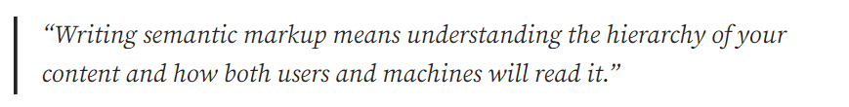
Overall,

Slide 11
Enough!
Let’s code!

Slide 12
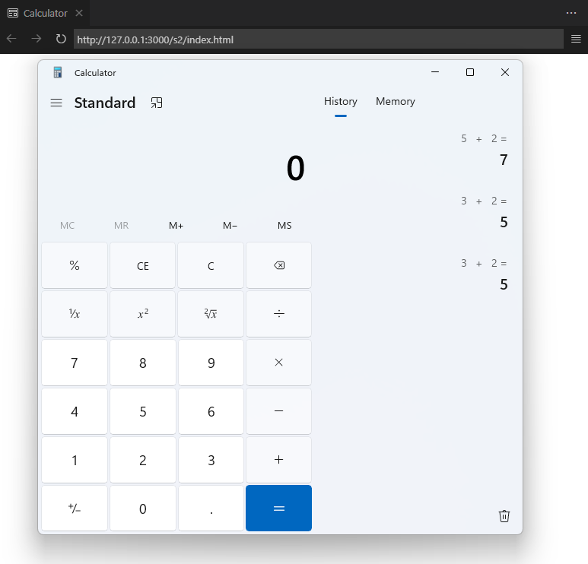
Calculator

Slide 13
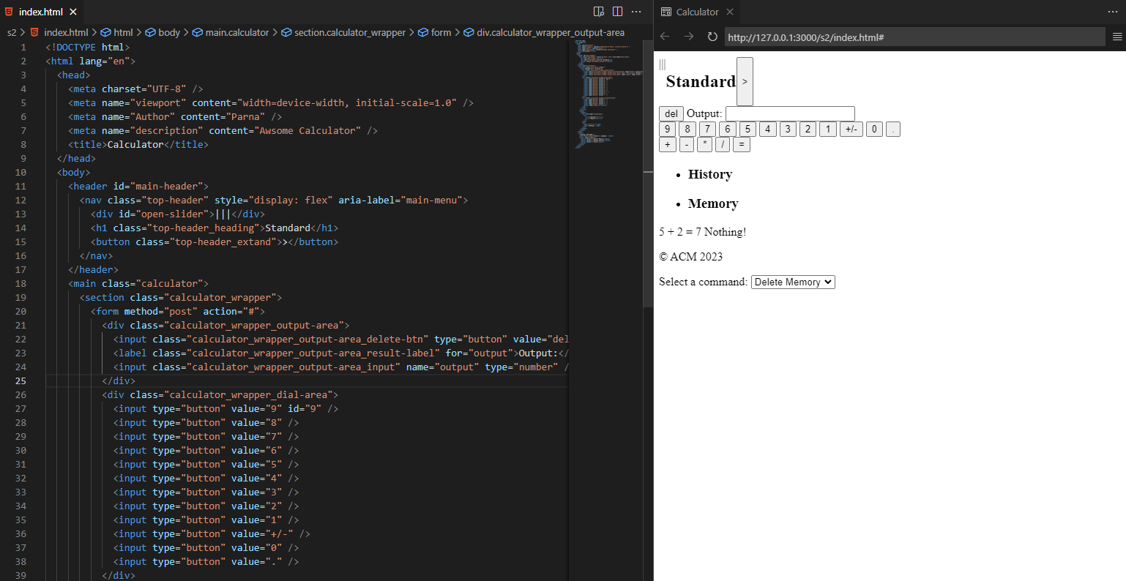
What we did.

Slide 14
Practice
Create project branch in your repo.
Add the code to your branch
Complete the code

Slide 15
