Slide 1

Hypertextmarkuplanguage
HTML!

Slide 2

Before we start…

Slide 3
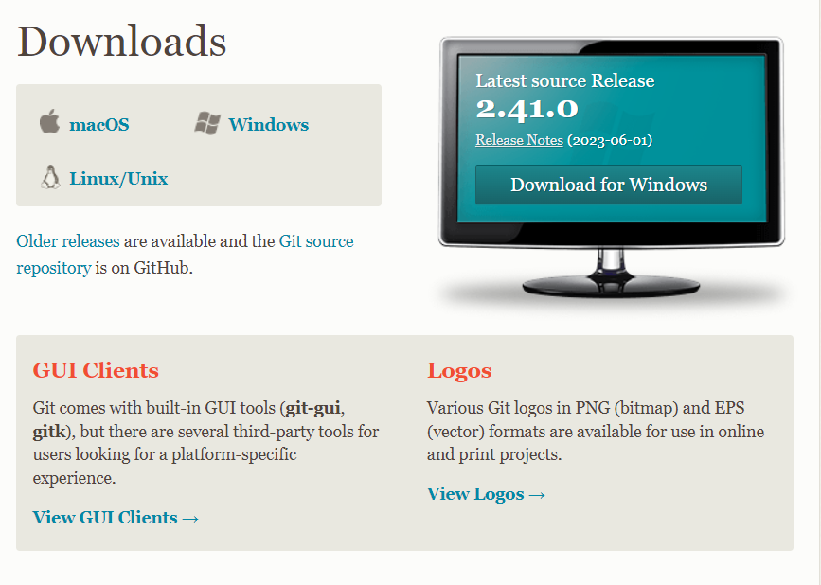
Install git
Git - Downloads (git-scm.com)

Slide 4
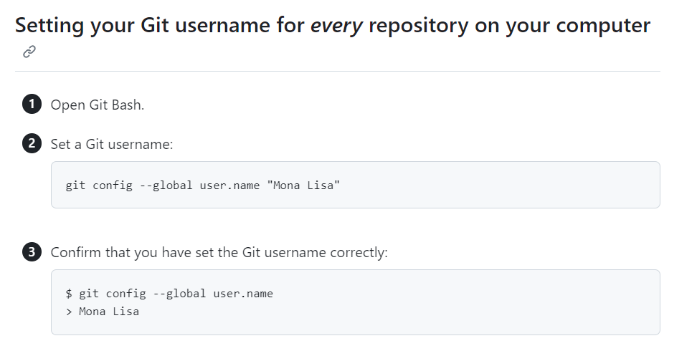
SETUP git
Setting your username in Git - GitHub Docs

Slide 5
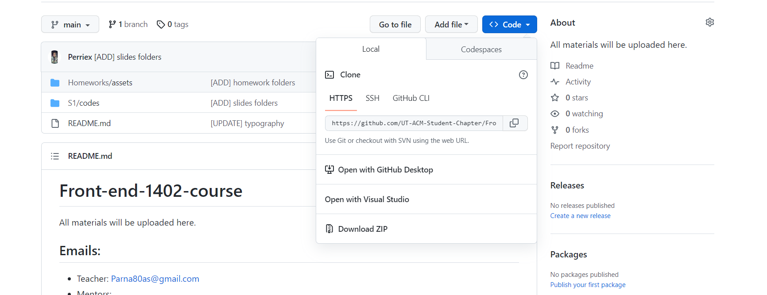
Clone your first repository!

Slide 6
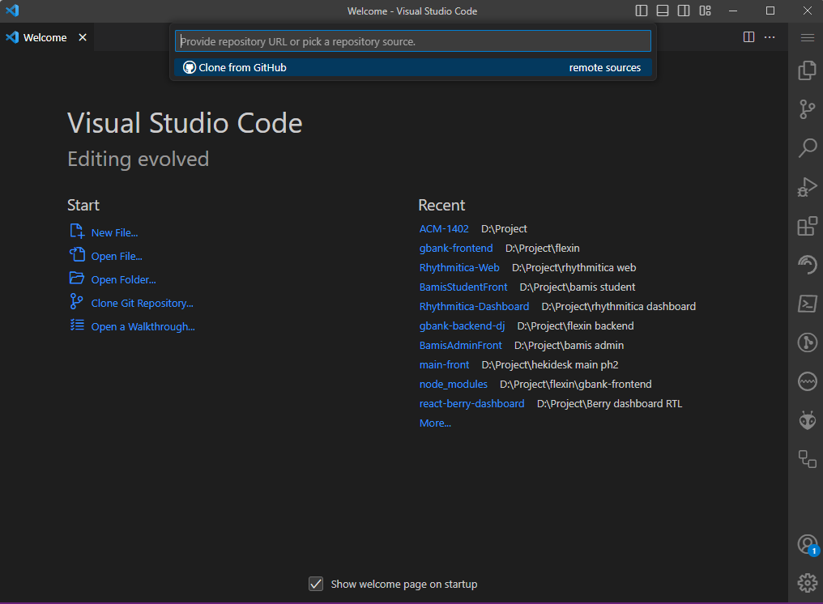
Open your vs code

Slide 7
HTML
introduction

Slide 8

Let’s start!
HTML For Beginners The Easy Way: Start Learning HTML & CSS Today »

Slide 9
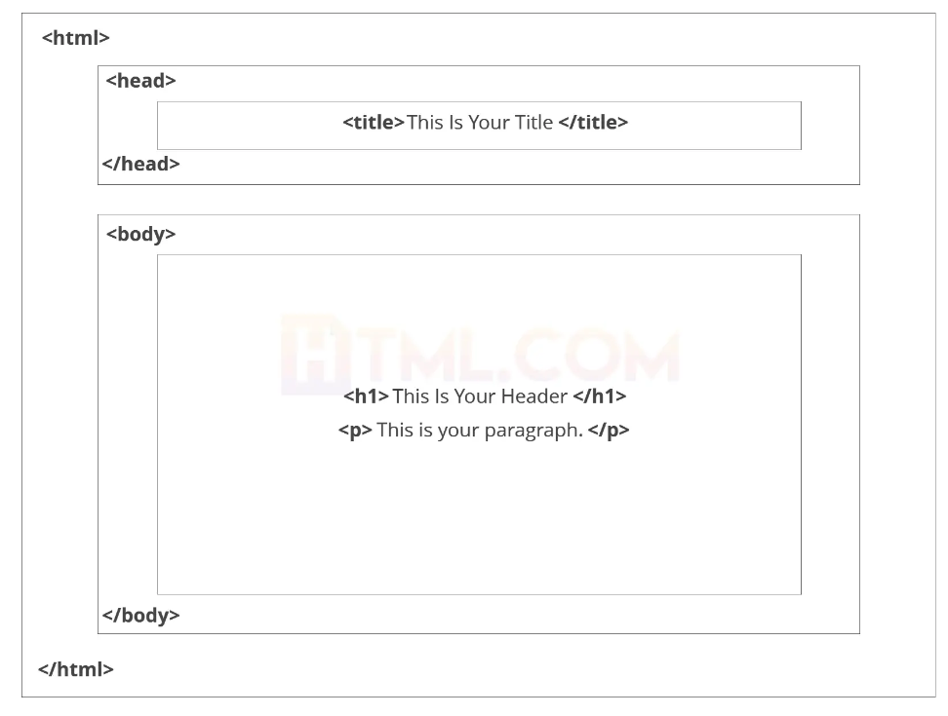
HTML

Slide 10
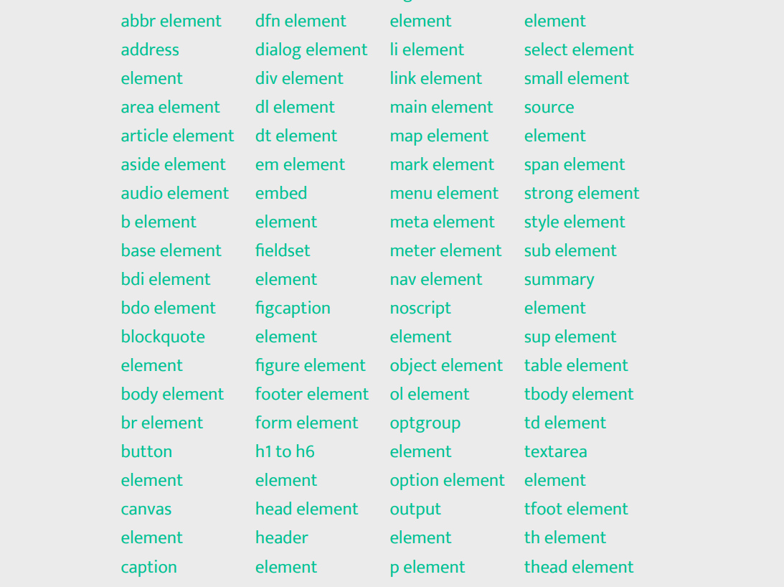
Tags

Slide 11
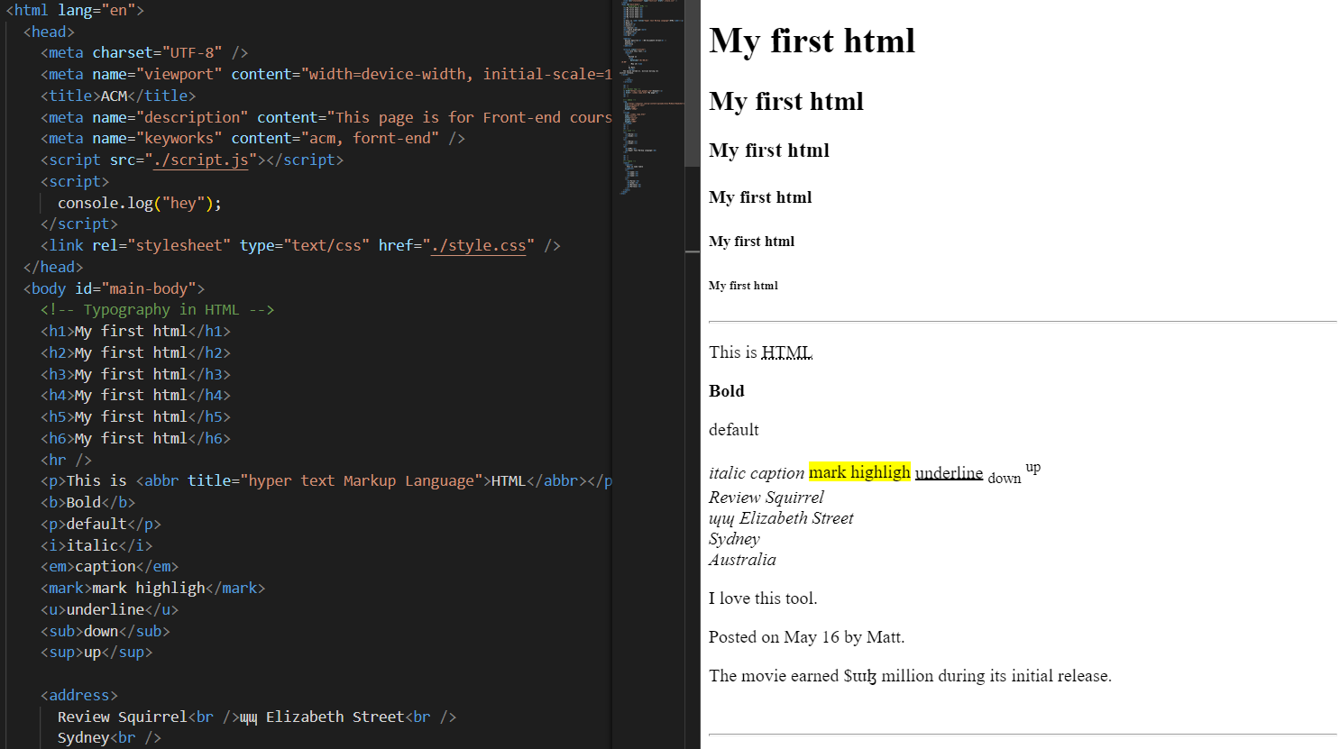
Example and explain

Slide 12
<DIV>How do you annoy a web developer?</SPAN>

