Slide 1

git
& github

Slide 2
Git
What is Git?
Where can we use git?
Who to install?
How to learn config?(or any command)
Is it github?
How to use git?

Slide 3
Git Structure
Working directory
Index (stage)
Head
Repository (github)
You
Others
How to copy from remove repository?
git pull
git add
git commit
If used git init
git remote add origin https_url
git push

Slide 4
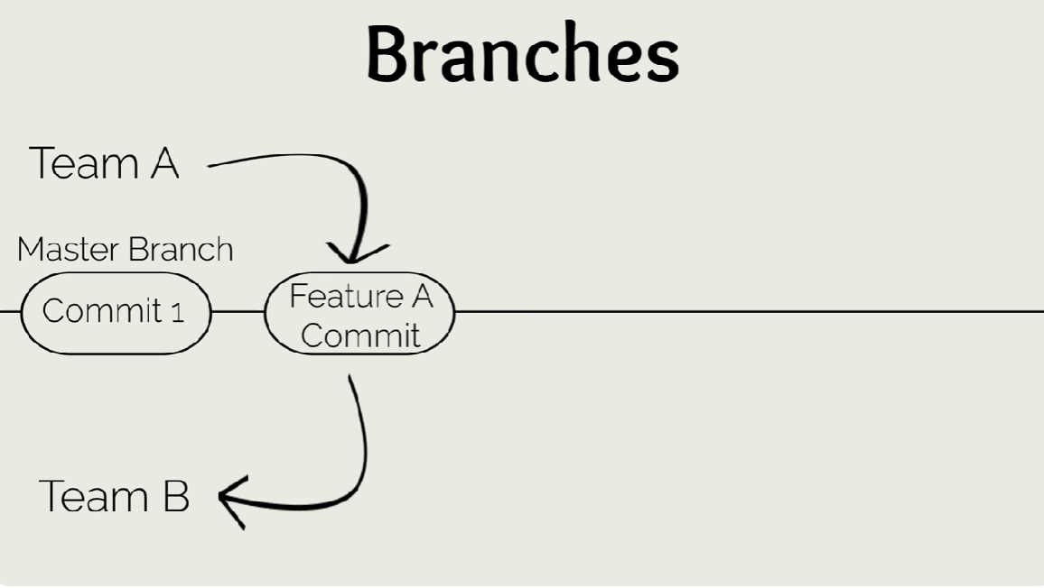
Git branches

Slide 5
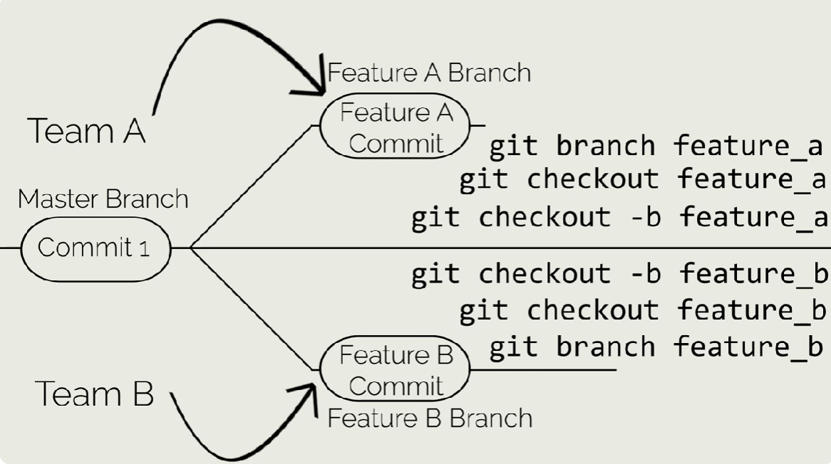
Git branches

Slide 6
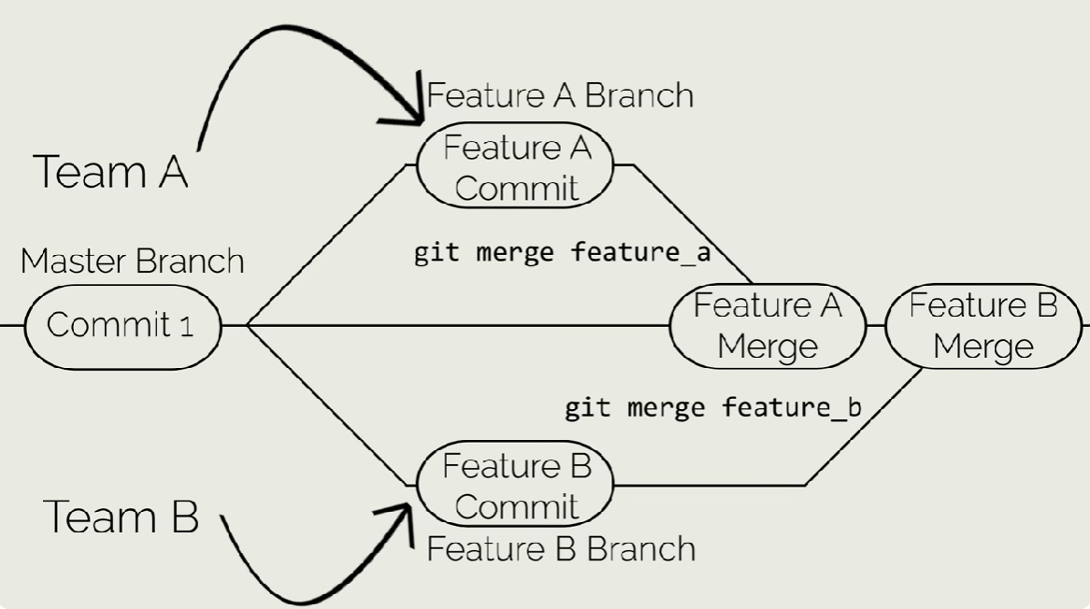
Git branches

