Slide 1
CSS
How to code in CSS?

Slide 2

CSS
“Cascading Style Sheets”
… is a styling language!
In spite of HTML.
Used for presentation.
You can implement thing in different ways.

Slide 3
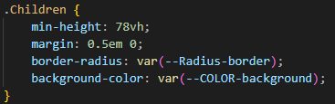
Syntax
Selector
Property
value

Slide 4
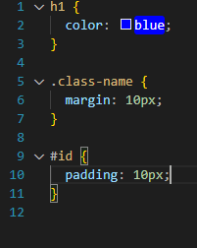




Selectors
Elements in HTML
Class name
ID
Combination

Slide 5
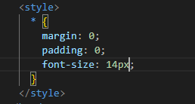

Load CSS
Why is it horrible to use these options?
Inline style
Style element
CSS file

Slide 6


Slide 7
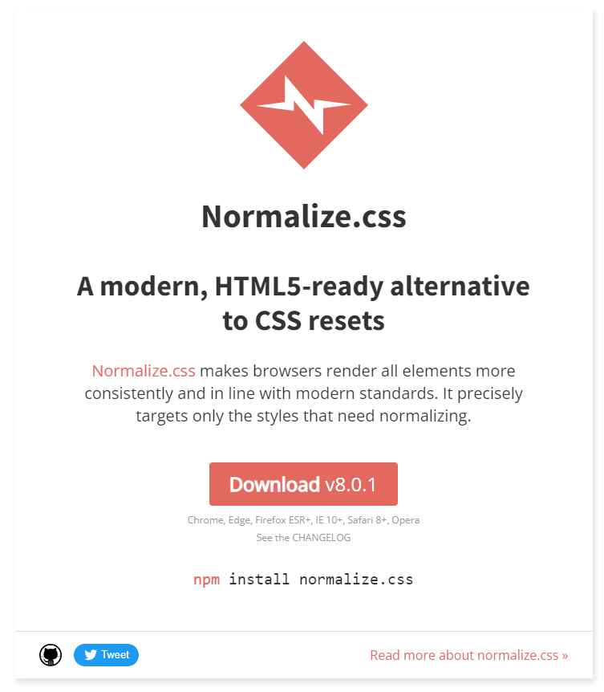
Normalize css
Normalize.css: Make browsers render all elements more consistently. (necolas.github.io)

Slide 8
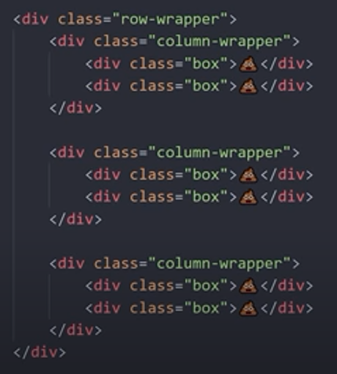
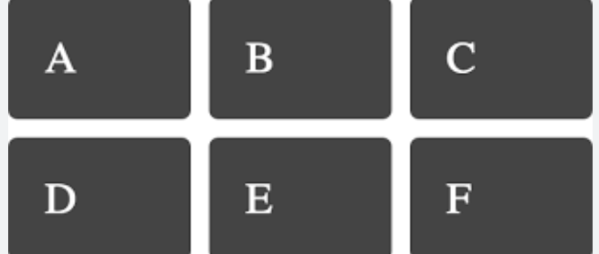
Flex is not good for multiple items ☹
https://youtu.be/Qhaz36TZG5Y?si=1mWdJ17n-yA1v83W

Slide 9
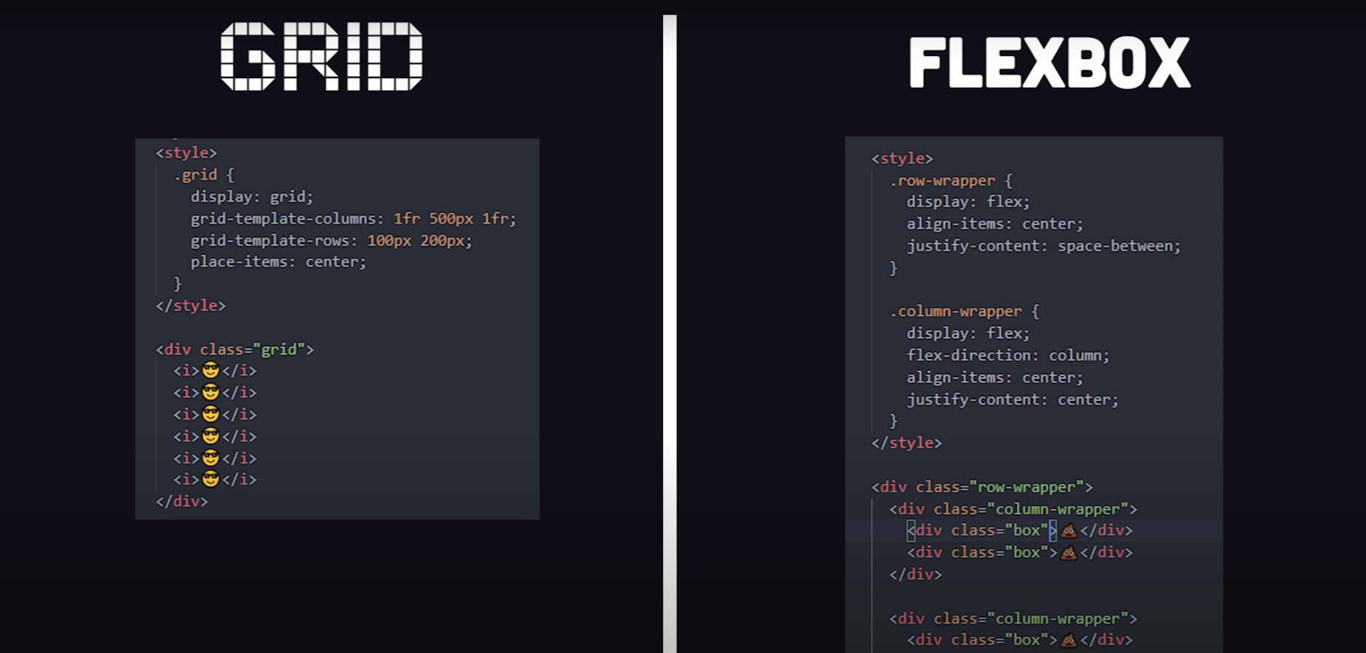
Grid to the rescue!

Slide 10
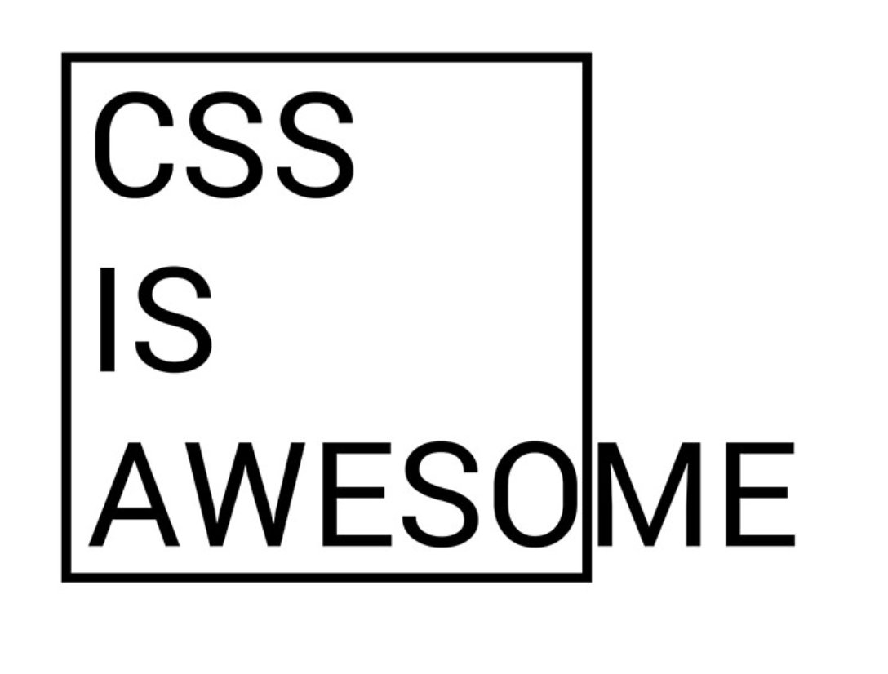
Infinity…
Learn more, then you know less!

Slide 11
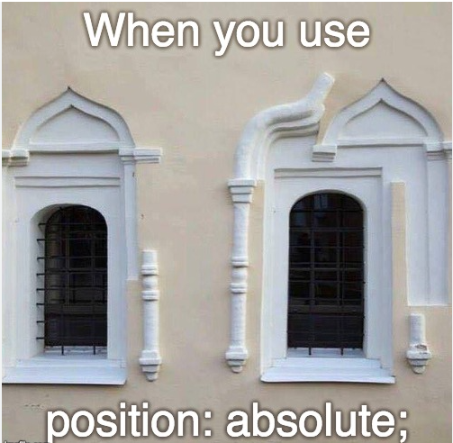
Next session: examples!

Slide 12

Q?

