Slide 1
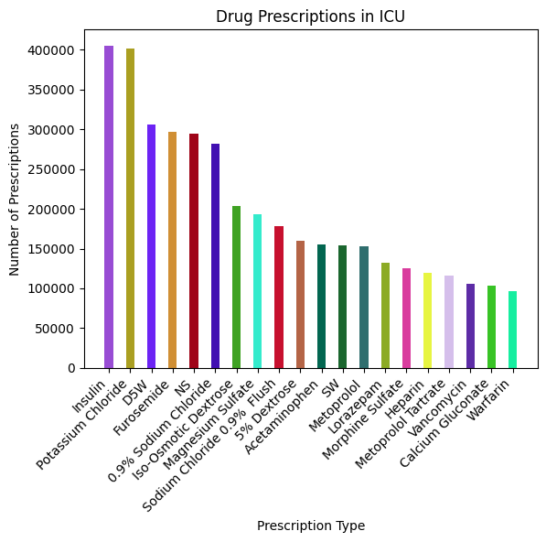
Drug Prescriptions in ICU
🔹 What is this showing?
This visualization captures the most commonly prescribed drugs in the ICU, offering a snapshot of medication trends in critical care. It highlights which treatments are most frequently administered, revealing patterns in patient care and medical necessity. The dominance of Insulin, Potassium Chloride, and D5W suggests a strong emphasis on glucose management, electrolyte balance, and fluid resuscitation—essential components of ICU treatment protocols.
🔹 How did you make this?
The dataset was processed using pandas, filtering prescriptions to include only ICU patients. The number of times each drug was prescribed was counted and ranked. To enhance clarity, only the top 20 most frequently prescribed drugs were included in the final visualization. The chart was plotted using Matplotlib, with rotated x-axis labels for readability and distinct color variations to differentiate medications.

