Slide 1
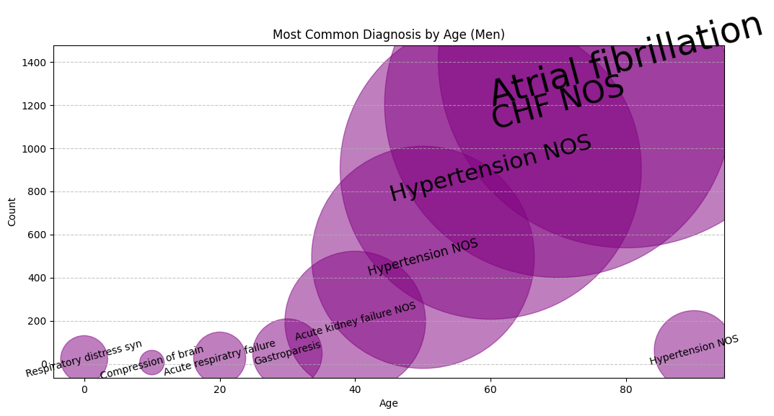
Most Common Diagnoses by Age (Men)
🔹 What is this showing?
This visualization maps the most frequently recorded diagnoses across different age groups for men. The **size of each bubble** represents how common a given diagnosis is, with larger bubbles highlighting more prevalent conditions. Trends emerge—early diagnoses are diverse, but as age increases, we see a dominance of conditions like **Atrial Fibrillation, CHF (Congestive Heart Failure), and Hypertension**. This chart tells a story of how chronic conditions take hold with age.
🔹 How did you make this?
Using **pandas**, I grouped the dataset by age and diagnosis, summing up the occurrence of each condition. To visualize it effectively, I used a **bubble chart with Matplotlib**, where the **x-axis represents age**, the **y-axis represents diagnosis count**, and the **bubble size reflects the frequency** of each diagnosis. The text was adjusted dynamically based on bubble size to highlight key patterns.

Slide 2
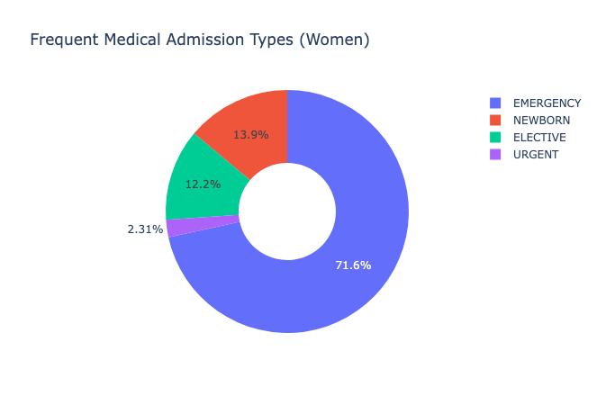
Frequent Medical Admission Types (Women)
🔹 What is this showing?
This donut chart breaks down the most common types of hospital admissions for women. It’s clear that **emergency admissions dominate**, making up over 70% of cases, followed by **newborn, elective, and urgent** admissions. This highlights the significant role of emergency care in women’s health, while also showing the proportion of planned (elective) procedures and births that require hospitalization.
🔹 How did you make this?
Using **pandas**, I aggregated admission types from the dataset, calculating the percentage share for each category. The visualization was created using **Plotly**, which allows for an interactive donut chart format. Labels and colors were adjusted to enhance clarity, and the legend provides an easy reference for the different admission types.

Slide 3
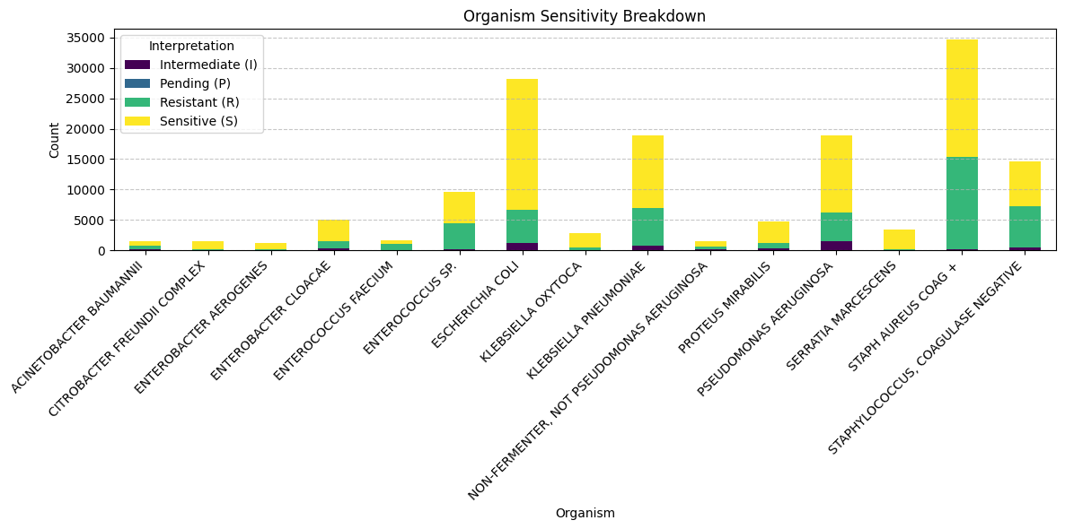
Organism Sensitivity Breakdown
🔹 What is this showing?
This visualization presents the **sensitivity patterns of various bacterial organisms** based on lab tests. Organisms are categorized by their response to treatment—whether they are **Sensitive (S), Resistant (R), Intermediate (I), or Pending (P)**. We can see that **E. coli, Klebsiella pneumoniae, and Staphylococcus aureus** account for a large portion of resistant infections, highlighting key pathogens of concern in antimicrobial stewardship.
🔹 How did you make this?
Using **pandas**, I grouped the dataset by bacterial organism and antibiotic interpretation, counting occurrences for each category. A **stacked bar chart** was created with **Matplotlib**, where each bar represents an organism, and the color-coded segments indicate resistance, sensitivity, or intermediate response. Organisms with the highest sample counts were prioritized for clarity.

