Slide 1
Use ChatGPT API for healthcare: An example in drug synergy prediction

Slide 2

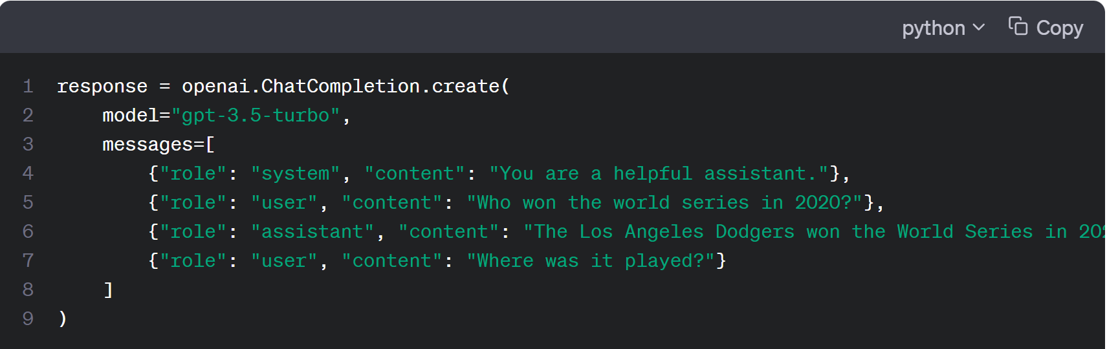
ChatGPT API
OpenAI's GPT models have been trained to understand natural language and code. GPTs provide text outputs in response to their inputs.
To use a GPT model via the OpenAI API, you’ll send a request containing the inputs and your API key, and receive a response containing the model’s output.
https://platform.openai.com/docs/guides/gpt

Slide 3
Advantages using ChatGPT API
Integration into Applications
The primary advantage of the API is that developers can integrate ChatGPT into their own applications, services, or platforms. This could be anything from a mobile app, a web service, a chatbot, to a research tool.
Automation & Workflow
Through the API, businesses can automate certain tasks or services. For example, a company might use the API to provide automated customer support on their website.
Customization
With the API, developers can create custom workflows, integrate the system with their databases, and generally tailor the experience to their needs.
E.g. Get embeddings from ChatGPT model
Scalability
When integrated into a product, the API allows for scaling up the usage based on demand. If a developer wants to have multiple simultaneous conversations, they can do so using the API.

Slide 4
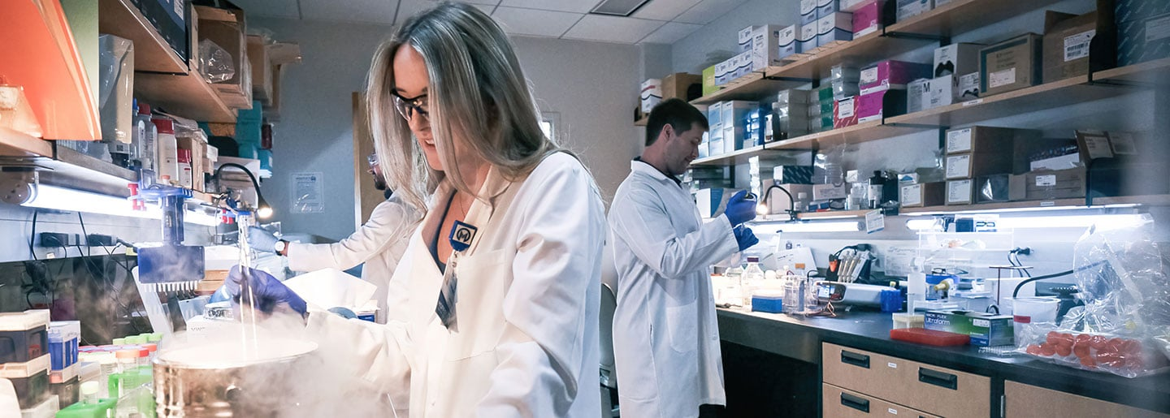
An example in healthcare: Drug synergy prediction
Drug synergy refers to the phenomenon where the combined effect of two drugs is greater than their individual effects.
Researchers usually use experimental methods to find potential drug combination for cancer treatment. However, it is expensive and time-consuming.
https://www.nature.com/articles/nchembio.1205

Slide 5
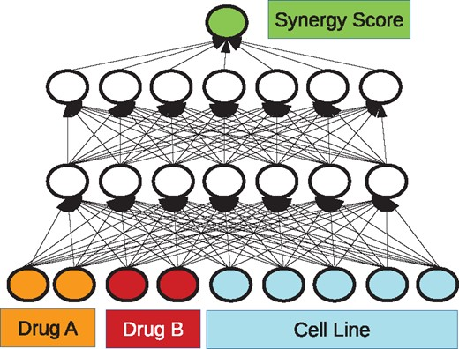
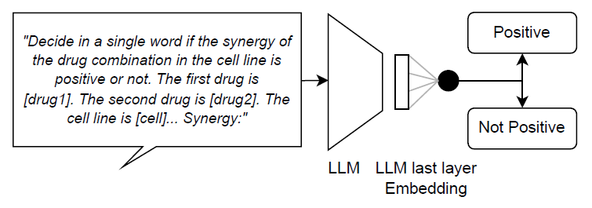
Deep learning in drug synergy prediction
Some previous works use machine learning models to predict synergy. However, with limited data and features, the performance of rare cancers is poor.
Leveraging prior knowledge in scientific literature encoded in LLMs is a new way to predict drug synergy for cancers.
https://academic.oup.com/bioinformatics/article/34/9/1538/4747884

Slide 6
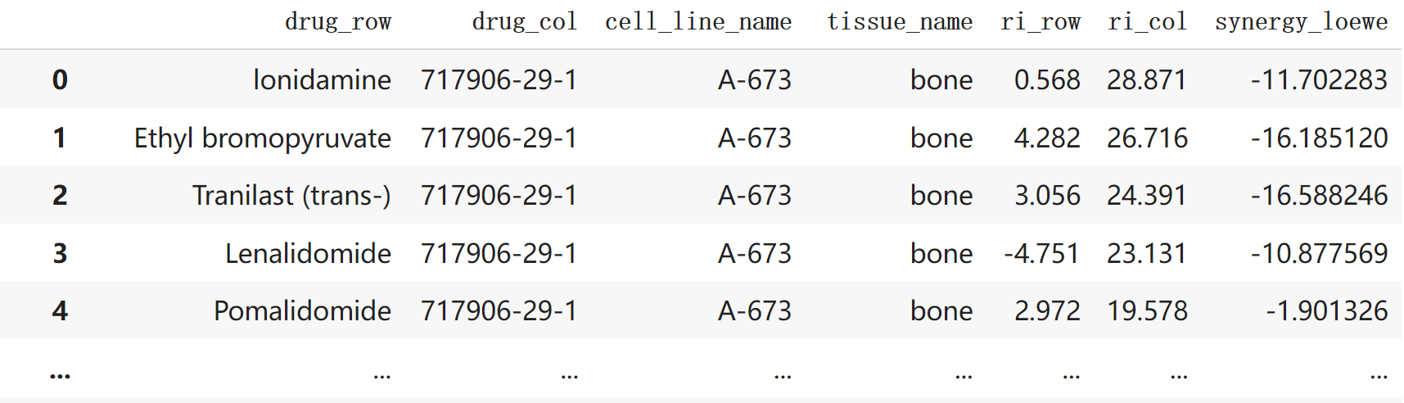
Drug synergy prediction using LLM
Task: Given two drugs and a cell line, determine whether the drugs have synergistic effect on the cell line, based on each drug’s sensitivity to the cell line
Data: DrugComb dataset
https://drugcomb.fimm.fi/

Slide 7
Zero shot learning by ChatGPT
Send a request to ChatGPT API using prompt and get response from it
See Google Colab Demo

Slide 8
Prompt: Add a role
Adding a role boosts ChatGPT performance
See Google Colab Demo
https://promptengineering.org/role-playing-in-large-language-models-like-chatgpt/

Slide 9
Explanation: Continue a conversation
Explore why ChatGPT gives the answer by asking following questions
See Google Colab Demo

Slide 10
For better performance
Directly asking complex question to ChatGPT may get poor result
Asking simple questions step by step or using embeddings may get better performance
We will show using embeddings from ChatGPT API as an example

Slide 11
Get embeddings from ChatGPT
Embeddings are internal representations that the ChatGPT model learned during its training process, which are high-dimensional vectors
The length of embedding for GPT-3.5 model “text-embedding-ada-002” is 1536
See Google Colab demo
https://platform.openai.com/docs/guides/embeddings

Slide 12
Use the embeddings to do classification
Use a simple linear regression model for classification
Use embeddings as input and output is label
Simple model boosts the performance a lot
See Google Colab demo

Slide 13
Compare with model trained on common cancer data
ChatGPT is not an open-source model and cannot be used for large-scale finetuning
However, finetuning on common cancer data boosts performance on rare cancer data
We finetuned a GPT-2 model (CancerGPT) before and compared it with ChatGPT.
See Google Colab demo
https://arxiv.org/abs/2304.10946

Slide 14
Comparison of different models
In Endometrium cancer, CancerGPT is better than basic ChatGPT, but not as good as ChatGPT embedding + classification.
However, CancerGPT (~124M) is much smaller than ChatGPT (~175B)
Acturally, performance has patterns for different kind of rare cancers
https://arxiv.org/abs/2304.10946

Slide 15
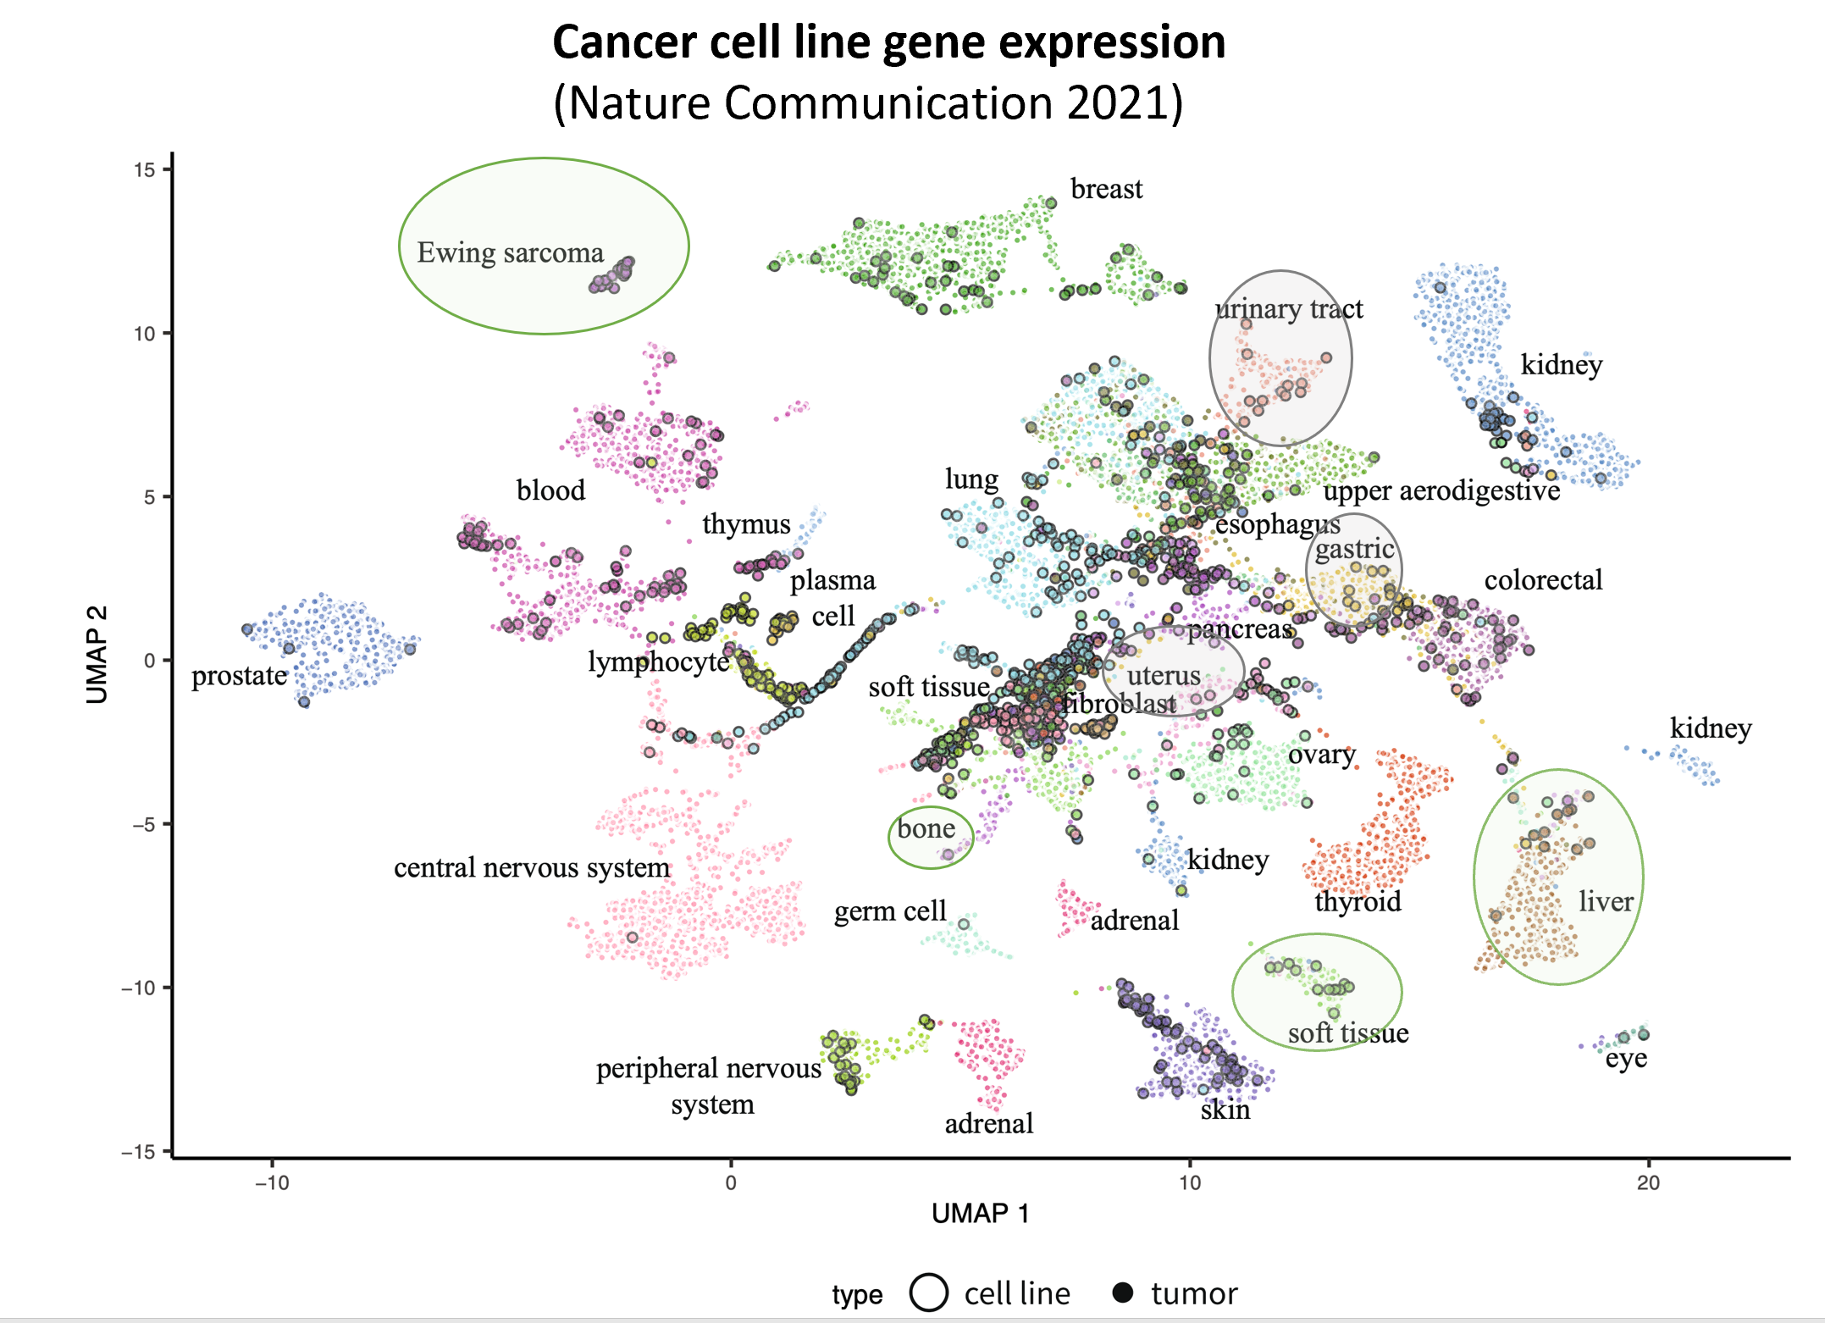
Model performance patterns
https://doi.org/10.1038/s41467-020-20294-x

