Slide 1
Mimic Visualizations
AI in Healthcare
Jef DeWitt
January 30, 2025

Slide 2
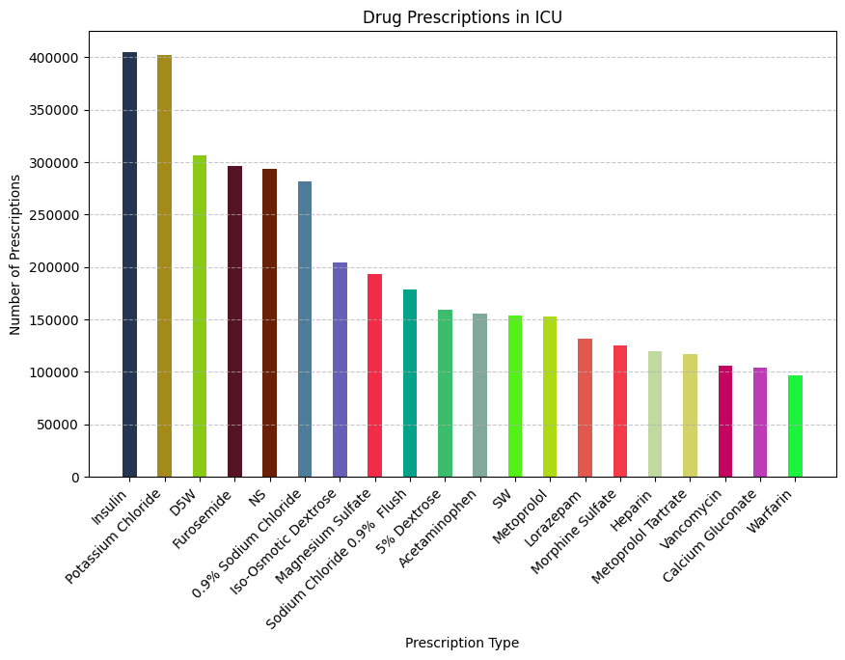
Drug Prescriptions in ICU
This visualization captures the most commonly prescribed drugs in the ICU; Insulin, Potassium Chloride, and D5W. Essential components of ICU treatment protocols for glucose management, electrolyte balance, and fluid resuscitation

Slide 3
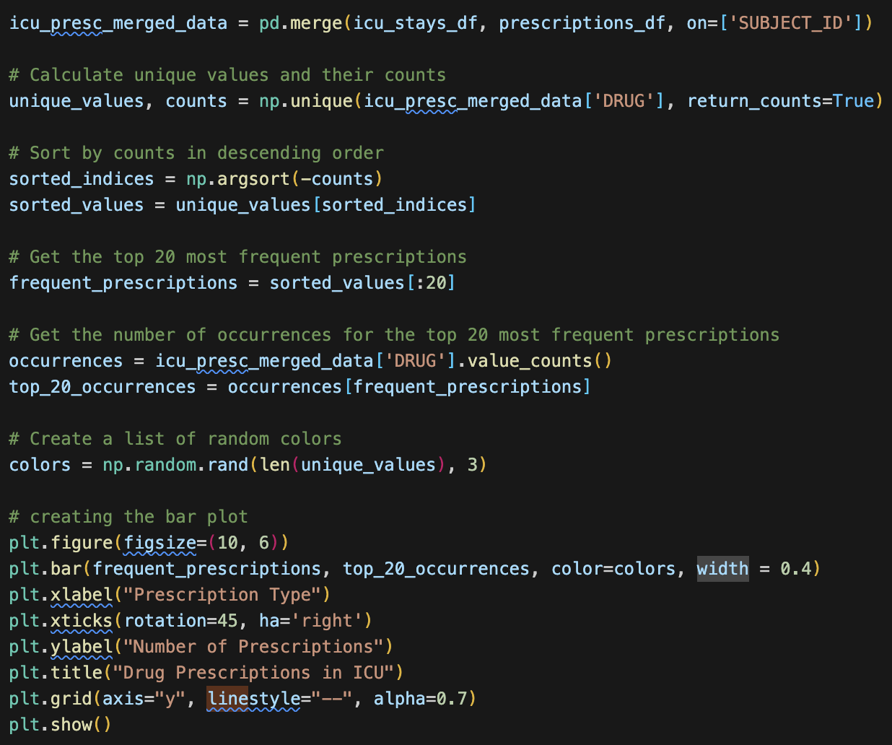
Code from the previous visualization.
The dataset filtered prescriptions to include only ICU patients. The number of times each drug was prescribed was counted and ranked, with only the top 20 included. The chart was plotted using Matplotlib, with rotated x-axis labels for readability and distinct color variations to differentiate medications.

Slide 4
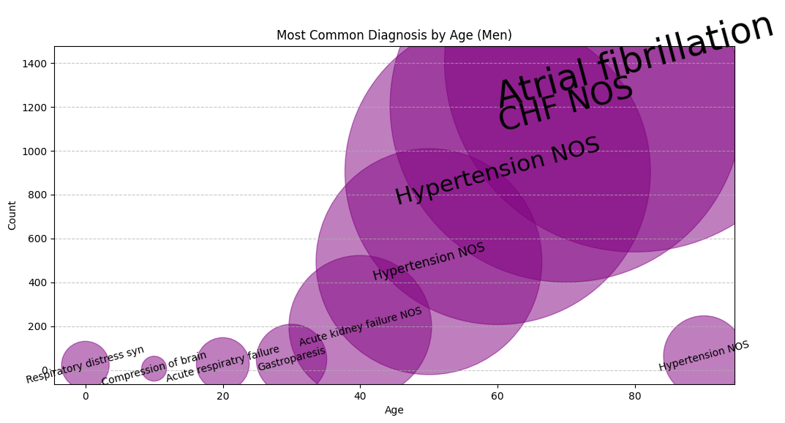
Most Common Diagnoses by Age (Men)
This visualization maps the most frequent diagnoses across age groups for men. Early diagnoses are diverse, but as age increases, conditions like Atrial Fibrillation and CHF (Congestive Heart Failure) become chronic.

Slide 5
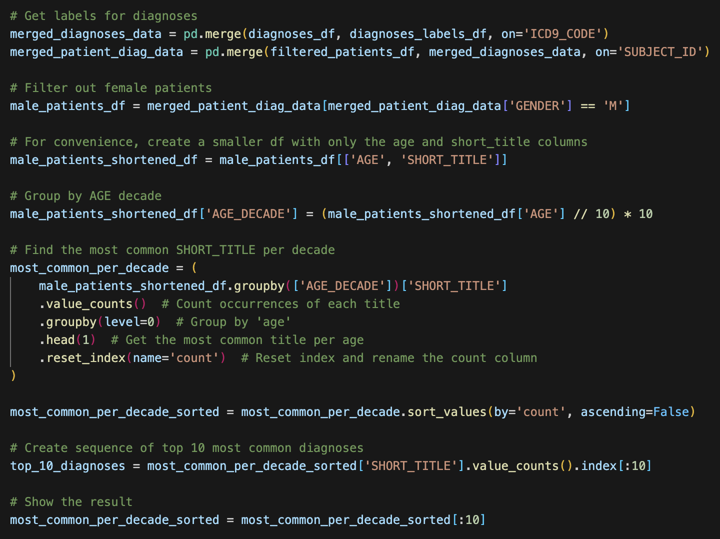
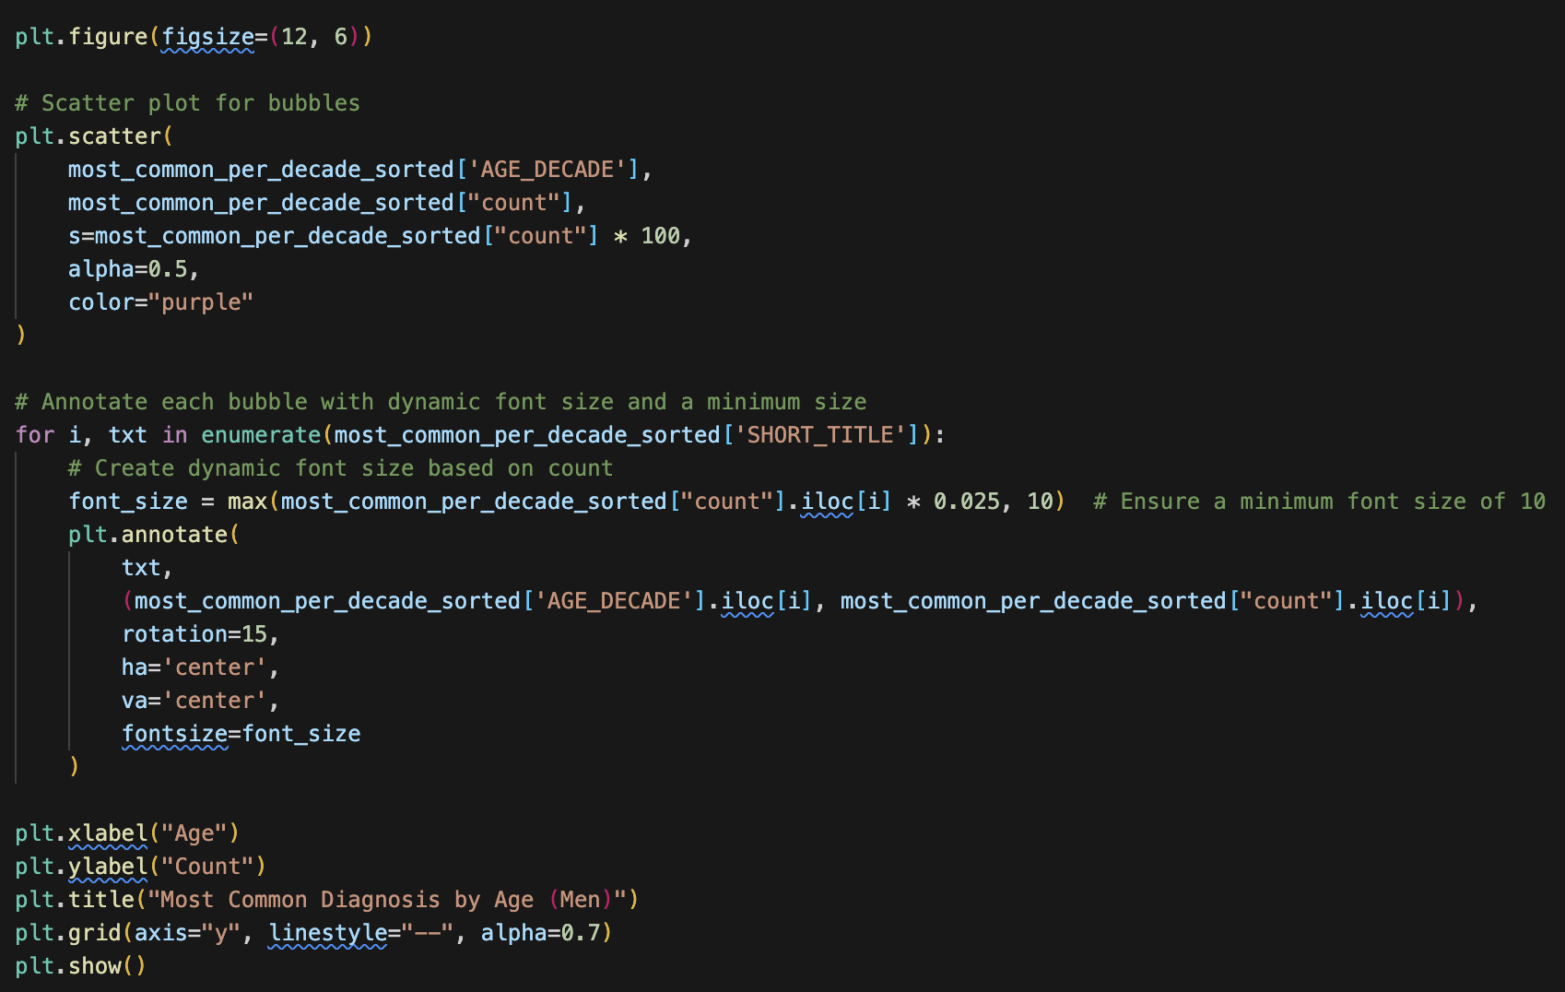
Code from the previous visualization.
Data was grouped by age and diagnosis, summing up the occurrence of each condition. The bubble size reflects the frequency of each diagnosis. The text was adjusted dynamically based on bubble size to highlight key patterns.

Slide 6
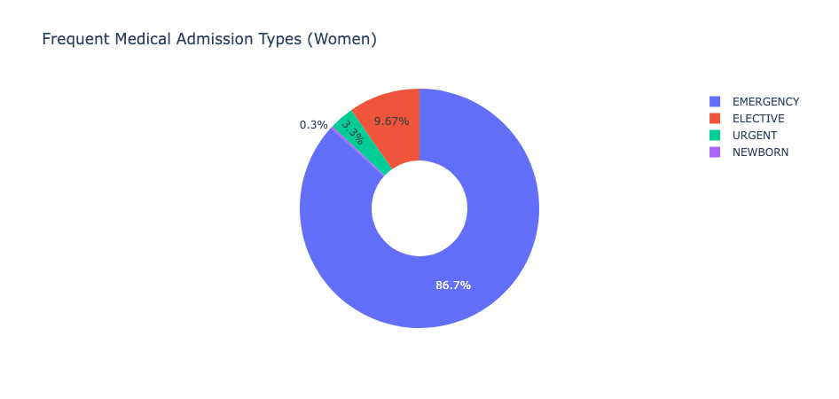
Frequent Medical Admission Types (Women)
This donut chart breaks down the most common types of hospital admissions for women. Emergency admissions make up over 70% of cases. This highlights the significant role of emergency care in women’s health.

Slide 7
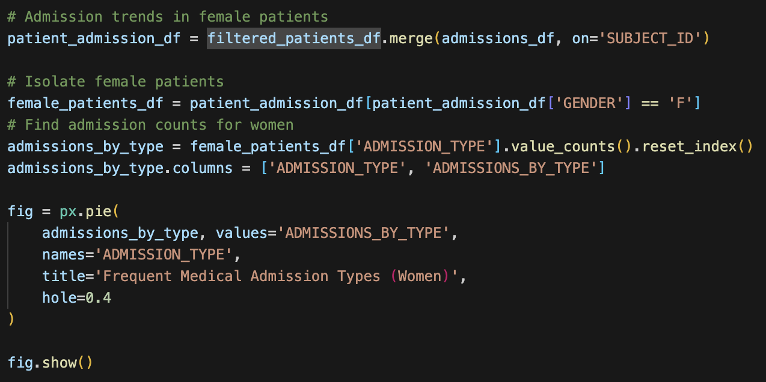
Code from the previous visualization.
Using pandas, I aggregated admission types and calculated the percentage share for each category. The visualization was created via Plotly. Labels and colors were adjusted to enhance clarity, and the legend provides an easy reference for the different admission types.

Slide 8
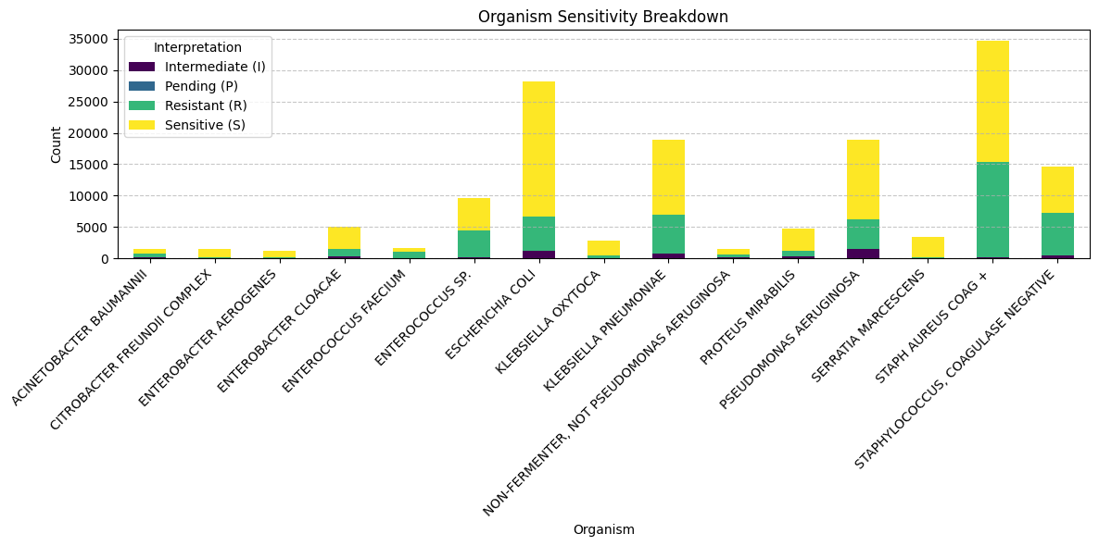
Organism Sensitivity Breakdown
This visualization presents the sensitivity patterns of various microorganisms. Organisms are categorized by their response to treatment—Sensitive (S), Resistant (R), Intermediate (I), or results are still Pending (P).

Slide 9
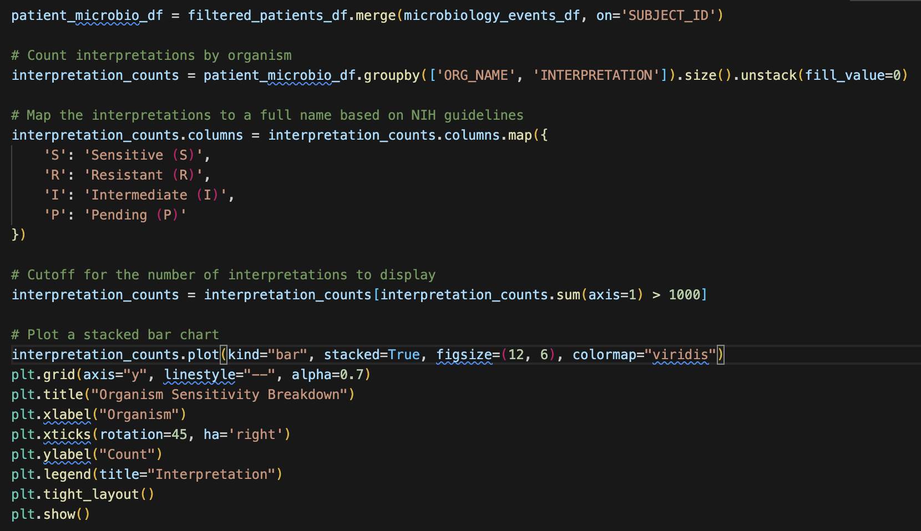
Code from the previous visualization.
I grouped the dataset by bacterial organism and antibiotic interpretation, counting occurrences for each category. The stacked bar chart was created with Matplotlib, showing color-coded segments. Organisms with the highest sample counts were prioritized for clarity.

Slide 10
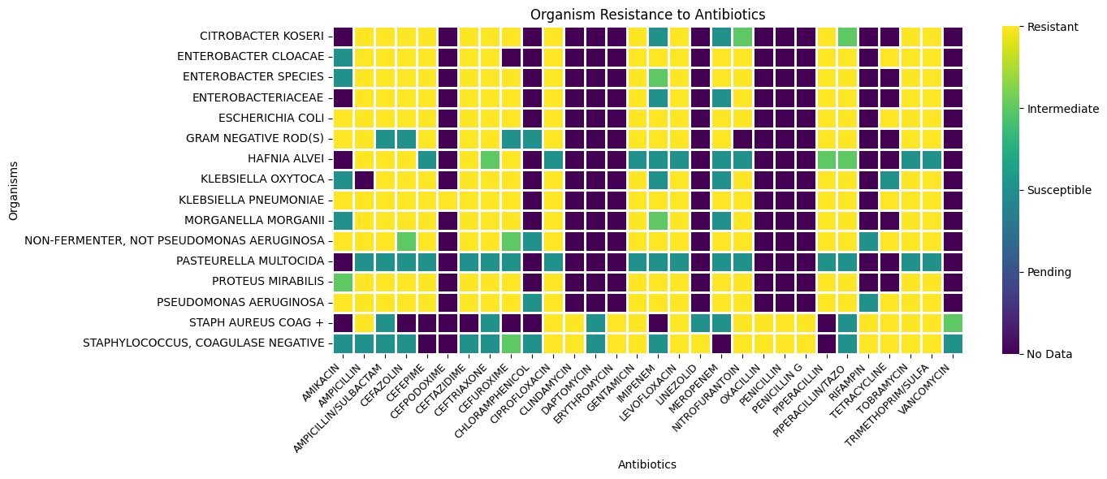
Organism Resistance to Antibiotics
This heatmap shows microorganism resistance to various antibiotics. Color coding reveals resistance (yellow), intermediate responses (green), and susceptibility (blue).

Slide 11
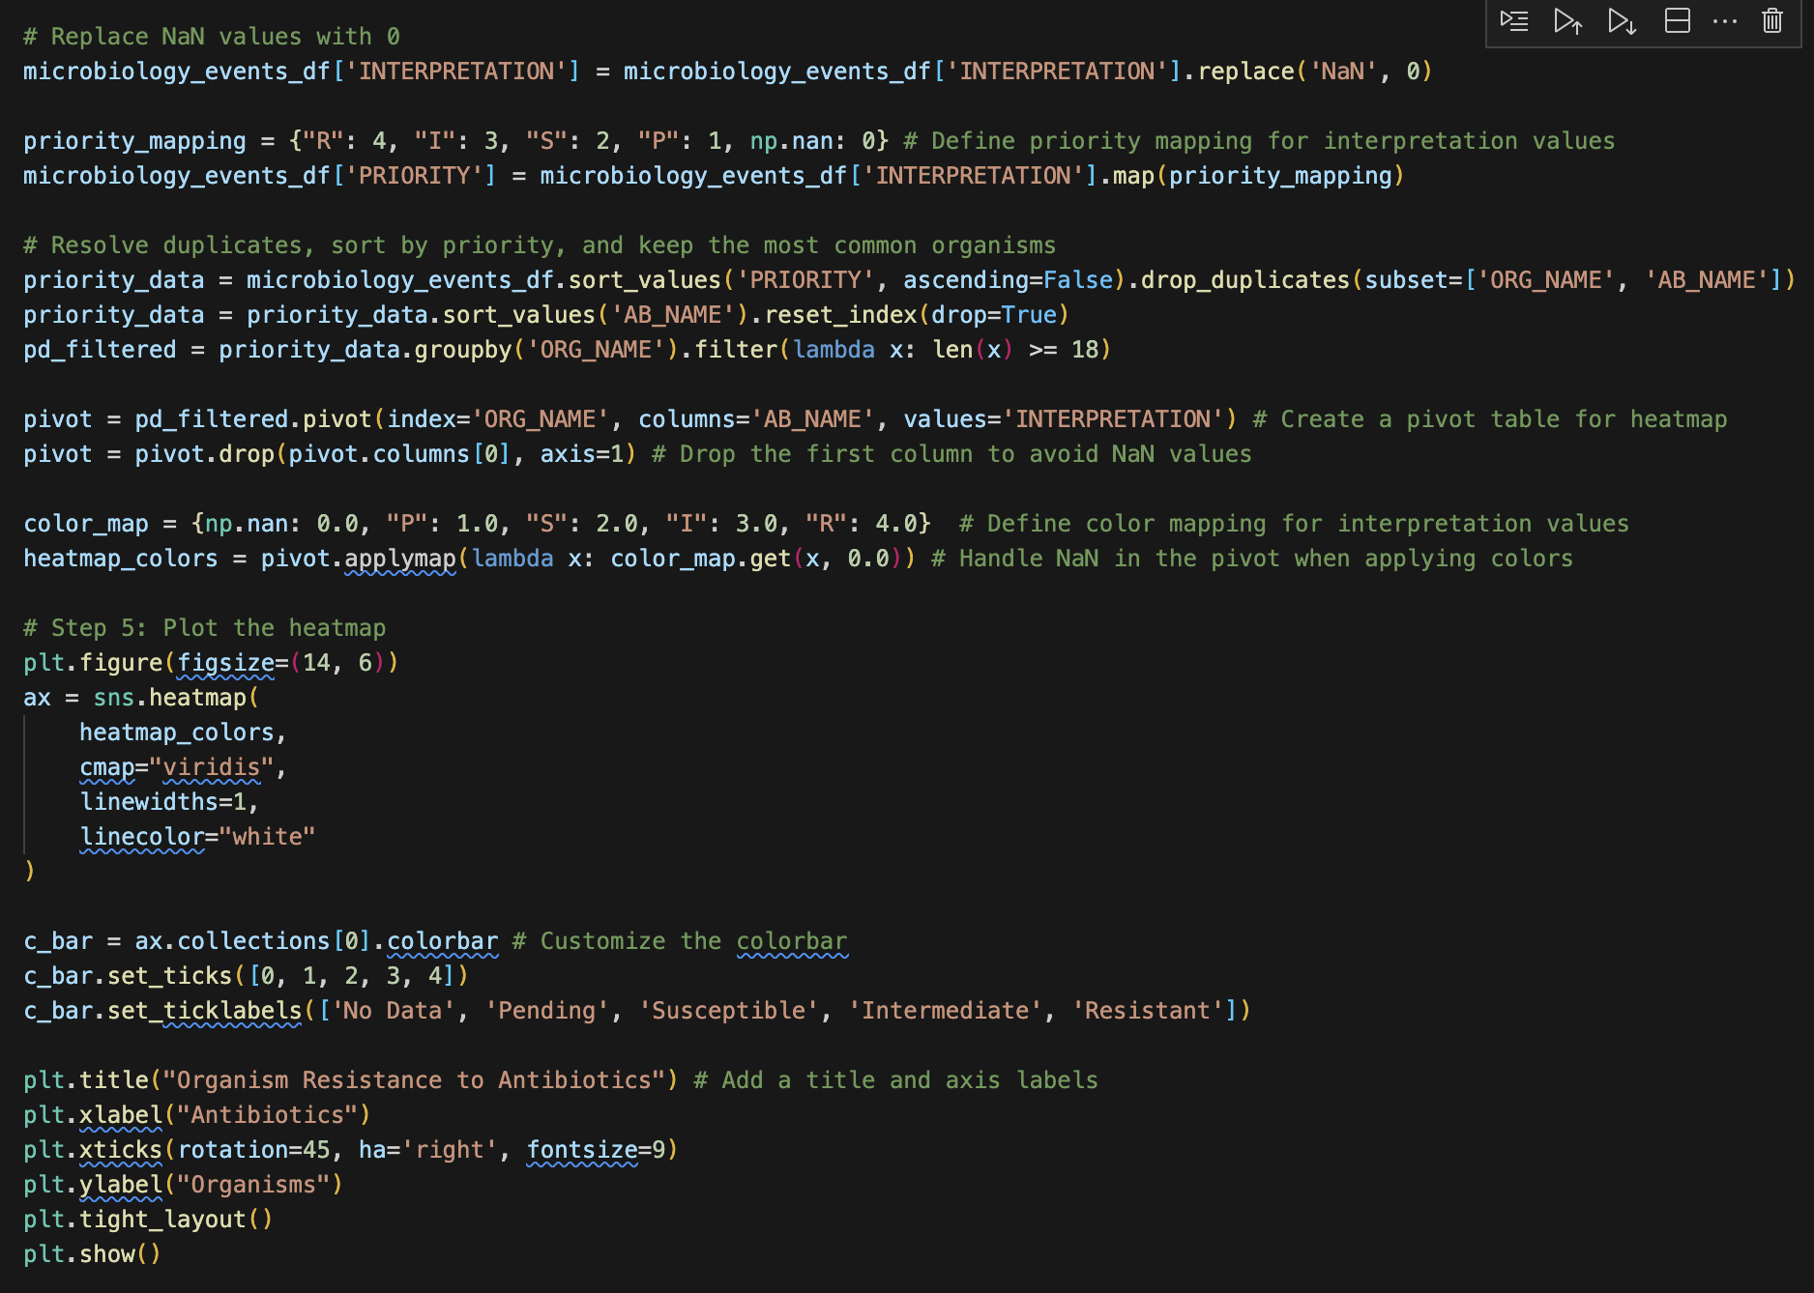
Code from the previous visualization.
I structured the dataset to create a table where rows represented bacterial organisms and columns represented antibiotics. Each cell contains the interpretation of susceptibility. The heatmap was generated with Seaborn, utilizing a categorical color map to differentiate resistance levels.

Slide 12
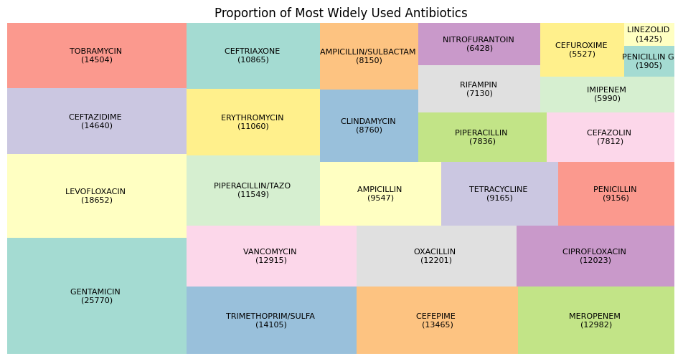
Bonus Graphic: Proportion of Most Widely Used Antibiotics using Squarify
This treemap is a snapshot of the most frequently prescribed antibiotics. Each block represents an antibiotic and its usage volume. This breakdown provides insight into antibiotic reliance and prescribing patterns in healthcare.

Slide 13
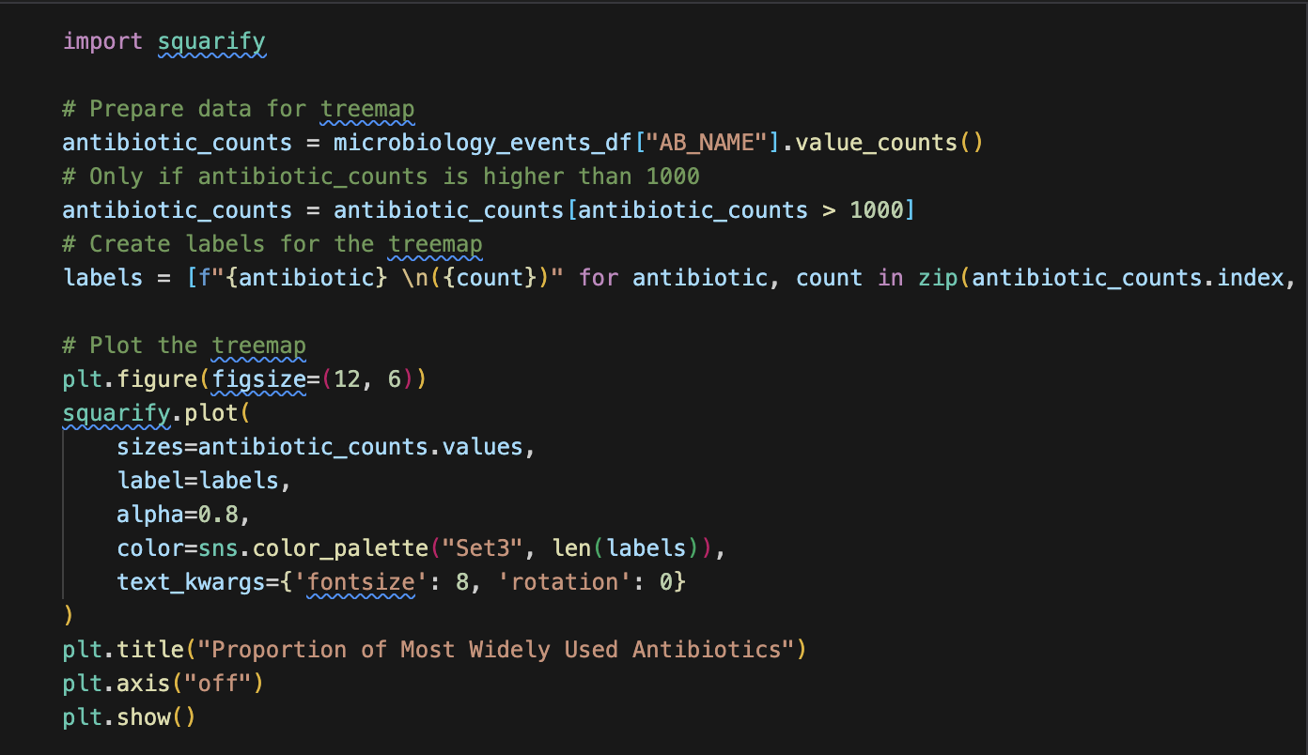
Code from the previous visualization.
I aggregated the antibiotic prescription counts from the dataset using pandas, ranking the most commonly used medications. The treemap was generated using Squarify to proportionally size each antibiotic based on its usage frequency.

Slide 14
Thanks for your time!
GitHub link:
https://github.com/UT-Austin-MSAI-Program/ai-in-healthcare-ai395t
Filename for this presentation: mimic-visualizations.ipynb

