Slide 1
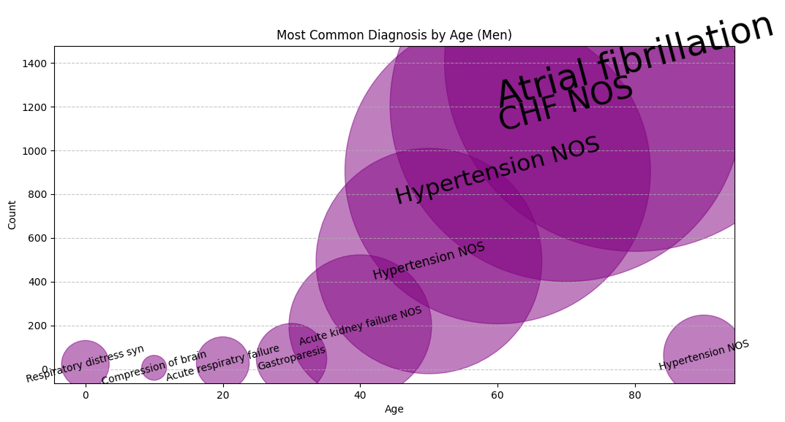
Most Common Diagnoses by Age (Men)
🔹 What is this showing?
This visualization maps the most frequently recorded diagnoses across different age groups for men. The **size of each bubble** represents how common a given diagnosis is, with larger bubbles highlighting more prevalent conditions. Trends emerge—early diagnoses are diverse, but as age increases, we see a dominance of conditions like **Atrial Fibrillation, CHF (Congestive Heart Failure), and Hypertension**. This chart tells a story of how chronic conditions take hold with age.
🔹 How did you make this?
Using **pandas**, I grouped the dataset by age and diagnosis, summing up the occurrence of each condition. To visualize it effectively, I used a **bubble chart with Matplotlib**, where the **x-axis represents age**, the **y-axis represents diagnosis count**, and the **bubble size reflects the frequency** of each diagnosis. The text was adjusted dynamically based on bubble size to highlight key patterns.

