Slide 1
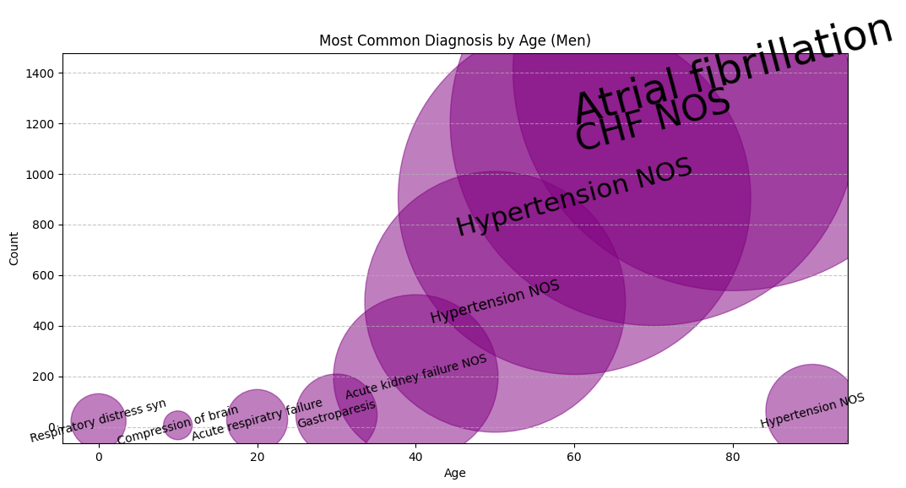
Most Common Diagnoses by Age (Men)
🔹 What is this showing?
This visualization maps the most frequently recorded diagnoses across different age groups for men. The **size of each bubble** represents how common a given diagnosis is, with larger bubbles highlighting more prevalent conditions. Trends emerge—early diagnoses are diverse, but as age increases, we see a dominance of conditions like **Atrial Fibrillation, CHF (Congestive Heart Failure), and Hypertension**. This chart tells a story of how chronic conditions take hold with age.
🔹 How did you make this?
Using **pandas**, I grouped the dataset by age and diagnosis, summing up the occurrence of each condition. To visualize it effectively, I used a **bubble chart with Matplotlib**, where the **x-axis represents age**, the **y-axis represents diagnosis count**, and the **bubble size reflects the frequency** of each diagnosis. The text was adjusted dynamically based on bubble size to highlight key patterns.

Slide 2
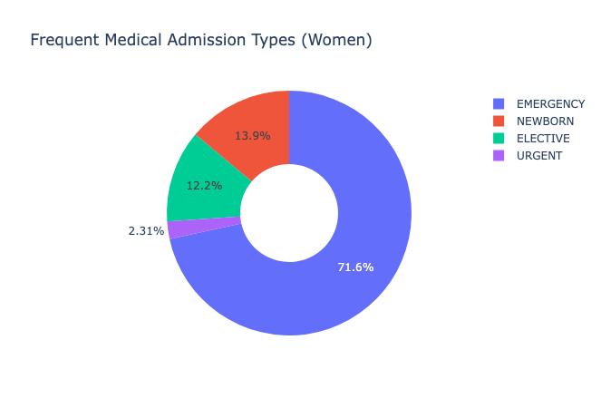
Frequent Medical Admission Types (Women)
🔹 What is this showing?
This donut chart breaks down the most common types of hospital admissions for women. It’s clear that **emergency admissions dominate**, making up over 70% of cases, followed by **newborn, elective, and urgent** admissions. This highlights the significant role of emergency care in women’s health, while also showing the proportion of planned (elective) procedures and births that require hospitalization.
🔹 How did you make this?
Using **pandas**, I aggregated admission types from the dataset, calculating the percentage share for each category. The visualization was created using **Plotly**, which allows for an interactive donut chart format. Labels and colors were adjusted to enhance clarity, and the legend provides an easy reference for the different admission types.

Slide 3
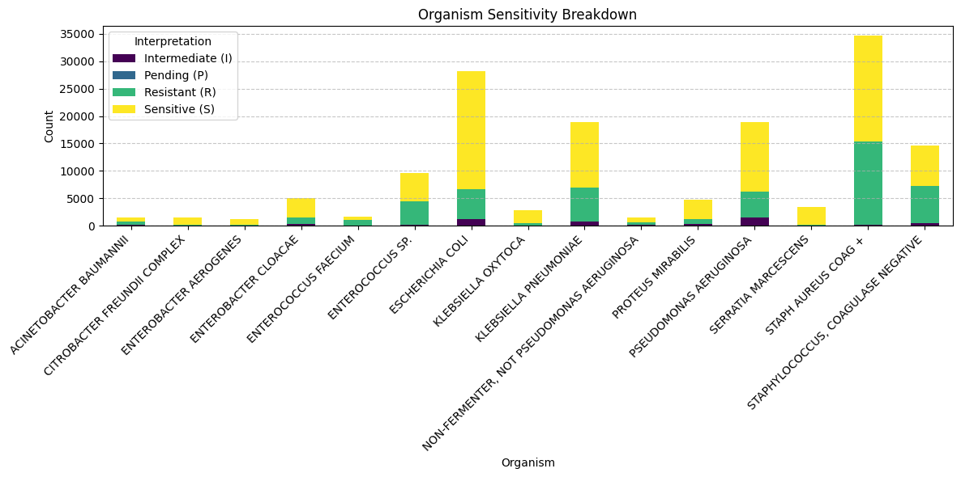
Organism Sensitivity Breakdown
🔹 What is this showing?
This visualization presents the **sensitivity patterns of various bacterial organisms** based on lab tests. Organisms are categorized by their response to treatment—whether they are **Sensitive (S), Resistant (R), Intermediate (I), or Pending (P)**. We can see that **E. coli, Klebsiella pneumoniae, and Staphylococcus aureus** account for a large portion of resistant infections, highlighting key pathogens of concern in antimicrobial stewardship.
🔹 How did you make this?
Using **pandas**, I grouped the dataset by bacterial organism and antibiotic interpretation, counting occurrences for each category. A **stacked bar chart** was created with **Matplotlib**, where each bar represents an organism, and the color-coded segments indicate resistance, sensitivity, or intermediate response. Organisms with the highest sample counts were prioritized for clarity.

Slide 4
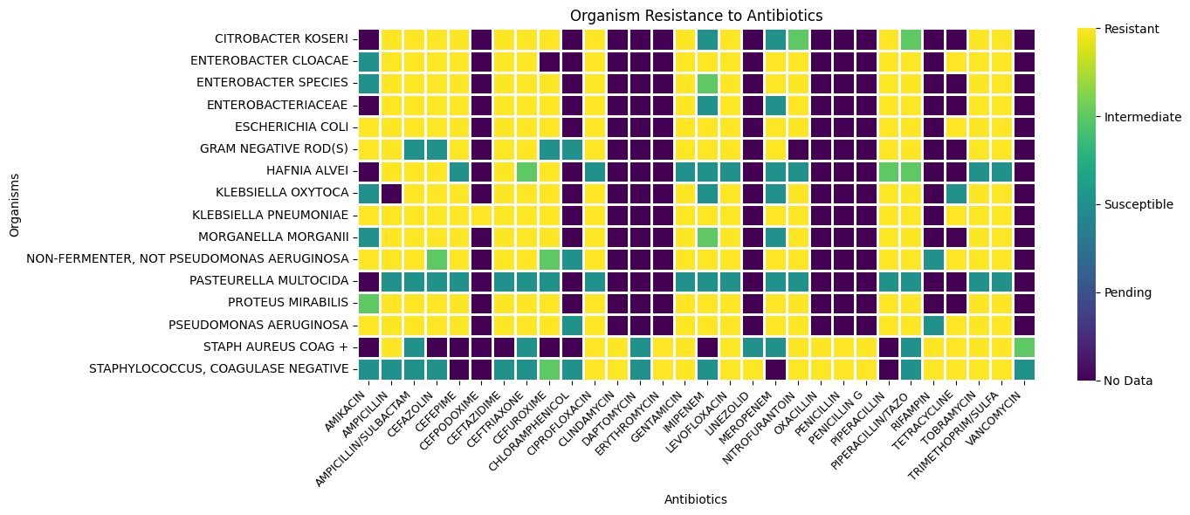
Organism Resistance to Antibiotics
🔹 What is this showing?
This heatmap visualizes **bacterial resistance patterns to various antibiotics**. Each row represents a bacterial species, while each column corresponds to an antibiotic. Color coding reveals resistance (yellow), susceptibility (green), and intermediate responses (teal). Gaps in the data indicate missing test results. This visualization is crucial for understanding **which bacteria are developing resistance to common treatments**, guiding antibiotic stewardship efforts.
🔹 How did you make this?
Using **pandas**, I structured the dataset to create a table where rows represented bacterial organisms and columns represented antibiotics. Each cell contains the interpretation of susceptibility. The heatmap was generated with **Seaborn**, utilizing a categorical color map to differentiate resistance levels. Missing data was visualized as distinct gaps to highlight areas where additional testing may be required.

Slide 5
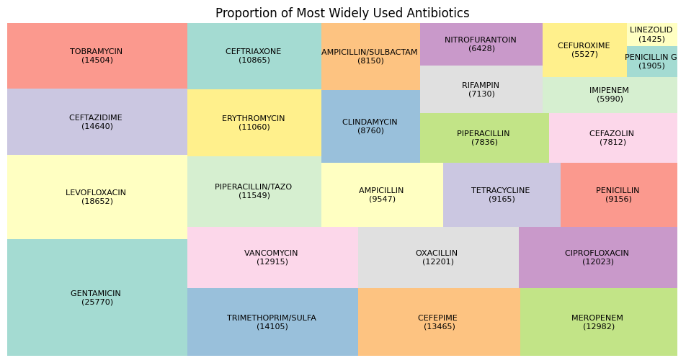
Proportion of Most Widely Used Antibiotics
🔹 What is this showing?
This treemap visualizes the **most frequently prescribed antibiotics**, with each block representing an antibiotic and its usage volume. Larger blocks indicate higher prescription counts, highlighting key drugs in clinical use. Broad-spectrum antibiotics like **Gentamicin, Tobramycin, and Levofloxacin** dominate, suggesting their widespread role in infection management. This breakdown provides insight into **antibiotic reliance and prescribing patterns** in healthcare.
🔹 How did you make this?
Using **pandas**, I aggregated antibiotic prescription counts from the dataset, ranking the most commonly used medications. The **treemap was generated using Seaborn** to proportionally size each antibiotic based on its usage frequency. Distinct colors were assigned to visually differentiate medications, enhancing readability while preserving data-driven insights.

