Slide 1
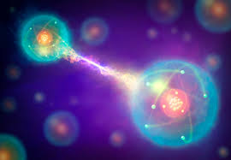
Quantum Entanglement

Slide 2
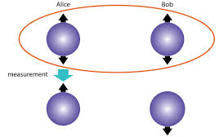
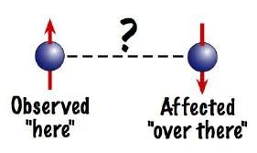
What is Quantum Entanglement Exactly?
Fancy Definition - physical phenomenon that occurs when a pair or group of particles is generated, interact, or share spatial proximity in a way such that the quantum state of each particle of the pair or group cannot be described independently of the state of the others, including when the particles are separated by a large distance.
Real Definition - Two particles can become connected, such that when you do something to one of the particles, the other particle does the opposite, no matter how far away they are.

Slide 3
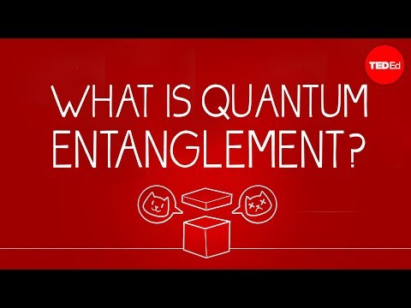
YOUTUBE

Slide 4
Quantum Entanglement Implications
Entangled particles can communicate faster than the speed of light.
When the state of one particle collapses, the other collapses as well.
The particles like in a state of superposition before collapsing, and then when collapsed the particles are polar opposites of each other.
Can be done with a pair or group of particles.
How does this help us with computer and information science.

Slide 5
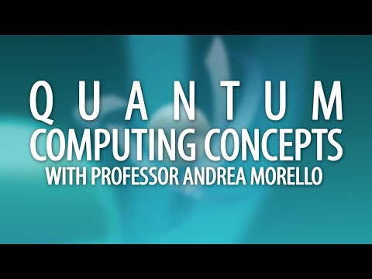
Quantum Computing with Entanglement

Slide 6
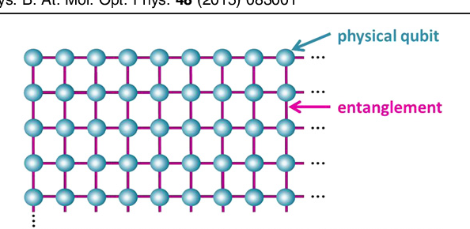
Quantum Computer
Through entanglement, qubits can be intertwined so that with one measurement the entire state can be collapsed.
This effect of value-sharing via entanglement is used in Shor's algorithm, phase estimation and in quantum counting.
Super important to understanding quantum speed up.

