Slide 1
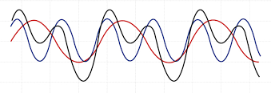
Superposition

Slide 2
Basic Definitions
two (or more) quantum states can be added together ("superposed") and the result will be another valid quantum state; and conversely, that every quantum state can be represented as a sum of two or more other distinct states.
The general principle of superposition of quantum mechanics applies to the states [that are theoretically possible without mutual interference or contradiction] ... of any one dynamical system. It requires us to assume that between these states there exist peculiar relationships such that whenever the system is definitely in one state we can consider it as being partly in each of two or more other states. The original state must be regarded as the result of a kind of superposition of the two or more new states, in a way that cannot be conceived on classical ideas. Any state may be considered as the result of a superposition of two or more other states, and indeed in an infinite number of ways. Conversely, any two or more states may be superposed to give a new state...

Slide 3
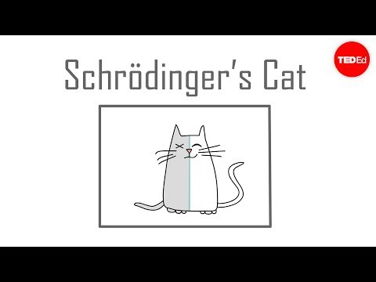
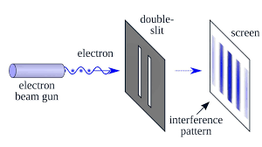

Slide 4
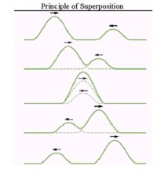
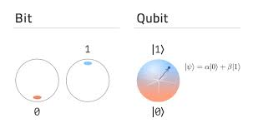
Basic Concepts
Quantum states can be added together in superposition
These states act as wave functions
This phenomenon allows us to perform unique computation

Slide 5
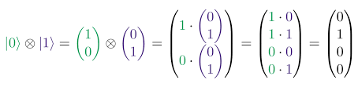
Application to Quantum Computing
Rather than having bits be in a discrete, binary positions, bits can be represented as wave functions
1s and 0s turn into |0> and |1>
Discrete math turns into linear algebra
Using superposition, we can perform computation on a superposition of bits all at once to quickly calculate the answer to some of the most challenging problems in computer science (Traveling salesman, Prime Factorization)

Slide 6
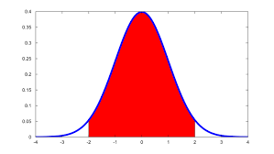
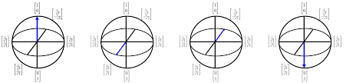
Probability Density Function
Superposition can be thought of a probability graph of bits collapsing to a certain state.
Once you measure a quantum state it collapses to a single possibility
There is a certain probability that the quantum state will collapse to a possible outcome.
Qubits
Superposition
Computation
Bits
0 1 0 0
Measurement

Slide 7

FIN

