Slide 1

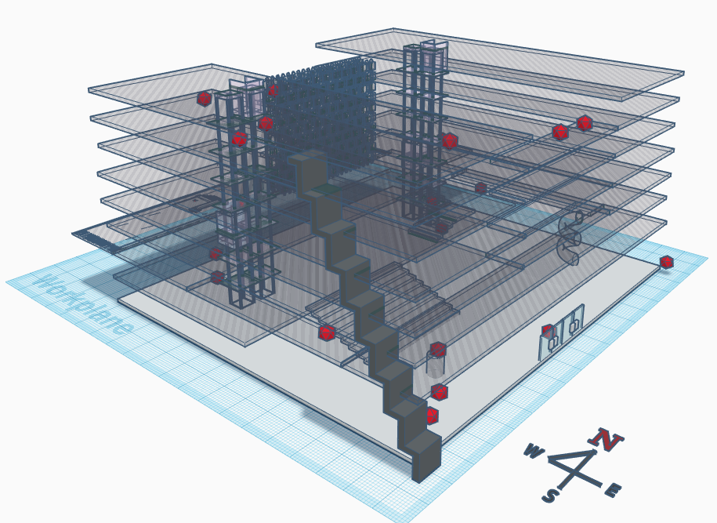
Nov 2019
User-side Acquisition of
People-Centric Sensing in the
Internet-of-Things
Chenguang Liu, Jie Hua, Tomasz Kalbarczyk, Sangsu Lee, and Christine Julien
Sangsu Lee
The University of Texas at Austin
SenSys DATA’ 19
Notes:
I’m sangsu Lee and I’ll talk about our dataset titled ~
This is a joint work with … who’s from university of texas

Slide 2







Sensor Data from Individuals
Human activity prediction
Urban problem solving
Social interaction analysis
1
Sensys DATA’ 19
User-side Acquisition of People-Centric Sensing in the Internet-of-Things
Notes:
The number of sensors carried by people are growing and the quantity and diverseness of sensor data are also improving. Now, what are the services that can be provided or things that we can do with these?
from smartphones to IoT devices, especially applications that involves human activity, or we can use data from individuals
Human activity prediction
Urban Applications: air pollution monitoring, assistive living, disaster management systems, and intelligent transportation
[1:00]

Slide 3





Conventional Approach for Acquiring Data
Privacy
Ownership
Security
Cost
Dependency
2
Sensys DATA’ 19
User-side Acquisition of People-Centric Sensing in the Internet-of-Things
Notes:
But how does all the data acquired? In conventional crowdsourcing settings, the data collected is sent to a central server and in order to do that, they go through an infrastructure, here we have cell towers. ?? A number of issues arise with this approach.
Privacy: potentially sensitive data will be sent to a third party
Ownership: The data that belongs to the user and sometimes collected using their own device is being used by someone else
Security: Someone might be overhearing the communication
Above three problem: especially a problem in people-centric sensing
Costly: not only the cost for the infrastructure(?)
Dependency: Infra dependent
[2:00]

Slide 4




Our Approach: User-side Acquisition
3
Sensys DATA’ 19
User-side Acquisition of People-Centric Sensing in the Internet-of-Things
Notes:
investigated how to allow users to fully control their data. In our approach, which is called the user-side acquisition, is a decentralized approach where data which are harvested on device stays on device. And we believe that this approach especially fits into the applications I mentioned in the first slide as they will be built using private user data As opposed to a model where all the data are gathered in one space, devices can share their data opportunistically to others when they want.
[4:00]

Slide 5



Example Scenario
4
Sensys DATA’ 19
User-side Acquisition of People-Centric Sensing in the Internet-of-Things
Notes:
Real life scenario where the user collects data. The user who also has sensors on them walks into the building and receives data from the sensors of the building which we’ll call static beacons. Receiver now has data of ambient context data and received signal strength indicator. When they meet other user, they exchange data as well. I’d like to point out that there is no assumption of centralized server. The data stays on user side and users themselves can decide share or not to share their data.
[5:00]

Slide 6


Testbed Setup
BLEnd Protocol
95%
“check-ins”
Database
5
Sensys DATA’ 19
User-side Acquisition of People-Centric Sensing in the Internet-of-Things
Notes:
In the testbed we set up to gather the data, we asked human participants to carry Android devices as well which stored the data to the local database. The static beacons installed on the wall of the building were set up to continuously look for devices near it to send the sensor data. We used a our approach for energy-efficient, completely decentralized neighbor discovery protocol called BLEnd, which has 95% probability of discovering others in 2 seconds. The advantage of this approach is that only people who knows that they are connected are just those two people, ensuring privacy and security. We also installed Android tablets to collect participants’ “check-in”s to a particular space in the building which provides some ground truth data for indoor location of participants.
[6:00]

Slide 7
Deployment
Nordic Thingy:52™
8 on-board sensors
Bluetooth Low Energy
Lithium Polymer Battery
Nordic Thingy52™
IoT Sensor Kit
6
Sensys DATA’ 19
User-side Acquisition of People-Centric Sensing in the Internet-of-Things
Notes:
We have programmed IoT sensor kits. They have sensors which collect ambient context information and equipped with Bluetooth technology, which is a nice tool for device interaction and can be potentially used for various applications such as indoor localization.

Slide 8

Deployment
24 Static beacons
7
Sensys DATA’ 19
User-side Acquisition of People-Centric Sensing in the Internet-of-Things
Notes:
24 of them are deployed as static beacons, which means they were placed as anchor nodes in the building.

Slide 9

Deployment
24 Static beacons
http://www.ece.utexas.edu/about/facilities/eerc
7
Sensys DATA’ 19
User-side Acquisition of People-Centric Sensing in the Internet-of-Things
Notes:
They are placed in 24 different locations in an academic building which was our testbed, continuously looking for others to broadcast context information.

Slide 10
Deployment
24 Static beacons
24 backups
7 Beacons & Android Devices carried by the human participants
3 Android Tablets for “check-ins”
7
Sensys DATA’ 19
User-side Acquisition of People-Centric Sensing in the Internet-of-Things
Notes:
24 more IoT kits were used as backups for replacing static beacons time to time. 7 Android devices and IoT kits were carried by human participants and 3 android tablets were used for check ins.

Slide 11

Example Data
Host ID | Time | Address | RSSI | … | Temp. | Air Pressure | eCO²(ppm)
4 | … | C1:DA:6A … | -67 | … | 22.96 | 994.88 | 427
1 | … | D1:DE:6B … | -99 | … | 27.70 | 996.43 | 400
0 | … | C1:DB:1B … | -98 | … | 23.29 | 993.97 | 408
… | … | … | … | … | … | … | …
8
Sensys DATA’ 19
User-side Acquisition of People-Centric Sensing in the Internet-of-Things
Notes:
Now let’s see how our data looks like. Each row represents sensor data from one beacon for one user. So from here HostId is the id of a human participant, and Bluetooth address is the beacon that was near the participant in some timestamp to provide sensor data. The columns represent sensor data including received signal strength indicator, and various sensor data gathered from the static beacon. For the main table we have merged local databases of each participants for the ease of use, but I’d like to emphasize that before the user voluntarily hand the data to third party, it belongs to them.

Slide 12

Uses of the Dataset
People-Centric Sensing
Personalized services
Data for common good
Social network applications
Building a Sensor System
9
Sensys DATA’ 19
User-side Acquisition of People-Centric Sensing in the Internet-of-Things
Notes:
We believe that our approach will greatly facilitate people-centric sensing, a paradigm where people become a true custodian of the sensors and data collected from them, in terms of providing services associated with them.
First of all our dataset can be used for these stuff. On top of that,
We believe our dataset can be a starting point for people to build a decentralized sensor system and also it can be a good example identify characteristics of decentralized sensor system, for people who wants to utilize dataset that is harvested in decentralized way.

Slide 13
Useful Links
BLEnd Code for Testbed: http://bit.ly/BLEndTestbed
Dataset: https://zenodo.org/record/3450691
BLEnd Protocol
Christine Julien, Chenguang Liu, Amy L. Murphy, Gian Pietro Picco. "Blend: Practical continuous neighbor discovery for bluetooth low energy," Proceedings of the 16th ACM/IEEE International Conference on Information Processing in Sensor Networks. 2017.
Context Authorization
Tomasz Kalbarczyk, Chenguang Liu, Jie Hua, Christine Julien. "LAD: Learning Access Control Polices and Detecting Access Anomalies in Smart Environments," Proceedings of the 16th IEEE International Conference on Mobile Ad-Hoc and Smart Systems (MASS). 2019.
9
Sensys DATA’ 19
User-side Acquisition of People-Centric Sensing in the Internet-of-Things
Notes:
Check out our paper for details and here are some useful links. Thank you for listening.

Slide 14
Q & A
Sensys DATA’ 19
User-side Acquisition of People-Centric Sensing in the Internet-of-Things

