Slide 1
Post-BERT
ROBERTA, XLNET, ALBERT, T5, ELECTRA, DISTILLATION
FMNLP, Fall 1401
Yadollah Yaghoobzadeh

Slide 2
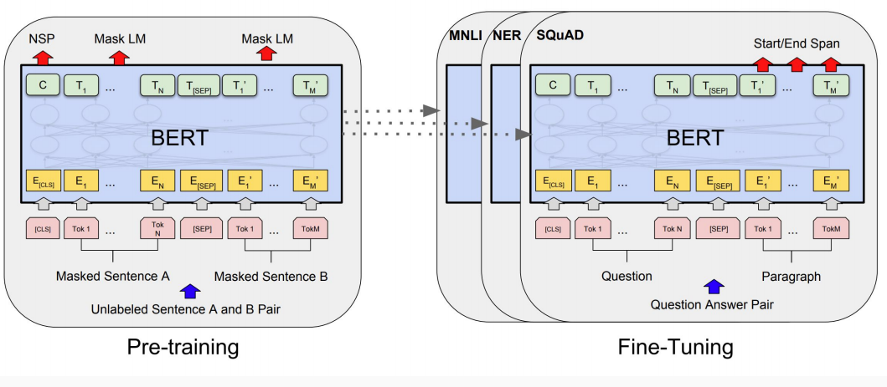
Background - BERT

Slide 3
Post-BERT
Better models like RoBERTa, XLNet, ALBERTA, ELECTRA, T5, ...
Better pretraining objectives and / or more data and / or more parameters
Multilingual models like MBERT, XLM-RoBERTa, MBART and MT5.
Pretraining on multilingual data
Domain-specific models like BioBERT, LegalBERT.
Adapting general-purpose models to specific domains.
Knowledge distillation
Distilling the knowledge in big models into smaller ones.
Zero and few shot learning
Given no or few examples, large models can still perform quite well.

Slide 4
Post-BERT
Better models like RoBERTa, XLNet, ALBERTA, ELECTRA, T5, ...
Better pretraining objectives and / or more data and / or more parameters
Multilingual models like MBERT, XLM-RoBERTa, MBART and MT5.
Pretraining on multilingual data
Domain-specific models like BioBERT, LegalBERT.
Adapting general-purpose models to specific domains.
Knowledge distillation
Distilling the knowledge in big models into smaller ones.
Zero and few shot learning
Given no or few examples, large models can still perform quite well.

Slide 5
RoBERTa
RoBERTa: A Robustly Optimized BERT Pretraining Approach (Liu et al, University of Washington and Facebook, 2019)
Trained BERT for more epochs and/or on more data
Showed that more epochs alone helps, even on same data
More data and larger batches also help
Improved masking and pre-training data slightly
dynamic masking
no NSP

Slide 6
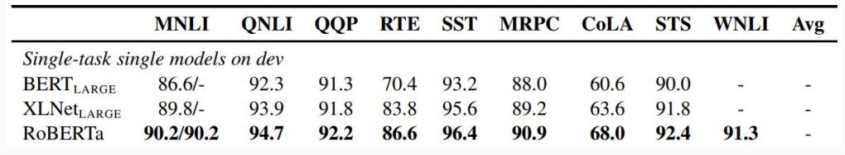
RoBERTa results

Slide 7
XLNET
There are two main limitations of BERT algorithm.
BERT corrupts the input with masks and suffers from pretrain-finetune discrepancy.
BERT neglects the dependency between masked positions.
Consider the sentence “New York is a city” and input to BERT to be “[MASK] [MASK] is a city”.
The objective of BERT would be: log p(New | is a city) + log p(York | is a city)

Slide 8
XLNET
Uses all permutations of a sequence: permutation language modeling
Integrates the idea of auto-regressive models and bi-directional context modeling
Read:
https://arxiv.org/abs/1906.08237
https://www.borealisai.com/en/blog/understanding-xlnet/
https://towardsdatascience.com/xlnet-explained-in-simple-terms-255b9fb2c97c

Slide 9
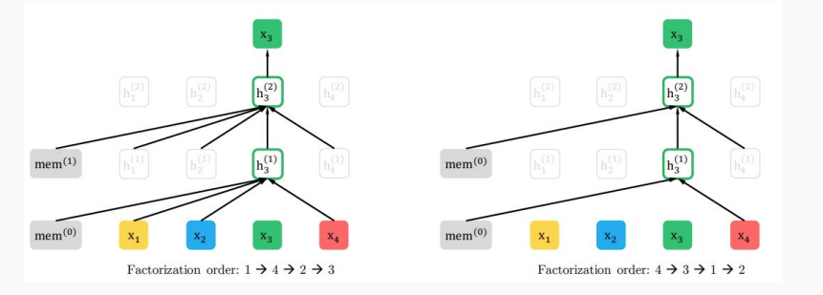
Permutation language modeling
Generates all permutations of a sequence indices, e.g., for a sequence of length 4 it generates 4! Permutations like: [1,2,3,4], [2,4,3,1], [1,4,2,3], …
Then, it does auto-regressive language modeling on these permutations.

Slide 10
XLNET: Some implementation details
It uses masking for all tokens not in the context of prediction
It uses the position of the prediction token but not the content by using Two-stream self-attention

Slide 11
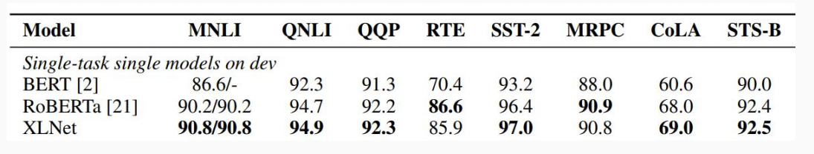
XLNET - results
Also used more data and bigger models, but showed that innovations improved on BERT even with same data and model size.

Slide 12
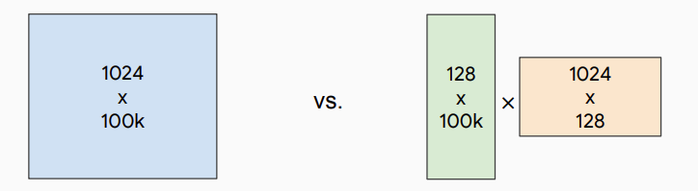
ALBERT
ALBERT: A Lite BERT for Self-supervised Learning of Language Representations (Lan et al, Google and TTI Chicago, 2019)
Innovation #1: Factorized embedding parameterization
Use small embedding size (e.g., 128) and then project it to Transformer hidden size (e.g., 1024) with parameter matrix

Slide 13
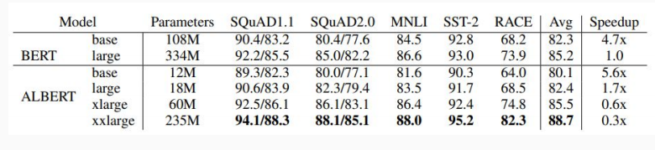
ALBERT
Innovation #2: Cross-layer parameter sharing
Share all parameters between Transformer layers
Results:

Slide 14
ALBERT
ALBERT is light in terms of parameters, not speed

Slide 15
T5 (Text-to-Text Transfer Transformer)
Exploring the Limits of Transfer Learning with a Unified Text-to-Text Transformer (Raffel et al, Google, 2019)
Ablated many aspects of pre-training:
Model size
Amount of training data
Domain/cleanness of training data
Pre-training objective details (e.g., span length of masked text)
Ensembling
Finetuning recipe (e.g., only allowing certain layers to finetune)
Multi-task training

Slide 16
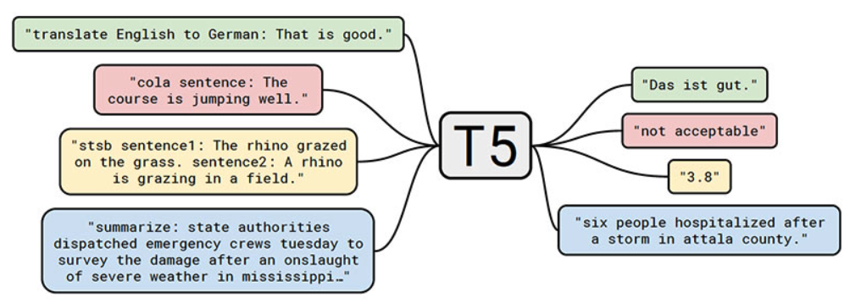

Slide 17
T5
Conclusions:
Scaling up model size and amount of training data helps a lot
Best model is 11B parameters (BERT-Large is 330M), trained on 120B words of cleaned common crawl text
Exact masking/corruptions strategy doesn’t matter that much
Mostly negative results for better finetuning and multi-task strategies

Slide 18
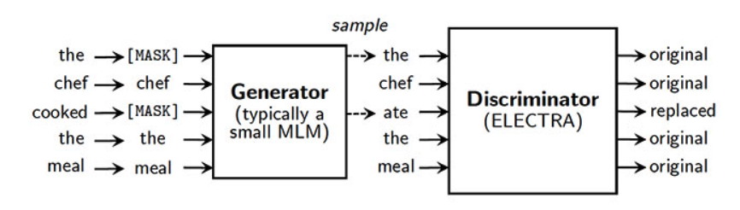
ELECTRA
ELECTRA: Pre-training Text Encoders as Discriminators Rather Than Generators, Kevin Clark, Minh-Thang Luong, Quoc V. Le, Christopher D. Manning
Alternative pre-training objective: replaced token detection

Slide 19
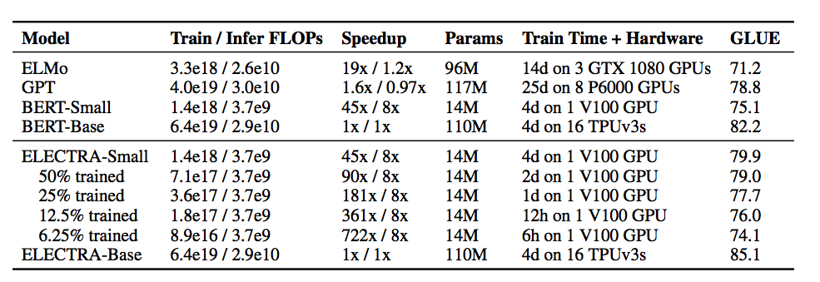
ELECTRA
More efficient pretraining
An ELECTRA model that performs comparably to XLNet and RoBERTa uses only 25% of their pre-training compute.

Slide 20
Distillation

Slide 21
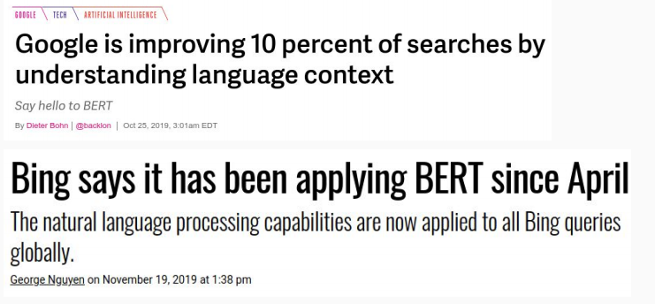
Applying Models to Production Services
BERT and other pre-trained language models are extremely large and expensive
How are companies applying them to low-latency production services?

Slide 22
Distillation
Answer: Distillation (a.k.a., model compression)
Idea has been around for a long time:
Model Compression (Bucila et al, 2006)
Distilling the Knowledge in a Neural Network (Hinton et al, 2015)
Simple technique:
Train “Teacher”: Use SOTA pre-training + fine-tuning technique to train model with maximum accuracy
Label a large amount of unlabeled input examples with Teacher
Train “Student”: Much smaller model (e.g., 50x smaller) which is trained to mimic Teacher output
Student objective is typically Mean Square Error or Cross Entropy

Slide 23
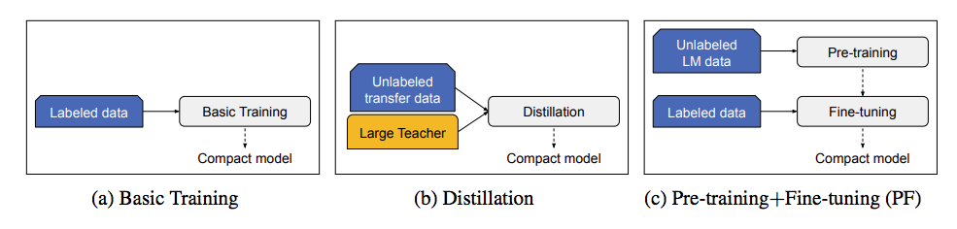

Slide 24
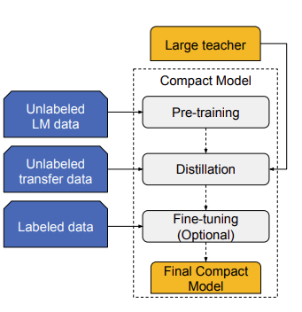
The pretrained Distillation technique

Slide 25
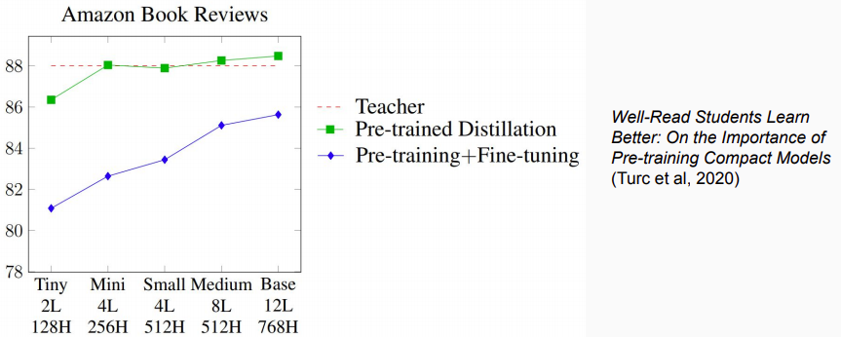
Example distillation results
50k labeled examples, 8M unlabeled examples
Distillation works much better than pre-training + fine-tuning with smaller model
Notes:
Well-Read Students Learn Better: On the Importance of Pre-training Compact Models (Turc et al, 2020)

Slide 26
Distillation
Why does distillation work so well? A hypothesis:
Language modeling is the “ultimate” NLP task in many ways
I.e., a perfect language model is also a perfect question answering/entailment/sentiment analysis model
Training a massive language model learns millions of latent features which are useful for these other NLP tasks
Finetuning mostly just picks up and tweaks these existing latent features
This requires an oversized model, because only a subset of the features are useful for any given task
Distillation allows the model to only focus on those features
Supporting evidence: Simple self-distillation (distilling a smaller BERT model) doesn’t work so well

Slide 27
Conclusions
Pre-trained bidirectional language models work incredibly well
However, the models are extremely expensive
Improvements (unfortunately) seem to mostly come from even more expensive models and more data
The inference/serving problem is mostly “solved” through distillation

