Slide 1
Applications: Classification
FMNLP, Fall 1401
Yadollah Yaghoobzadeh
University of Tehran

Slide 2
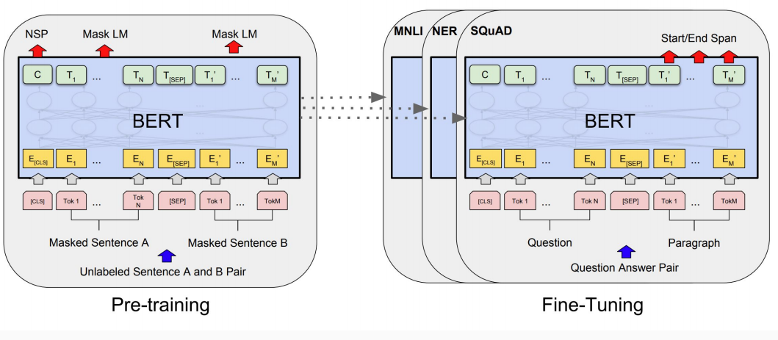
Background – Pre-training & Fine-tuning

Slide 3
Classification in NLP
Word / token / Phrase
Entity
Entity-pair
Sentence
Sentence pair
Text
Document
User profiles

Slide 4
Word / token classification
Out of context (global)
Categorization of words into concepts like food
Contextual
word sense disambiguation
part-of-speech tagging
semantic tagging
semantic role labeling
named entity recognition

Slide 5
Contextual labeling of words: Tagging or sequence lebeling

Slide 6
Entity classification
Out of context (global)
knowledge graph completion of entity types
Contextual
typing mentions of entities into
coarse-grained classes like Organization, Location, Person, Misc.
fine-grained classes like Author, City, Athlete, Country, etc.

Slide 7
Entity classification - global
food?
location?
city?
Entity representation
BERT
Mentions of an entity

Slide 8
Entity-pair classification
A.k.a relation classification or relation extraction
Today, Yazdani won the 2021 wrestling championship defeating Taylor in the final.
BERT
rel = winning(e1,e2)

Slide 9
Sentence classification
Sentiment & Emotion (CR dataset for customer reviews)
Language identification
Subjective / objective (SUBJ dataset)
Declarative / Question / Exclamative / Imperative
Linguistic acceptability (CoLA dataset)
Question classification (TREC dataset)

Slide 10
https://d2l.ai/chapter_natural-language-processing-applications/finetuning-bert.html

Slide 11
Sentence-pair classification
Paraphrase identification (MRPC dataset)
Duplicate question detection (Quora, Stackexchange datasets)
Natural language inference or textual entailment (SNLI, MNLI, RTE datasets)

Slide 12
Paraphrase identification
جمله اول:‌ دیروز مسابقات جام جهانی کشتی به خوبی برگزار گردید.
جمله دوم: دیروز ما جام جهانی کشتی با کیفیتی را داشتیم.
He does not like going to school.
He is not happy with going to school.

Slide 13
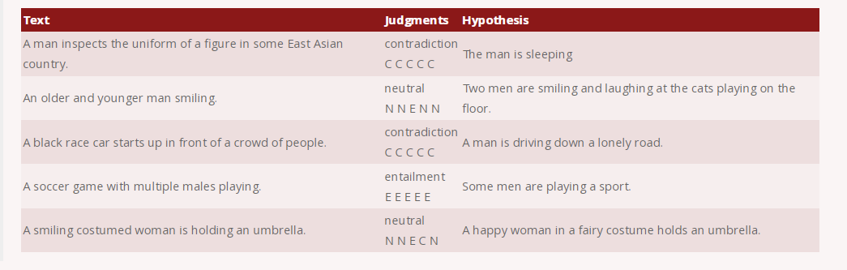
NLI
https://nlp.stanford.edu/projects/snli/

Slide 14
https://d2l.ai/chapter_natural-language-processing-applications/finetuning-bert.html

Slide 15
Text classification
Sentiment and emotion
aspect-based or simple
binary or multiple labels
Intent classification
used in Chatbots, and other users’ interactions
Urgency detection

Slide 16
https://d2l.ai/chapter_natural-language-processing-applications/finetuning-bert.html

Slide 17
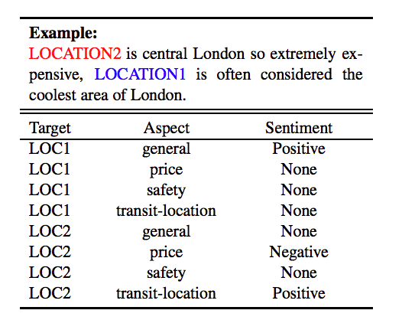
Example: Target aspect-based sentiment analysis
https://arxiv.org/pdf/1903.09588.pdf

Slide 18
Converting into sentence-pair classification
Sentence1:
LOCATION2 is central London so extremely expensive, LOCATION1 is often considered the coolest area of London.
Sentence2:
location — 2 — price
Label: Negative

Slide 19
Document classification
News & webpages categorization
Sentiment analysis
Email classification

Slide 20
User profiles
Categorization of Twitter/Facebook/Instagram accounts
Demographic features like Gender, Age, etc.
Psychological traits like openness

Slide 21
Summary
No need to change the architecture for simple classification applications like part-of-speech tagging, paraphrase identification, natural language inference, news categorization, sentiment analysis etc.
Usually better to fine-tune all parameters of FMs if training data is available

