Slide 1
Applications: ranking
FMNLP, Fall 1401
Yadollah Yaghoobzadeh
University of Tehran

Slide 2

What is ranking?
In search, we need to retrieve and rank the relevant items for a give query.
Ranking is done according to some criteria

Slide 3

IR tasks
Ad-hoc retrieval
ranking documents given a query
what google, Bing and other search engines are doing most of the time.
Question answering
returning spans of text for a given query

Slide 4
Text ranking example problems
Question Answering (QA)
extractive
factoid
Community Question Answering (CQA)
like Quora, StackExchange
Question | answer matching
Information Filtering (IF)
Opposite of search: in IF, query is fixed but documents change
Text Recommendation
showing other related search results
Text Ranking as Input to Downstream Modules

Slide 5
Desiderata of an IR system
Semantic understanding
Robustness to rare inputs
Robustness to corpus variance
Robustness to variable length inputs
Robustness to errors in input
Sensitivity to context
Efficiency

Slide 6
Evaluation
IR metrics focus on rank-based evaluation of retrieved results using ground truth information, as determined by manual judgments or implicit feedback from user behaviour data.
Metrics include:
Precision and recall
Reciprocal rank (MRR)
Average precision (MAP)
Normalized discounted cumulative gain (NDCG)
Notes:
RR(R, q) = 1/ rank_i where ranki is the smallest rank number of a relevant document i.
The intuitive way to understand average precision is that it is the average of precision scores at cutoffs corresponding to the appearance of every relevant document
(nDCG) is a metric that is most frequently used to measure the quality of web search results
Unlike the other metrics above, nDCG was specifically designed for graded relevance judgments

Slide 7
Learning to rank
Learning to rank (LTR) for IR uses training data, such as human relevance labels and click data, to train towards an IR objective.

Slide 8
Different loss functions
Regression loss
Classification loss
Contrastive loss
minimizing the distance between a relevant pair, while increasing the distance between irrelevant items
Cross-Entropy loss over document
maximizing the difference between scores generated by the model for relevant and less relevant document
Negative sampling (NEG)

Slide 9
Semantic matching
How suitable a document d is for a query q
In traditional Ad-hod retrieval:
exact term matching methods like BM25
some semantic features like word embeddings
Neural IR:
matching the representations of q and d
IR models that use exact matching tend to perform well on different queries than models that employ inexact matching. Models that combine both performs best.

Slide 10
Traditional IR models
TF-IDF
BM25
Language modeling
Translation models
Pseudo relevance feedback

Slide 11
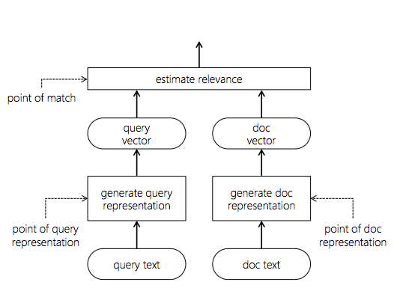
Neural information retrieval

Slide 12
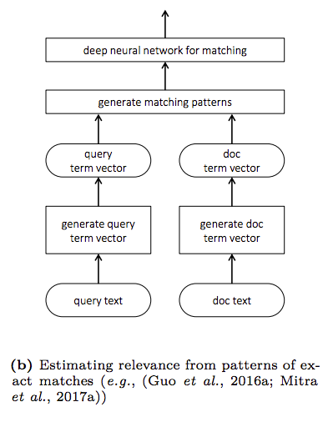
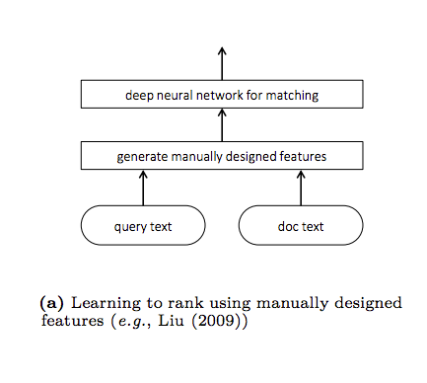

Slide 13
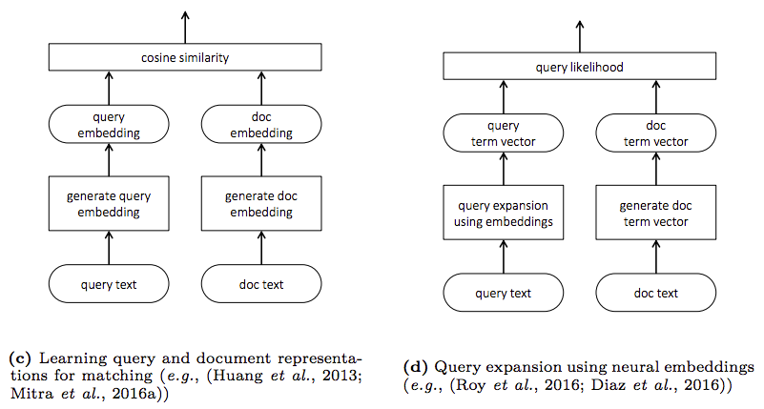

Slide 14

Google is using BERT
https://blog.google/products/search/search-language-understanding-bert/

Slide 15
Pre-BERT neural ranking models are generally classified into two classes: representation-based models and interaction-based models.

Slide 16
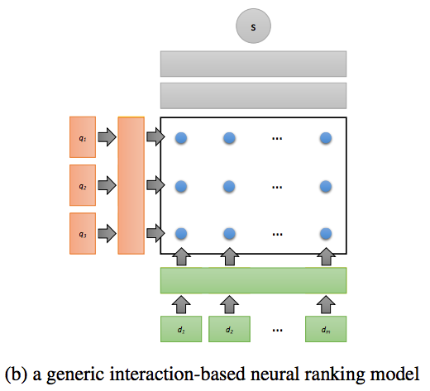

Slide 17
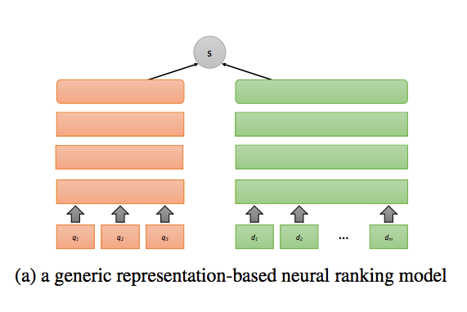

Slide 18
BERT in IR

Slide 19
Option 1: independent query and document representations
Siamese network architecture
Compute document representations offline and query representation at inference time
Efficient at inference
No interaction between query and documents → suboptimal performance
BERT
query (q)
score
BERT
ɸ(q,d)
document (d)

Slide 20
Option 2: joint representation of query and document
Everything is done online
Not efficient for ranking → only used in re-ranking top-K results
query (q)
BERT
score
ɸ(q,d)
document (d)
ɸ

Slide 21
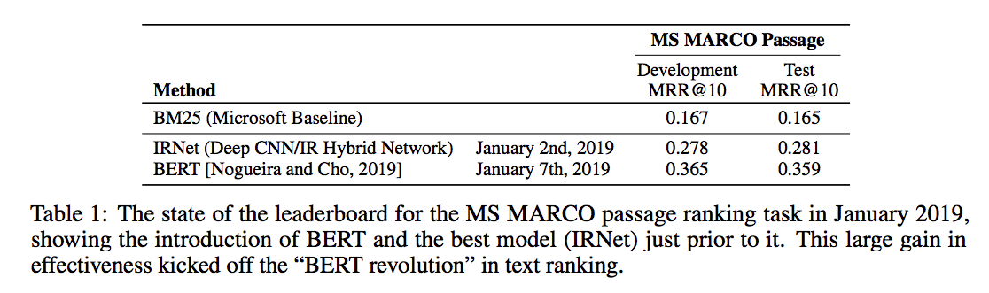
BERT revolution in IR

Slide 22
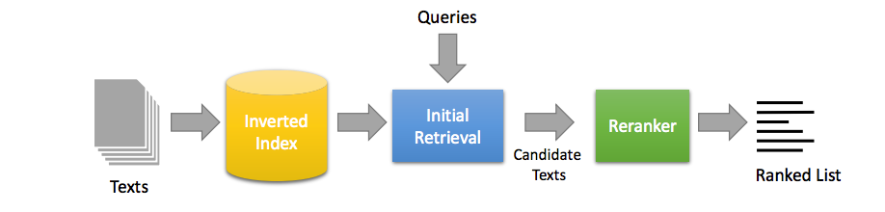
Retrieve-and-rerank architecture
Notes:
In the candidate generation stage (also called initial retrieval or first-stage retrieval), candidate texts are retrieved from the corpus, typically with bag-of-words queries against inverted indexes. These candidates are then reranked with a transformer-based model such as monoBERT.

Slide 23
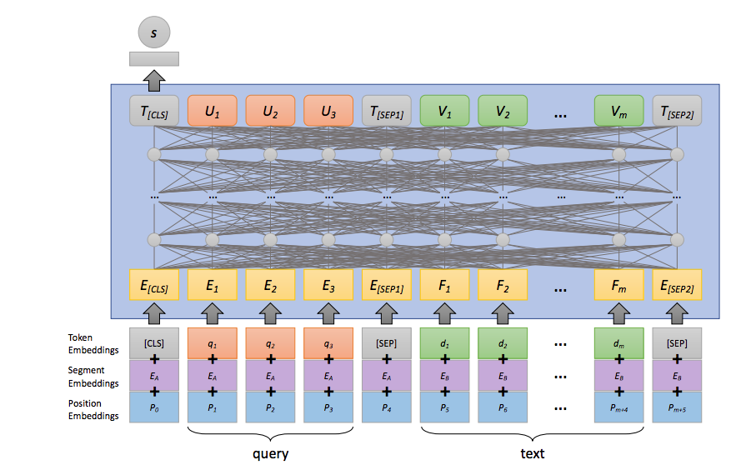
Reranker: MonoBERT
Notes:
The monoBERT ranking model adapts BERT for relevance classification by taking as input the query and a candidate text to be scored (surrounded by appropriate special tokens). The input vector representations comprise the element-wise summation of token embeddings, segment embeddings, and position embeddings. The output of the BERT model is a contextual embedding for each input token. The final representation of the [CLS] token is fed to a fully-connected layer that produces the relevance score s of the text with respect to the query.

Slide 24
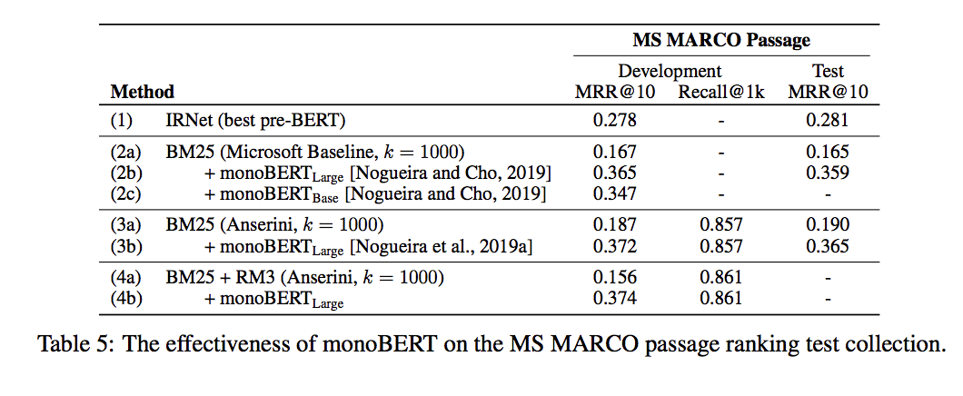
https://arxiv.org/pdf/2010.06467.pdf

Slide 25
The most straightforward application of transformers to text ranking is to convert the task into a text classification problem, and then sort the texts to be ranked based on the probability that each item belongs to the relevant class.
This relevance classification approach is usually deployed in a module that reranks candidate texts from an initial keyword search engine.
Researchers have proposed additional innovations, including query expansion (Zheng et al., 2020), document expansion (Nogueira et al., 2019b; Nogueira and Lin, 2019) and term importance prediction (Dai and Callan, 2019a, 2020).
Distillation of large models for efficiency

Slide 26
Arguably, the single biggest benefit brought about by modern deep learning techniques to text ranking is the move away from sparse signals, mostly limited to exact matches, to dense representations that are able to capture semantic matches to better model relevance.
In the simplest approach, ranking becomes the problem of approximate nearest neighbor (ANN) search based on some simple metric such as cosine similarity
limitations on text length and effectiveness–efficiency tradeoffs are important considerations
It becomes increasingly difficult to accurately capture the semantics of longer texts with fixed-sized representations, and increasingly complex comparison architectures increase latency and may necessitate reranking design

Slide 27
References
https://www.microsoft.com/en-us/research/uploads/prod/2017/06/fntir2018-neuralir-mitra.pdf
https://arxiv.org/pdf/2010.06467.pdf

